Slide 1
Module2 Unit 1
She learnt English.
新标准英语
三年级起点五年级下册

Slide 2

listen
watch
listened
watched
danced
dance
go
went
teach
taught
play
played
write
wrote

Slide 3
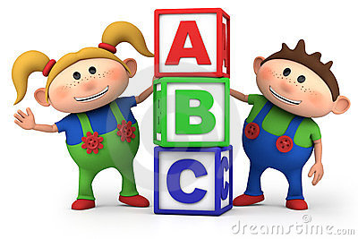
watch
-watched
listen
-listened
go
- went
dance
- danced
play
-played
teach
-taught
write
- wrote

Slide 4
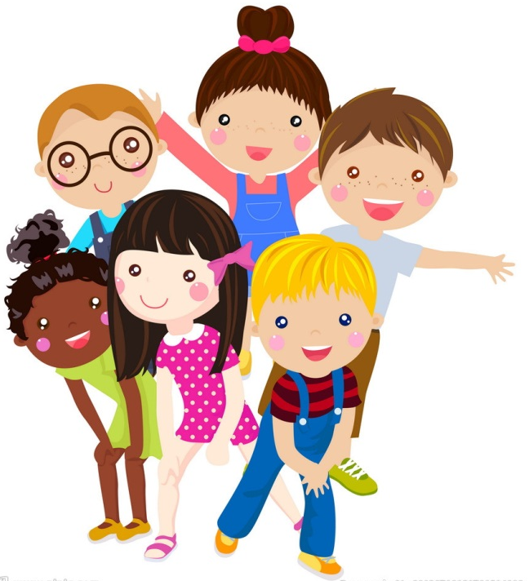
游戏：遍地开花
I …， last night.
What did you do？

Slide 5

Did he/she …?
Yes, he/she did.
No, he/she didn’t.

Slide 6
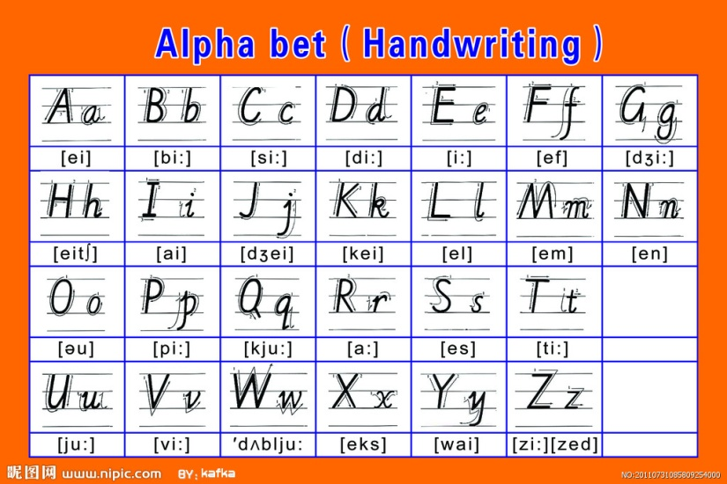
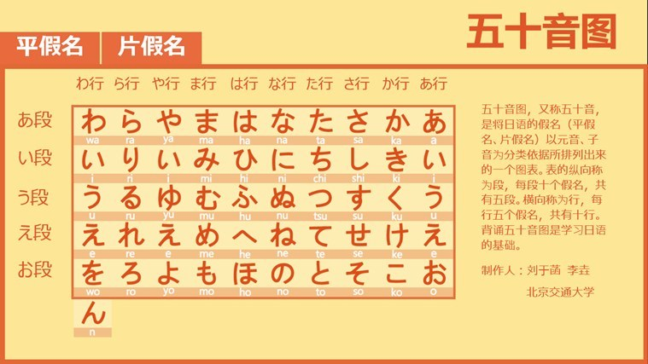
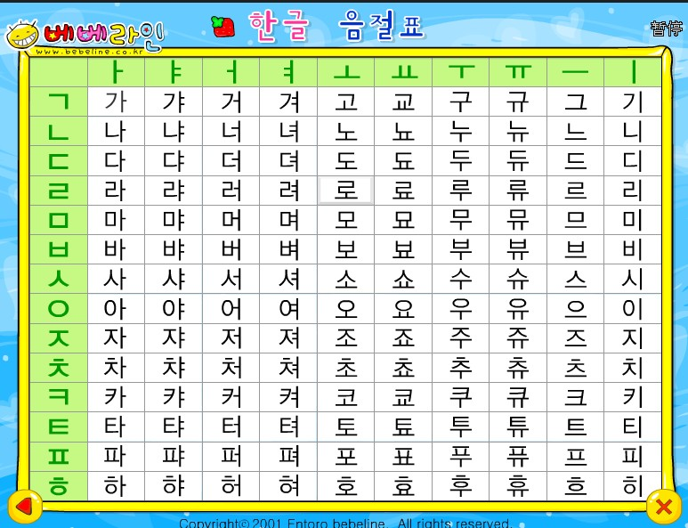
Japanese
English
foreign languages
Korean

Slide 7
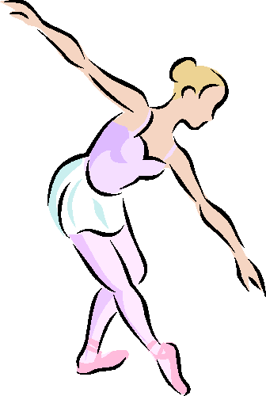

Watch, listen and answer:
1. What was Lingling’s grandma?
She was a dancer.
2. What was Lingling’s grandpa?

Slide 8


你发现了什么？
dance
dancer
drive
driver
teach
teacher
work
worker
构词法： 动词加er或r，变成这个动作的执行者（做…的人 / 职业）
你还能说出更多这样的词吗?

Slide 9

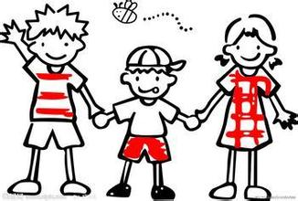
Watch, listen and answer:
1. What was Lingling’s grandma?
She was a dancer.
2. What was Lingling’s grandpa?
He was a driver.

Slide 10
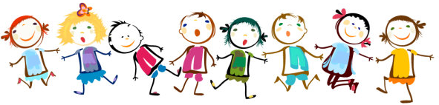
Watch, listen again and answer:
3. Did Lingling’s grandpa learn English, too?
4. What is Lingling’s grandpa learn now?
No, he didn’t.
He is learning English now.

Slide 11
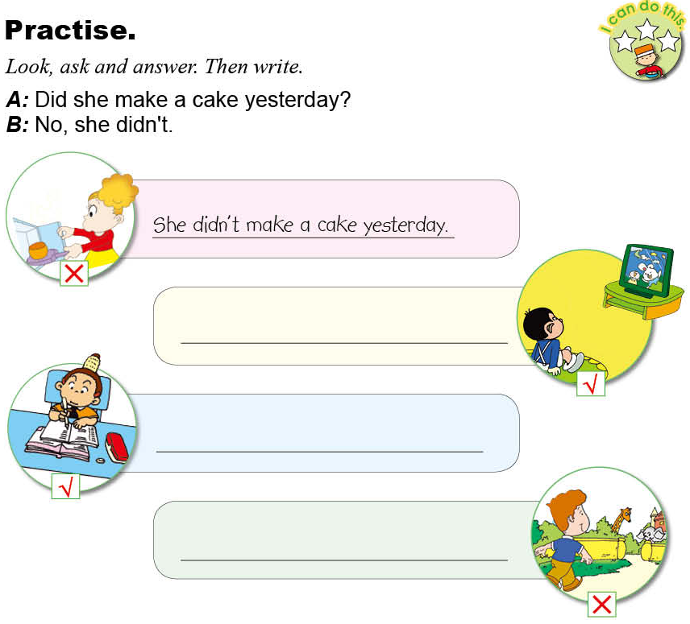
He watched TV yesterday.
She did her homework yesterday.
He didn’t go to the zoo yesterday.

Slide 12
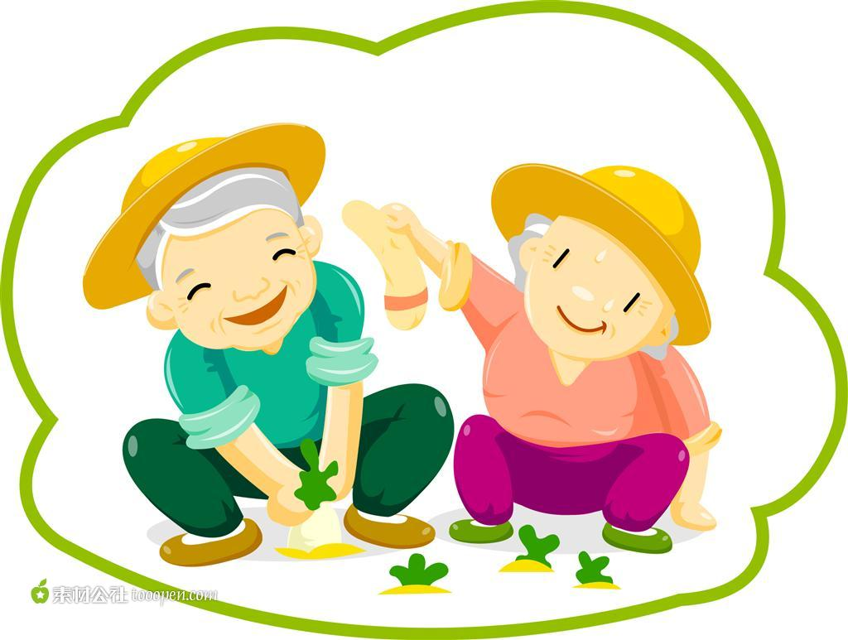
Homework
Ask your grandparents‘ jobs.
(问问你的爷爷奶奶或者外公外婆以前的工作是什么)

