Slide 1

Sounds Fun 3
Unit 8

Slide 2

cr
fr
gr
dr
br
tr

Slide 3
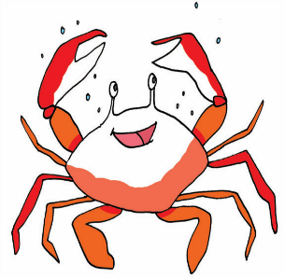
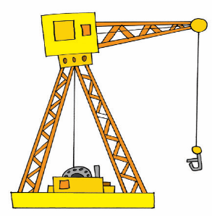
crab
cr
crane

Slide 4


frog
fr
frame

Slide 5
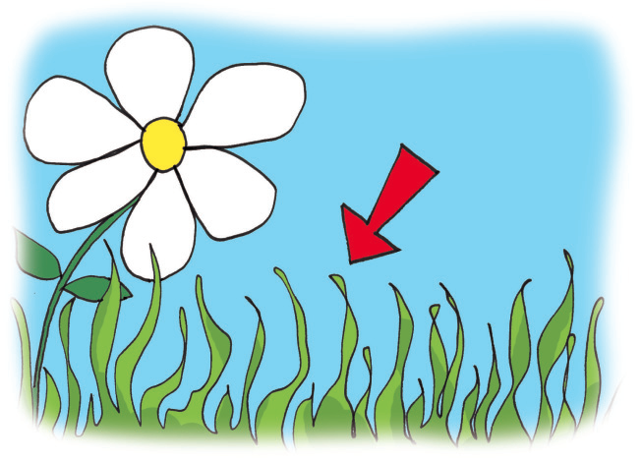
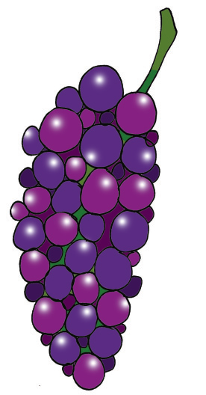
grass
gr
grape

Slide 6
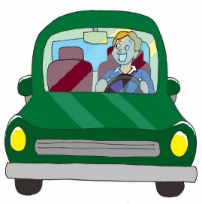
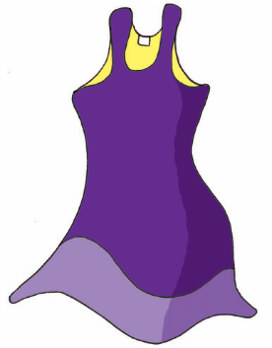
drive
dr
dress

Slide 7
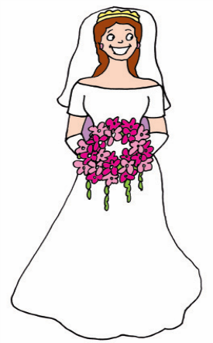
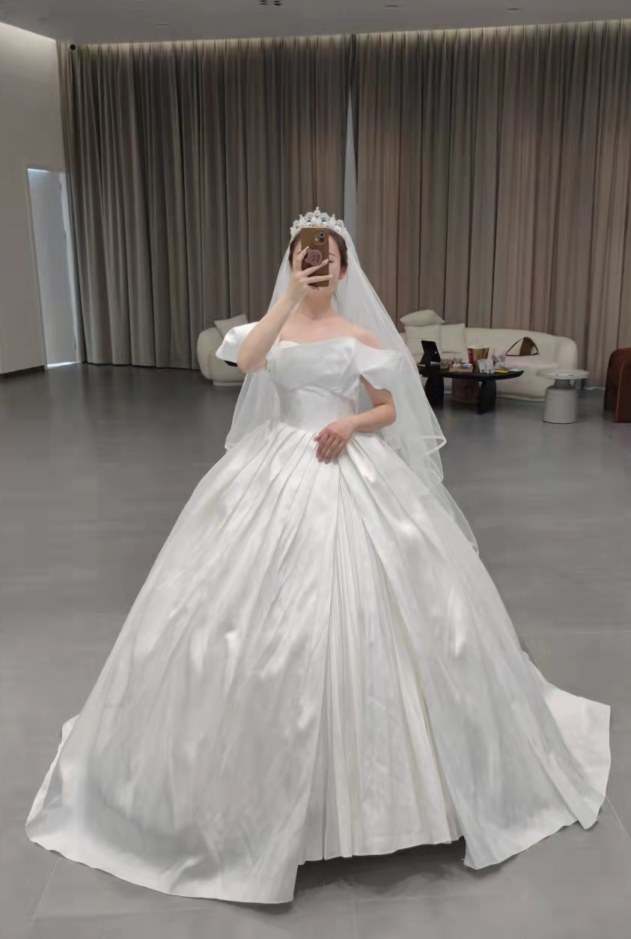
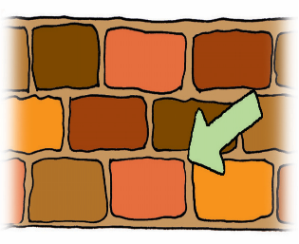
bride
br
brick

Slide 8
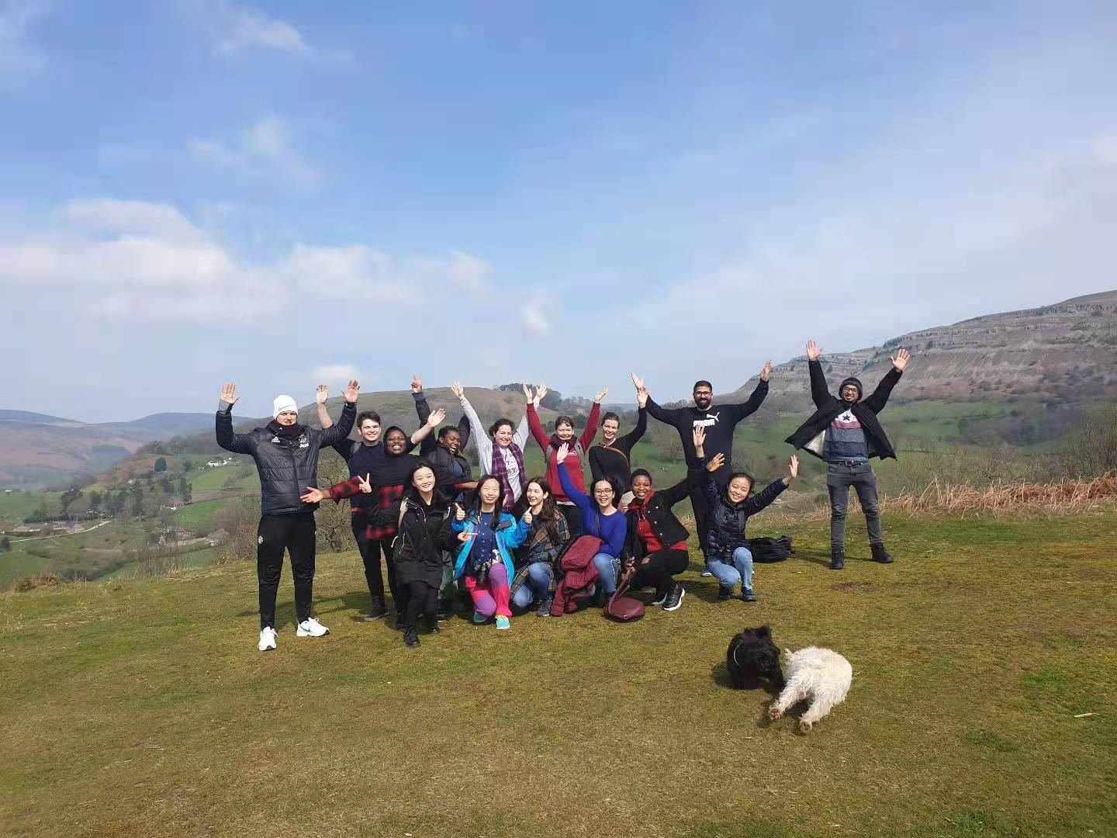
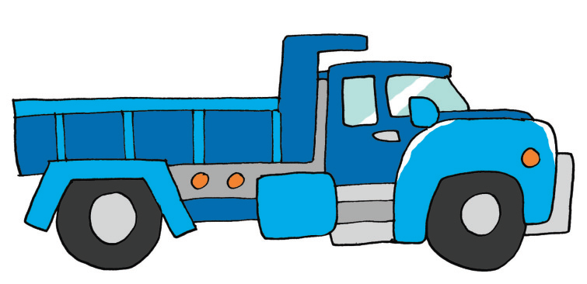
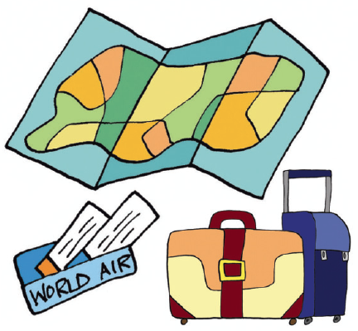
truck
tr
trip

Slide 9

trip

Slide 10
crab
crane
frog
frame
grass
grape
drive
dress
bride
brick
truck
trip

Slide 11













