Slide 1

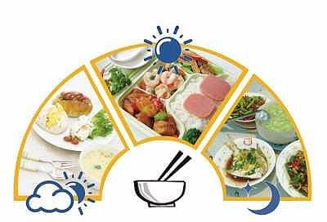
Module 2 Unit 1
I don’t like meat.

Slide 3
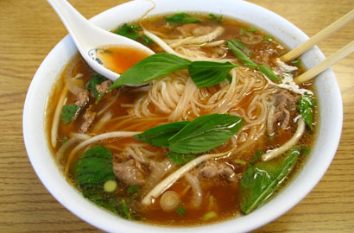
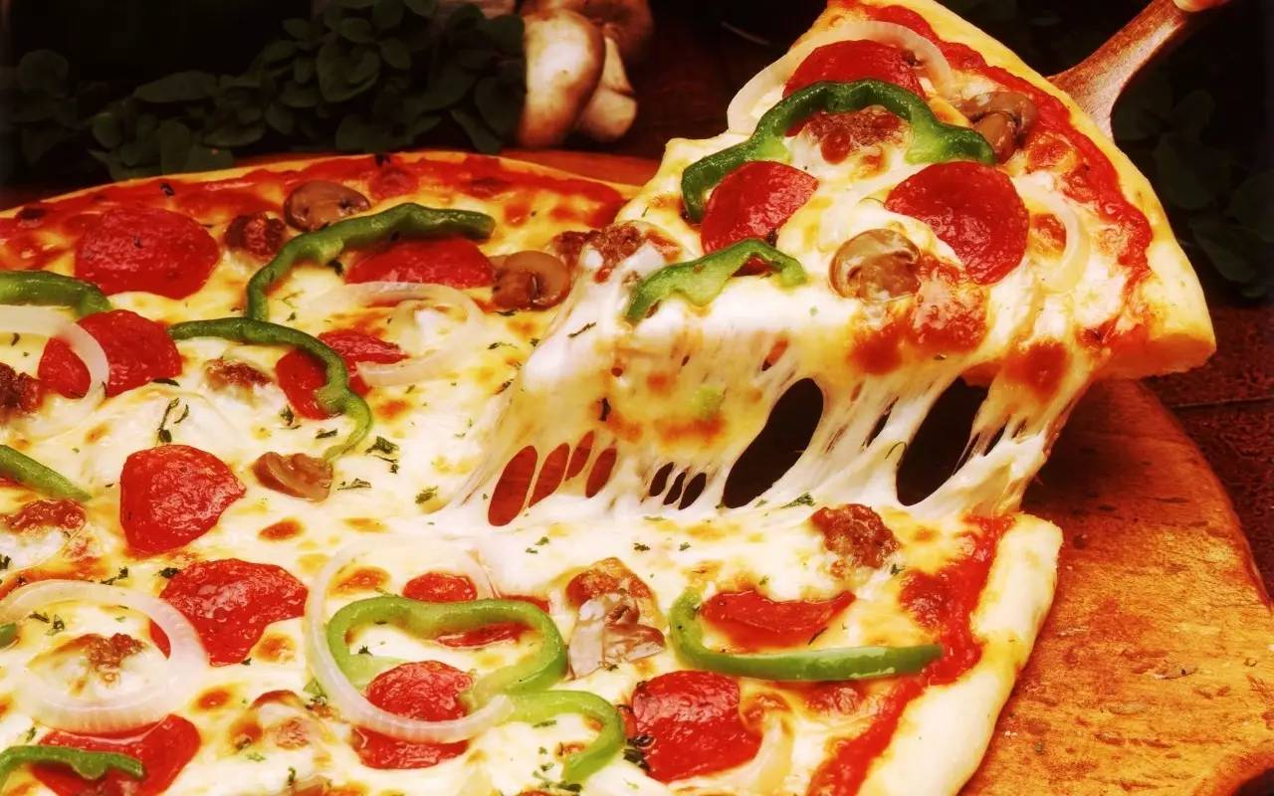
What other food do you know?
noodles
pizza

Slide 4
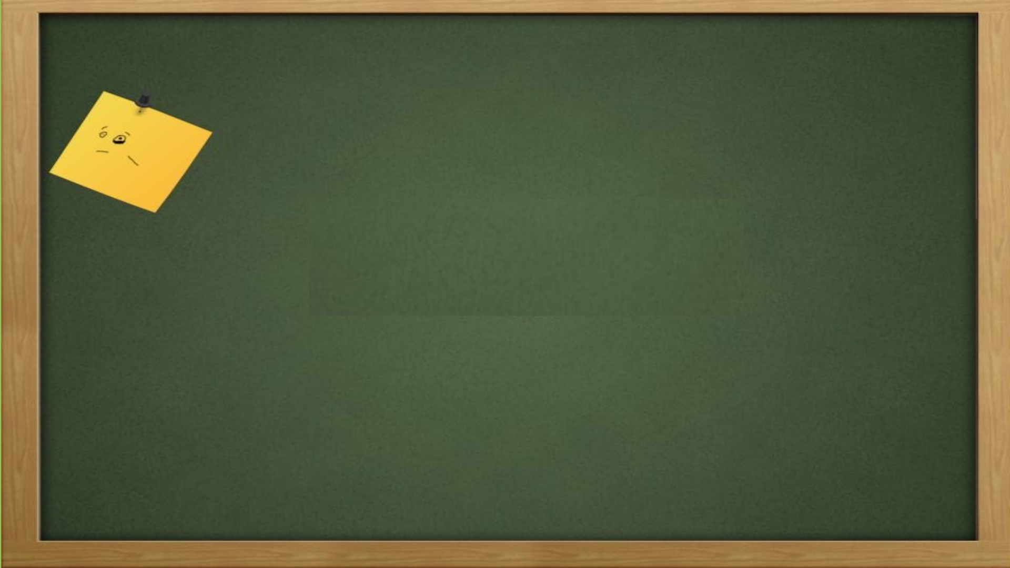
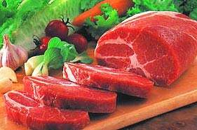
me 我
meet 遇见
meat 肉

Slide 5

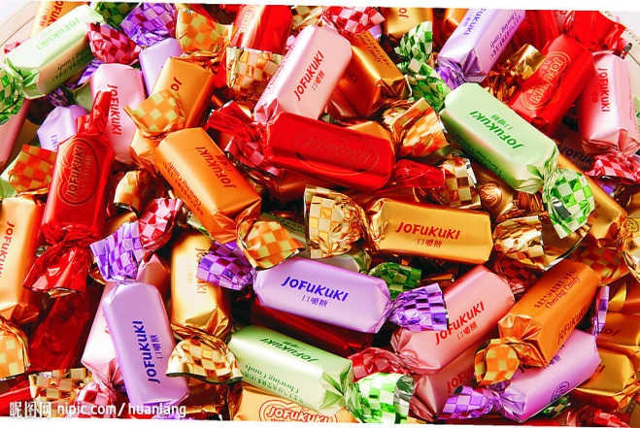
see 看见
tree 树
sweets 糖果

Slide 6
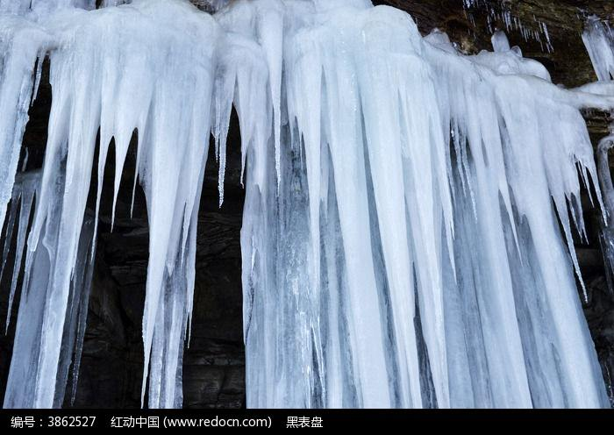
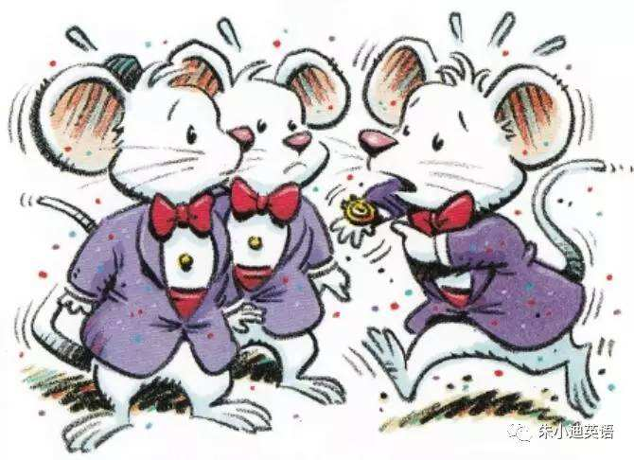
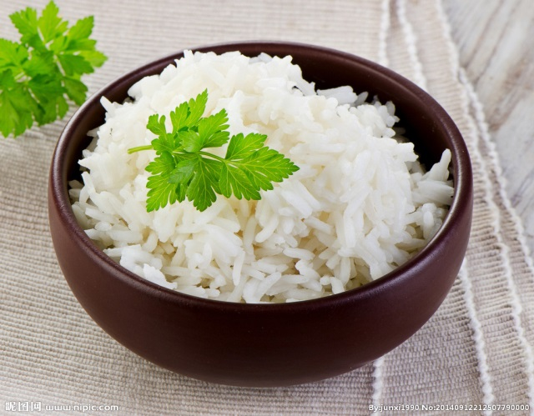
ice
mice
rice

Slide 7


What food do you like?
noodles
pizza
meat
sweets
rice

Slide 8
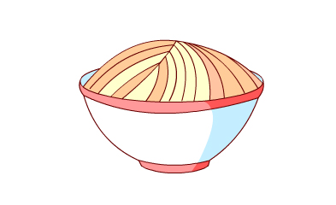
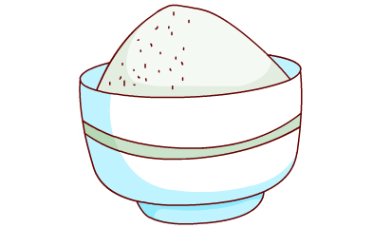



I like
A cue(提示):m…
meat.

Slide 9

I don’t like
noodles.
A cue(提示):n…

Slide 10
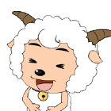
I like
A cue(提示)：
They’re blue and red…
sweets.

Slide 11
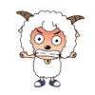
I don’t like
A cue(提示)： It’s white.
rice.

Slide 12
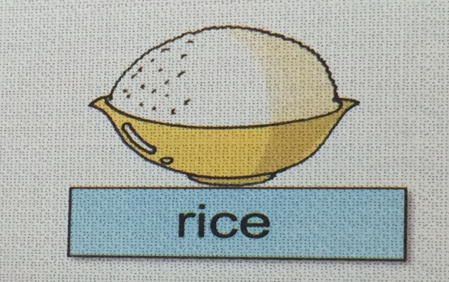



I like …
But,I don’t like ...

Slide 13
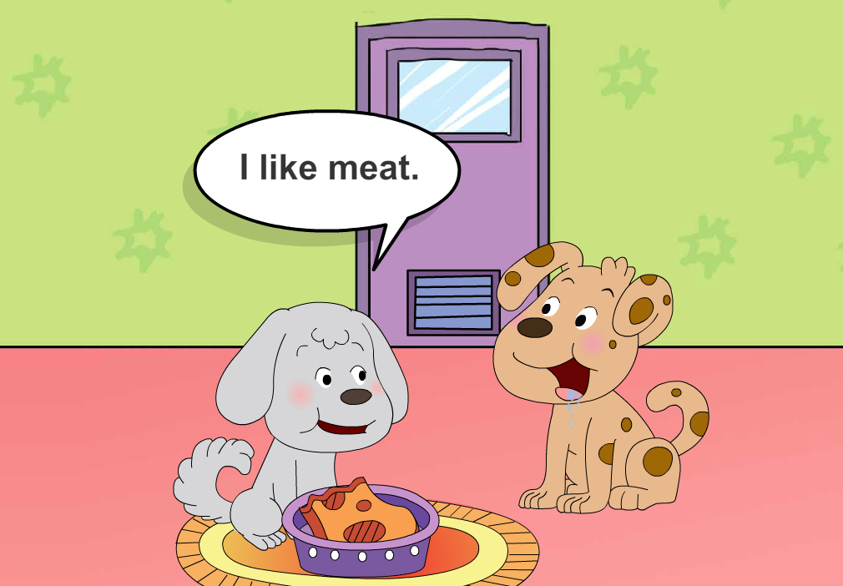
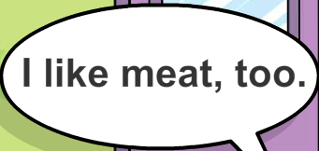

What food do they like?

Slide 14
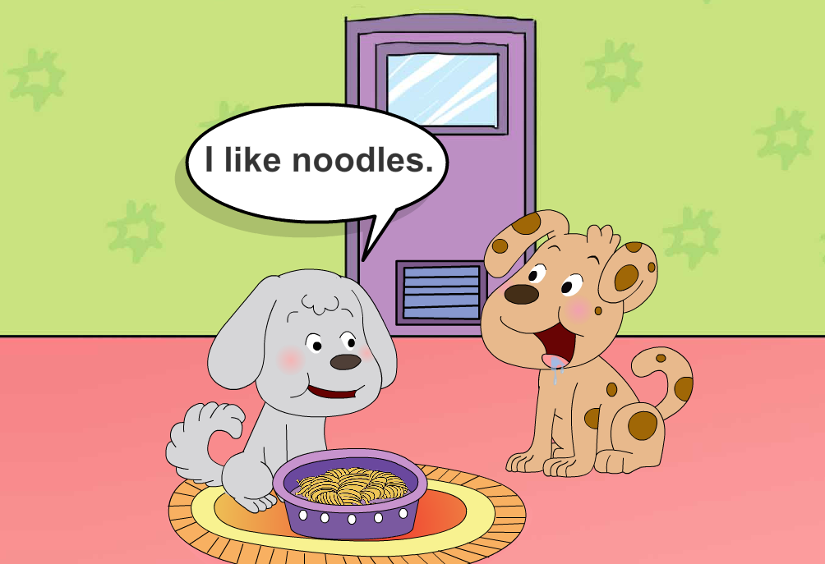
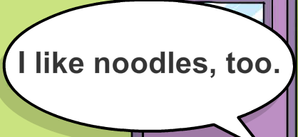

Slide 16
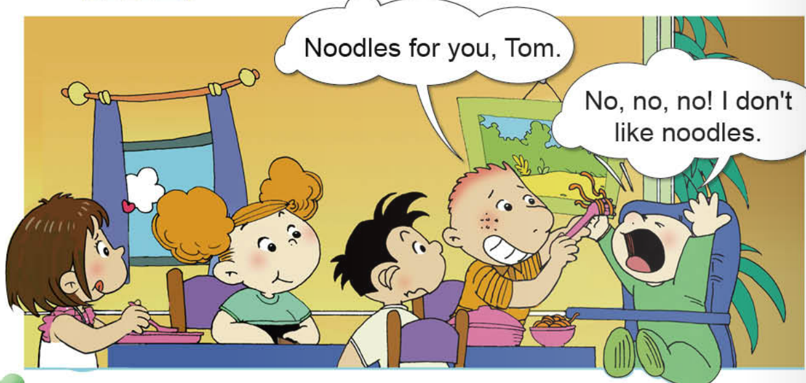
What does Tom like?
don't

Slide 17
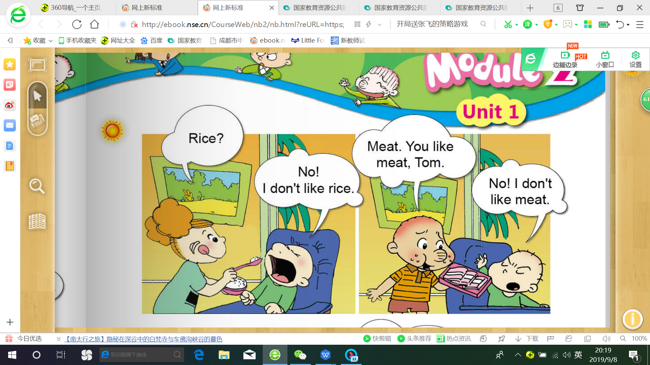
don't

Slide 18
I don't
like meat.

Slide 19
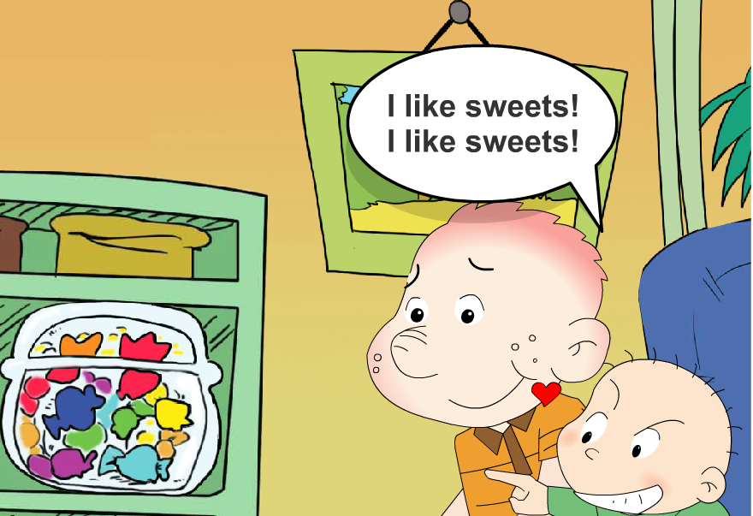

Slide 20
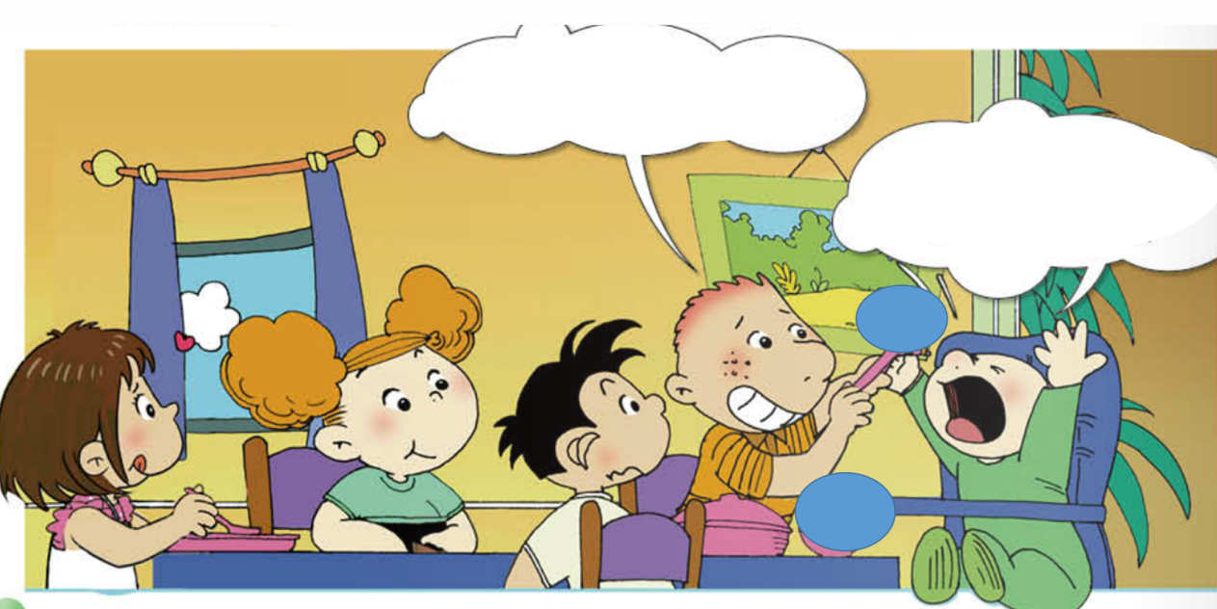
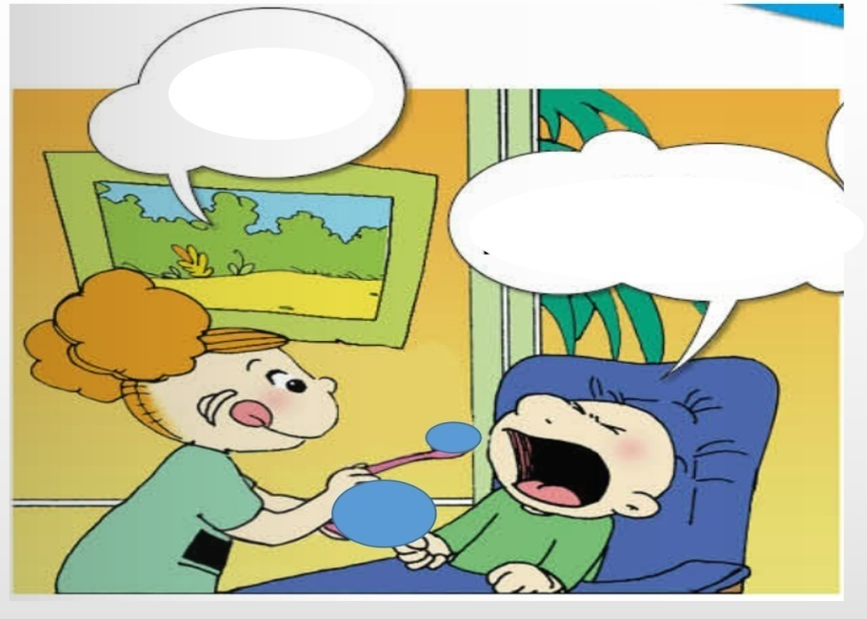

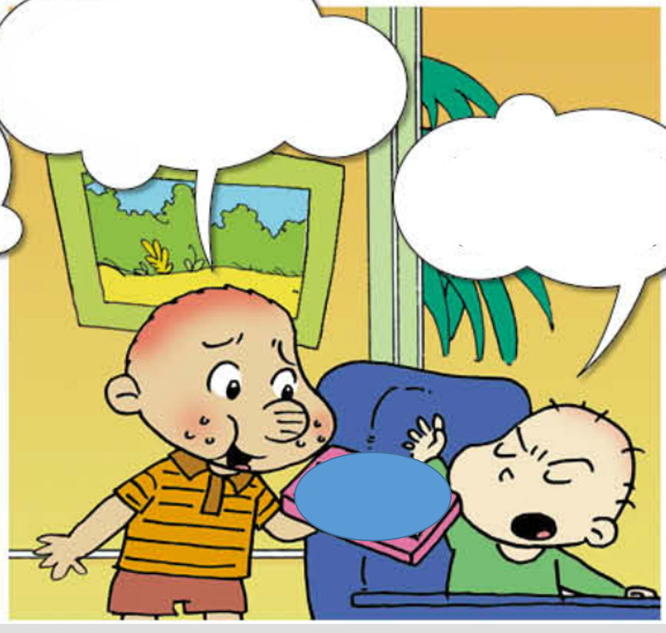
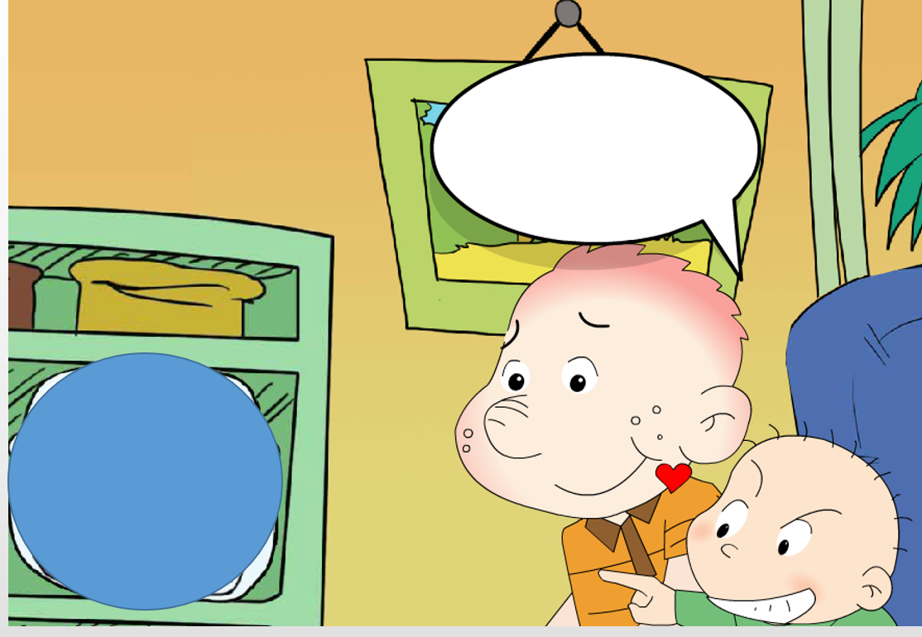

I don't like _____.
noodles
rice
I like ___.
meat
sweets

Slide 21
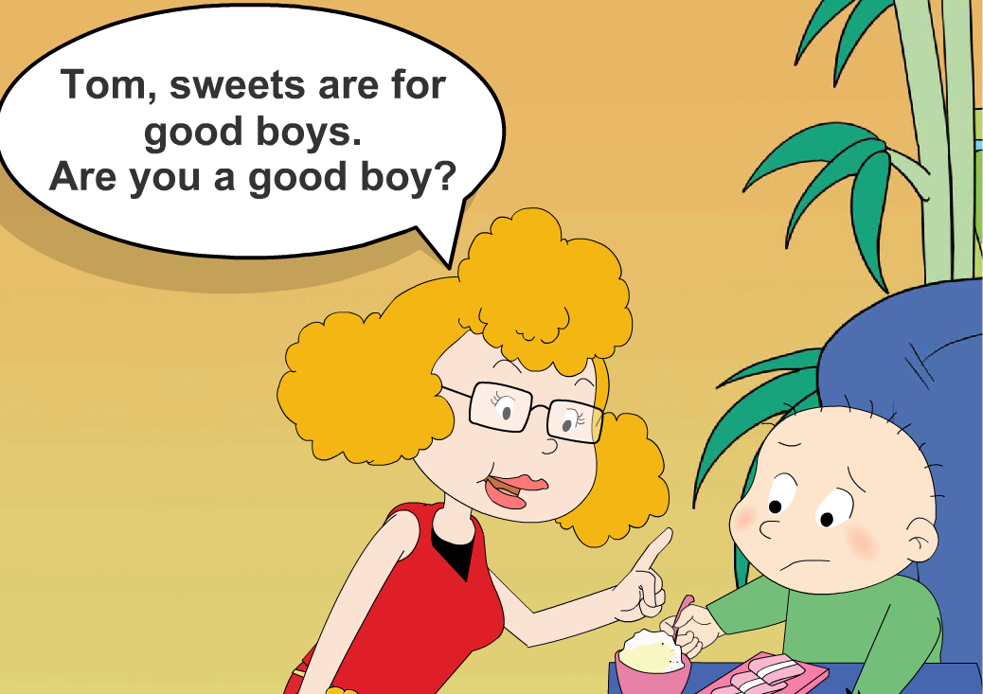

Slide 22
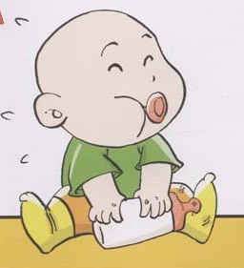
If you were Tom, what
will you do?
(如果你是Tom,你会怎么做？)

Slide 23
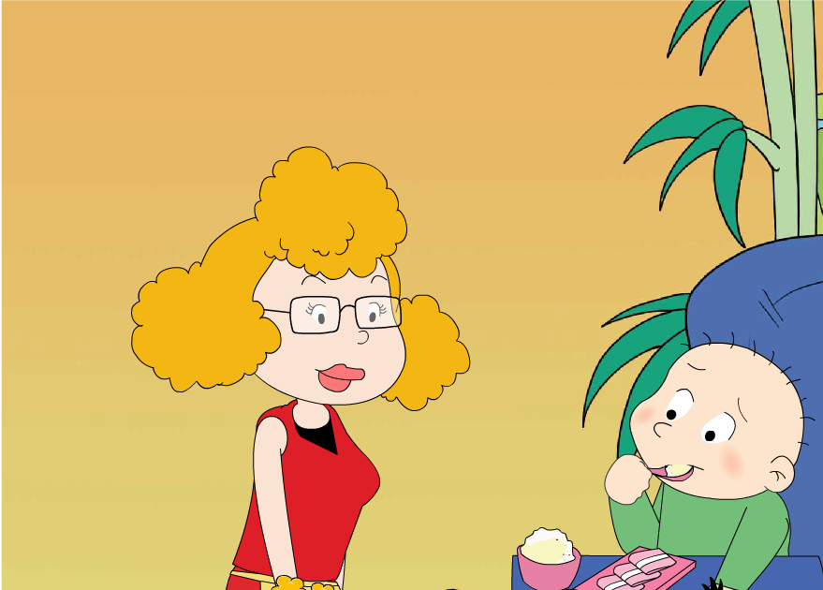
OK.I like rice.
I like meat.

Slide 24
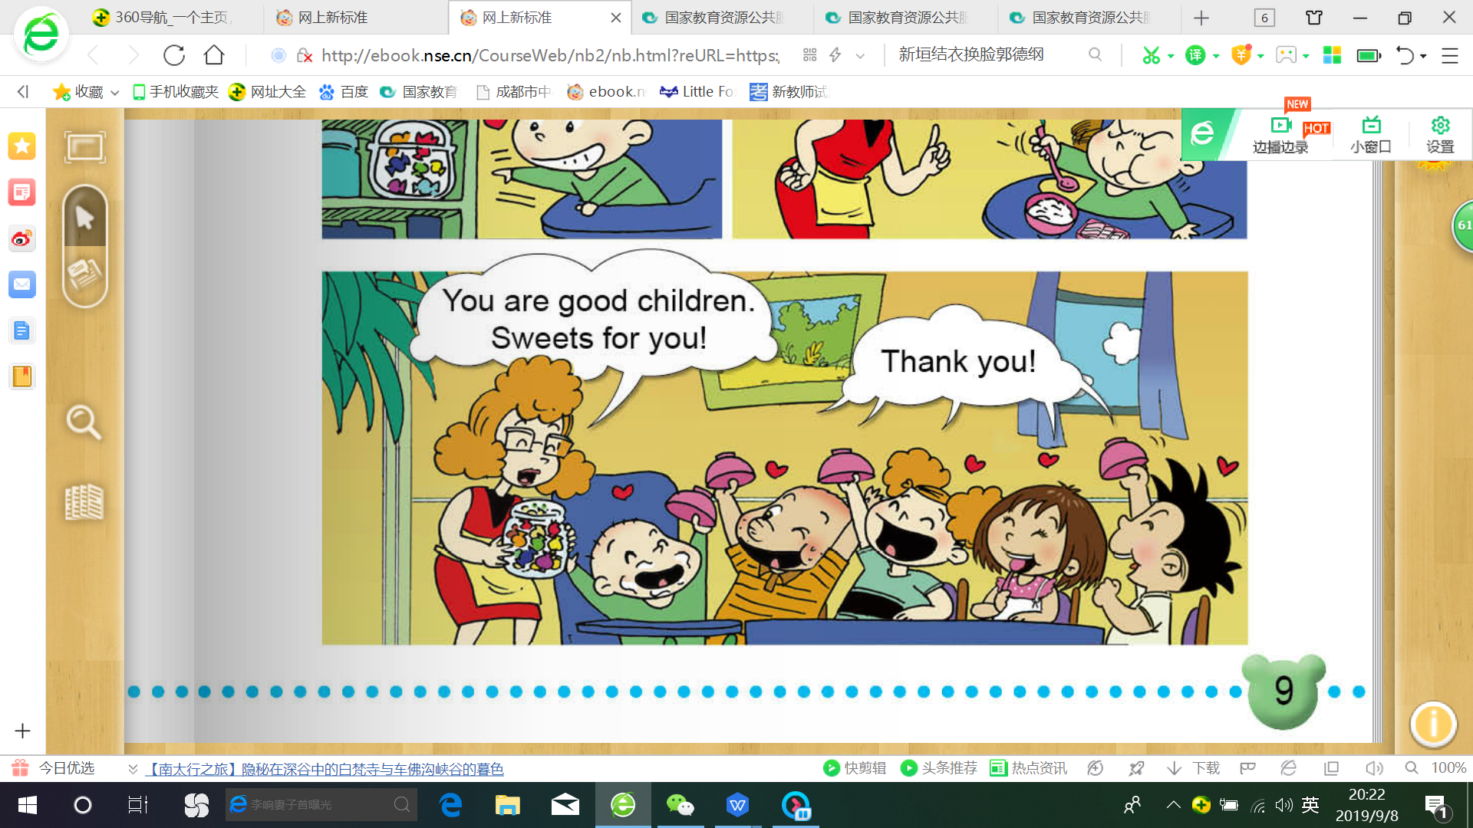
children

Slide 25
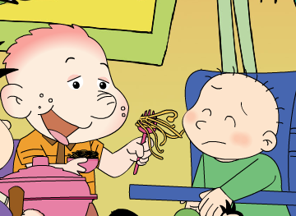
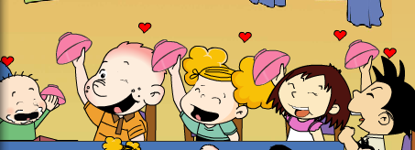
child
children

Slide 26
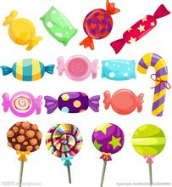
What is Tom’s favourite food（食物） ?
Meat.
Noodles.
Sweets.

