Slide 1

Let’s listen and sing.

Slide 2
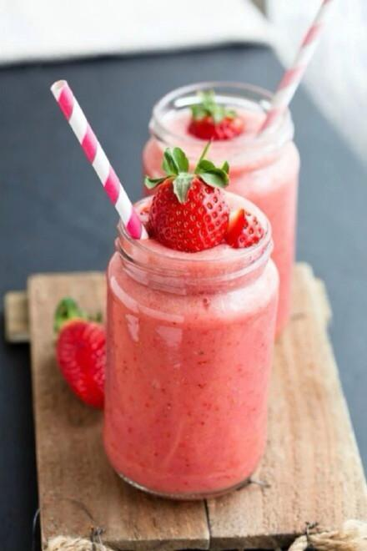
M3 U1 lesson 2
Do you like the milkshake ?

Slide 3

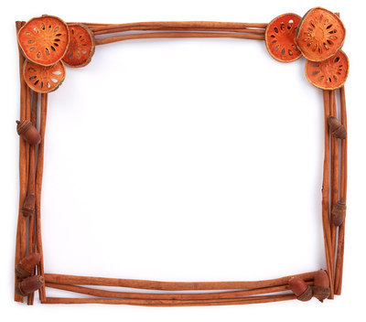

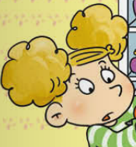
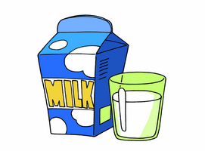

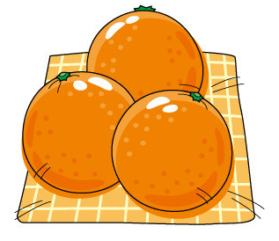
What are Amy's questions?
Do you like bananas?
Do you like apples?
Do you like milk?
Do you like oranges?

Slide 4
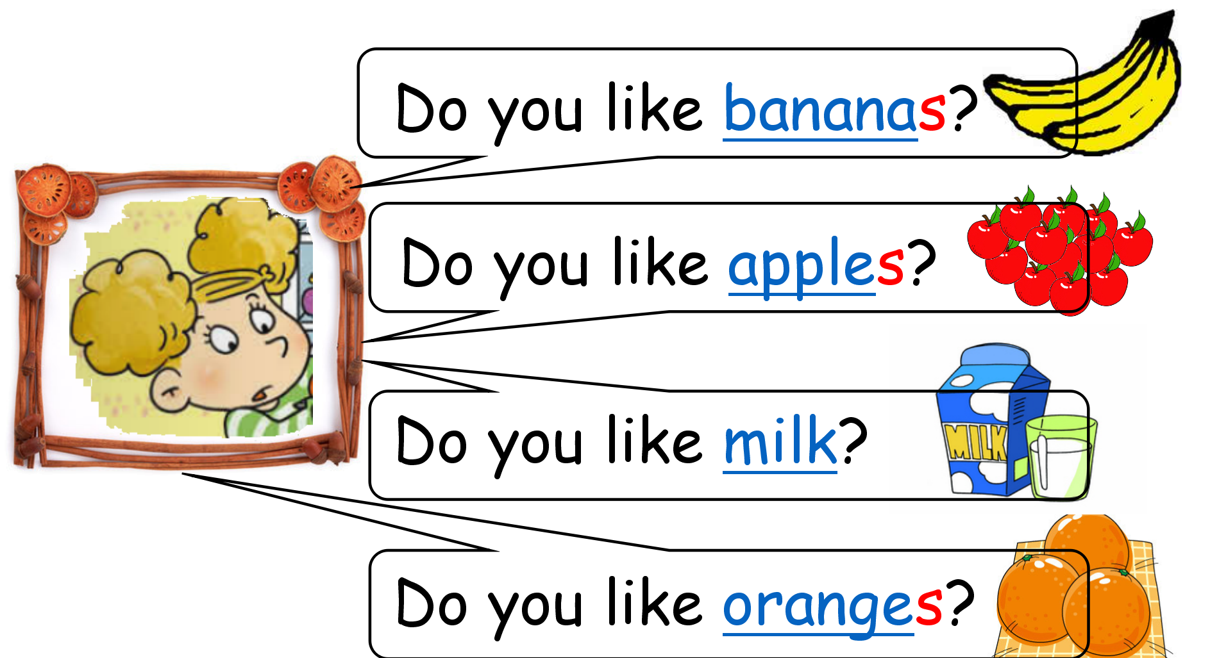

What are Lingling's answers?
Yes, I do.
No, I don't.

Slide 5
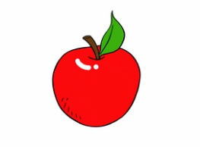

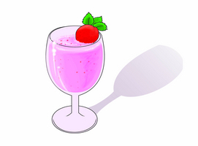
＋
＋
fruit milkshake
=

Slide 6

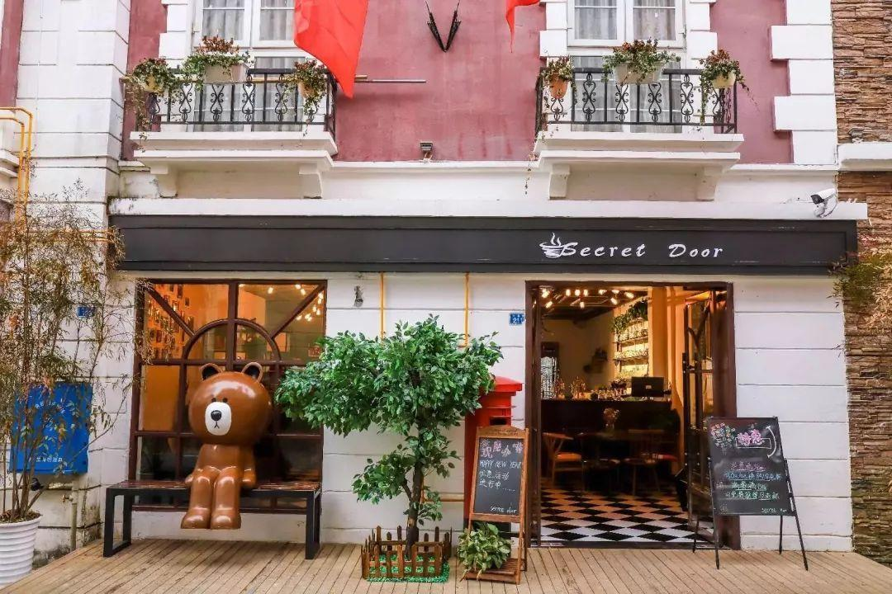
Kiki’s Milk shake Shop
Kiki的奶昔店

Slide 7
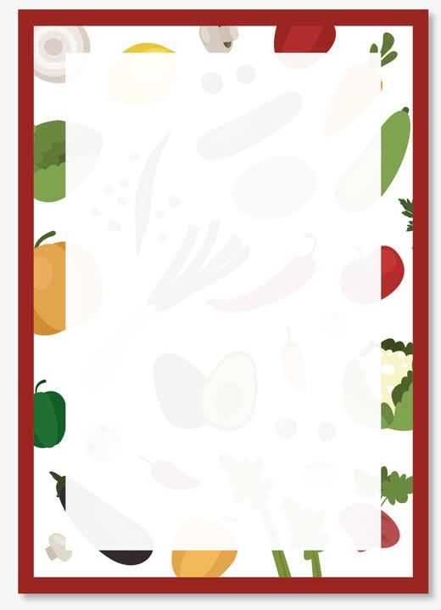
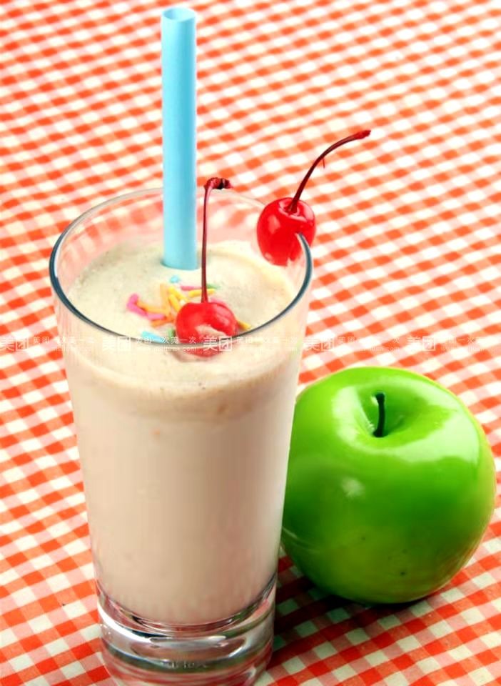
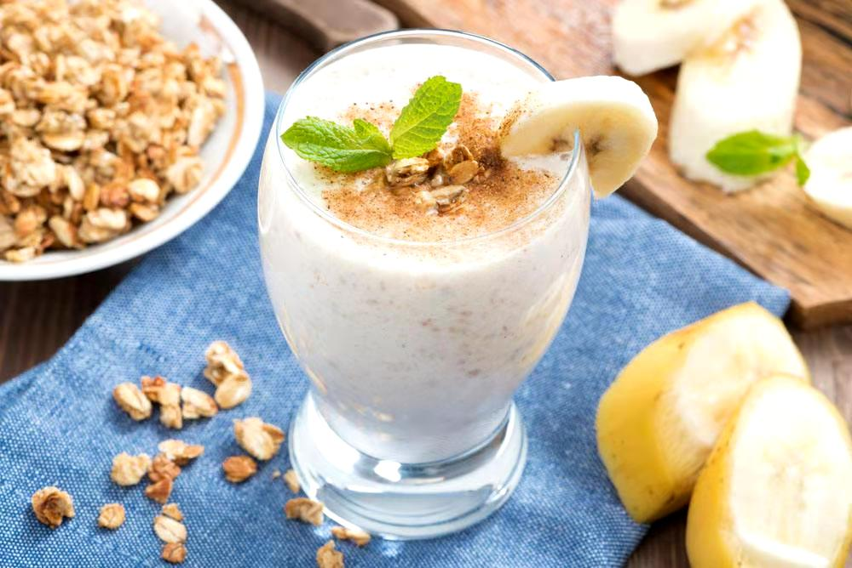
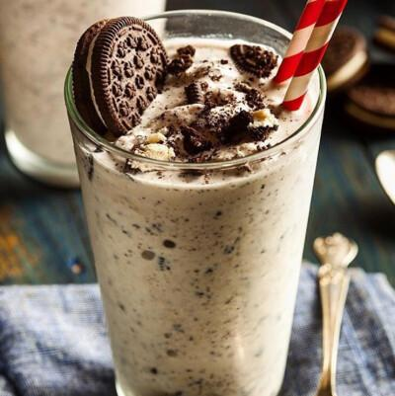
menu 菜单
strawberry
milkshake
Oreo
milkshake
apple
milkshake
banana
milkshake

Slide 8
A:Do you like…milkshake?
B:Yes, I do ./ No, I don’t.
strawberry
milkshake
Oreo
milkshake
apple
milkshake
banana
milkshake

Slide 9
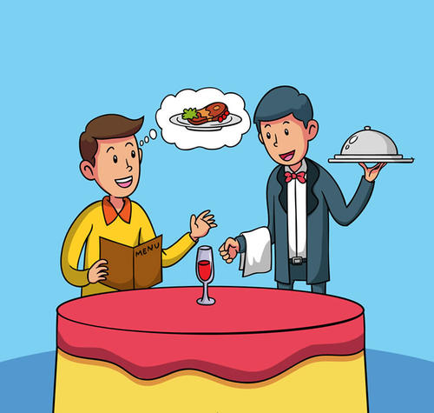
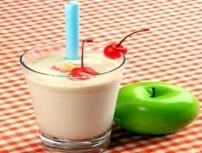
Waiter：Good morning ! Can I help you（我能帮助你吗）?
Guest : Yes, please! I want(想要) a milkshake.
Waiter: Do you like apple milkshake? It’s nice!
Guest: yes, I do . /
No,I don’t. I like … milkshake.
waiter
guest

Slide 10
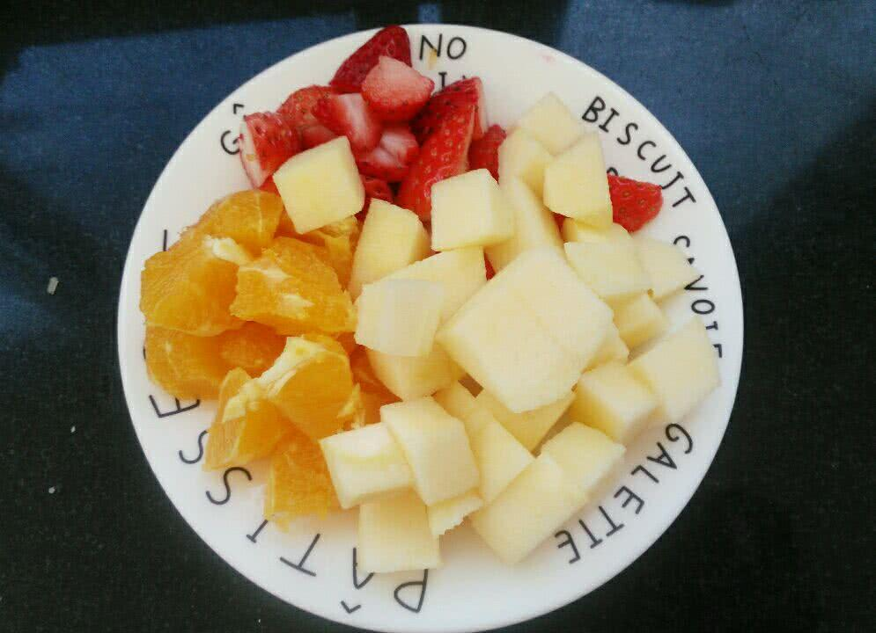
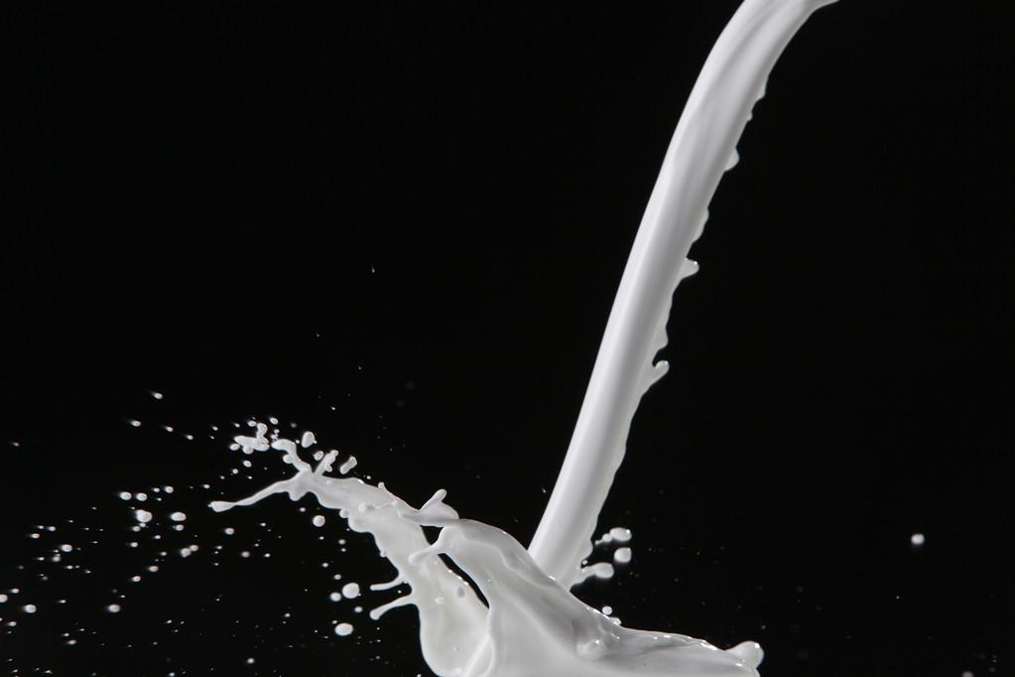
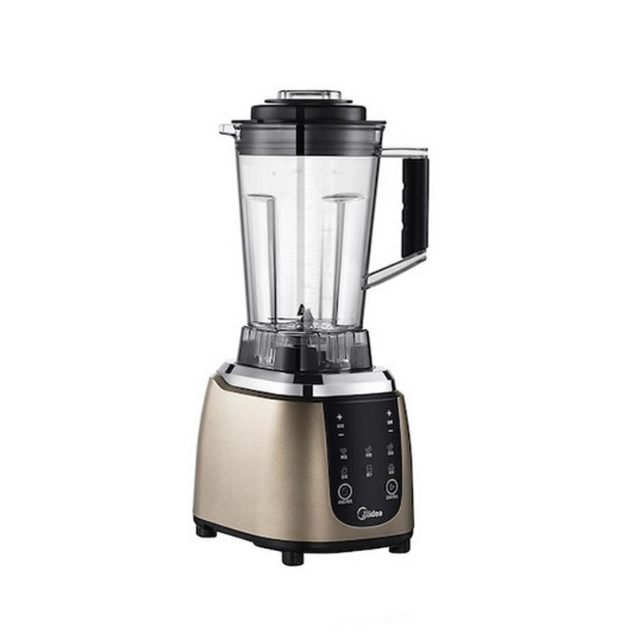
blender 搅拌机
How to make a milkshake?
Step 1 : Put(放) the fruits in .
Step 2 : Pour（倒） the milk in .
Step 3 : Turn（打开） the bender on .
Step 4 :Pour（倒出） the milkshake out .

Slide 11
Waiter：Good morning ! Can I help you（我能帮助你吗）?
Guest : Yes, please! I want(想要) a milkshake.
Waiter: Do you like apple milkshake? It’s nice!
Guest: yes, I do . /
No,I don’t. I like … milkshake.
Waiter : OK. Here you are.
Guest: Thank you !
A: You are welcome!
waiter
guest

Slide 12
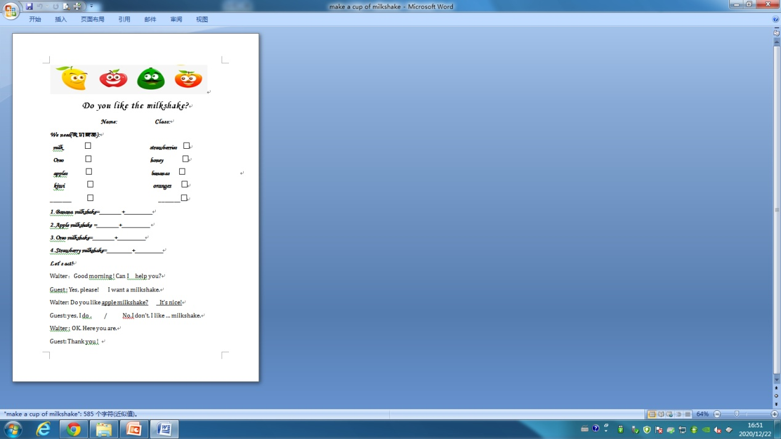


Home work
Make a milkshake with your family.
2.Act it out
3.Finish this worksheet

Slide 13

Love English !
Love life !

