Slide 1

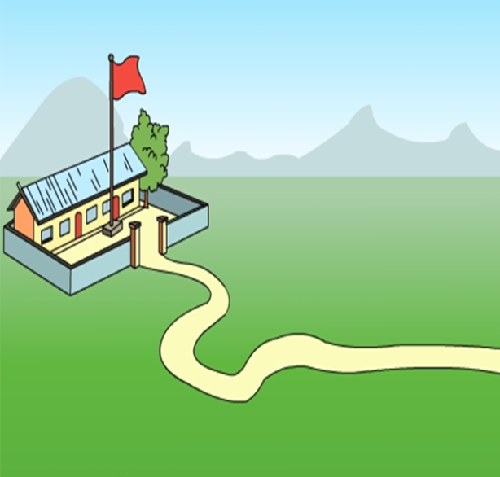
Module 7 Unit1
How do you go to school?

Slide 2

空白演示
在此输入您的封面副标题

Slide 3
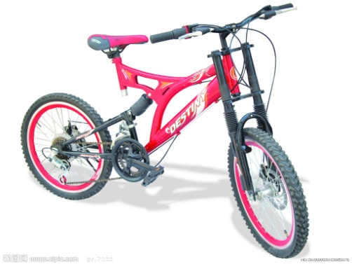
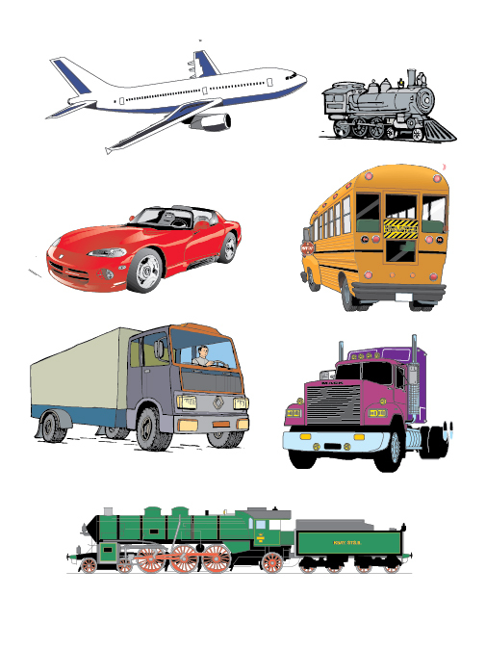
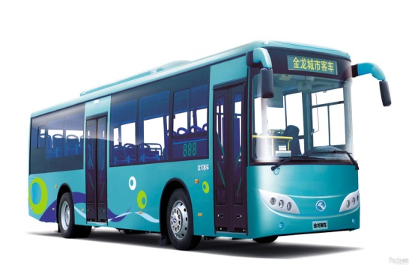
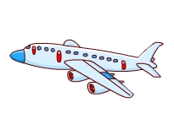
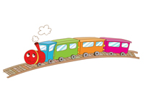
vehicles 车辆
bike
car
bus
plane
train

Slide 4
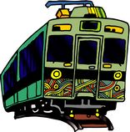




What's missing?
Game time
train
bike
bus
car
plane

Slide 5

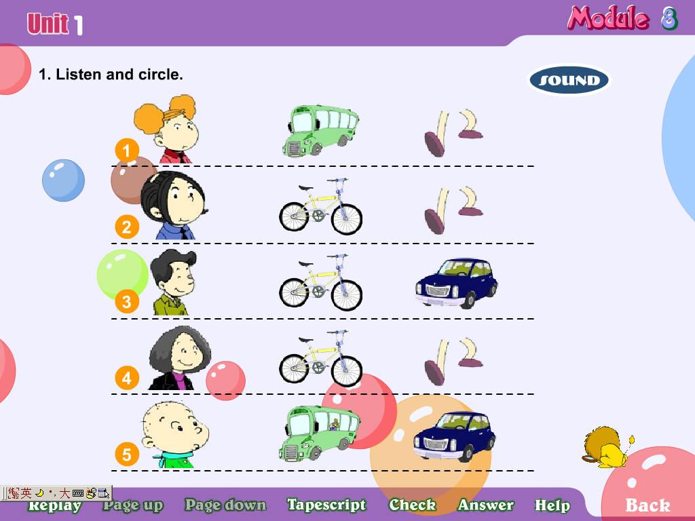
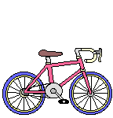
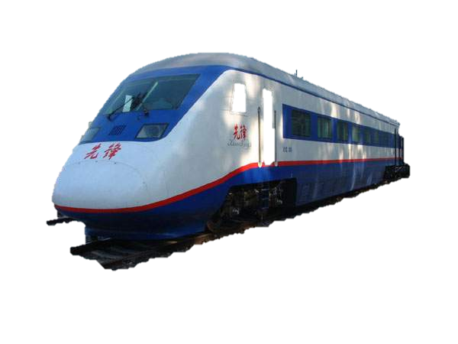
car, car, di di di.
bus, bus, beep beep beep.
bike, bike, ling ling ling.
train , train, chug chug chug.

Slide 6
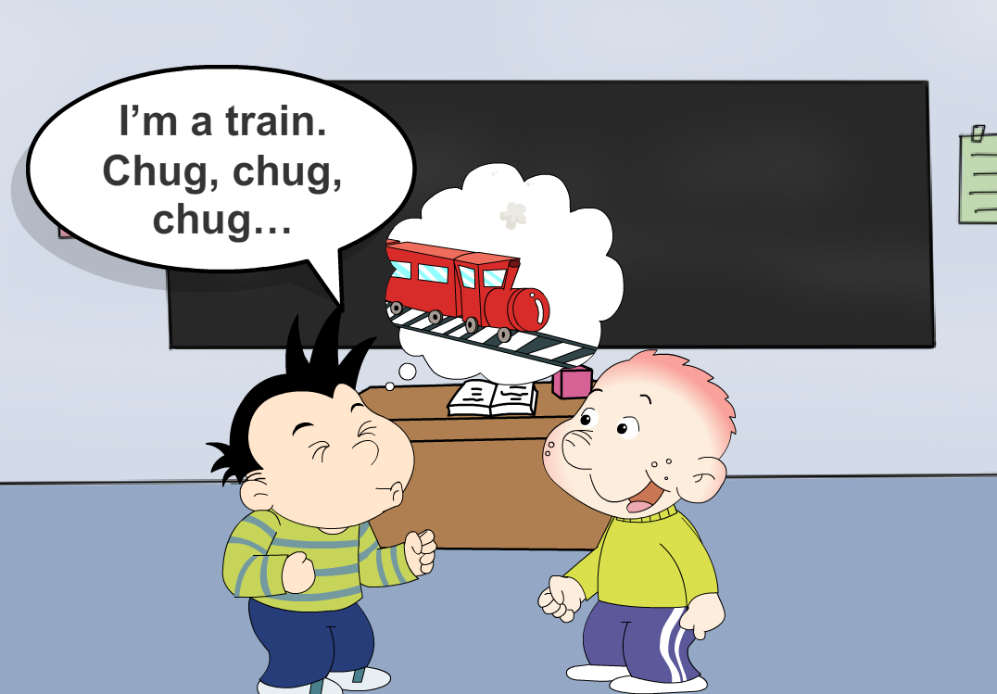


Slide 7
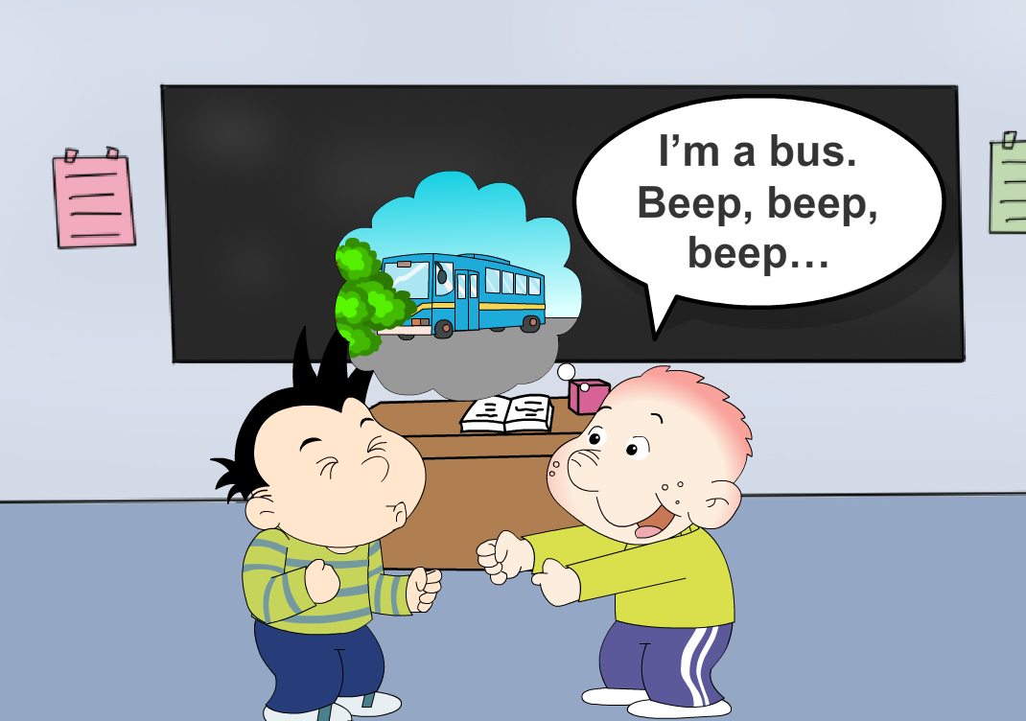

Slide 9
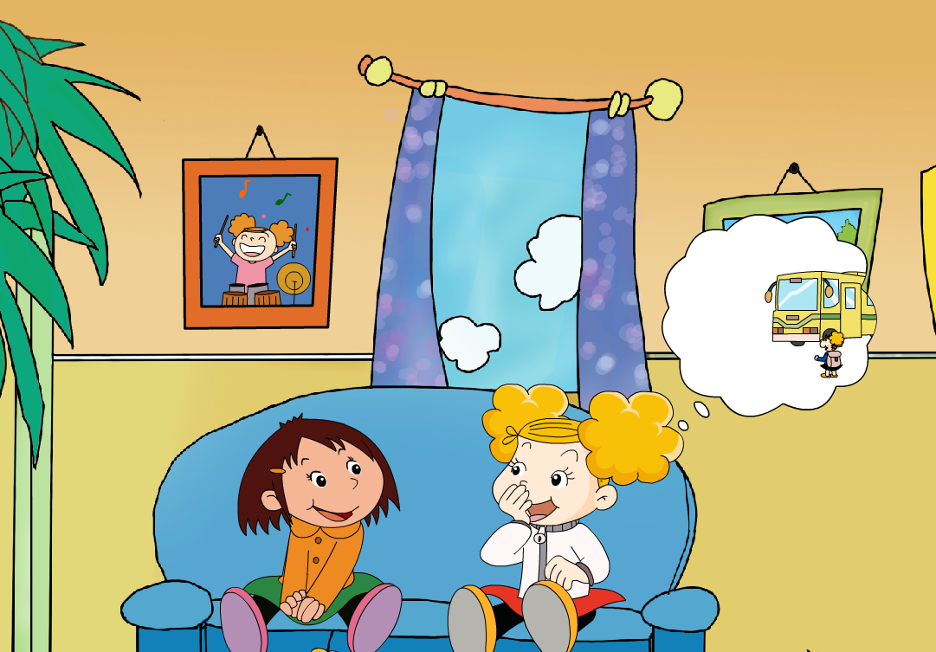
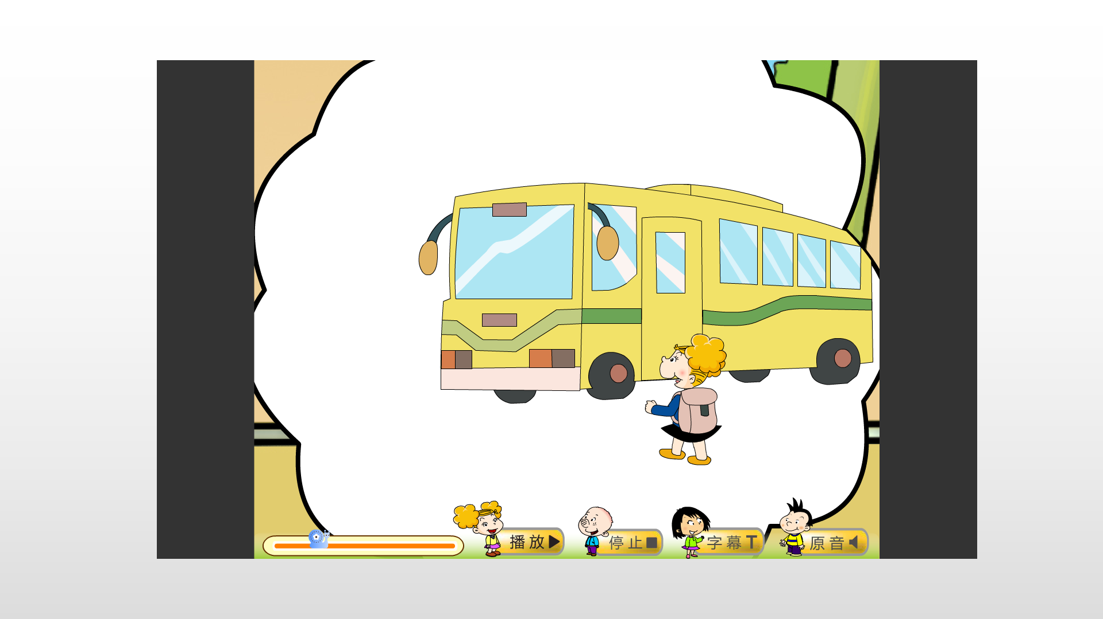
How do you
go to school
Amy?
I go to school
_______.
by bus

Slide 10
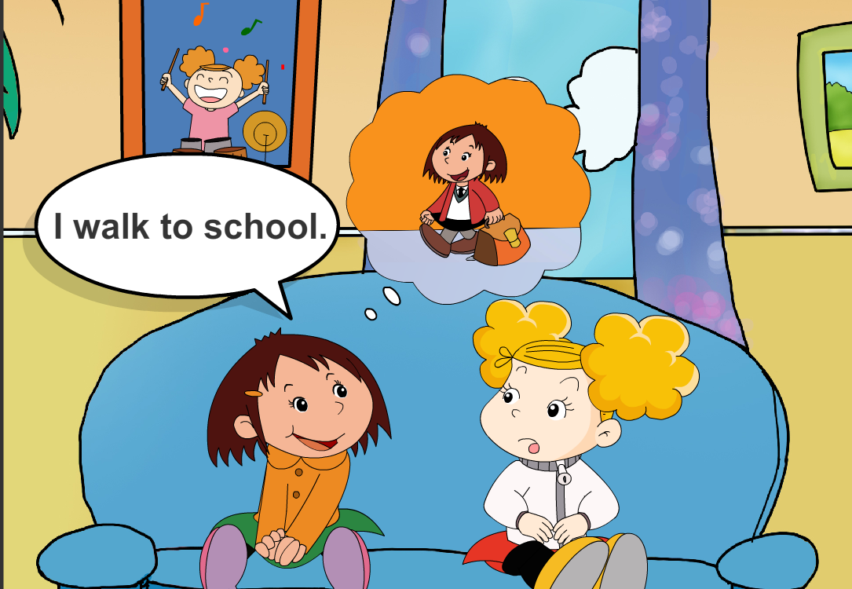
And how do you go to school ?
walk

Slide 11
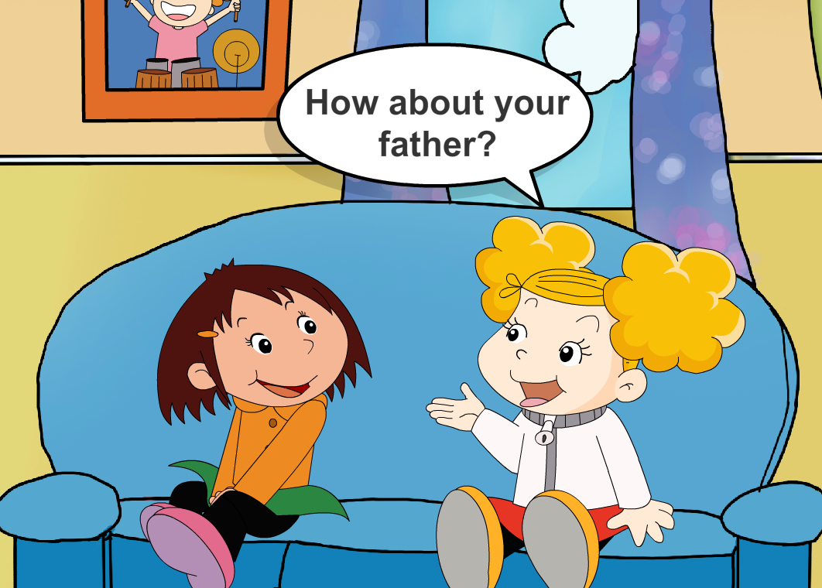
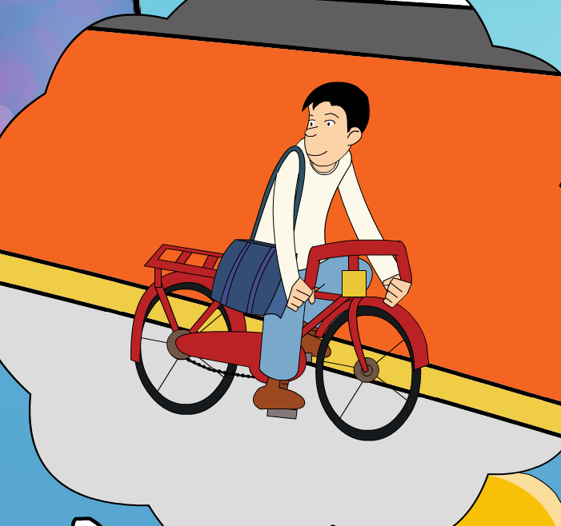
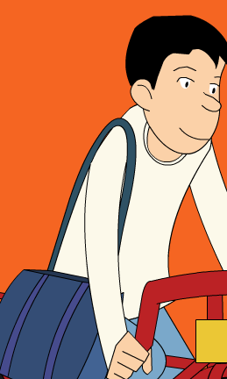
How about
He goes to work
_______.
by bike

Slide 12

walk
走
work
工作

Slide 13
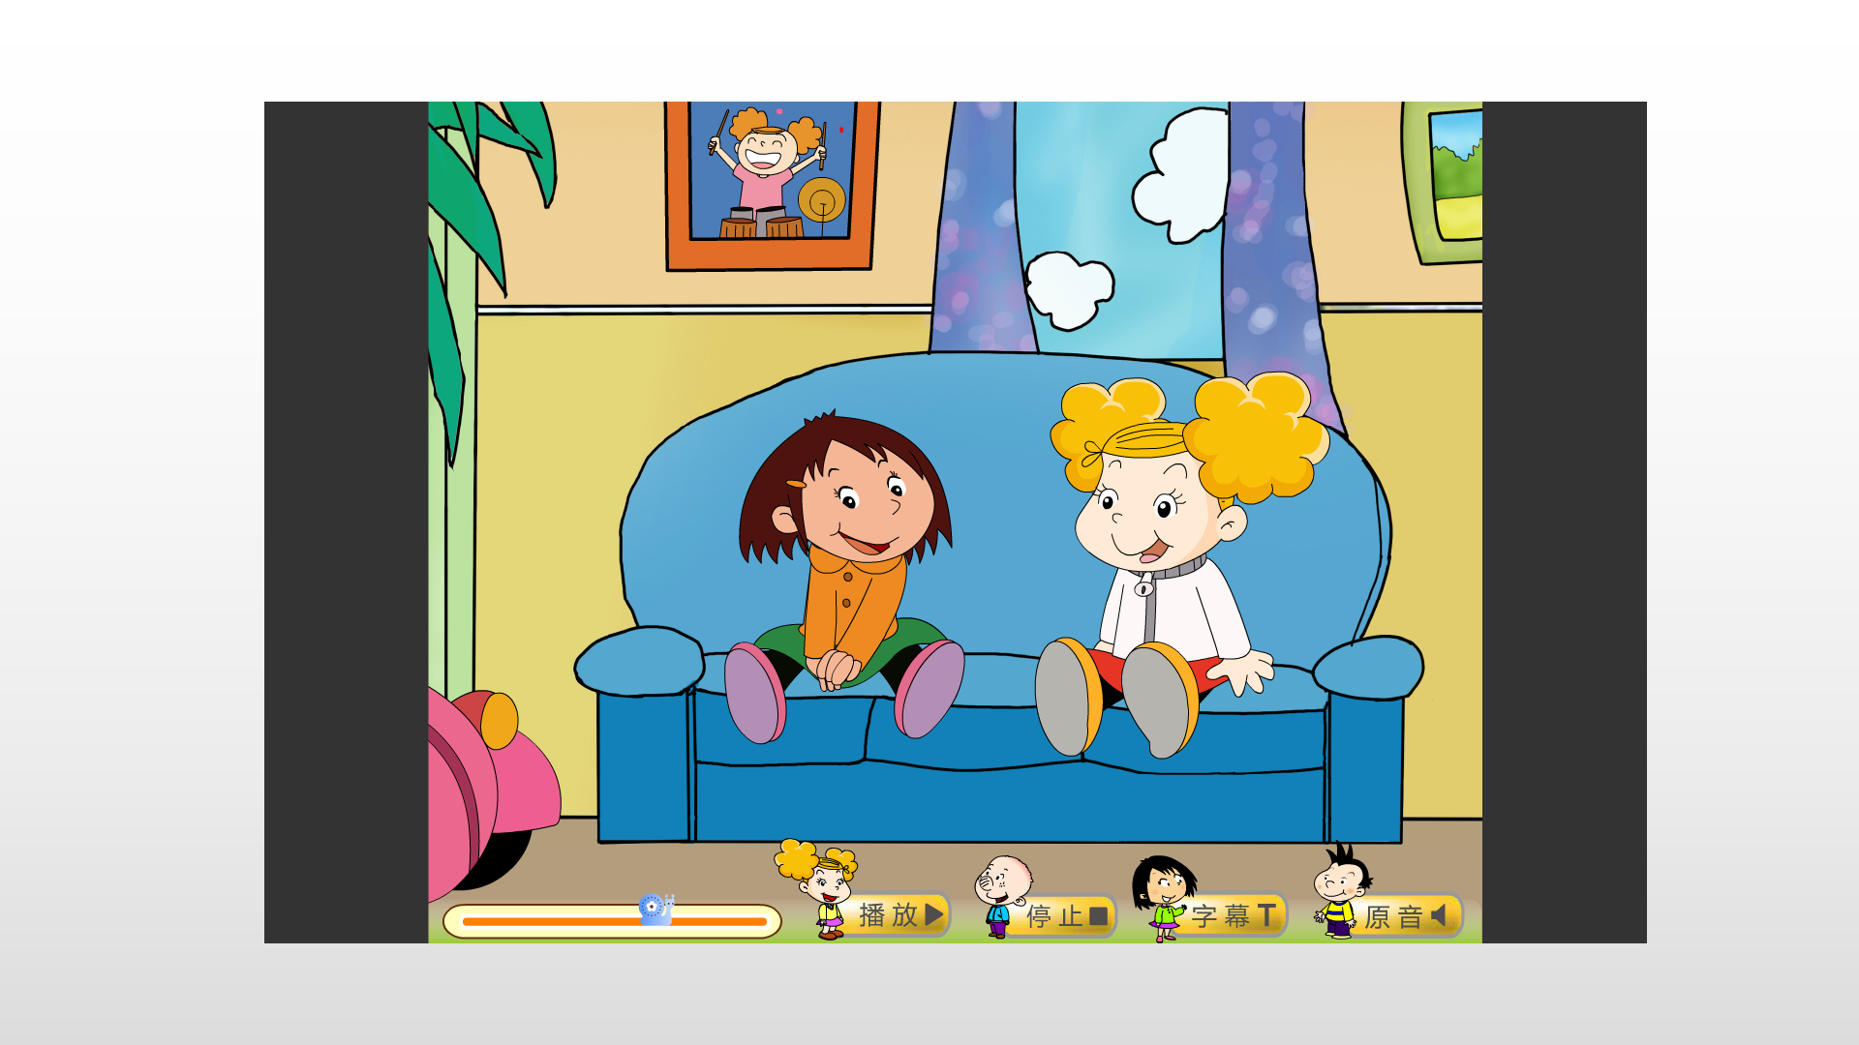
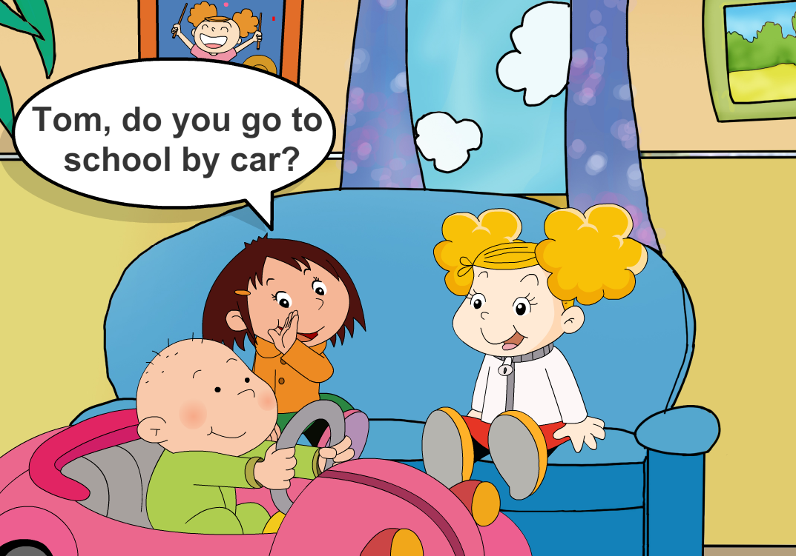

No, I don't.

Slide 14
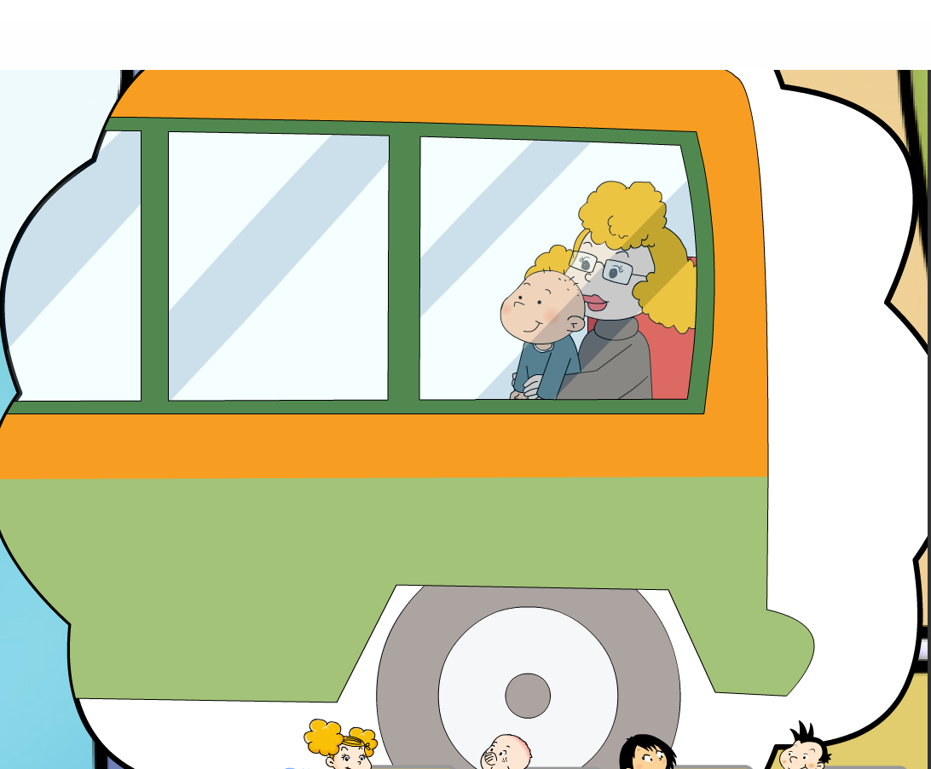
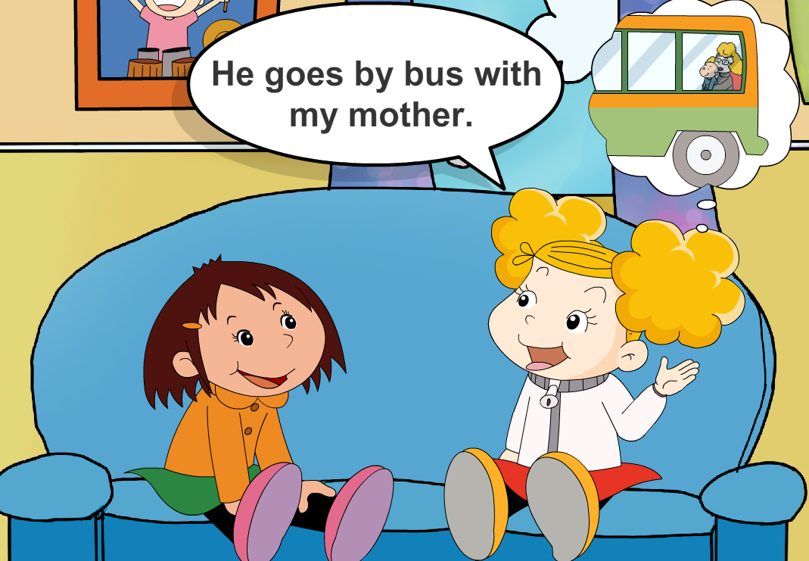
How does he go to school ?
He goes by bus
with my mother.

Slide 15
P38

Slide 16
Listen and find “How...?”
How do you go to school,Amy?
And how do you go to school?
How about your father?

Slide 17


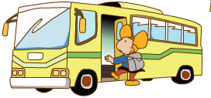
How do you go to school, Amy?
I go to school by bus.

Slide 18
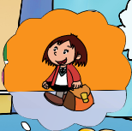
And how do you go to school?
I walk to school.

Slide 19
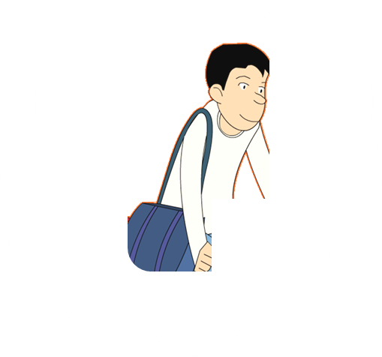
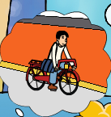
How about your father?
He goes to work by bike.

Slide 20
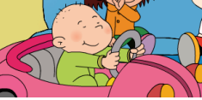
Tom, do you go to school by car?
No, I don't.
my mother
He goes by ___ with_________.
bus

Slide 21

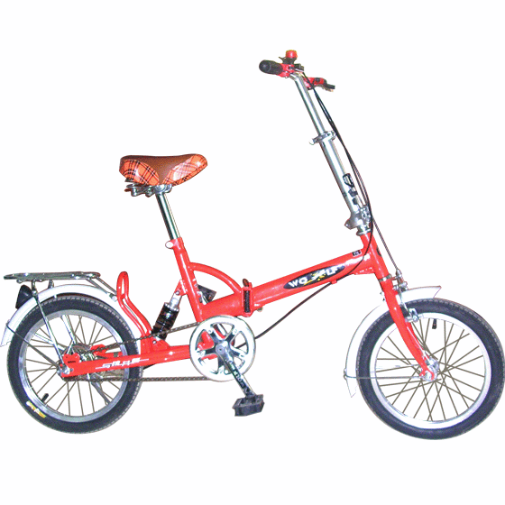
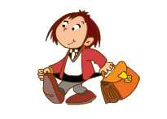
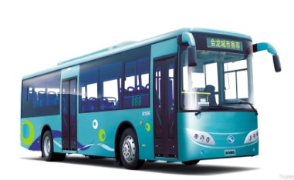
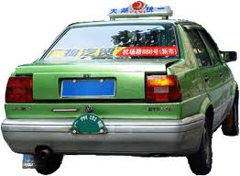
A: How do you go to school?
I go to school by ______.
B:
I walk to school.
bus
car
taxi
bike
walk

Slide 22
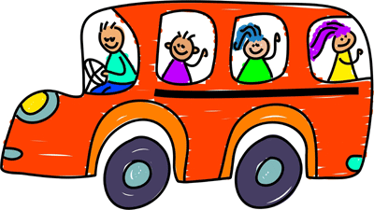

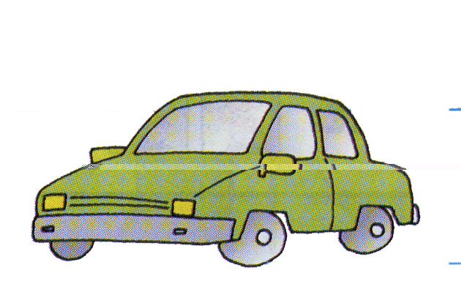
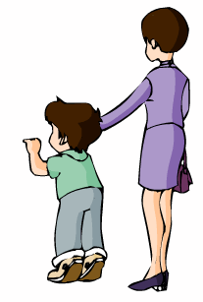
How do you go to school?
by bus.
I go to school
by bike.
by car.
I
walk
to school.

Slide 23
How does he go to school?
by bus.
He goesto school
by bike.
by car.
He
walks
to school.

Slide 24

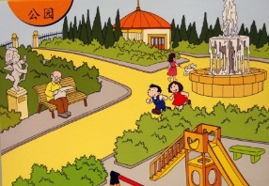
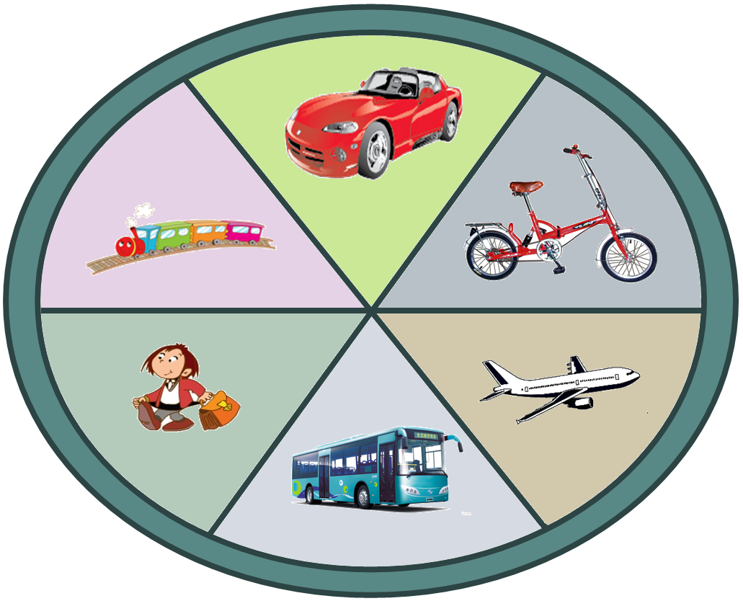
How do you go to the ?
I go to the… by ___./ I walks to…

Slide 25

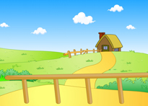
How do you go to the ?
I go to the… by ___.

Slide 26


How do you go to the ?
I go to the… by ___.

Slide 27

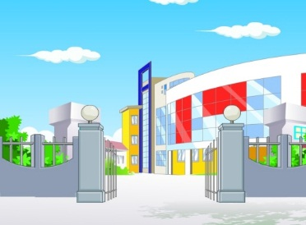
How do you go to ?
I go to… by ___.

