Slide 1
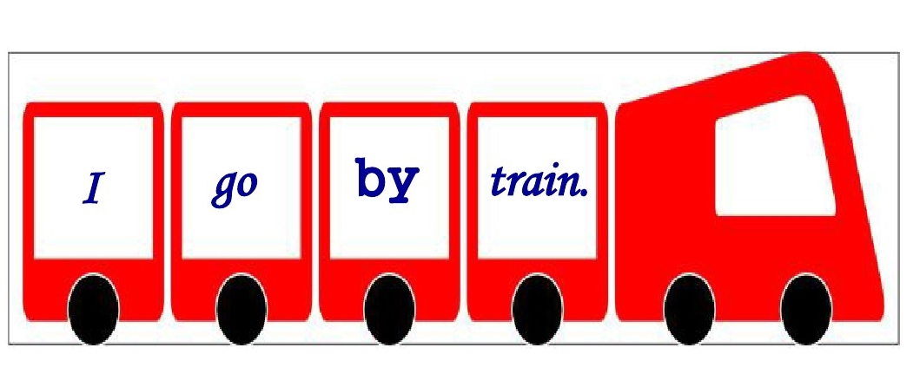
Module 7 Unit 2

Slide 2


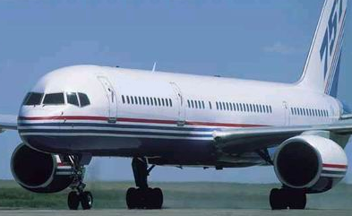
It’s not a bird. It can fly in the sky. It’s very big. What is it?
plane

Slide 3
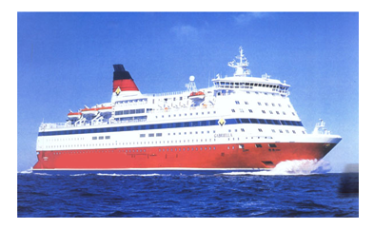
It lives in the sea. It can swim. But it’s not a fish. It’s a vehicle. Please tell me “What is it?”
ship

Slide 4
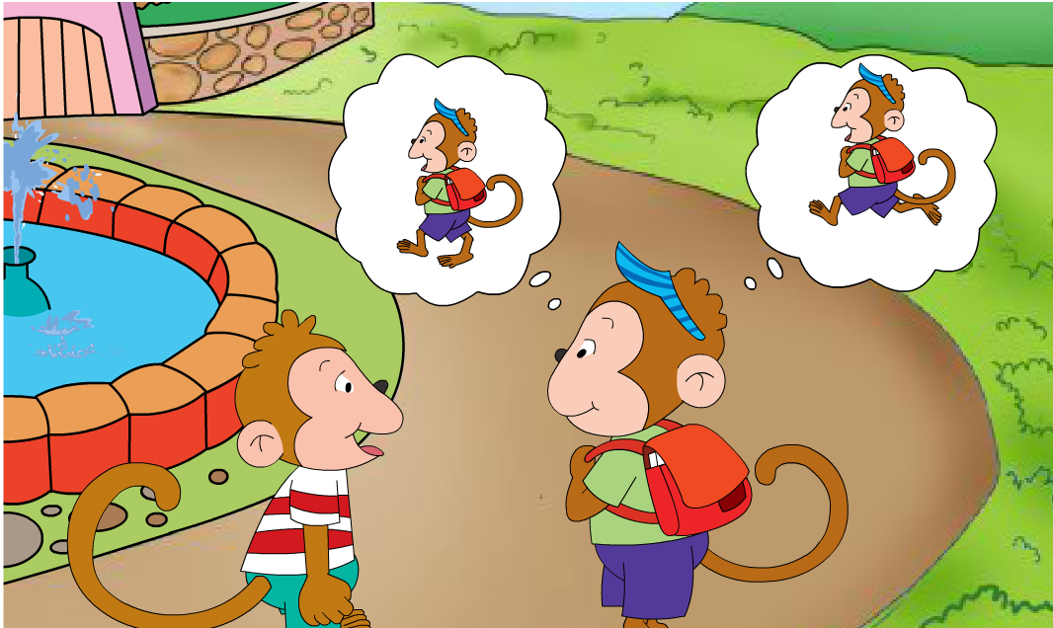

How do you
run
walk
go to school？
I walk and run to school.

Slide 5
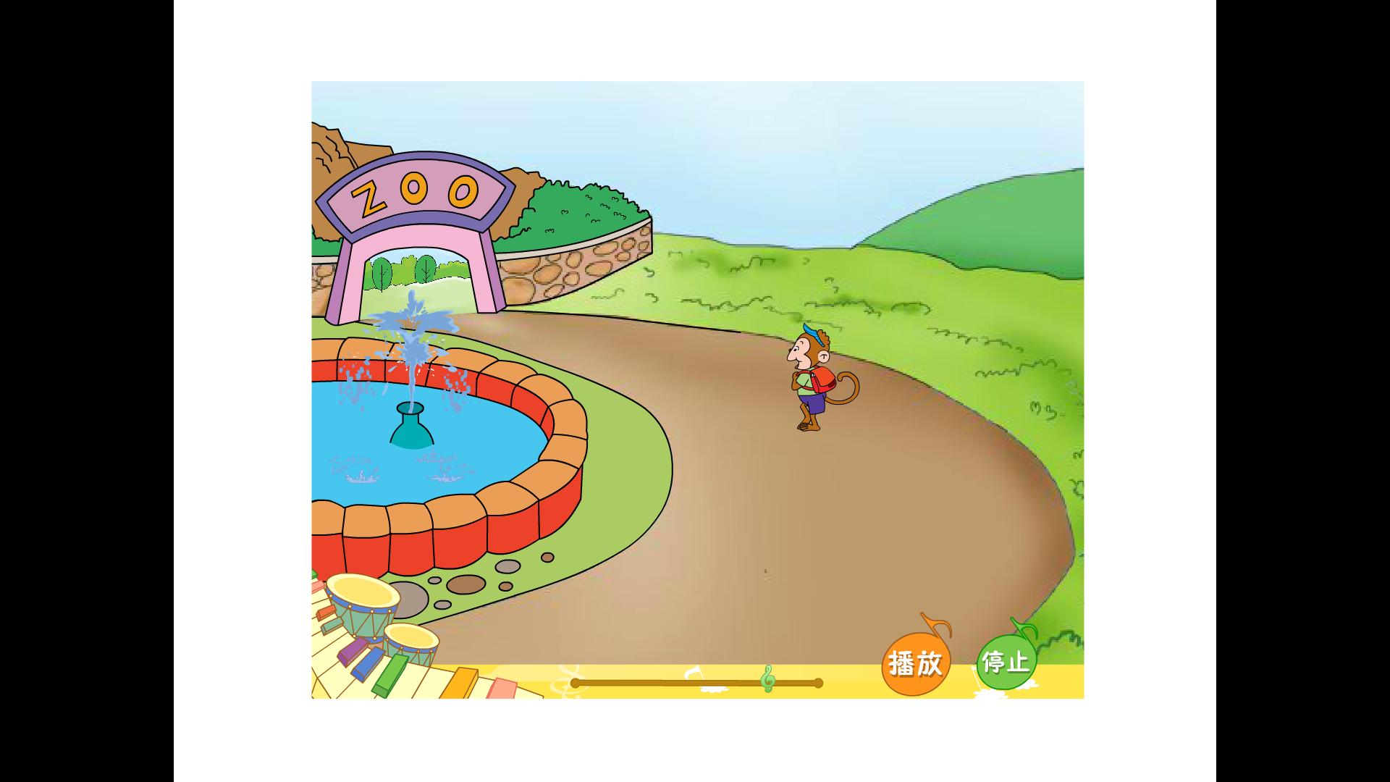
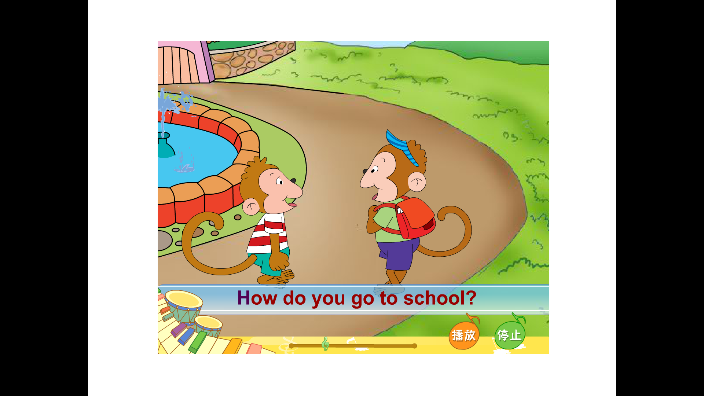
My school is __________.
And where's your school ?
at the zoo

Slide 7
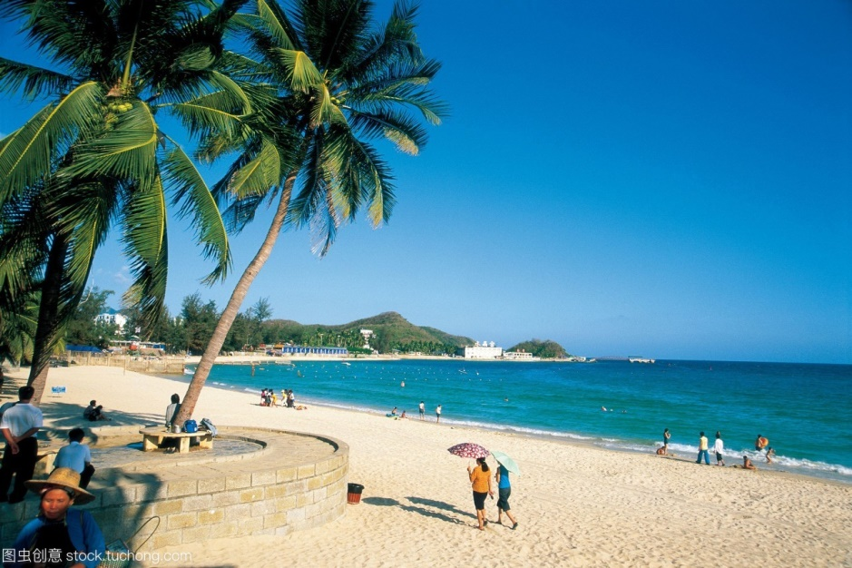
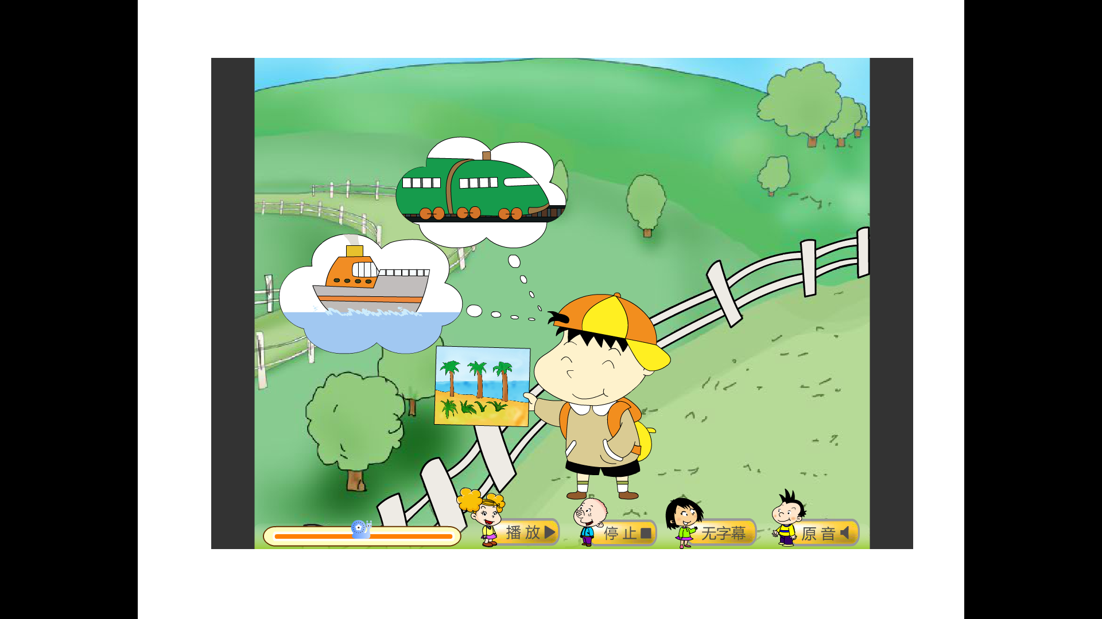
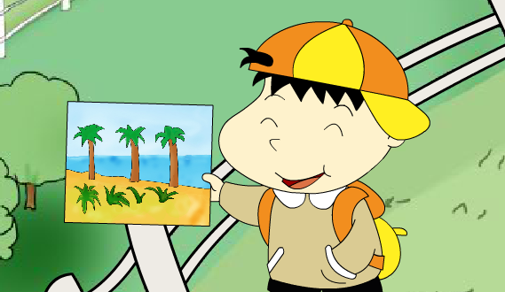
Hainan
How do you go to Hainan,Baobao?
on holiday
I go to Hainan on holiday.
I go by train.
Then I go ______.
by ship
Hi！I’m Baobao.

Slide 8
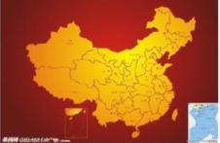
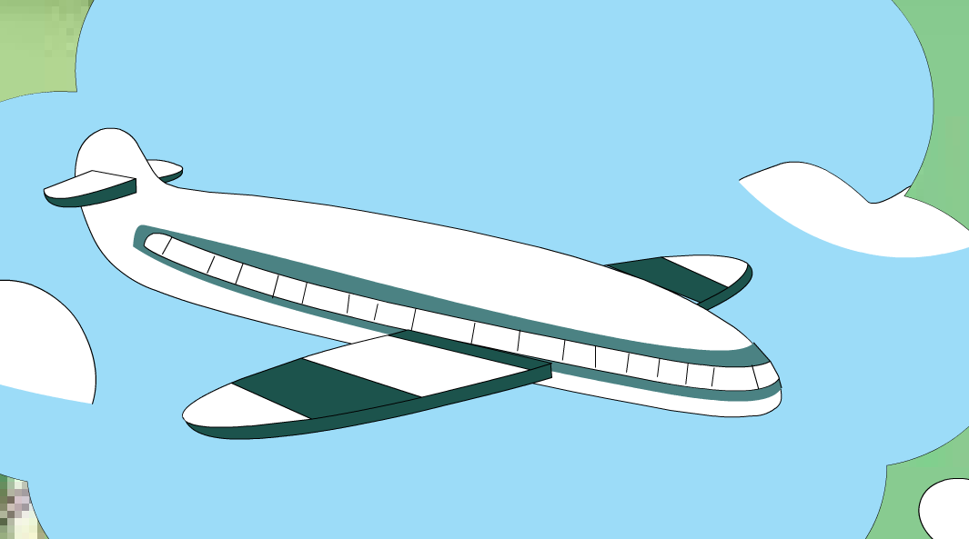
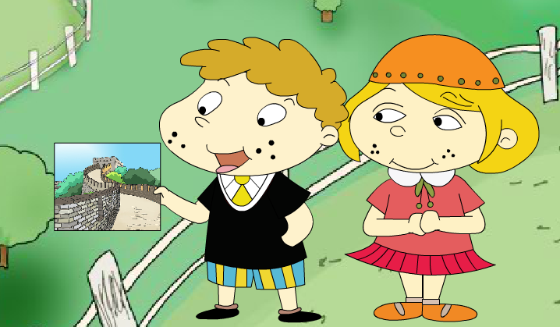
We go to China on holiday.
We go by plane.
China
We love China.

Slide 9
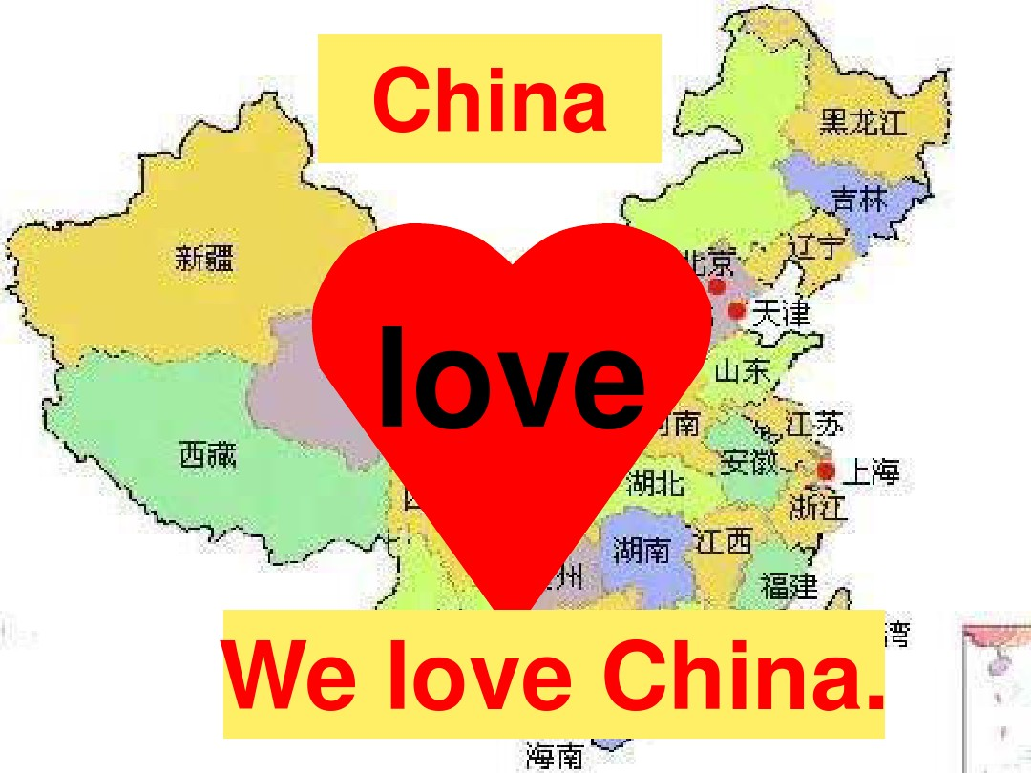

Slide 10
P41

Slide 11
P42

Slide 12









How do you go to...?
plane
train
bus
I go by
ship
bike
car
I walk to ...

Slide 13


Do you go to ……by……?
Yes, I do.
No, I don’t.
zoo
farm
school
Beijing
Shanghai
Dalian

Slide 14
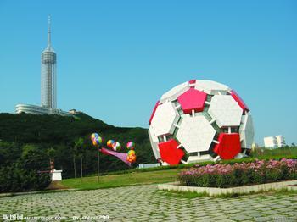
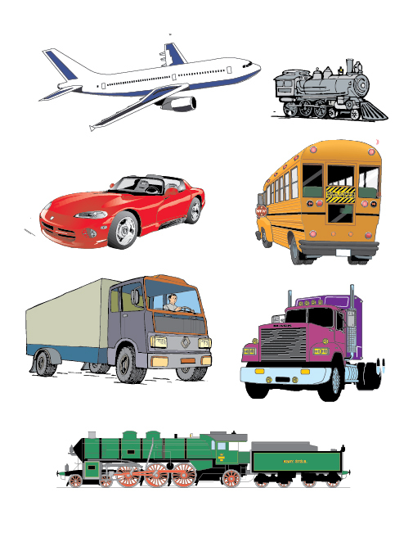

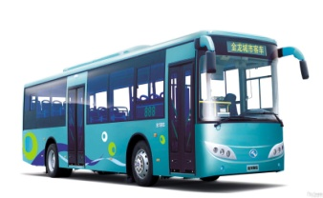
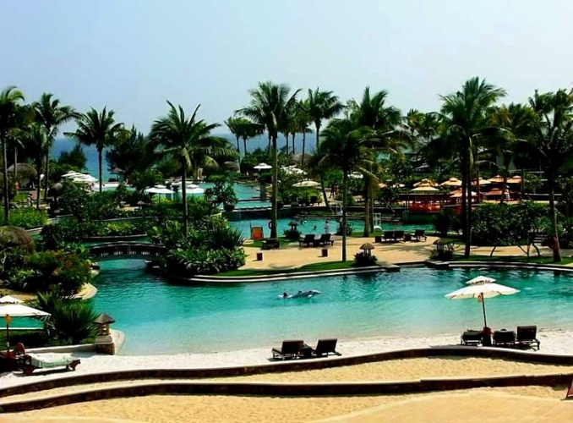
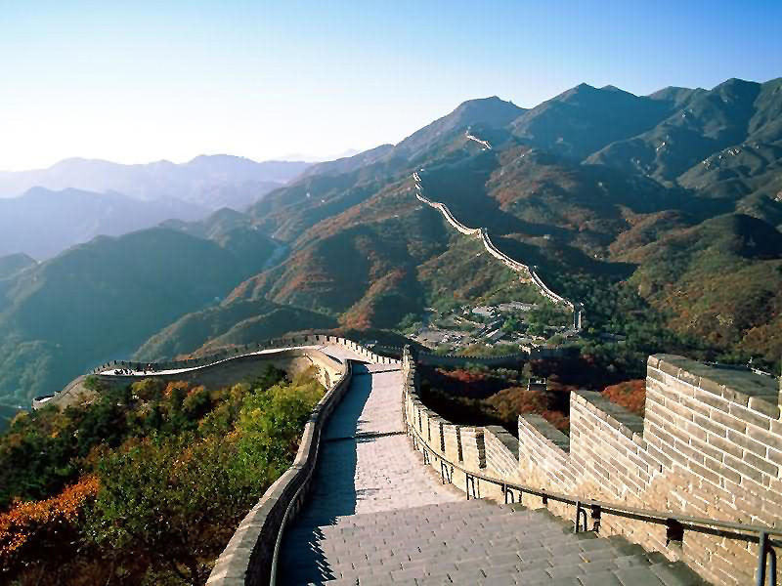

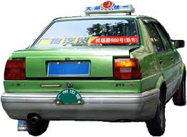
Dalian
Guilin
How do you go to……?
I go by……
Sanya
Beijing

