Slide 1
M2U1
What’s your name?
棠外附小 Ivy

Slide 2
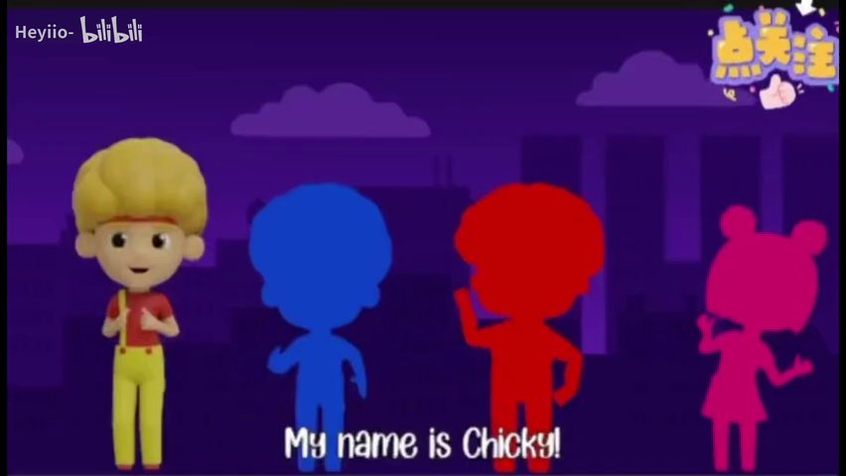

Warm-up: sing and dance

Slide 3
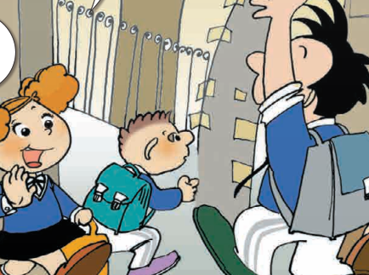

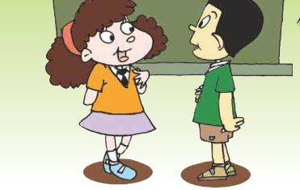
Review
如何打招呼及介绍自己？
Hello! /Hi! I’m.......

Slide 4



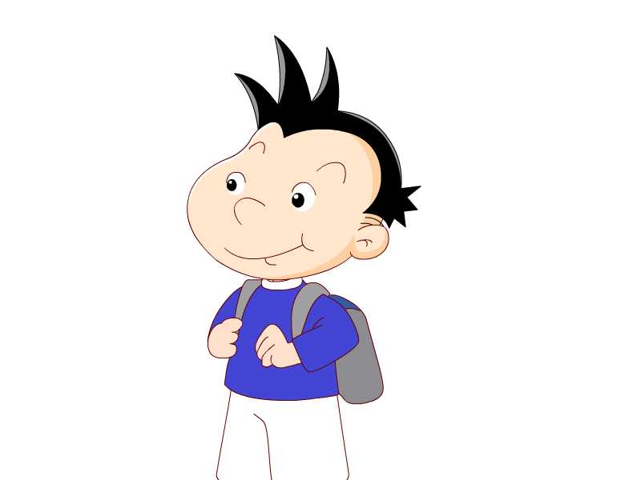

Look and say.
Hello, I’m.......
Amy
Sam
Daming
Lingling
name名字

Slide 5
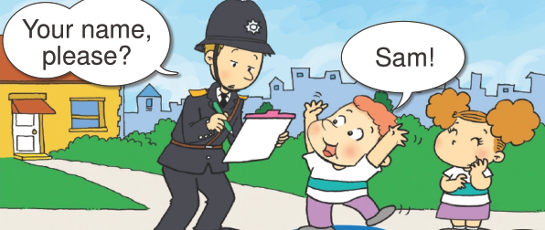
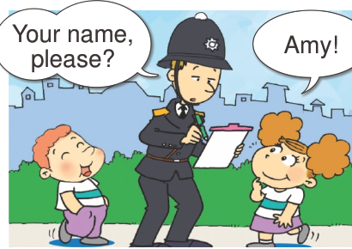

Look and say.
How to ask their names?
怎样问别人的名字？

Slide 6
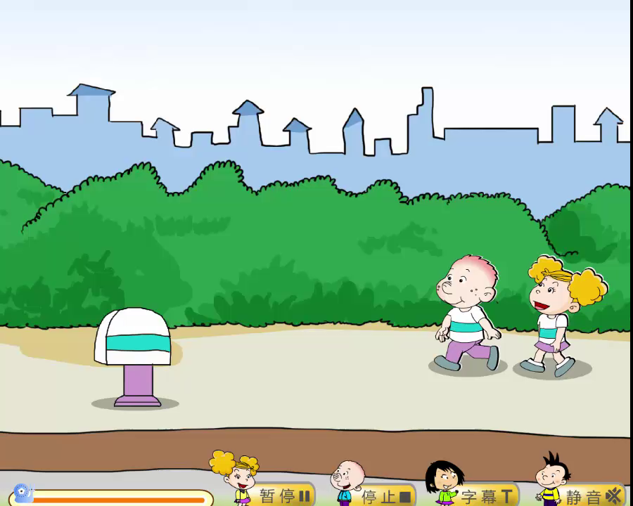
Watch and repeat.

Slide 7
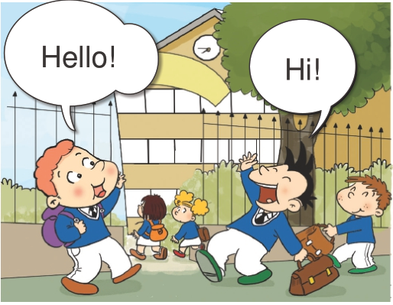
Look and say.
morning or afternoon
早上 下午

Slide 8
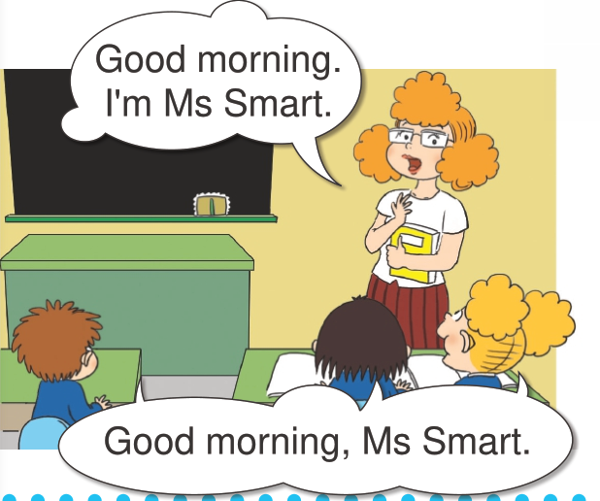
Look and say.
Who?What will she say?
谁？ 说什么？
早上好

Slide 9
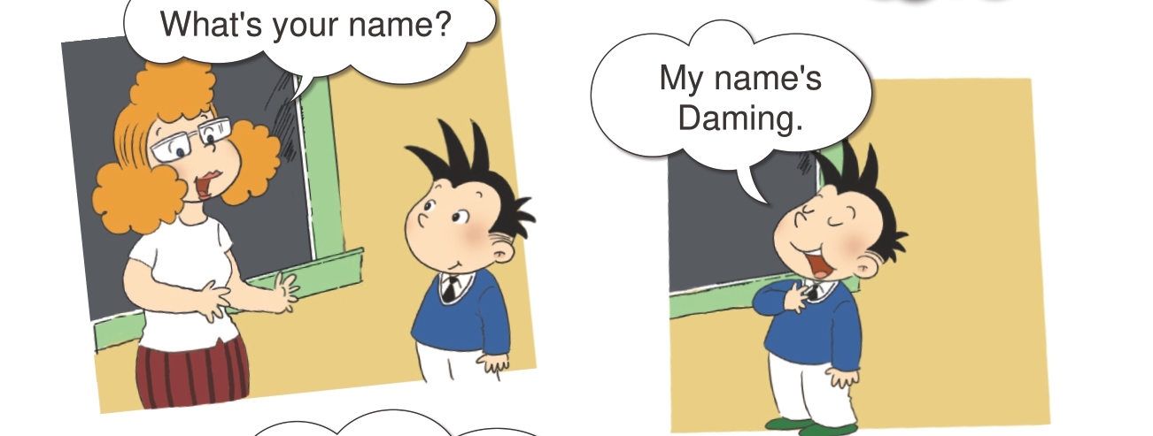
Listen and say.
How to ask name?怎么问名字？
my 我的
name 名字

Slide 10
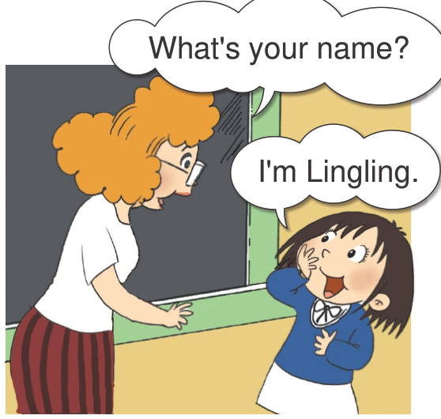
Look and guess(猜)

Slide 11
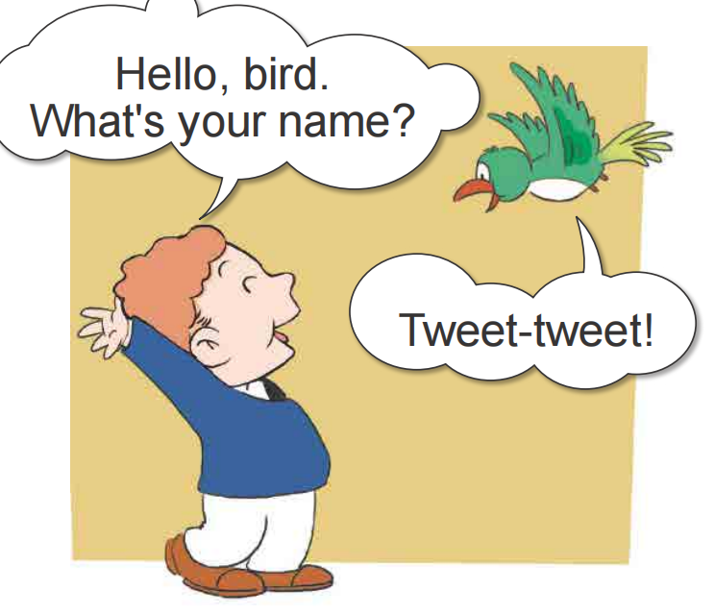
Look and say
What will they say?
什么？

Slide 12
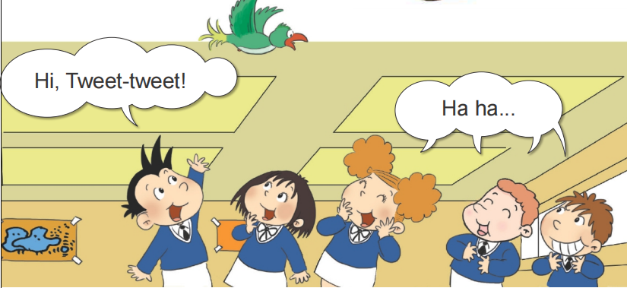
Do they like this bird?
喜欢

Slide 13
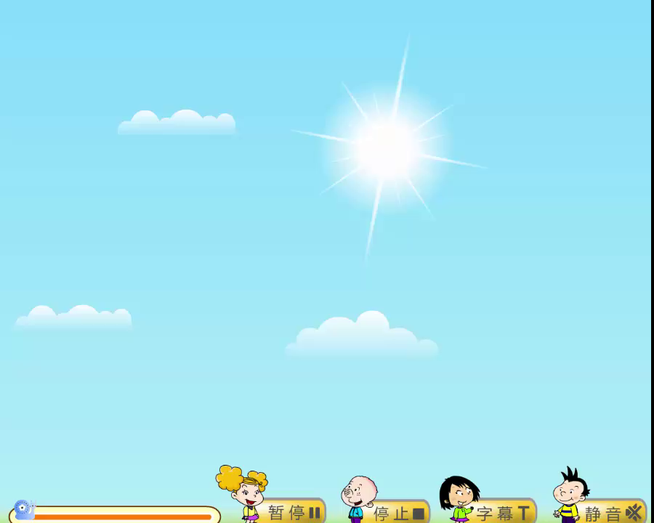
Listen and repeat

Slide 14
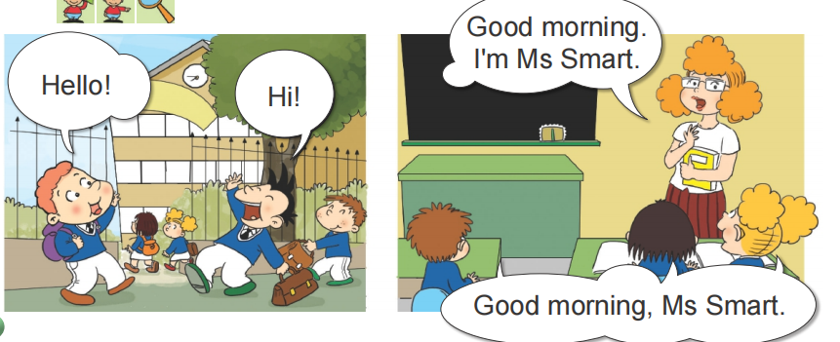
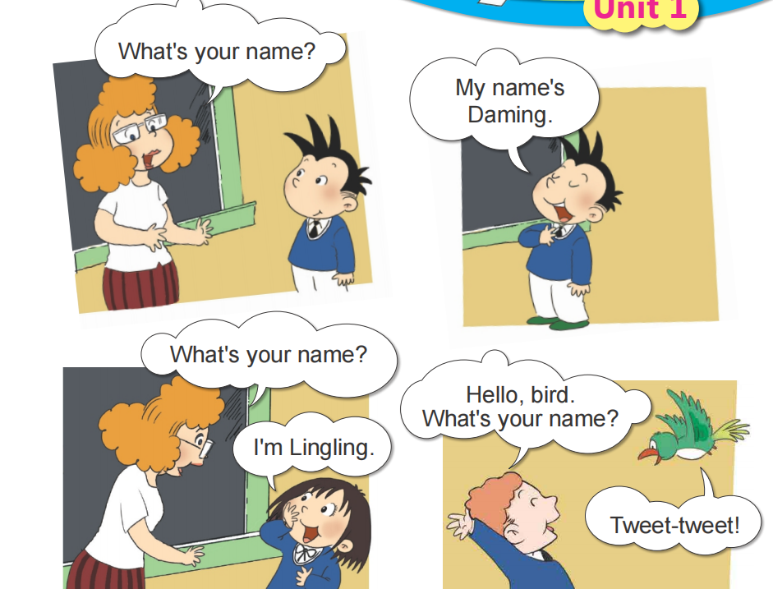
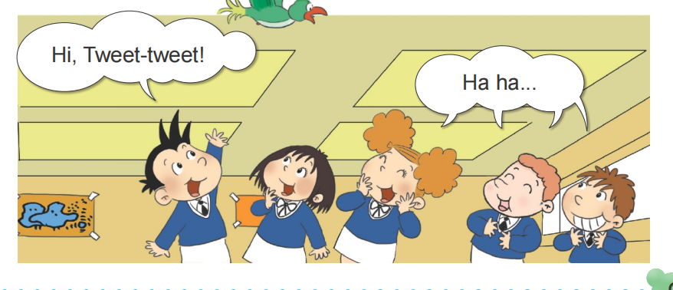
Let’s read.

Slide 15
Let’s act（演）.

Slide 16
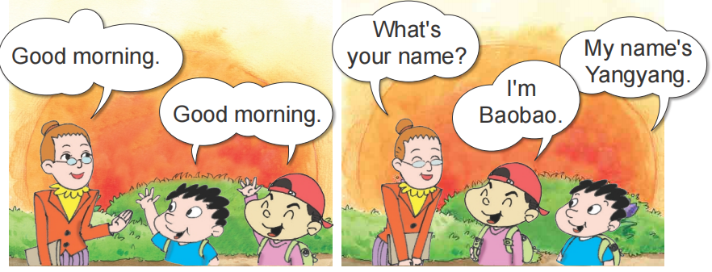
Listen and say.

Slide 17
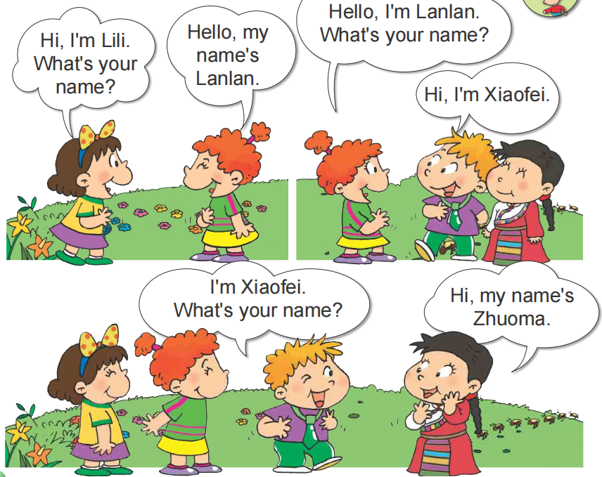
Practise.

Slide 18
Practise.
1
2
3
4

