Slide 1
Module 6 unit 2

Slide 2
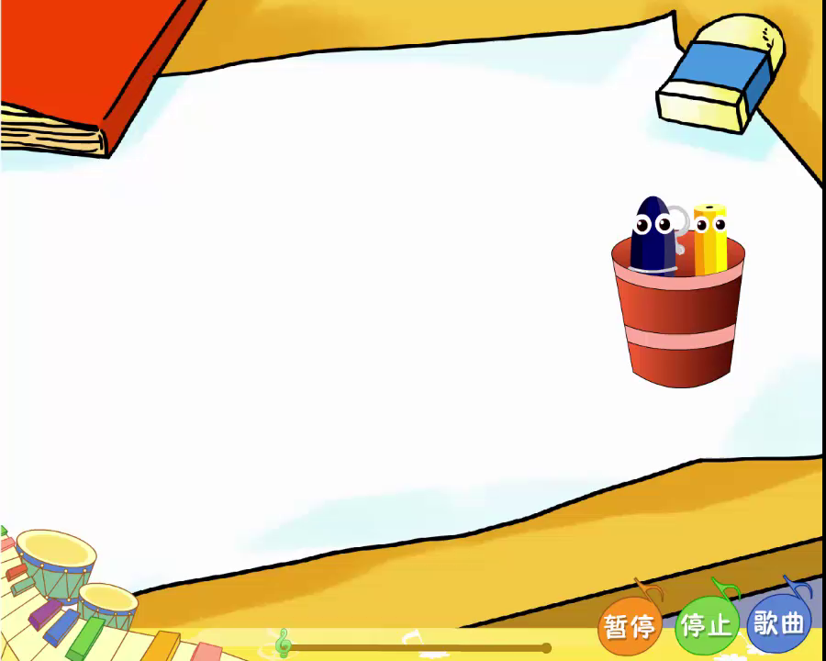
Let’s chant.

Slide 3


and ,
and ,
and say it again!

Slide 4
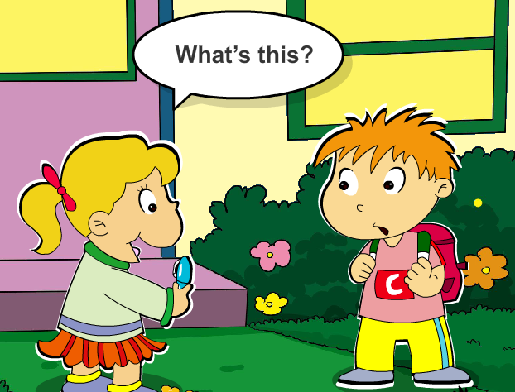

It's a ___.
pen

Slide 5

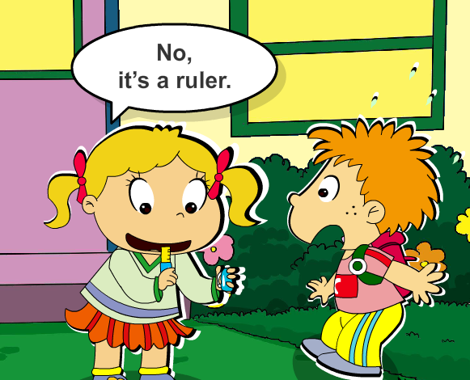
How is he feeling now?
happy
sad
surprised 惊讶的

Slide 6
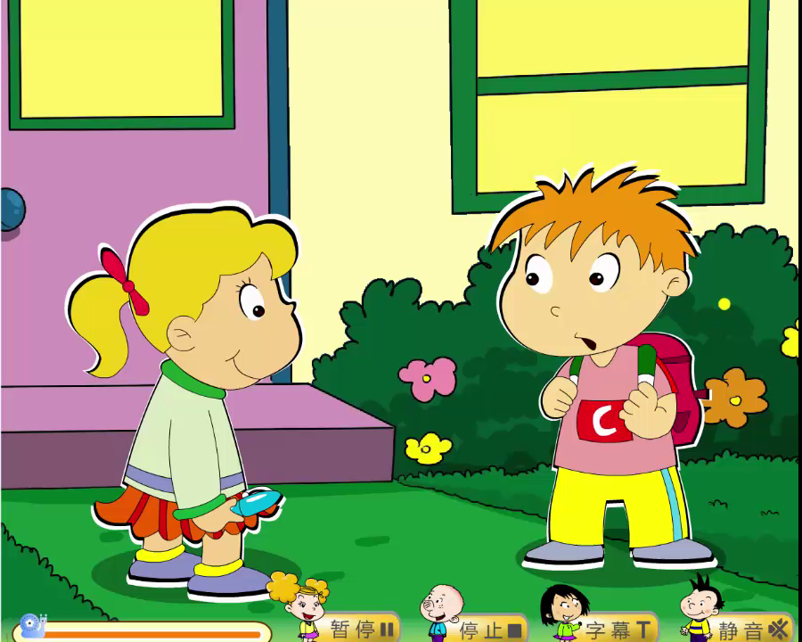
Watch and answer: Why is he surprised?

Slide 7
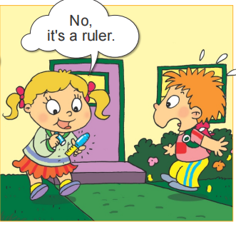

Slide 8
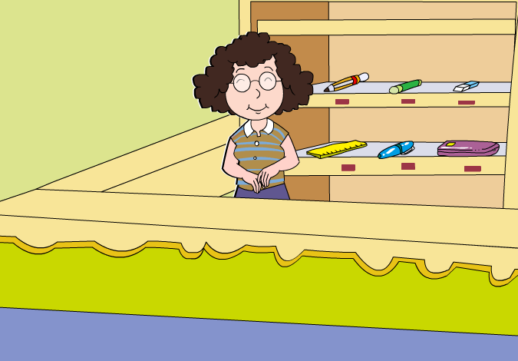
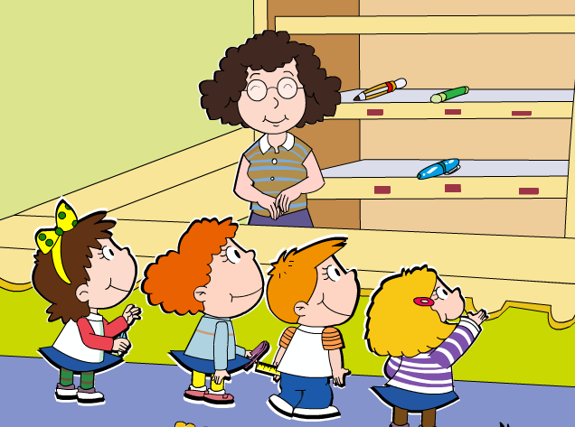
Where(哪里) is this place?

Slide 9
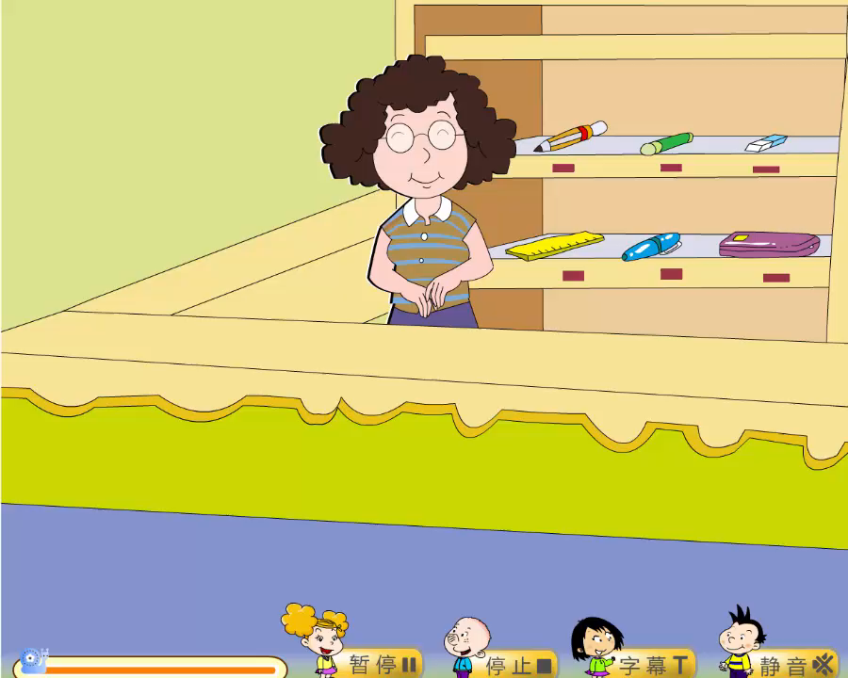

Slide 10
Lost and Found
失物招领
Where(哪里) is this place?

Slide 11
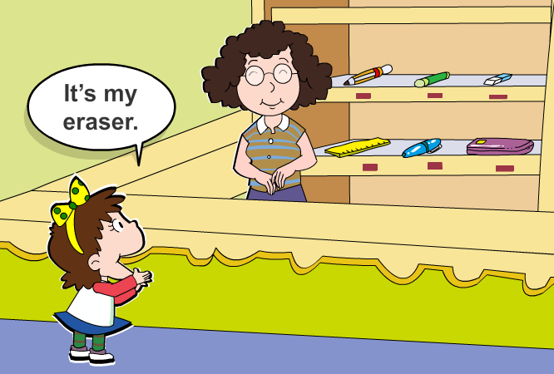


Slide 12
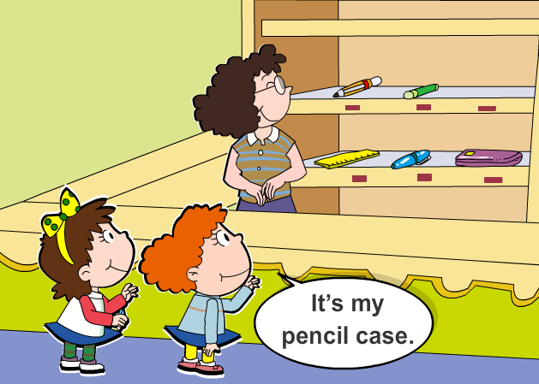
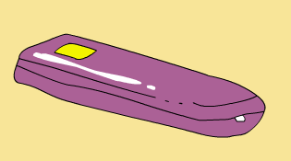

Slide 13
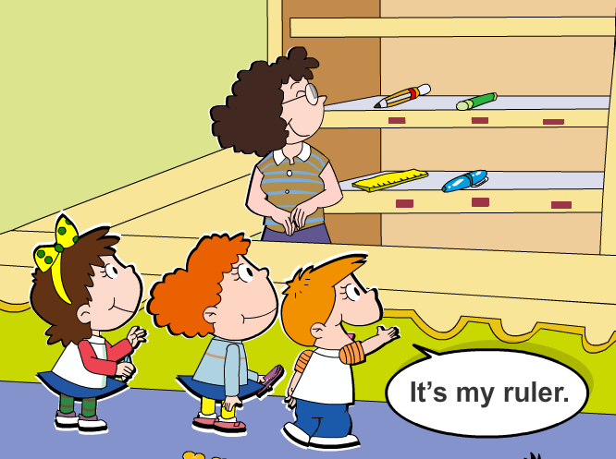


Slide 14
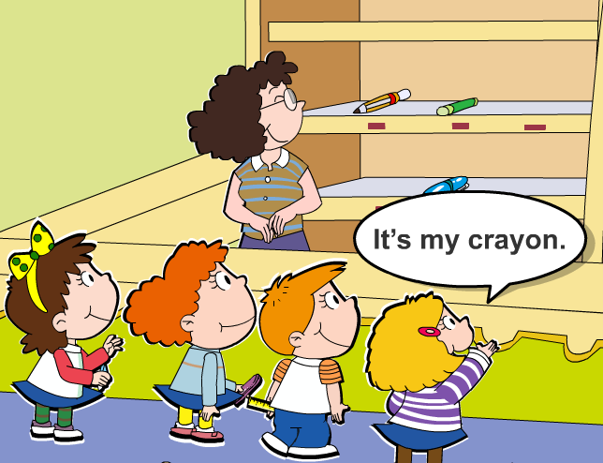


Slide 15
watch and repeat

Slide 16
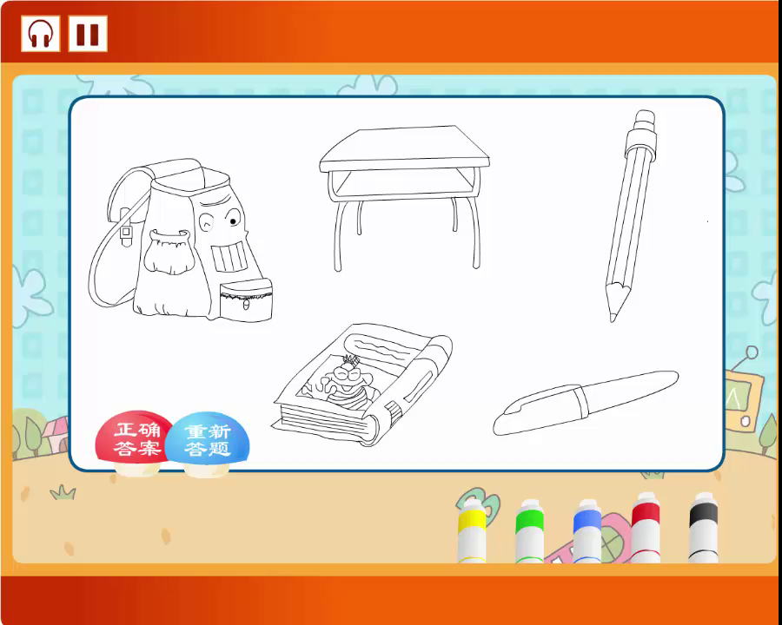
Listen and colour

Slide 17

practise

