Slide 1


Module 3 Unit 1
Where’s the orange cat ?

Slide 2
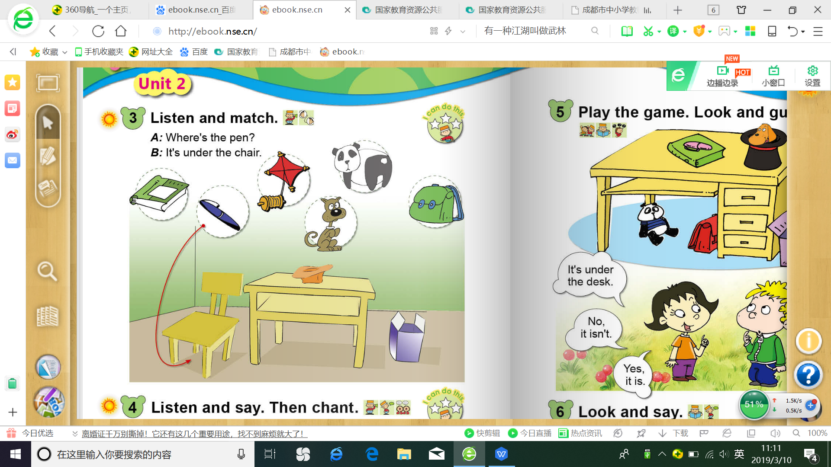


Slide 3
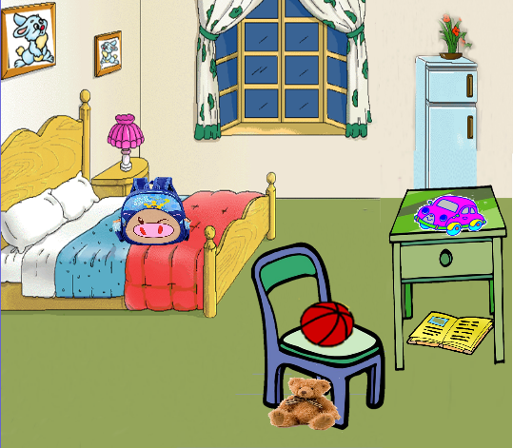
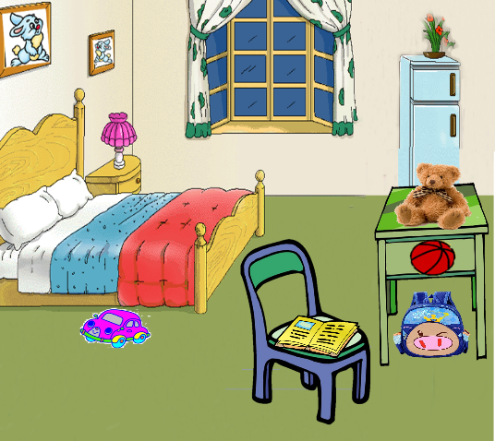

Look and say
floor
图中有五处不同，小朋友们，你们能找出来吗？

Slide 4
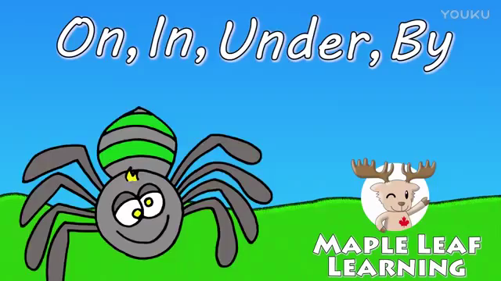

Slide 5
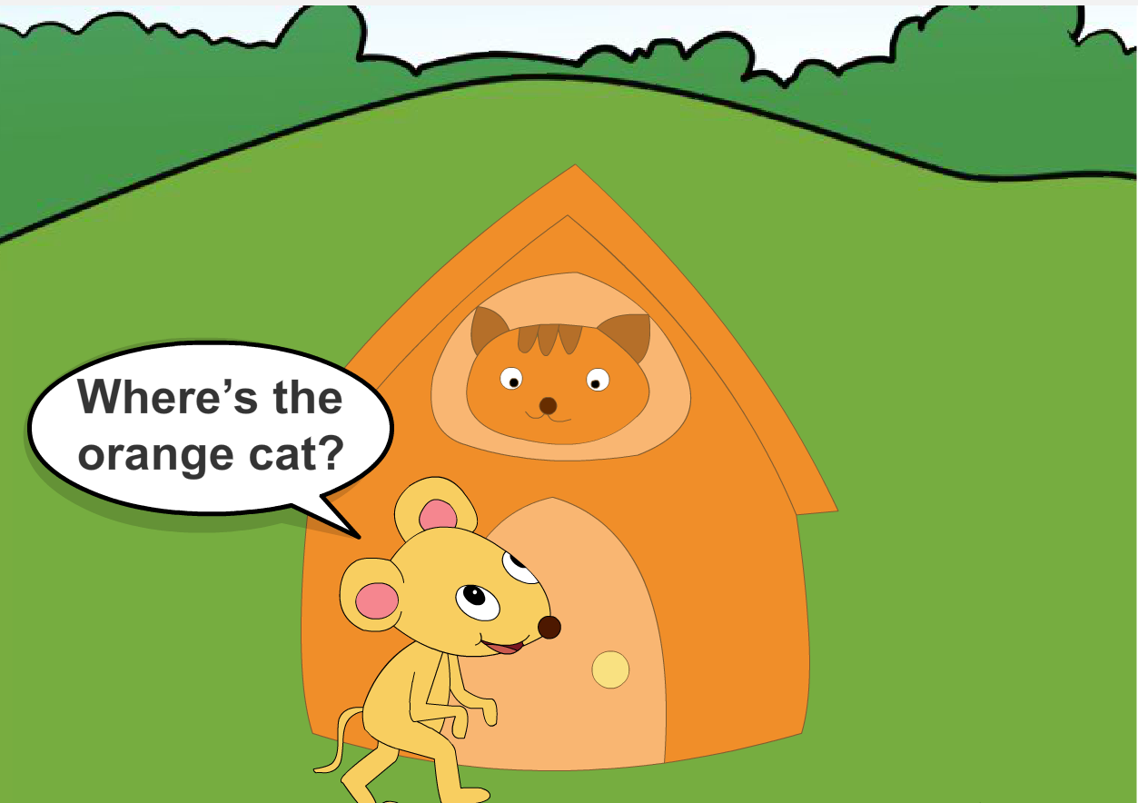


Slide 6
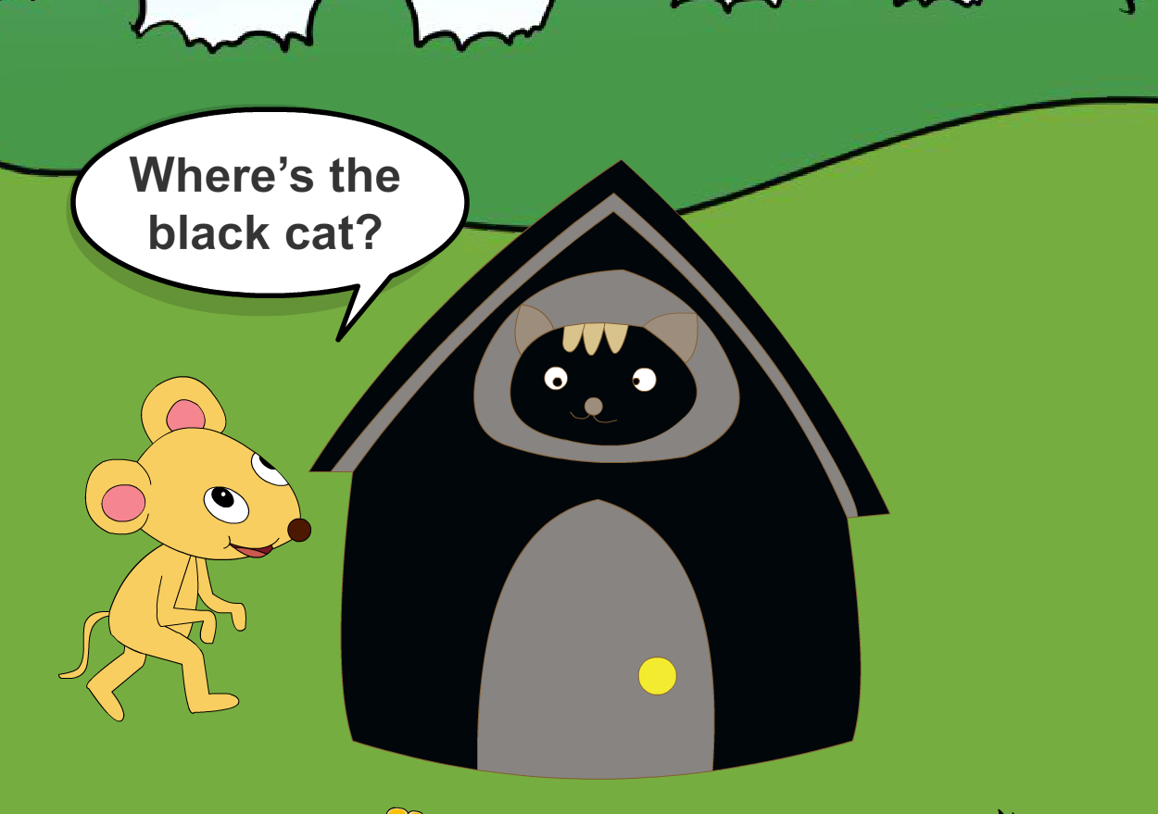
black
——

Slide 7
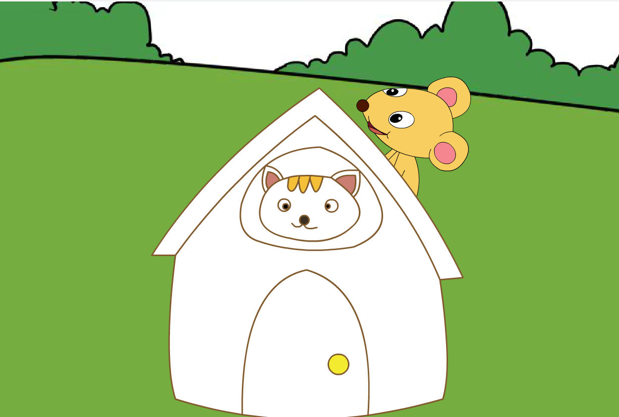
Where's the
_____________________
white cat ?

Slide 8
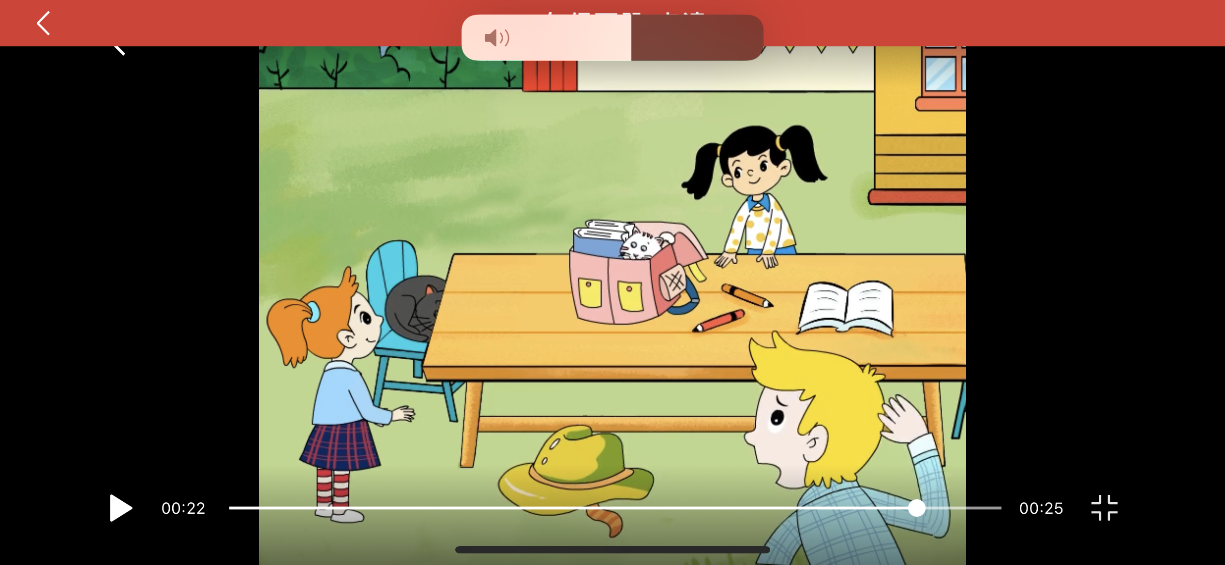
Where’s the --- cat ?

Slide 10
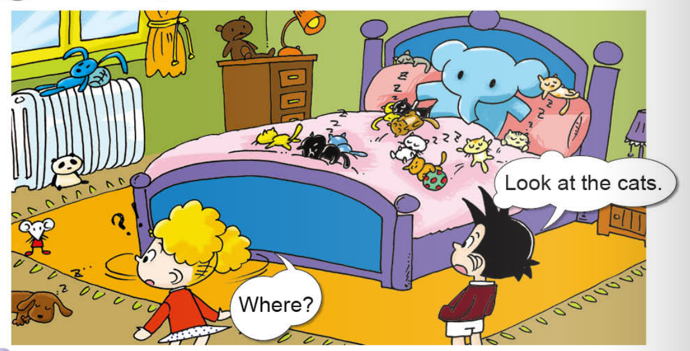
What can you see?
Are the cats toys(玩具)?

Slide 11
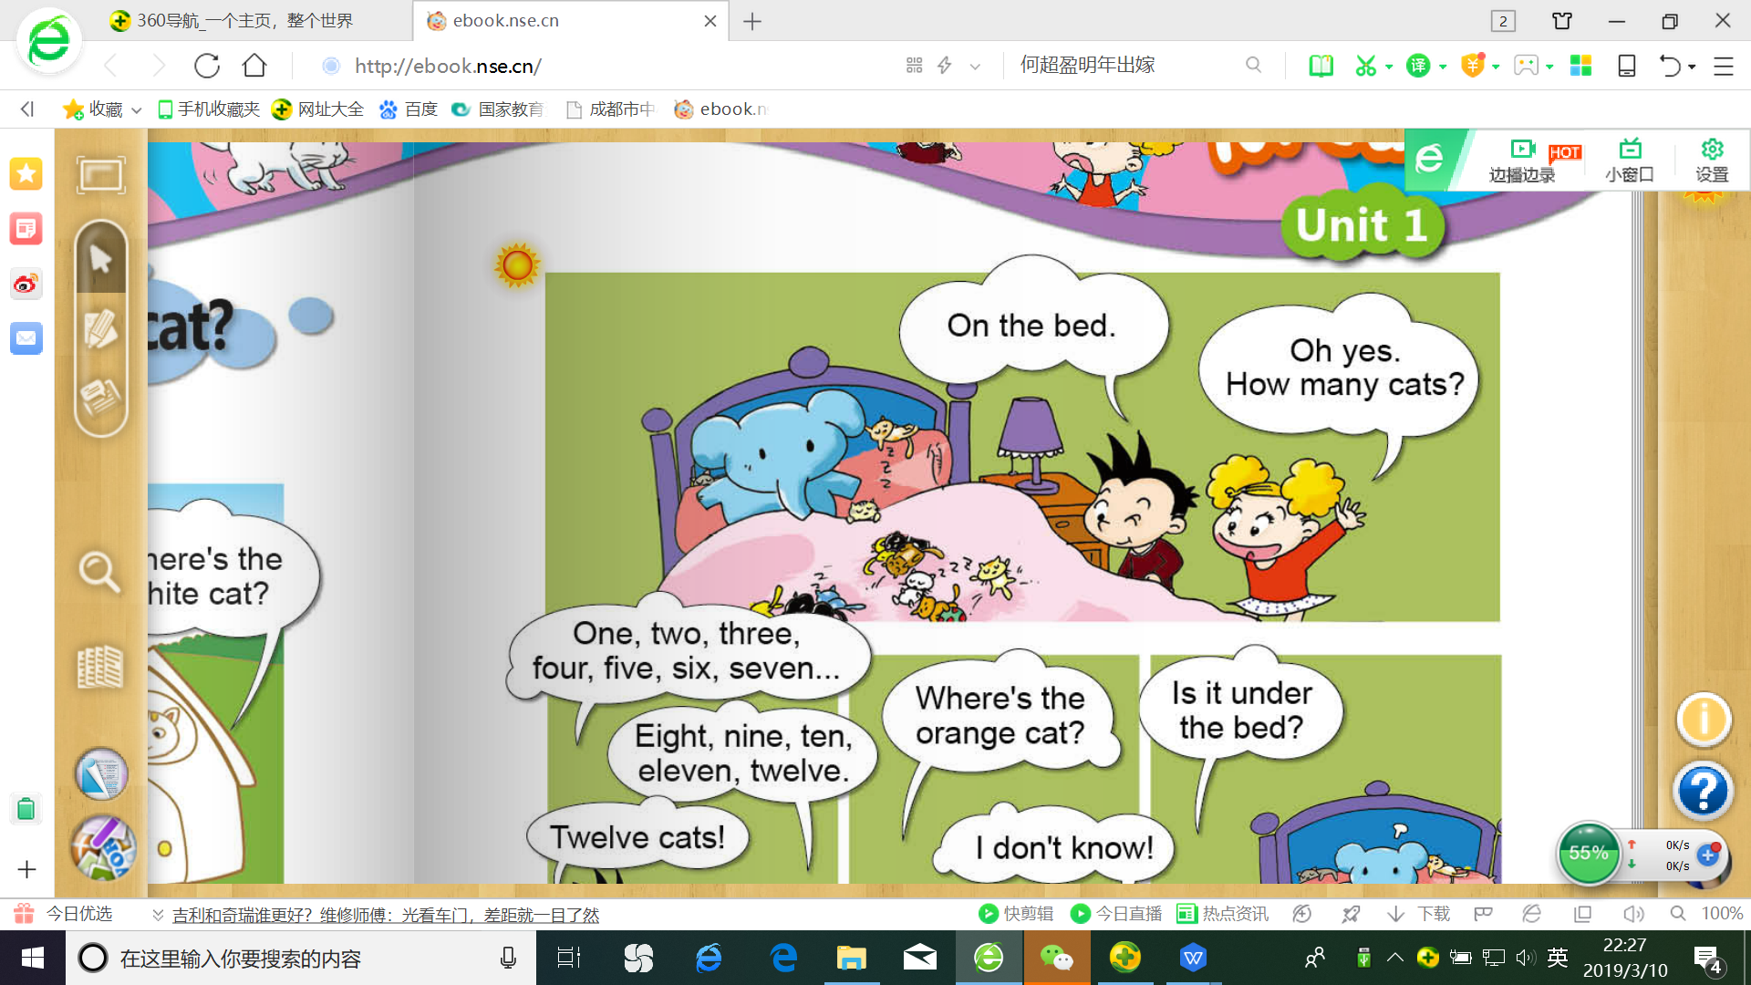
Where are the cats ?
Guess !

Slide 12
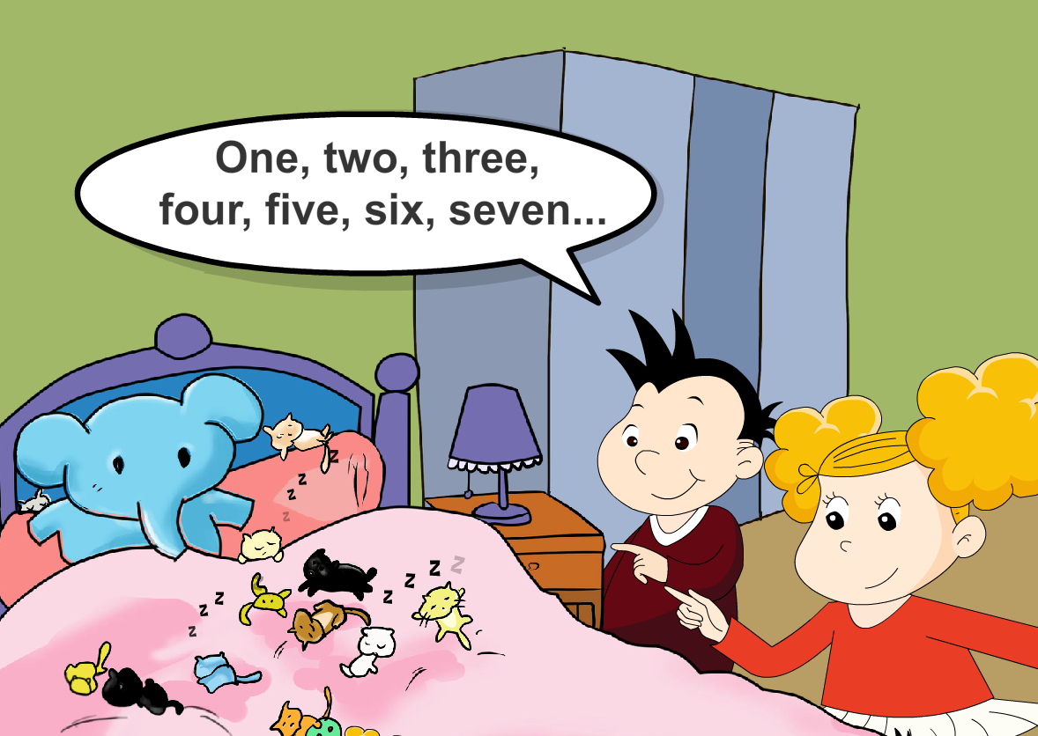
How many cats?
Twelve cats
Eight, nine, ten, _____, _____.
eleven
twelve

Slide 13
eleven 11
seven 7
five 5
twelve 12

Slide 14


How many pencils ?
eleven

Slide 15


How many hats ?
twelve

Slide 16
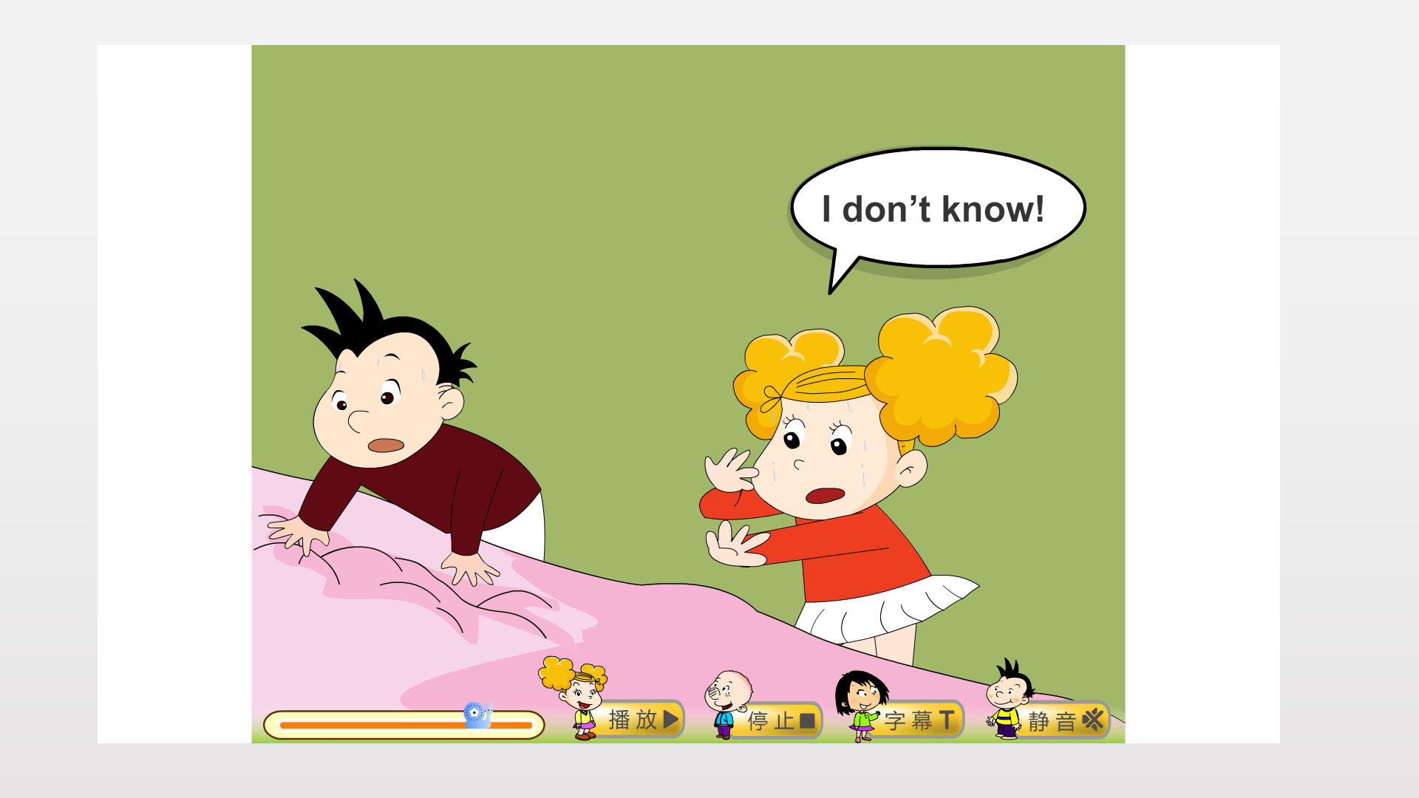
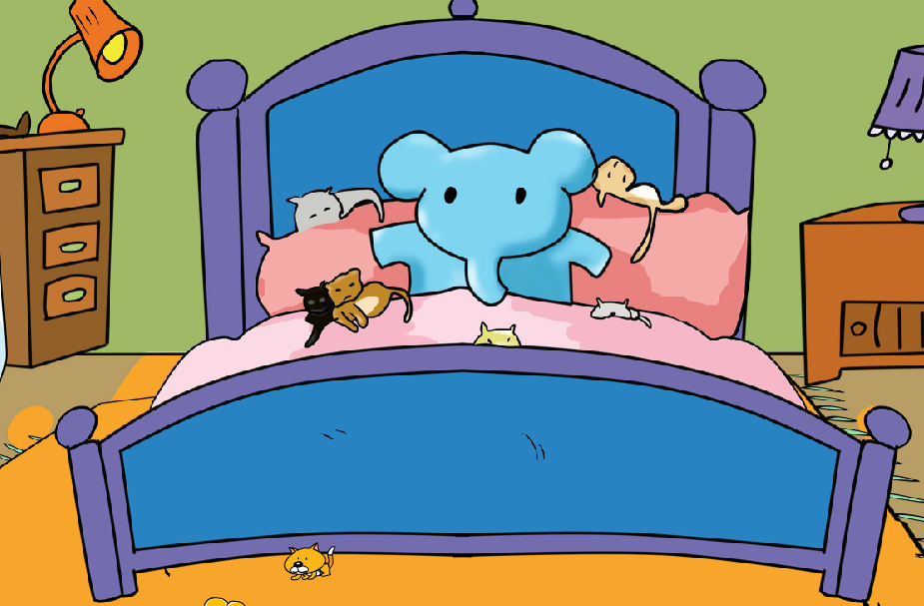
Guess !
Where’s the
orange cat?
I don't know.

Slide 17
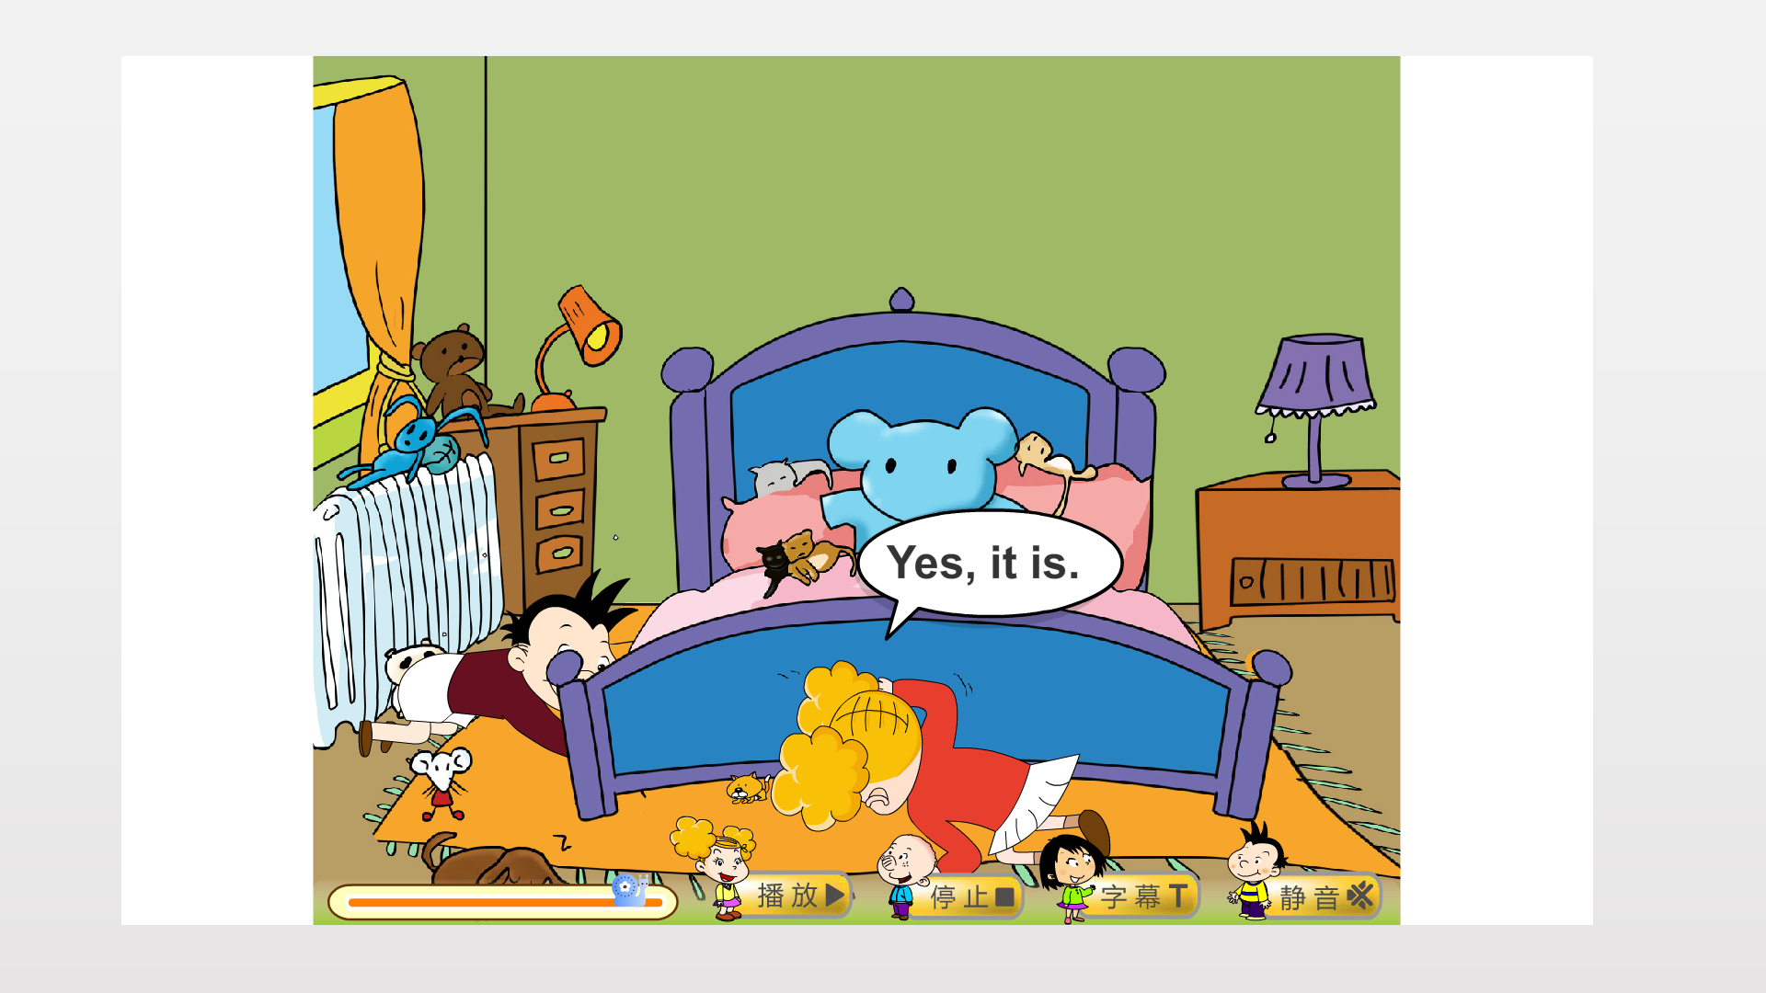
They are looking for(寻找) the orange cat.
Yes, it is .
Is it under
the bed ?

Slide 18
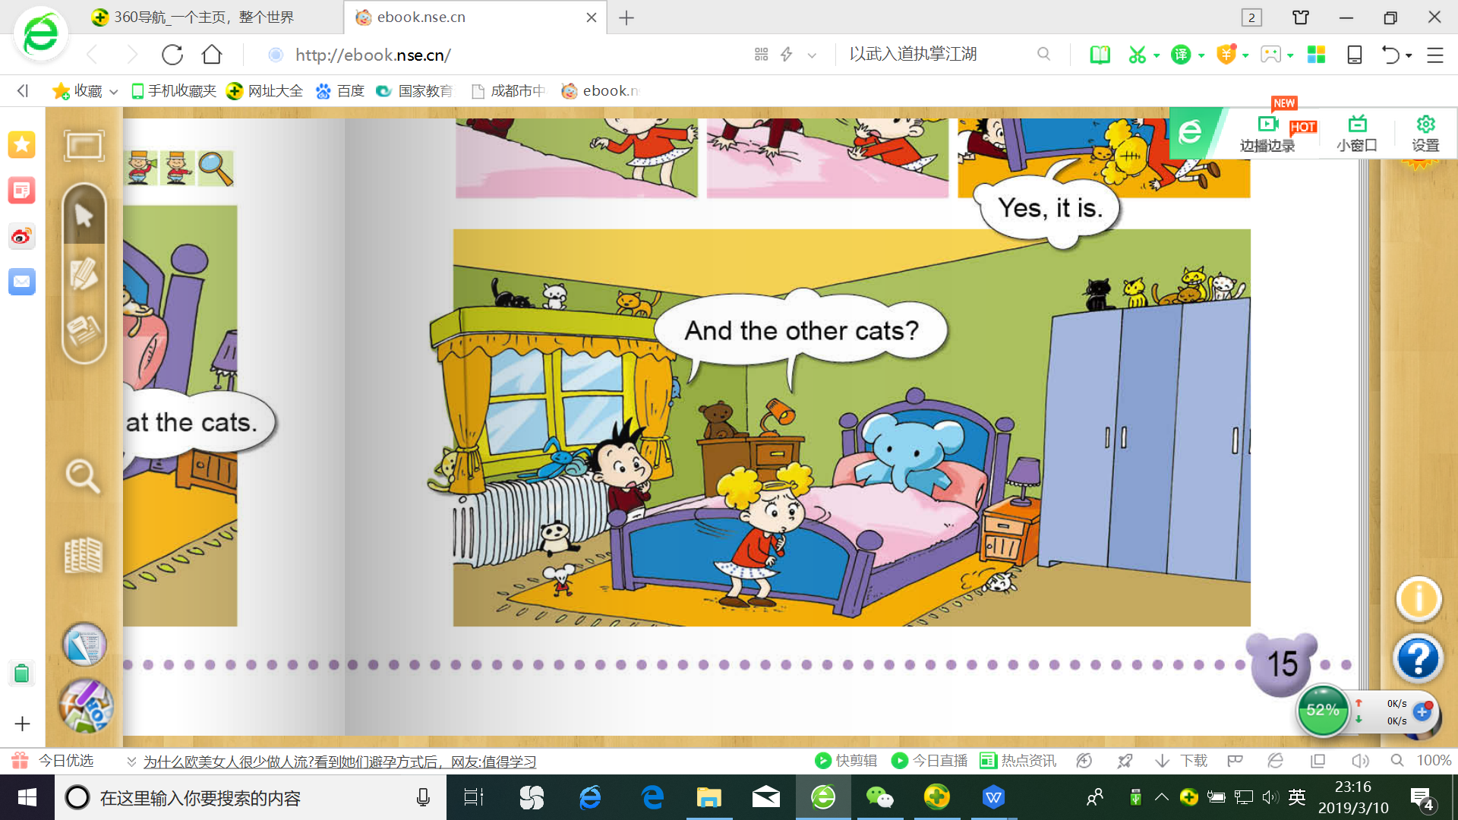
What happens? Look at the bed.

Slide 19
What happens?
the other cats其它的猫
other

Slide 20
father
mother
other 其他的

