Slide 1
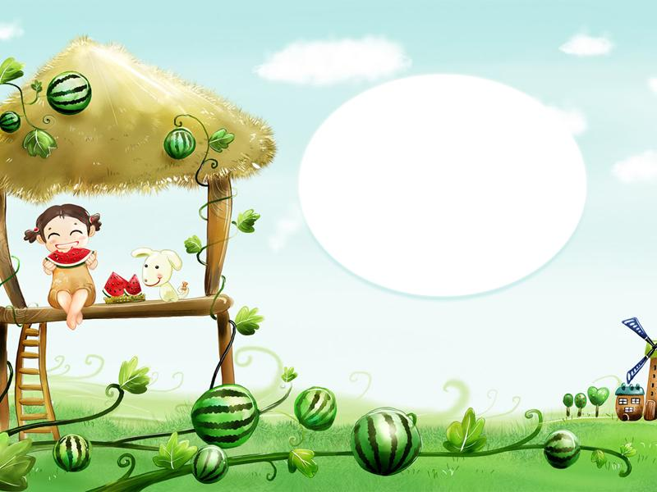
Module 4 Unit 1
This is my head.

Slide 2
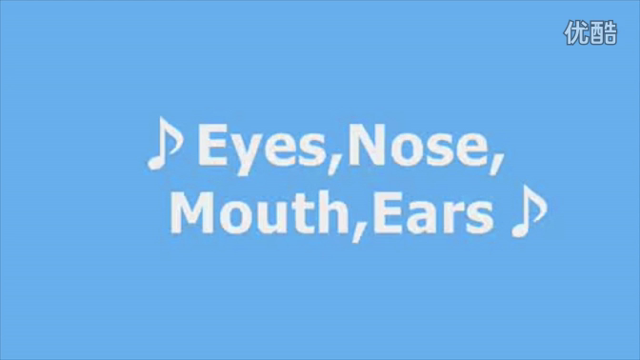

Slide 3
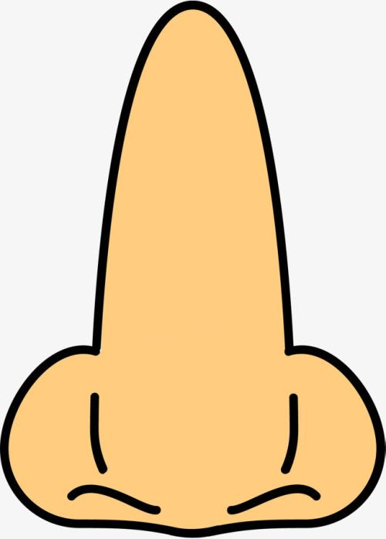

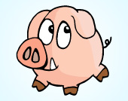
nose

Slide 4



face
sad face
happy face
angry face

Slide 5
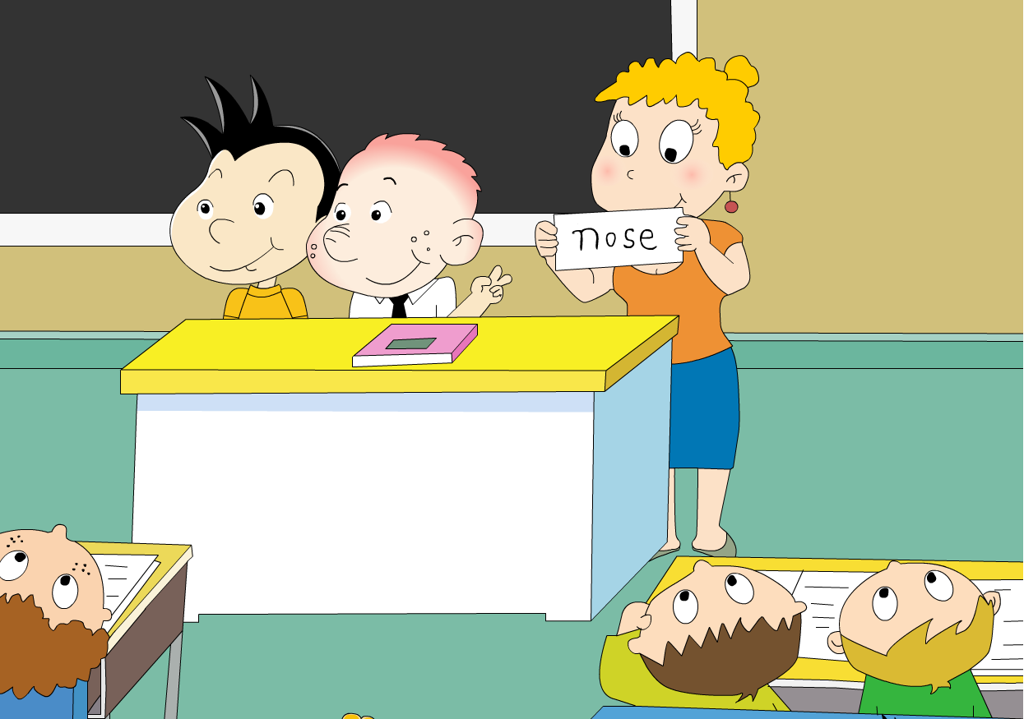

Touch your nose.

Slide 7
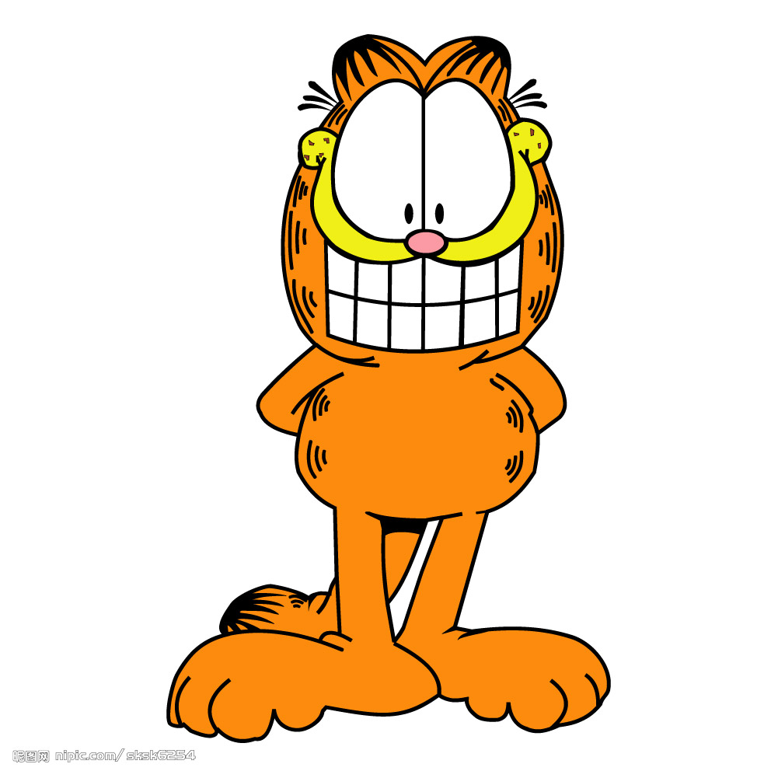
mouth

Slide 8
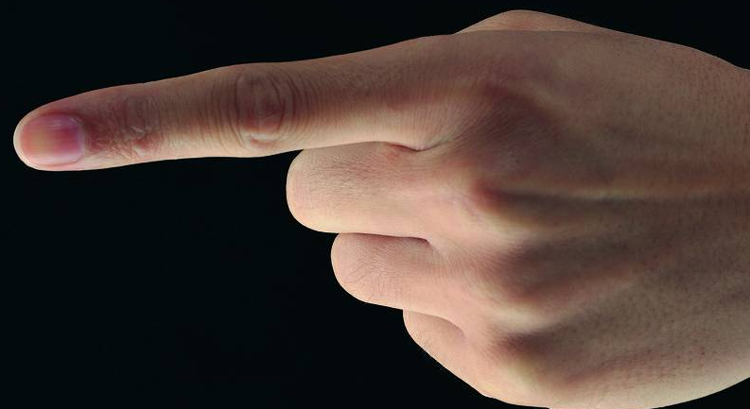
mouth
Touch your .

Slide 9

eye
s

Slide 10
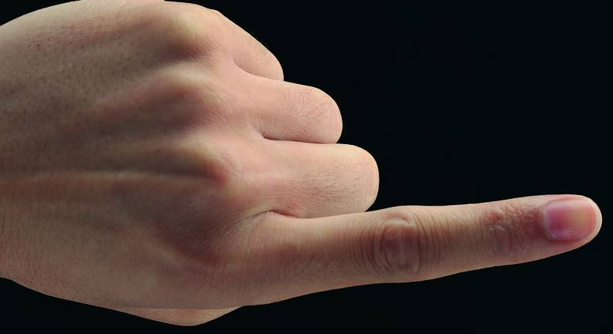
Touch your .
eyes

Slide 11

ear
s

Slide 12
Touch your .
ears

Slide 13
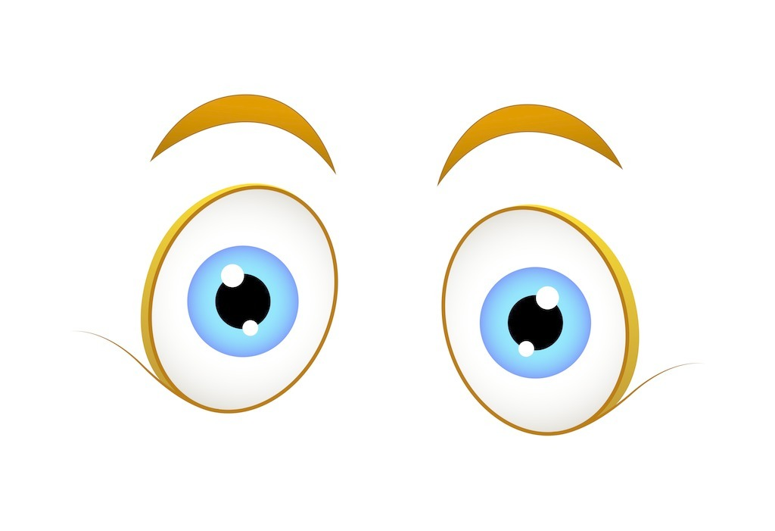


eyes
nose
mouth
ears

Slide 14
nose

Slide 15
Touch your .
nose

Slide 16

Touch your .
face

Slide 17
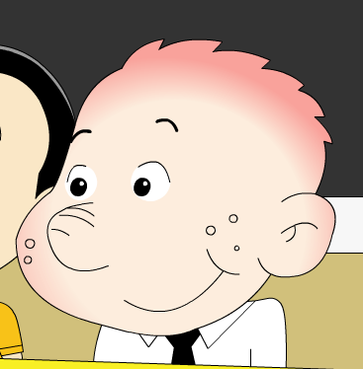
head
eye
ear
face
nose
mouth

Slide 18
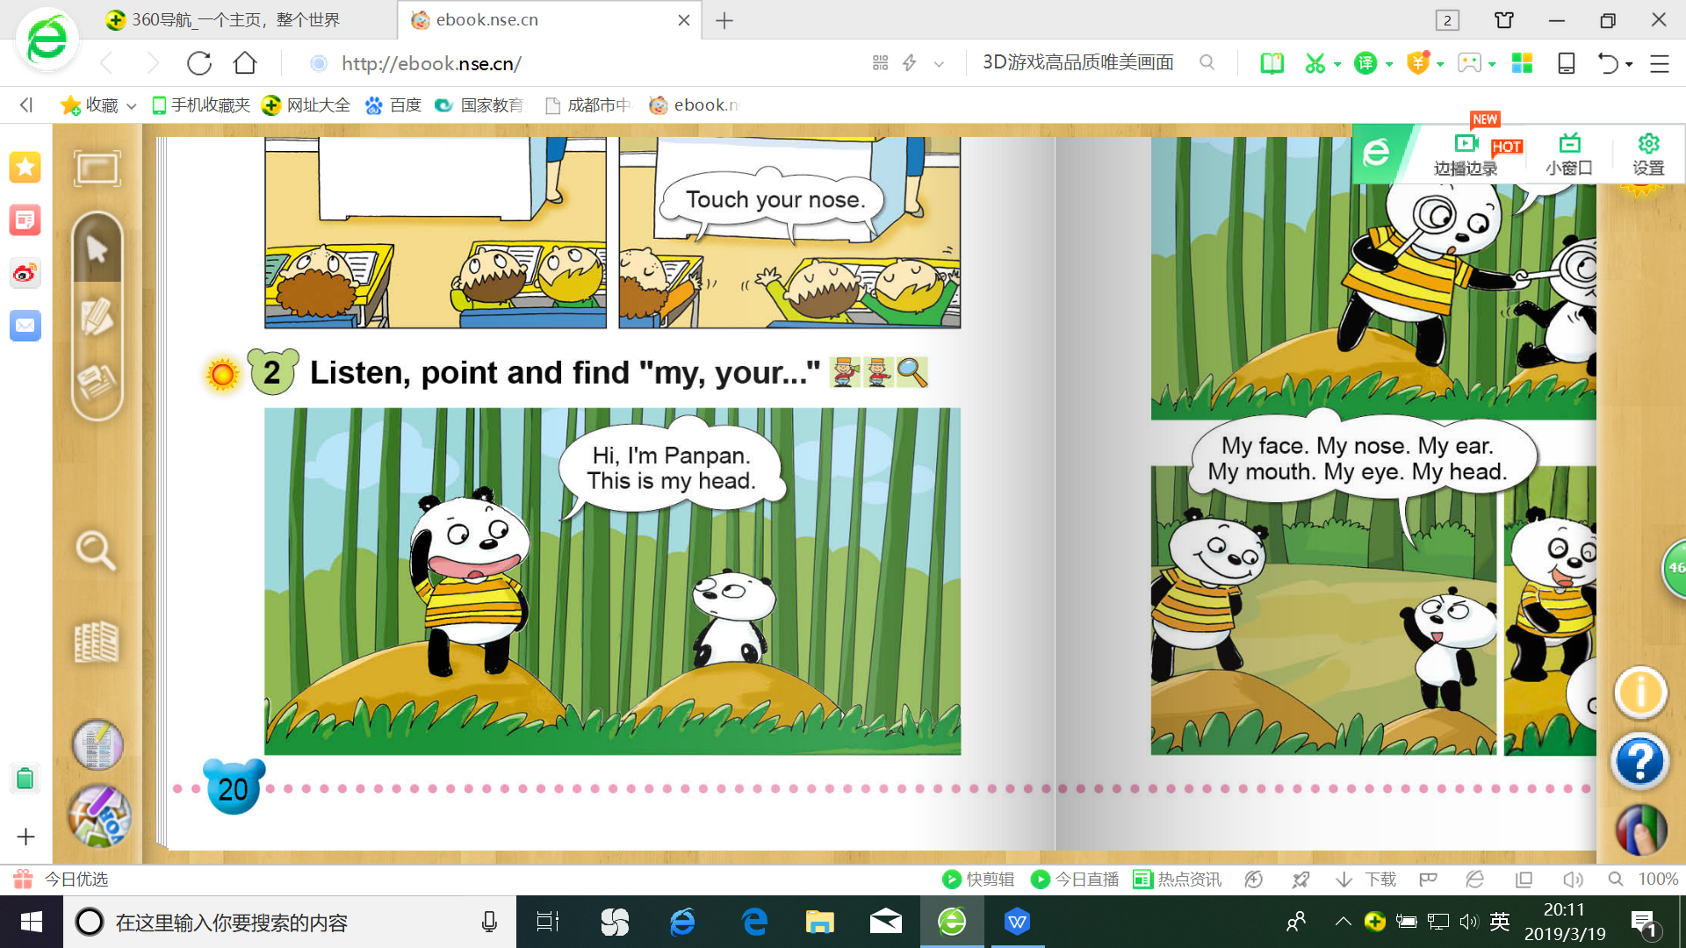
head

Slide 19
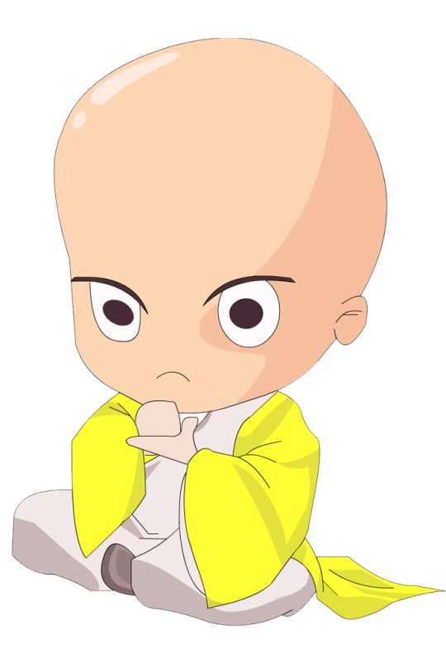
head

Slide 20
Touch your .
head

Slide 21
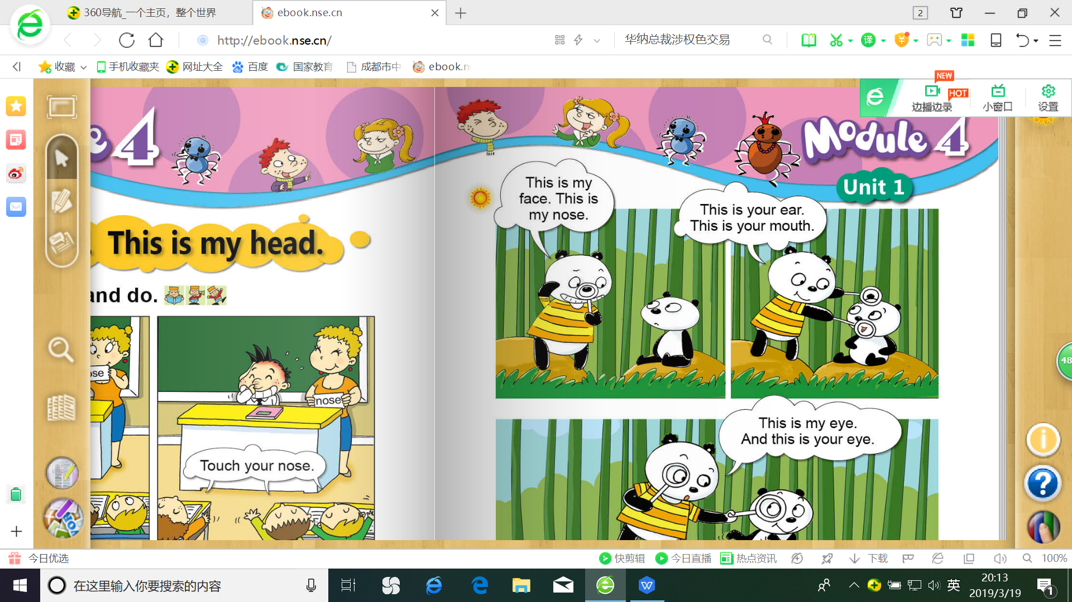
face
This is
______
______
my nose
_______
______

Slide 22
face
nose
head

Slide 23
your
你的
This is your ear
________________
This is your
mouth
______

Slide 24
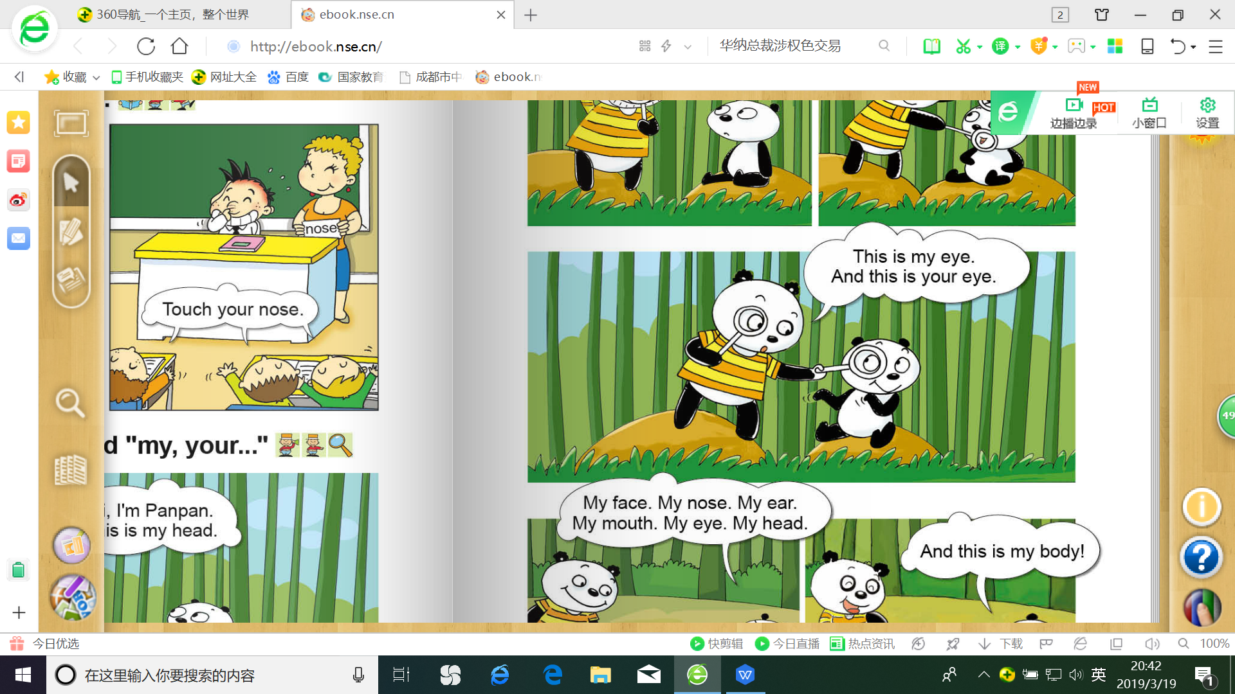
This is my eye
________________
my
我的
And this is your eye
__________________
your
你的

Slide 25
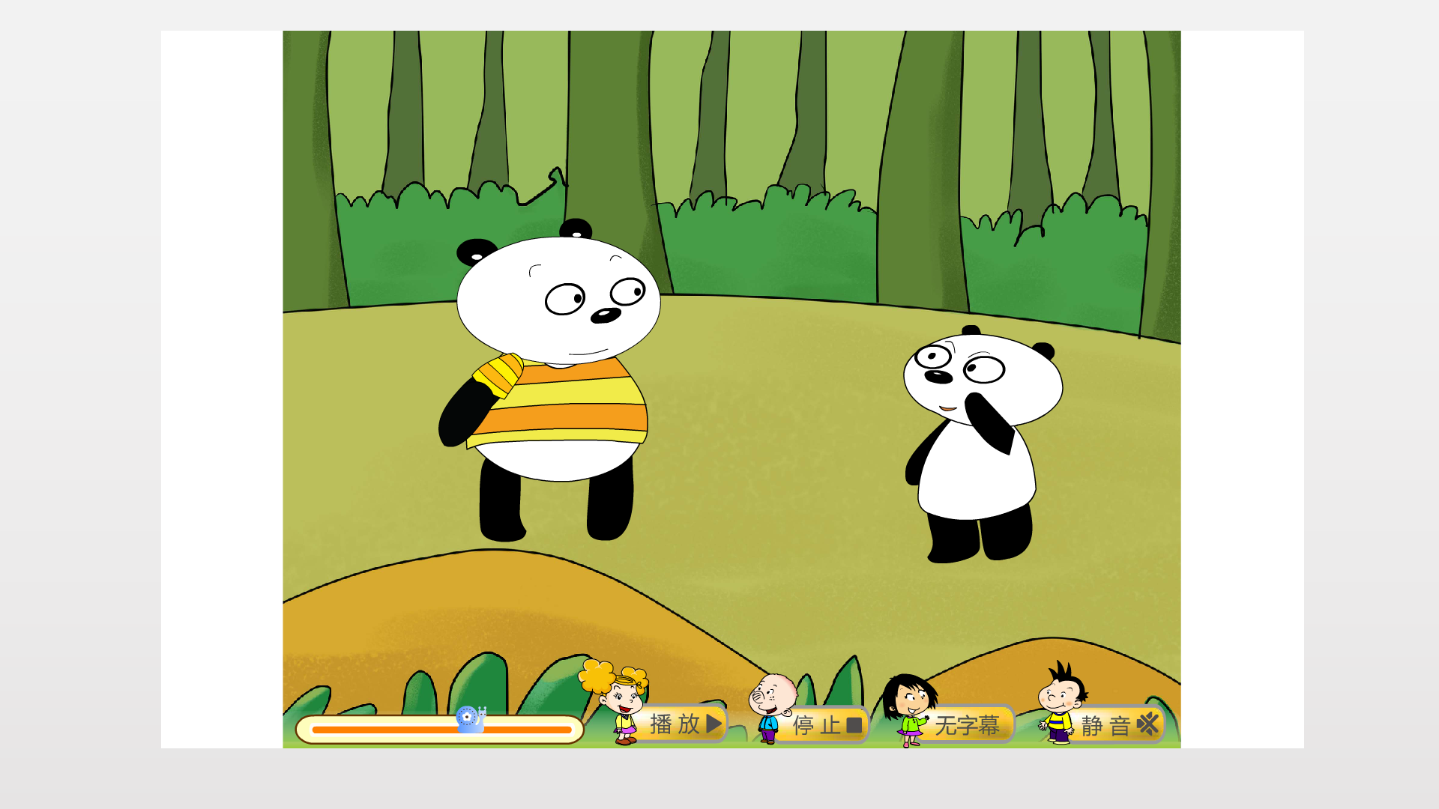
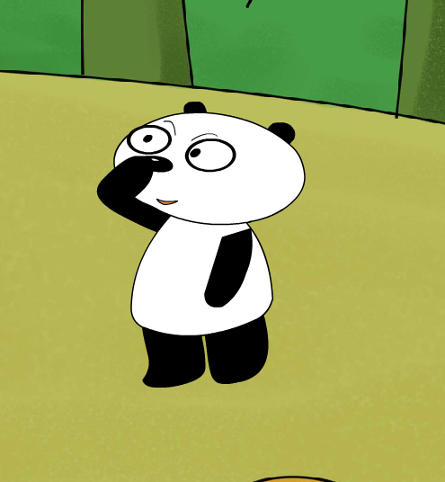




This is my____.
face
head
ear
1
2
3
mouth
eye
nose
4
5
6

Slide 26
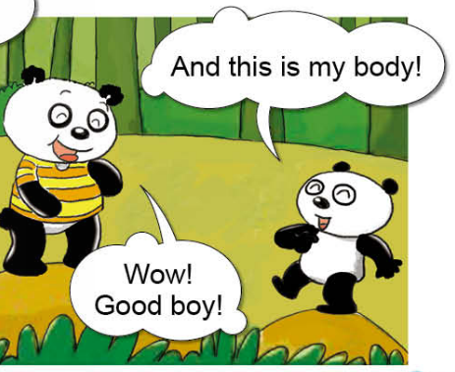
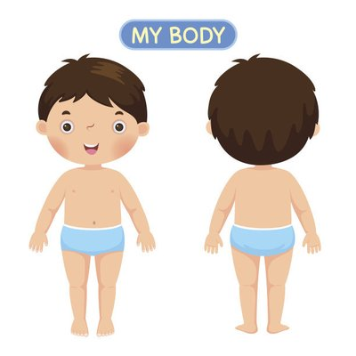
And this is my body

Slide 28
Touching game.
ear
head
eye
face
mouth
nose

Slide 29
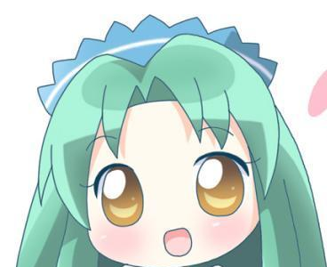
Remeber and guess

Slide 30
Remeber and guess
eye

Slide 31
Remeber and guess
eye
face

Slide 32
Remeber and guess
eye
ear
face

Slide 33

Remeber and guess
eye
ear
face
head

Slide 34
Remeber and guess
eye
ear
mouth
face
head

Slide 35
Remeber and guess
eye
ear
nose
mouth
face
head

Slide 36

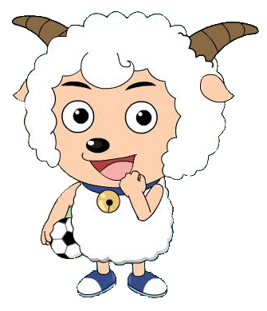


This is my … .

Slide 37

This is my … .

Slide 38
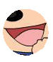
This is my … .

Slide 39
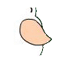
This is my … .

Slide 40
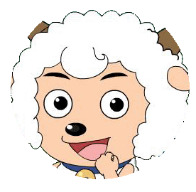
This is my … .

Slide 41




我会选
nose
eye
A.nose
B.hand
B
A
1
2
mouth
face
head
ear
3
A
B
4

Slide 42

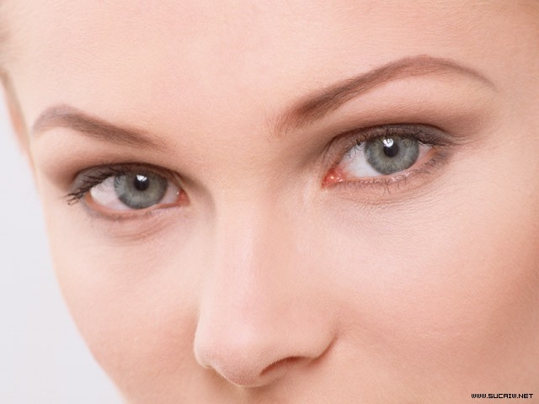
Play a game!
nose

Slide 43
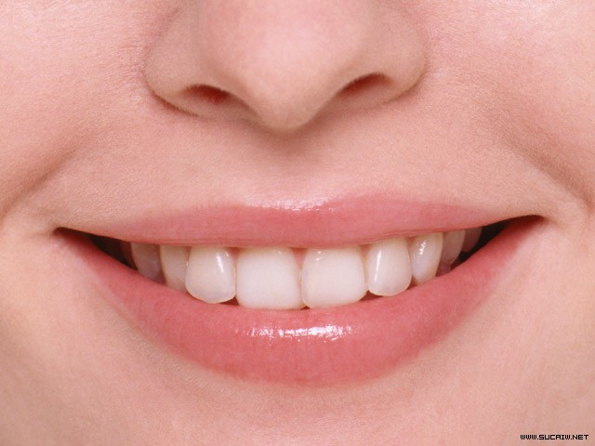
Play a game!
mouth

Slide 44
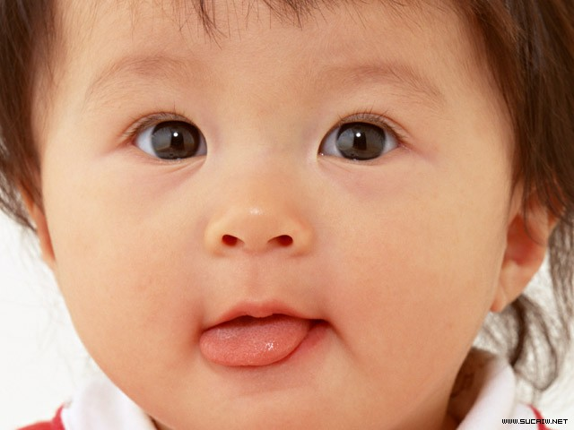

Play a game!
face

Slide 45
Play a game!
head

Slide 46

Let's find.

Slide 47



Slide 48


Thank you!

Slide 49
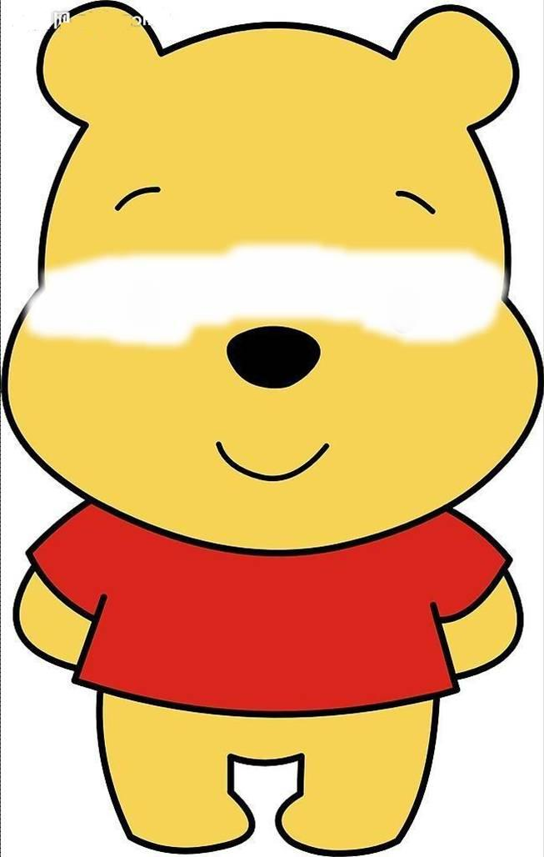

Slide 50
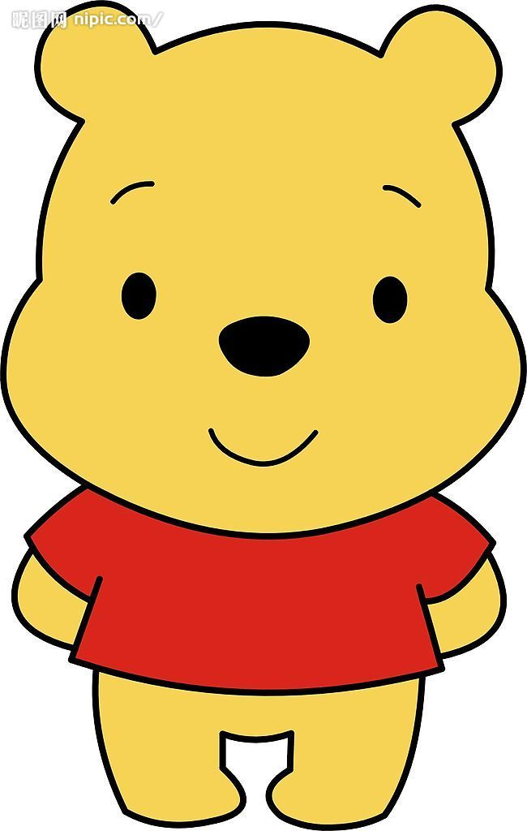
Thank you!

Slide 51
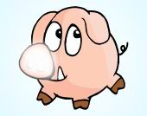

Slide 52
Thank you!

Slide 53
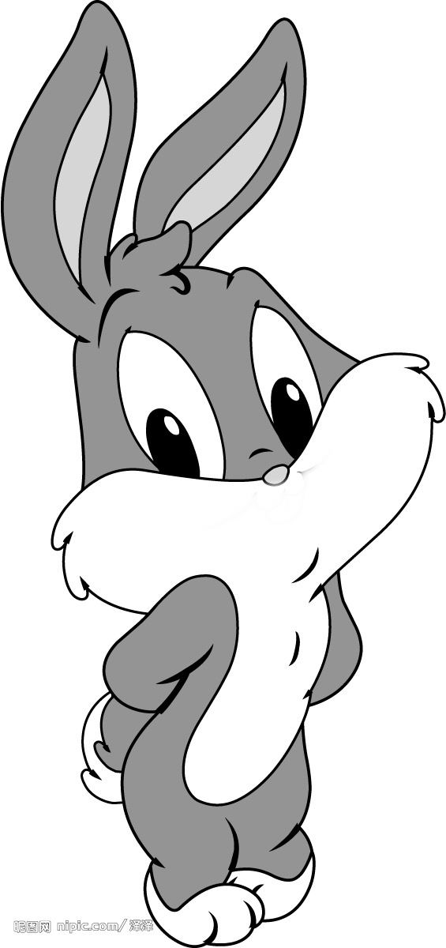

Slide 54
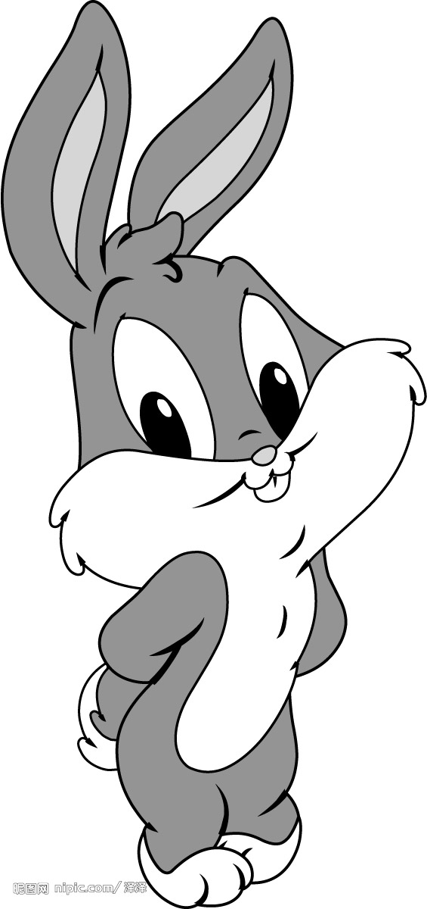
Thank you!

Slide 55


Slide 56

Thank you!

Slide 57
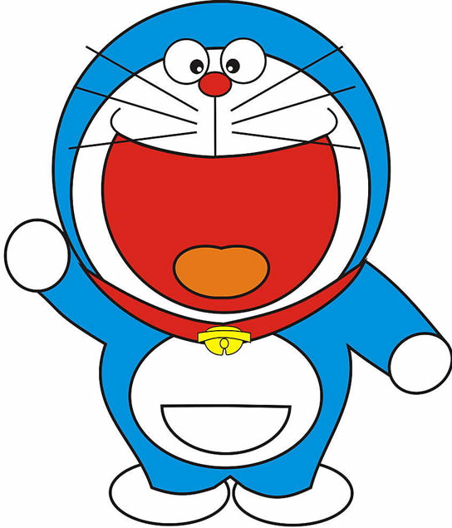

Slide 58
Thank you!

