Slide 1
Module 7 Unit 1
I helped Mum.
新标准英语
三年级起点四年级下册

Slide 2
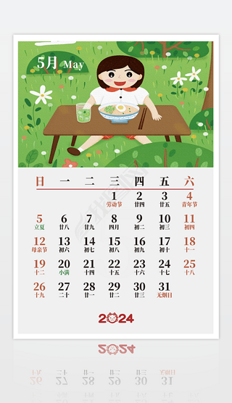
Today is Monday.
was
Yesterday ____ Sunday.

Slide 3
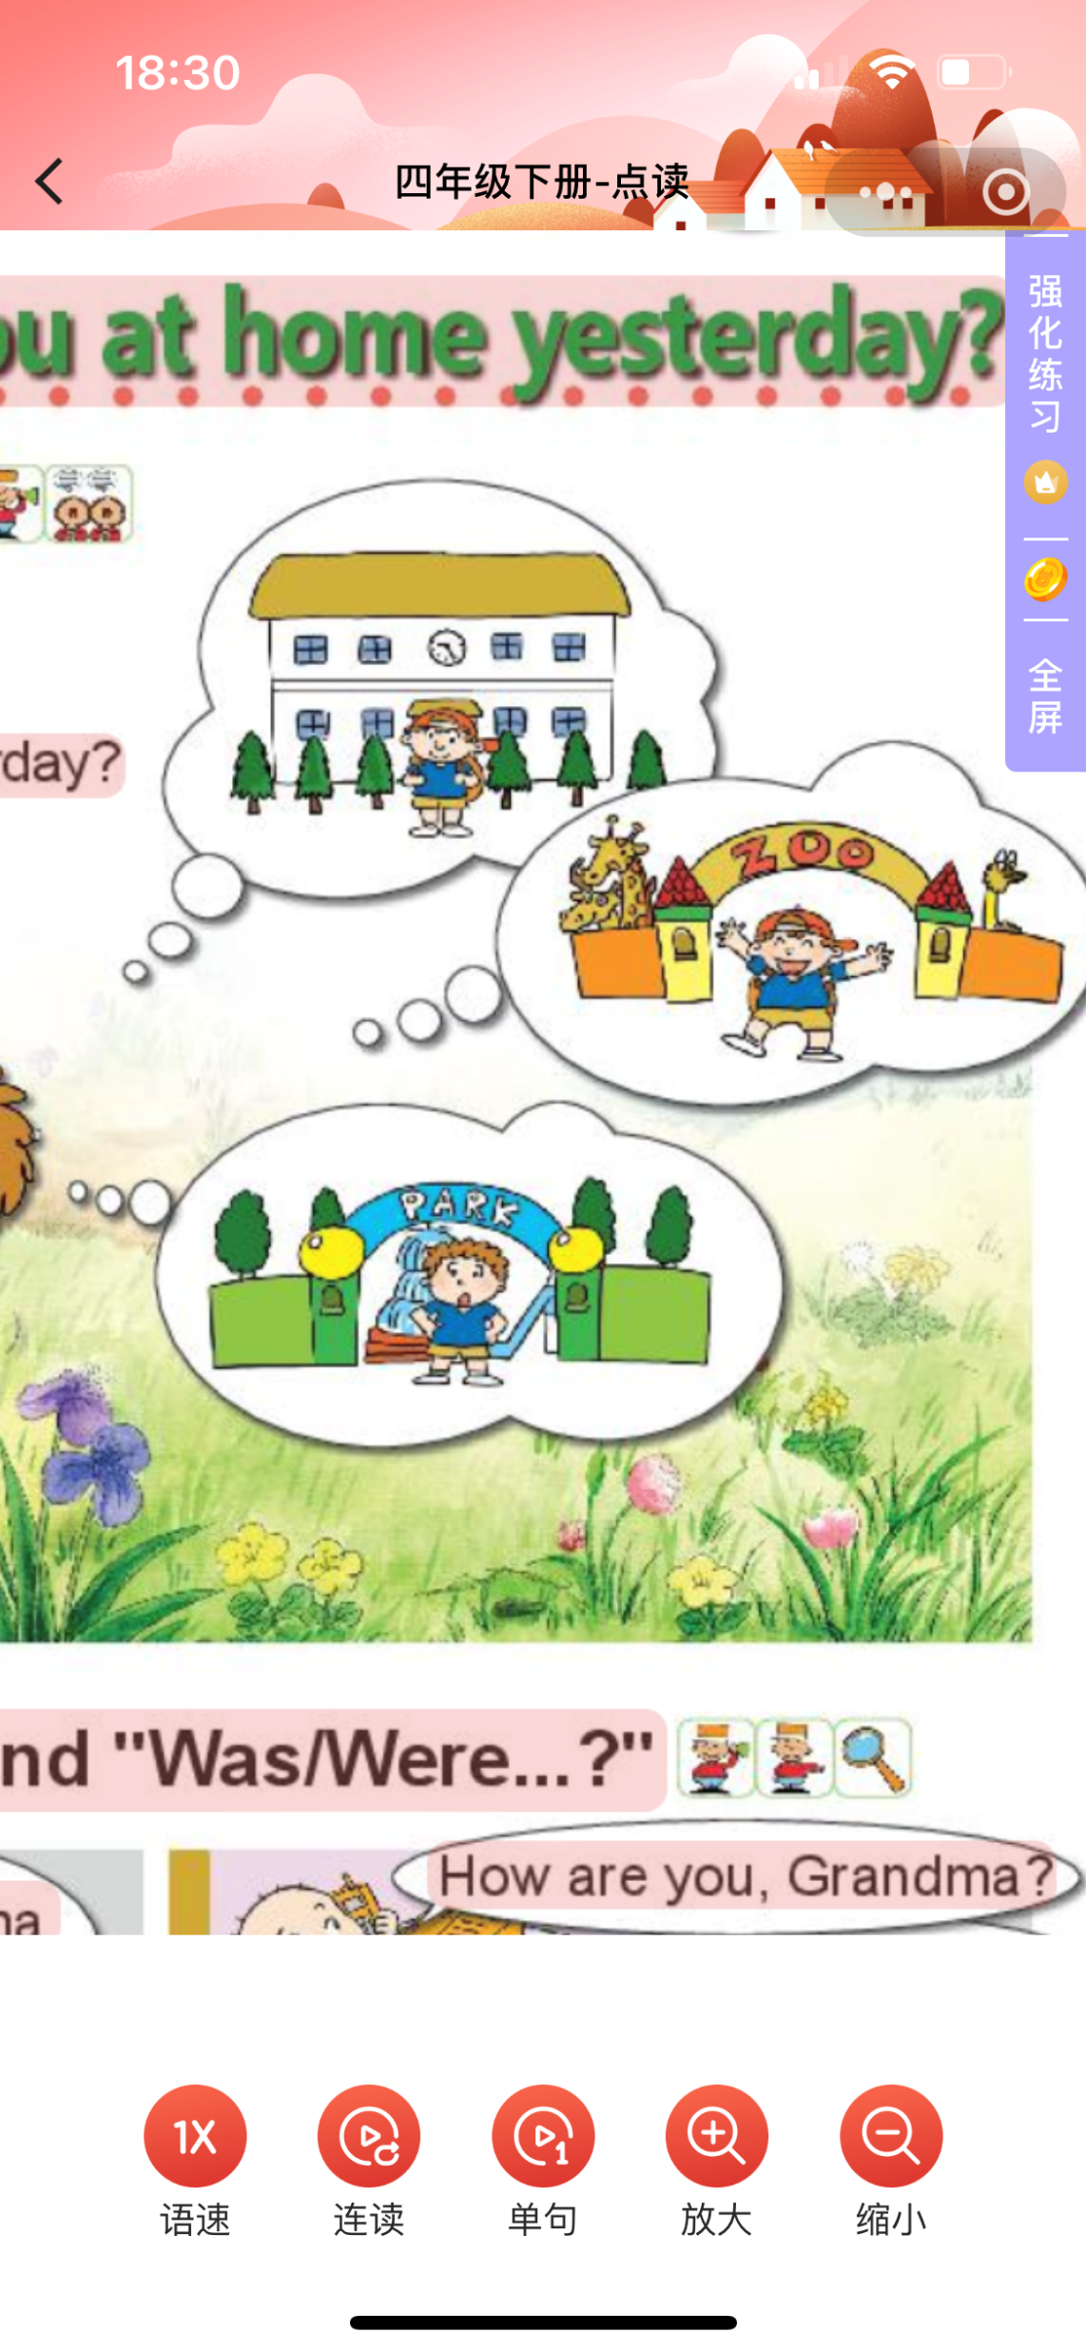
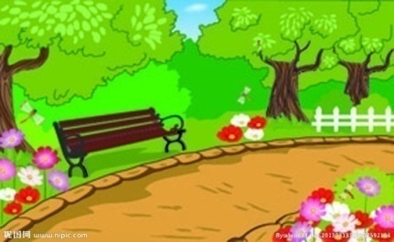
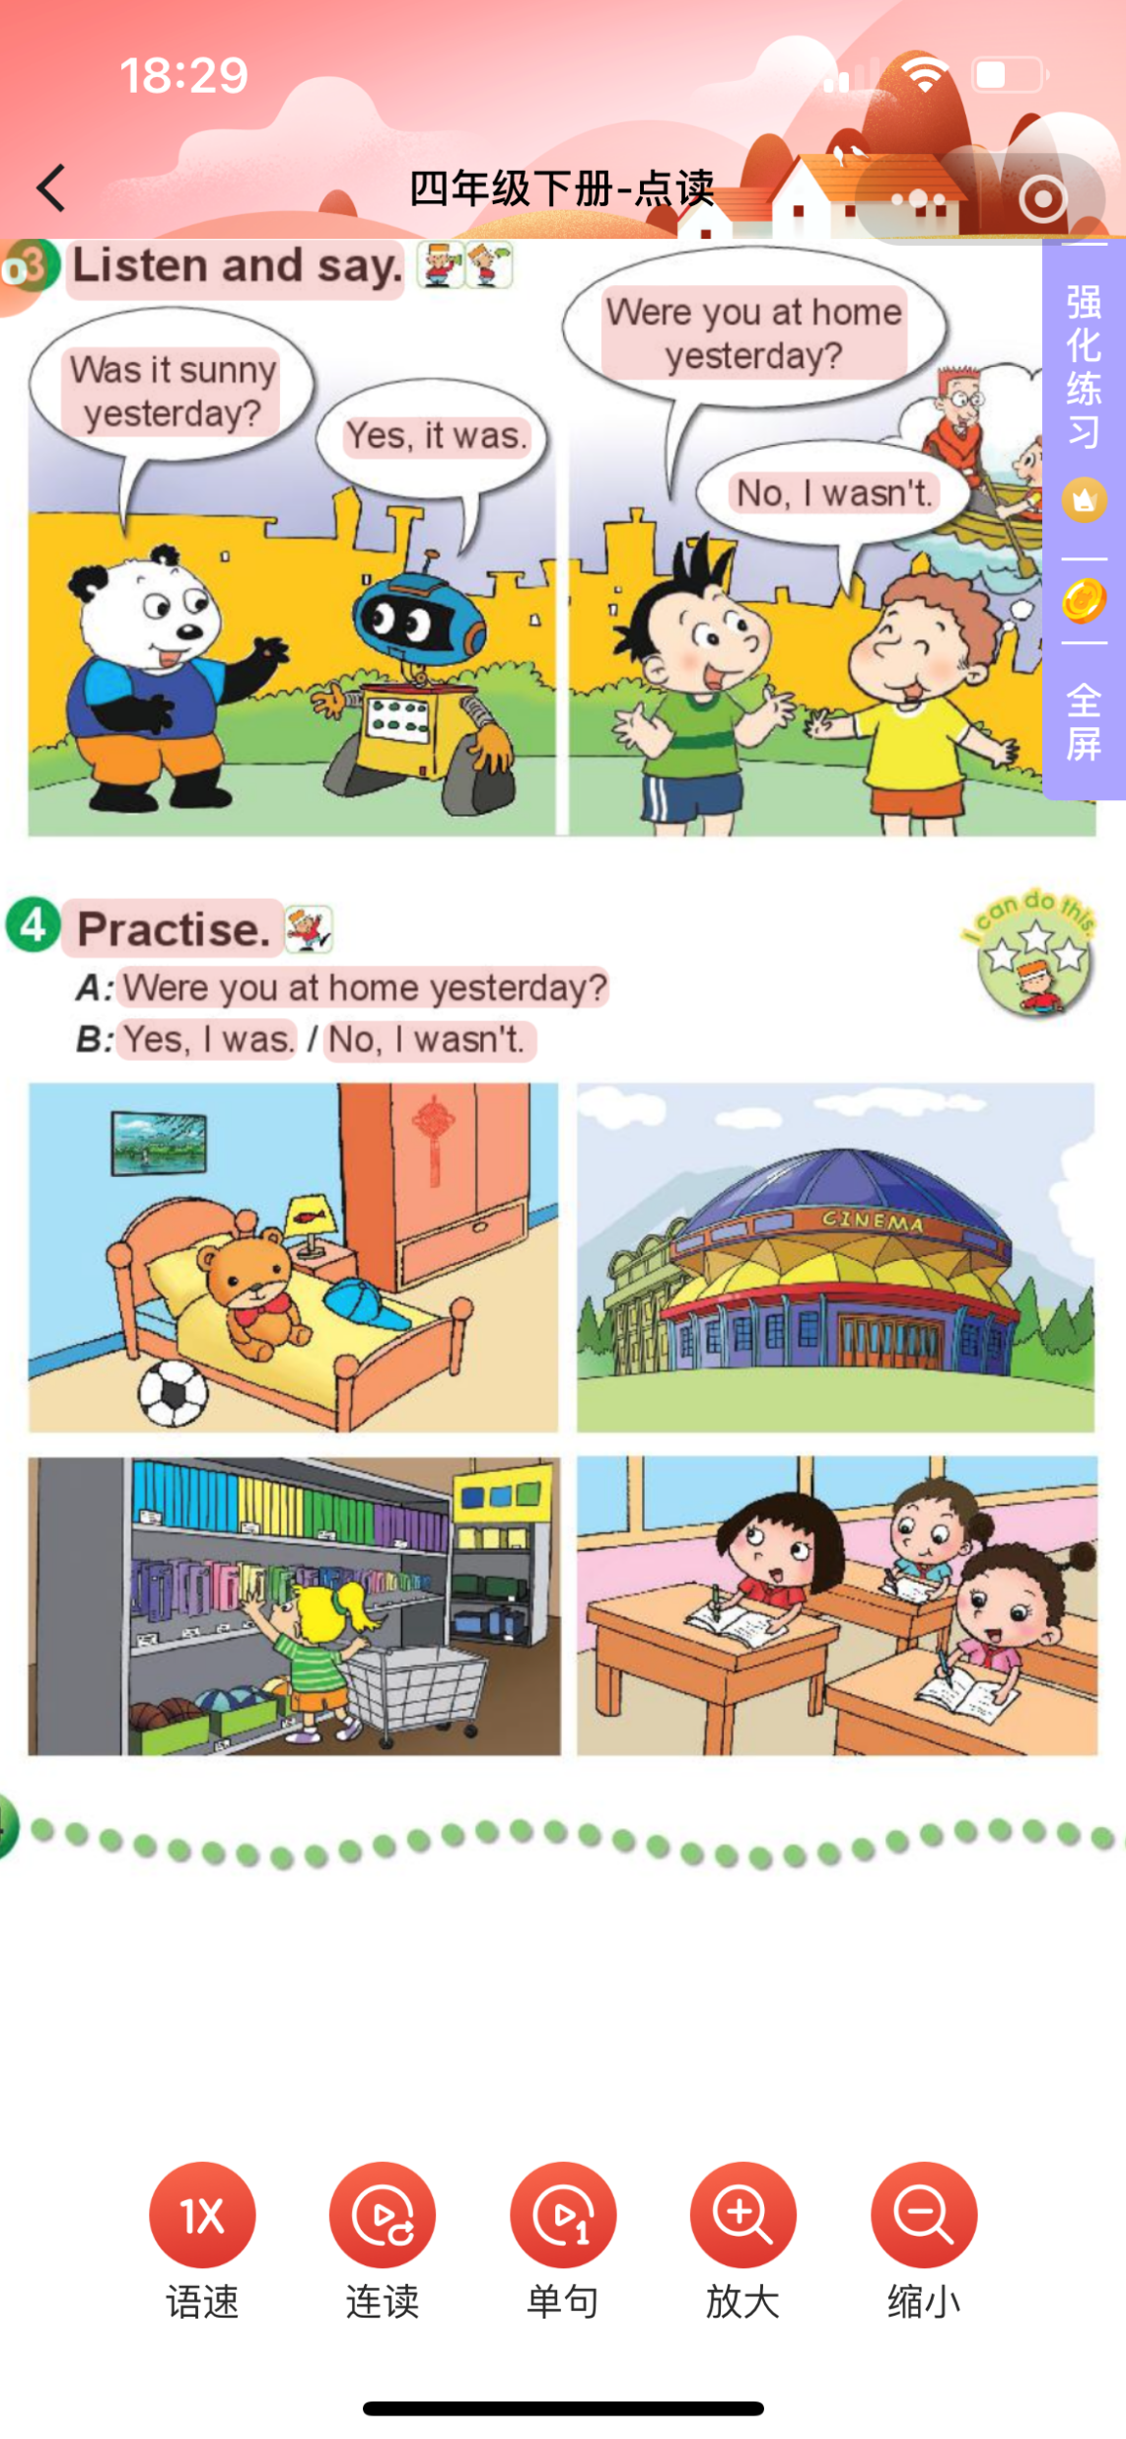
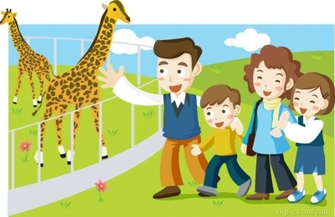
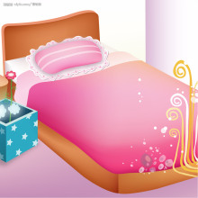
Talk about yesterday.
T： Were you at...yesterday?
S : Yes. I was. / No, I was at...
Notes:
（一）热身导入

Slide 4
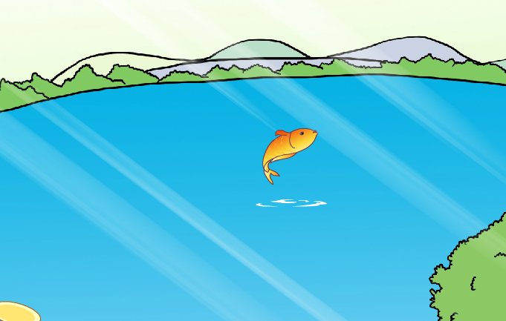
was
Yesterday ____ a holiday.
was
It ____ a beautiful day.

Slide 5
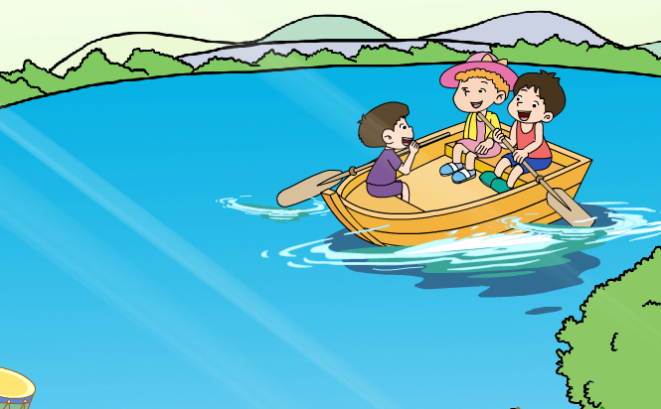
What did they do on the lake?
row a boat
ed
We __________ on the lake yesterday.
have
had
We all ____a very happy day yesterday.

Slide 6
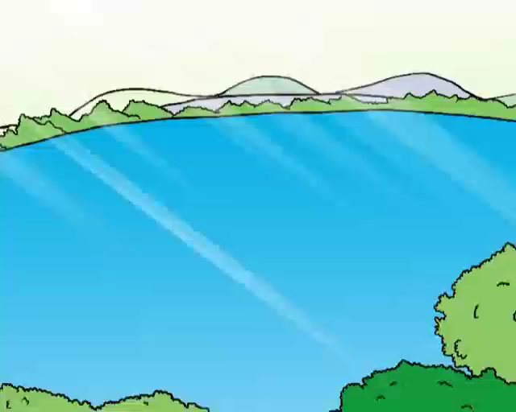
Activity1: Listen and chant.

Slide 7
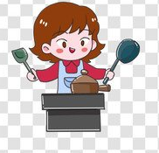
row-rowed
cook-cooked

Slide 8
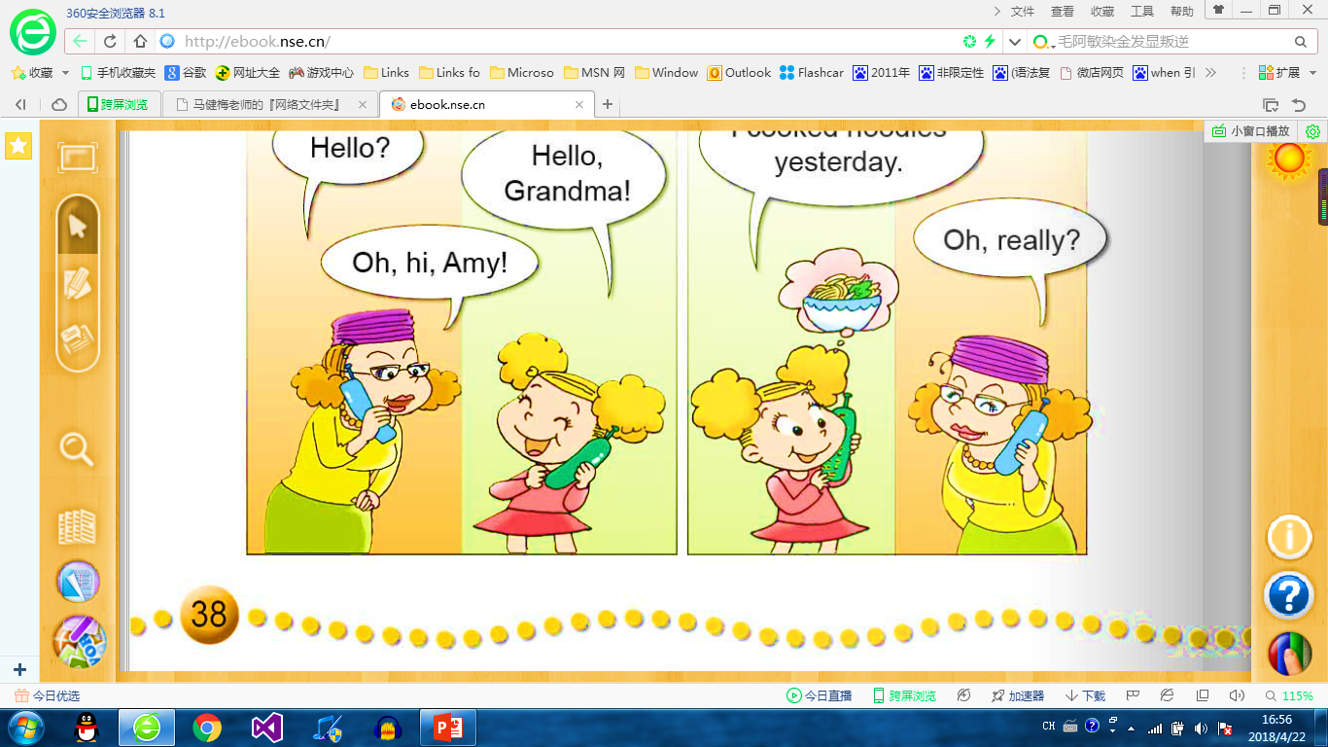

What did Amy do yesterday?
Hello?
Hello,Grandma!
Oh,hi,Amy!
phone
（给…）打电话
phone
d
On Monday Amy ________Grandma.

Slide 9

I ...
You are a
good girl.
What did Amy say to Grandma?

Slide 10
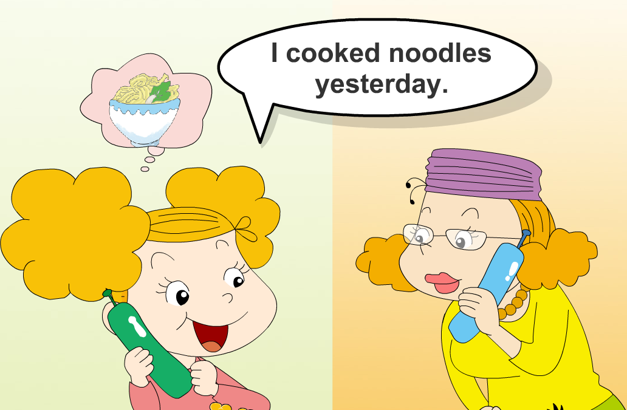
What other things (其他事情)did Amy do yesterday?
__________________

Slide 11
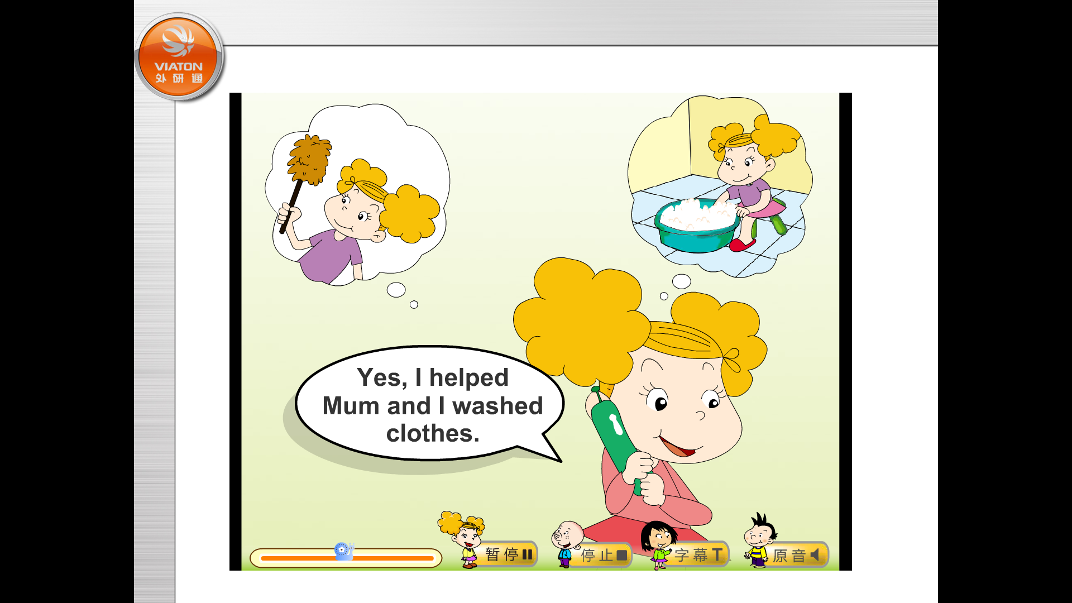
Listen! What other things (其他事情)did Amy do yesterday?
I helped Mum
and I washed clothes.
_______________
_______________
You are a
good girl.
What about
Sam?
Notes:
（三）课文学习

Slide 12
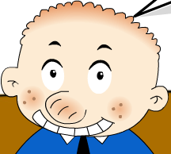
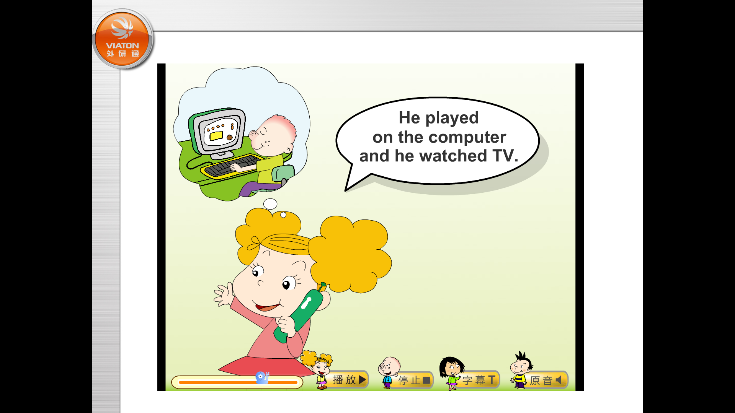

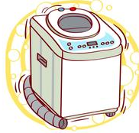

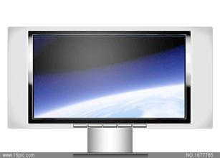
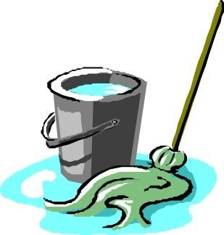
Activity2: Read P39 with your partner and answer.
(请同桌合作阅读P39并选出正确答案) (3mins)
What did Sam do yesterday?
Is Sam a good boy? Why?
He didn't help Mum.
He ______ on the computer
and he _________ TV.
played
watched
A.
B.
C.
D.

Slide 13
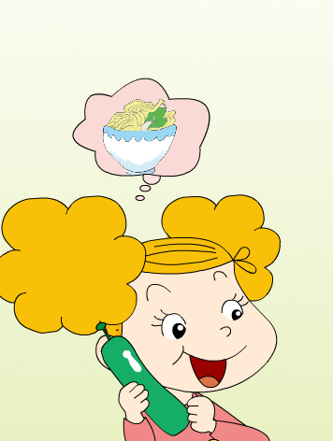
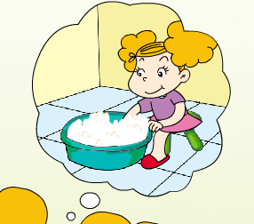
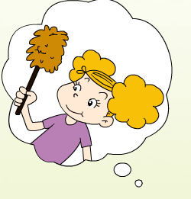
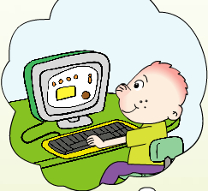
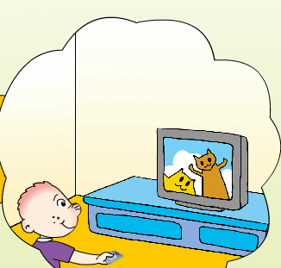
helped
cooked
washed
played
watched
How about Tom?
What did Tom do?

Slide 14
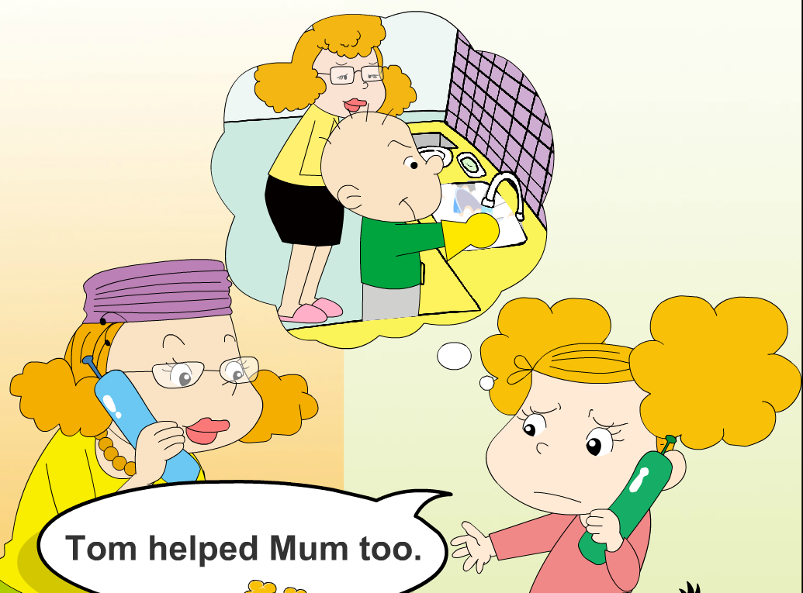
Activity3: Watch the video and answer.
Is Tom a good boy? Why?
Oh,he is a
good boy.
I love him.

Slide 15
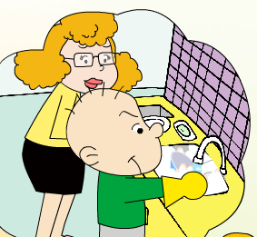
Let’s retell.
phoned
yesterday
Amy
good girl
cooked
washed
helped mum
Tom
good boy
Sam
didn’t help mum
?
played
watched

Slide 16
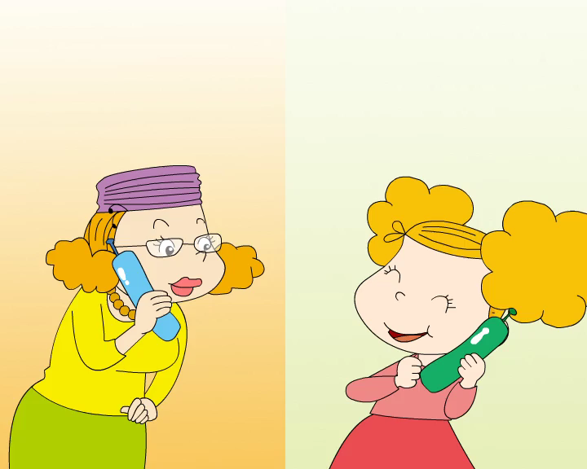
Watch,listen and read then find “-ed ?”
跟读课文，并用笔勾出文章中所有含过去式-ed的单词。

Slide 17
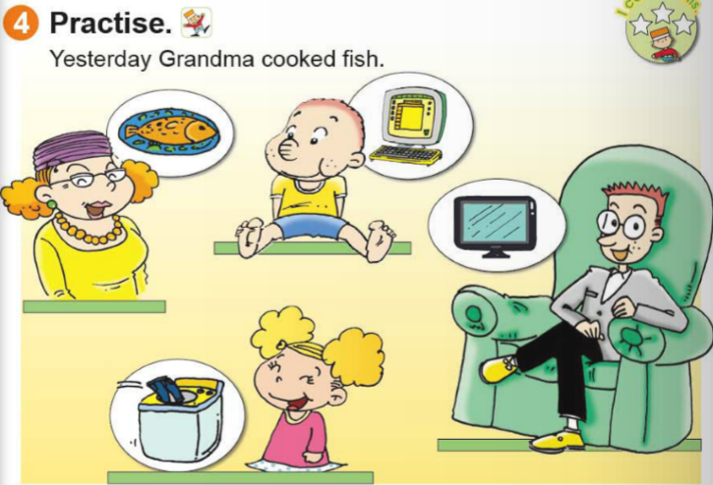
Activity4: Talk about these pictures with your partner.
(请与同桌进行对话，描述图片中发生的事情) (3mins)
Yesterday, Grandma cooked fish. Sam...
Notes:
（三）课文学习

Slide 18
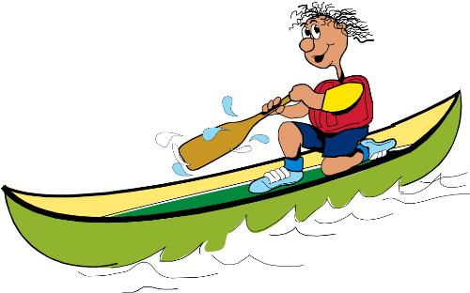
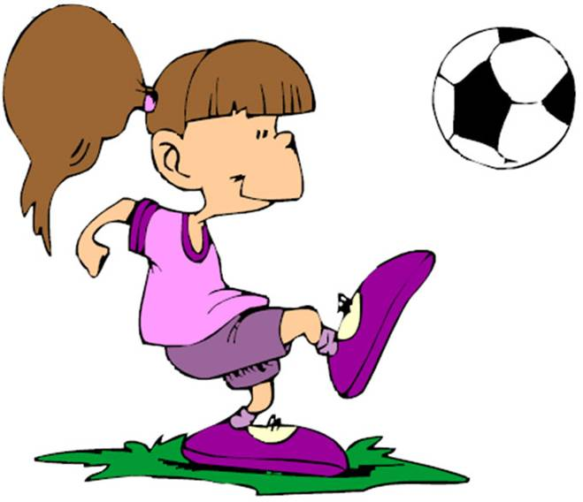
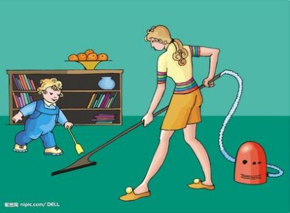
Activity5: Talk about your Sunday.
(四人小组合作谈论自己上周日的活动) (5mins)
My last Sunday（我的上周日）
Last Sunday,
My father ___ed.(didn’t)
He is ____.(good/nice)
My mother ______ed.
She is _____.(good/nice)
I ______ed. I am____.
I had a happy day!
Words bank:
rowed played
cooked helped
washed watched
had did/didn't
Notes:
（四）拓展运用

Slide 19
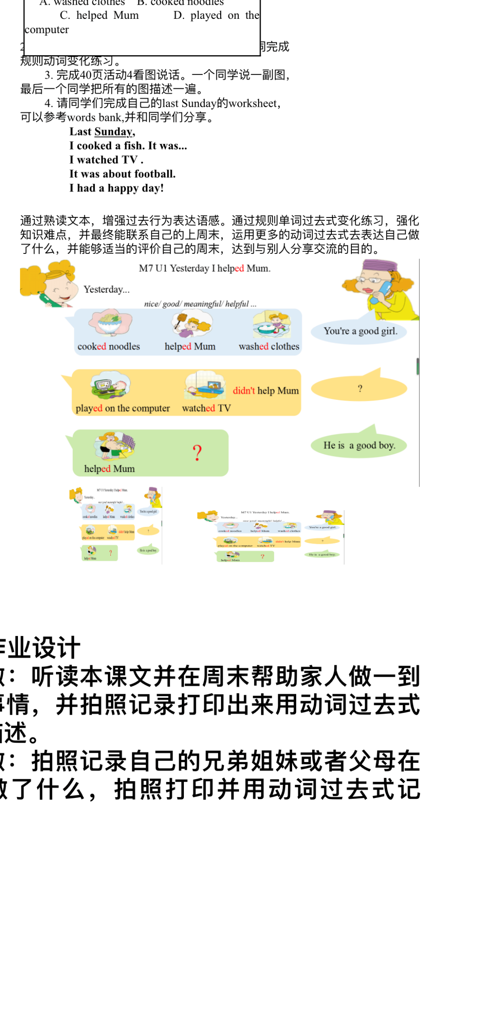

Slide 20
Thank you !

