Slide 1
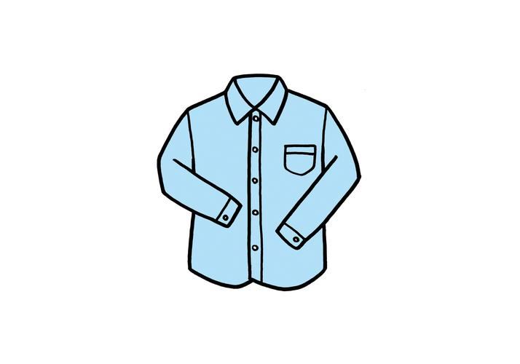
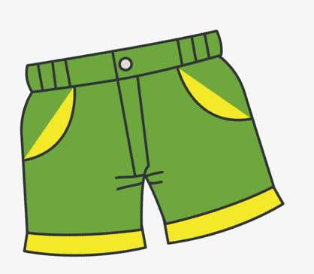
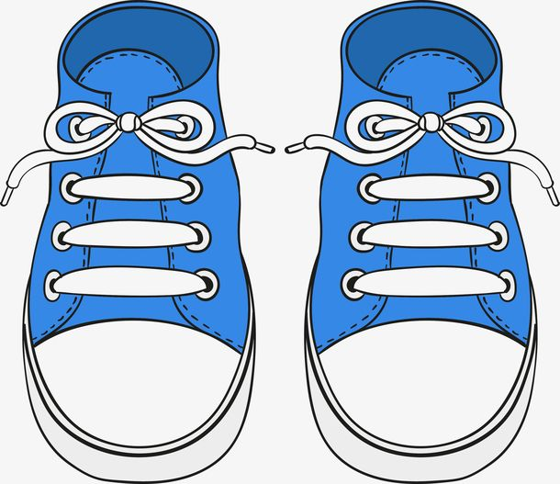

clothes
a shirt
a pair of shorts
a pair of shoes
a pair of socks

Slide 2
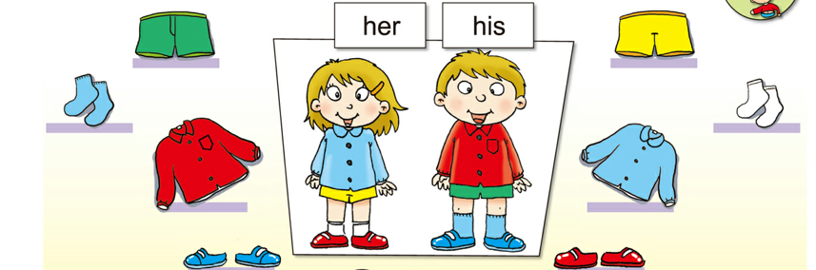
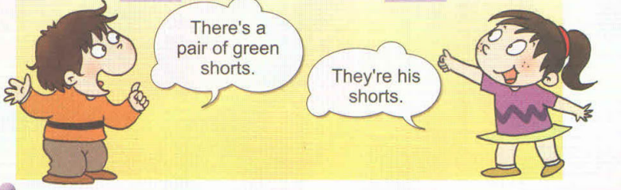
Look and say
a pair of ---一双/一条
a pair of green shorts
a pair of yellow shorts
a pair of blue socks
a pair of white socks
a red shirt
a blue shirt
a pair of blue shoes
a pair of red shoes
It’s

Slide 3
There’s a pair of yellow shorts. They’re her shorts.
There’s a pair of white socks. They’re her socks.
There’s a pair of red shoes. They’re her shoes.

Slide 4
There’s a pair of green shorts. They’re his shorts.
There’s a pair of blue socks. They’re his socks.
There’s a pair of blue shoes. They’re his shoes.

Slide 5
Make a sentence.
There’s a/a pair of __________.

Slide 6
Module 8
Unit 2

Slide 8
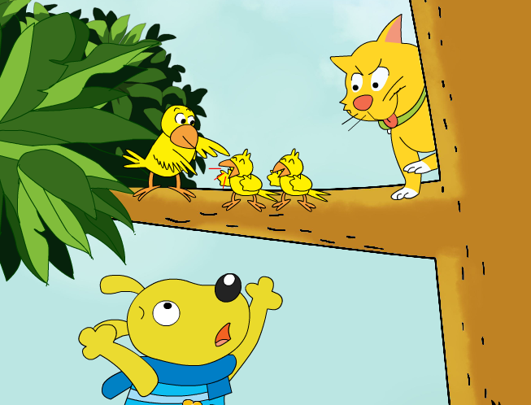
What can you see in the picture?

Slide 9

Do the birds see the cat?
Hey,birds.
There's a cat in the tree!

Slide 10
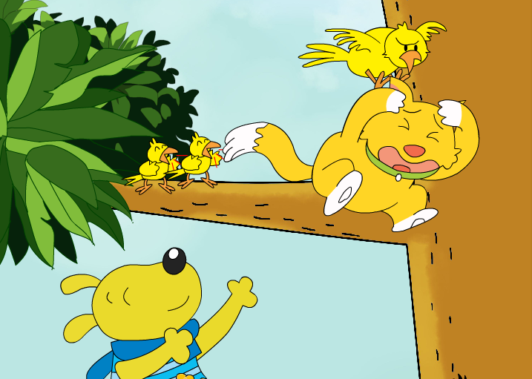
There's a cat ____________!
under a big bird

Slide 12
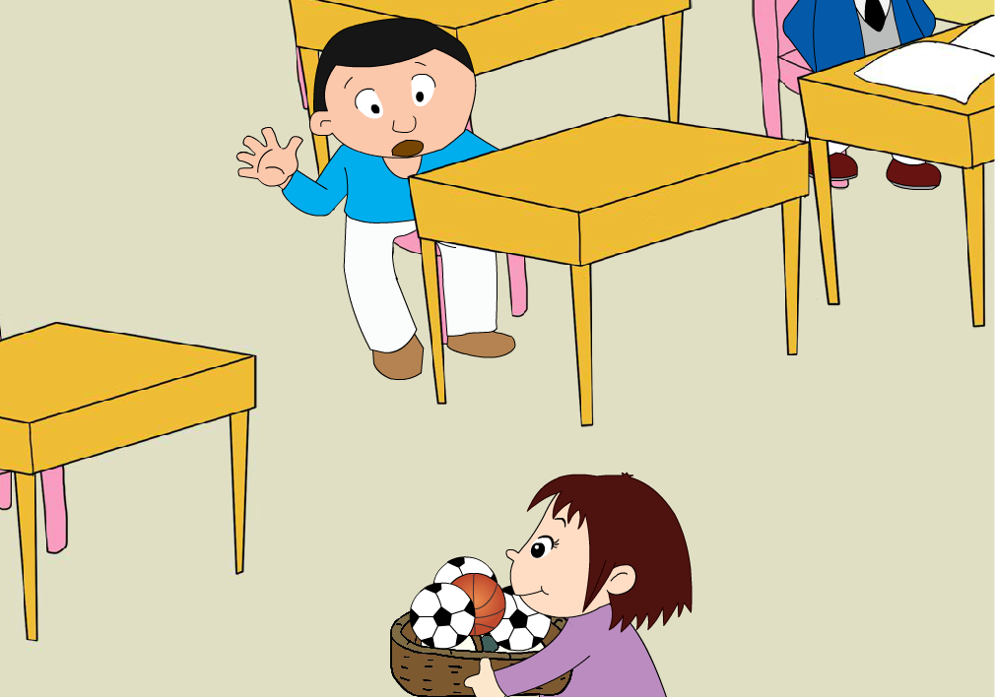
What can you see?
Where are they?

Slide 13
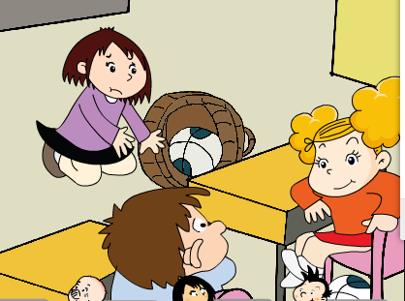
basketball
Why?
Oh no! Sorry.
Lingling, there's a basketball under my chair.

Slide 14

basketball

Slide 15
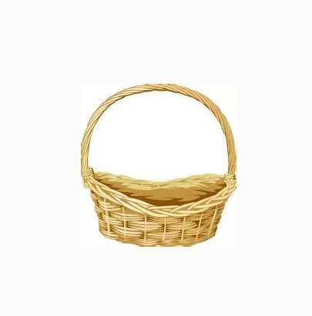
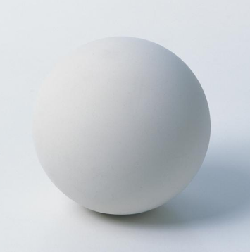
basket
ball
basketball

Slide 16
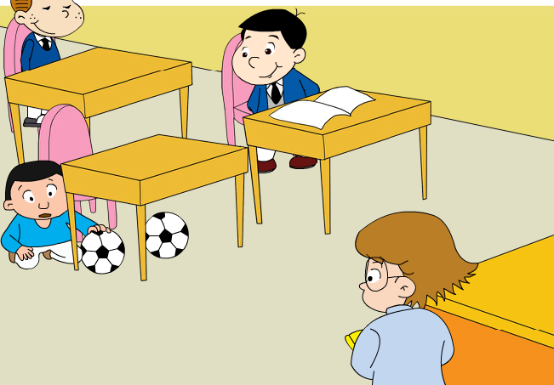
Where are the footballs?
There are ___ ______ under my desk.
two footballs
two footballs

Slide 17
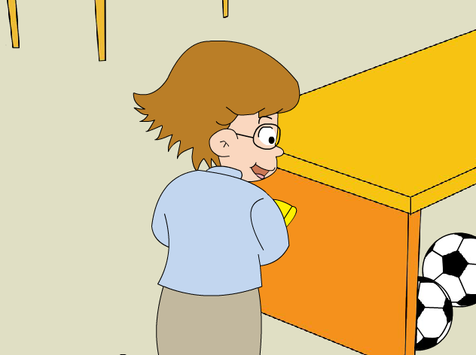
Where are the footballs?
There are ______________________________.
two footballs under my desk, too.

Slide 18

football

Slide 19
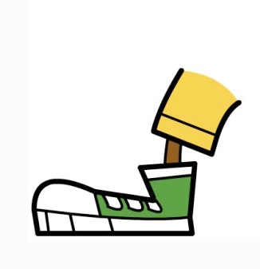
foot
ball
football

Slide 20
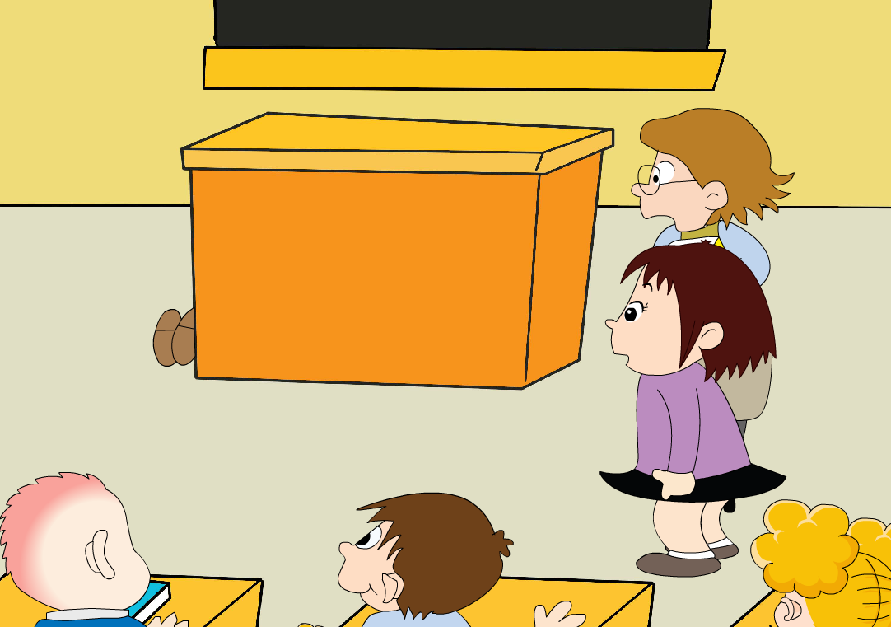
Whose feet?
feet

Slide 21
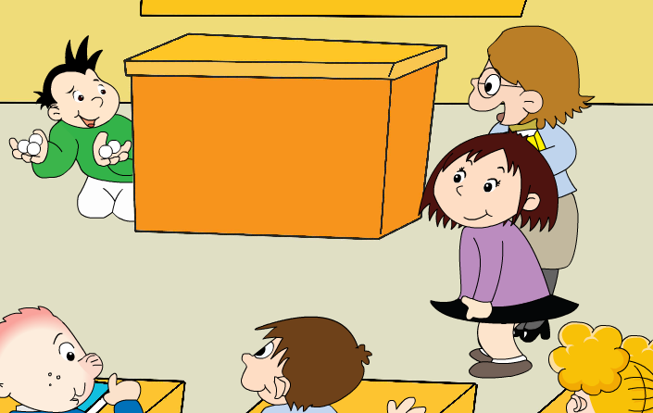
Lingling, there are five ping-pong balls here.
Oh, it's Daming.
Ha ha...

Slide 22
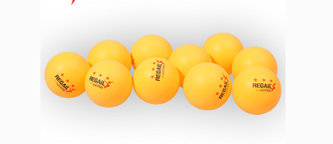
ping-pong ball

Slide 23
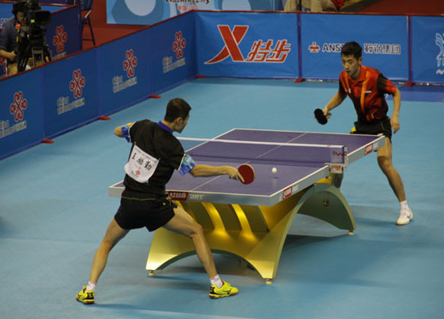
How many ping-pong balls?
There are _____ ______s.
ping-pong
ping-pong ball
ball

Slide 24

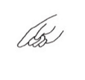

Listen, point and say.
P47
How many basketballs/footballs?
There are ---.

Slide 26
Let's review.
Lingling, there's a basketball ___________.
under my chair
There are two footballs ___________.
under my desk

Slide 27
Oh, there are _________________.
two footballs
under my desk, too
Lingling, there are ________
__________.
five ping-pong
balls here

Slide 28
football
ping-pong ball
basketball

Slide 29
Look, point and say.
There is ...=There's ...
There are...= There're...

Slide 30
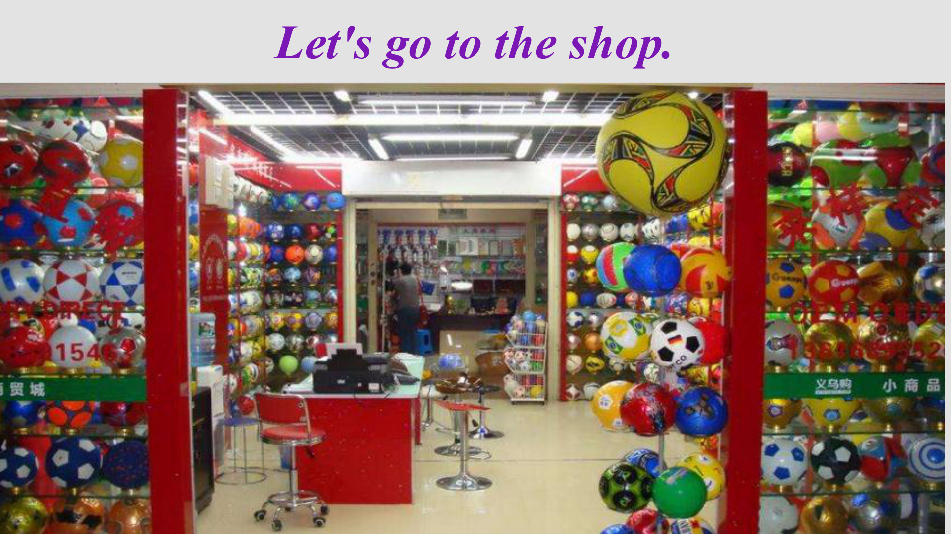

Slide 31
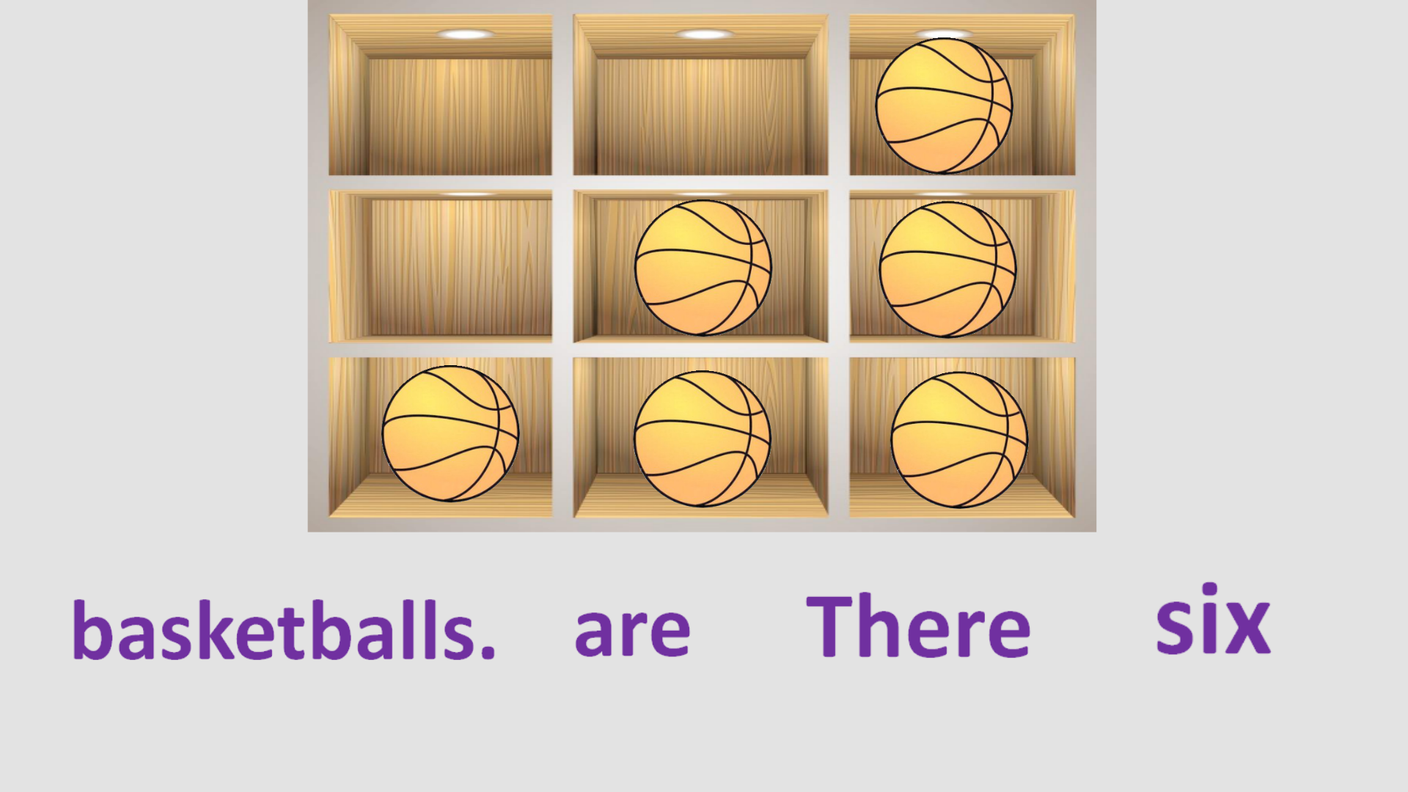
basketballs.
There are
six

Slide 32
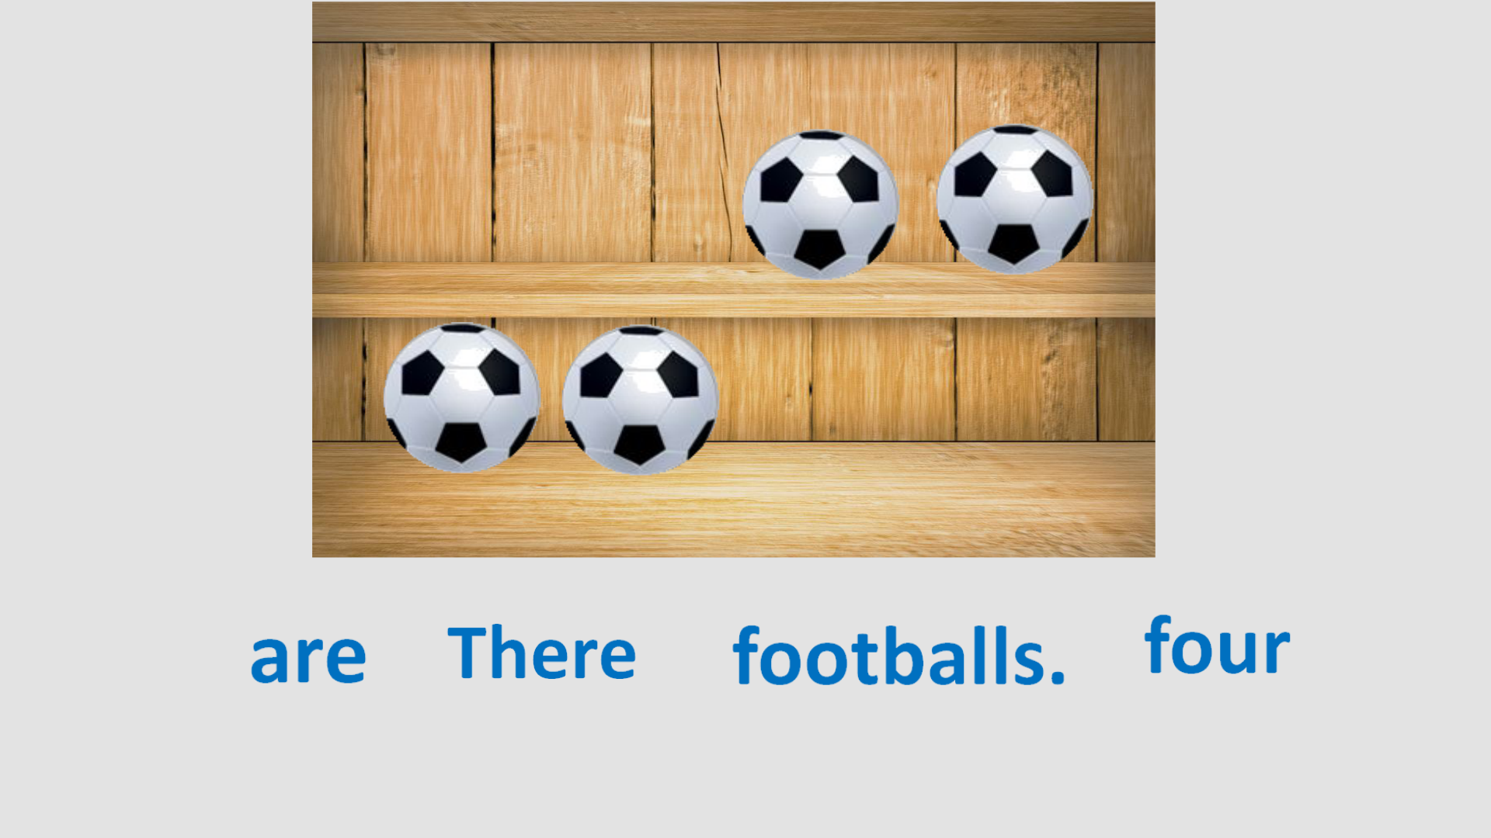
footballs.
There are
four

Slide 33
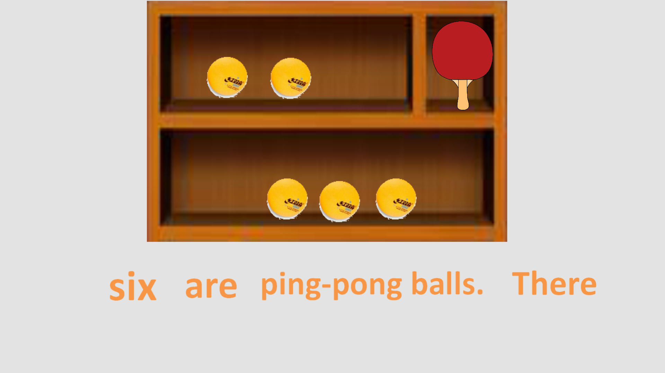
ping-pong balls.
There are
five

Slide 34
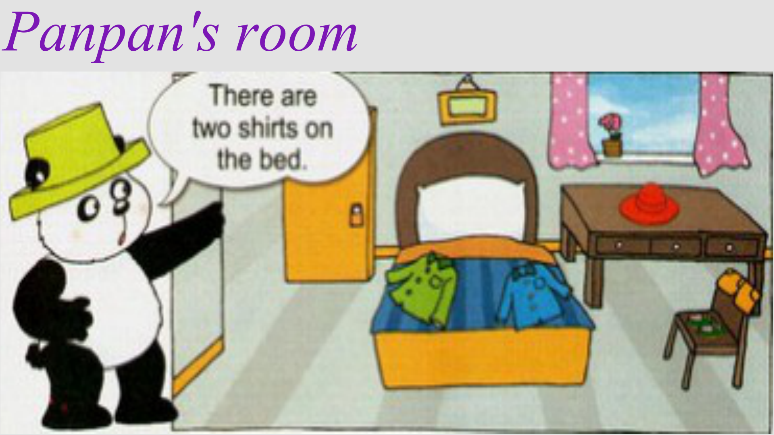
There are two shirts on the bed.

Slide 35
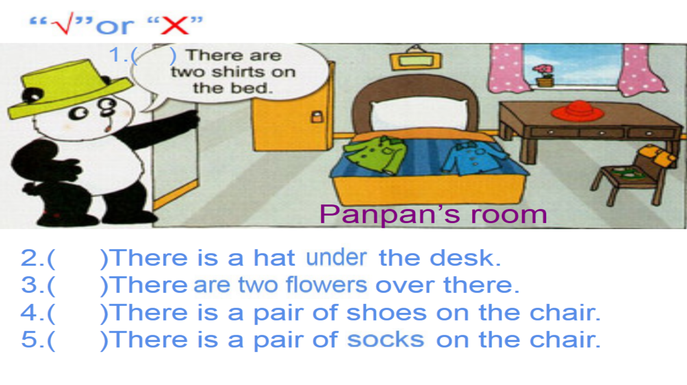
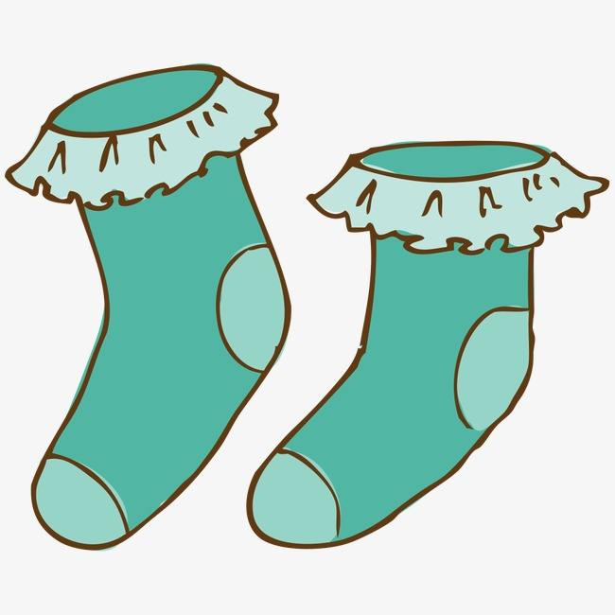
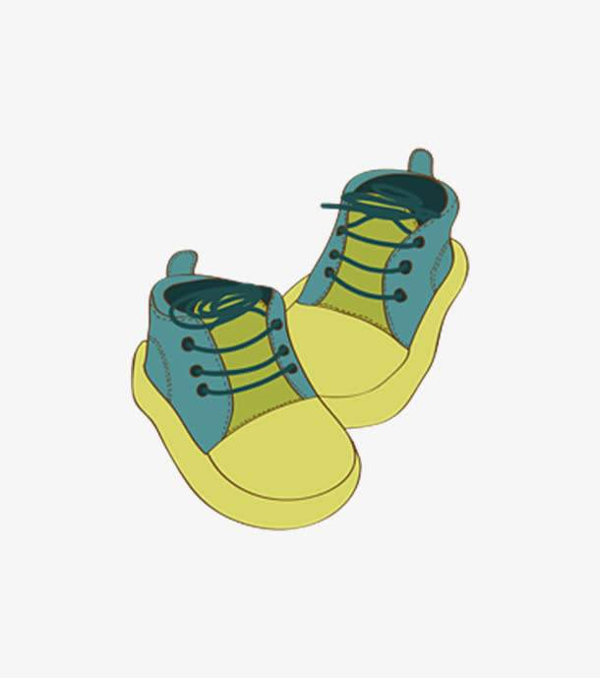
√
√
×
×
√
√
bed

Slide 36
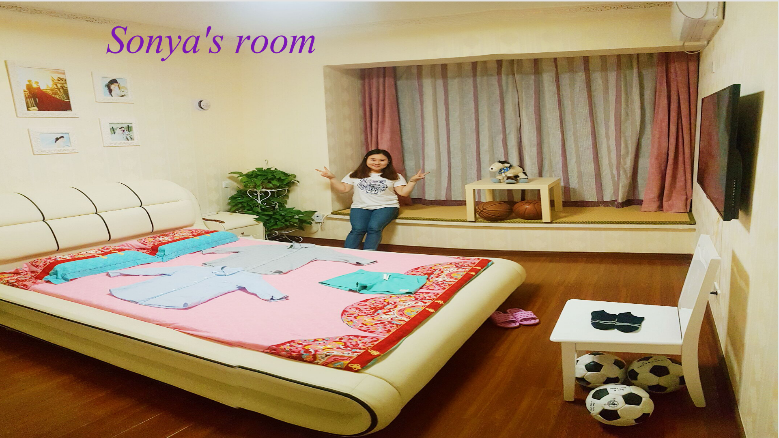

Slide 37
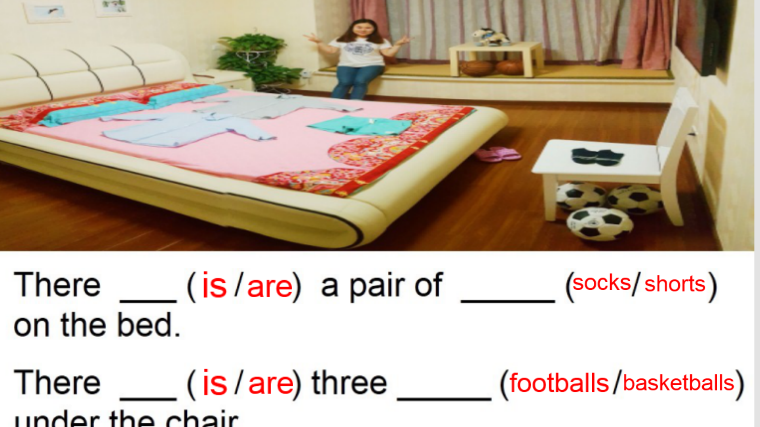
is
shorts
footballs
are
under the chair.

Slide 38
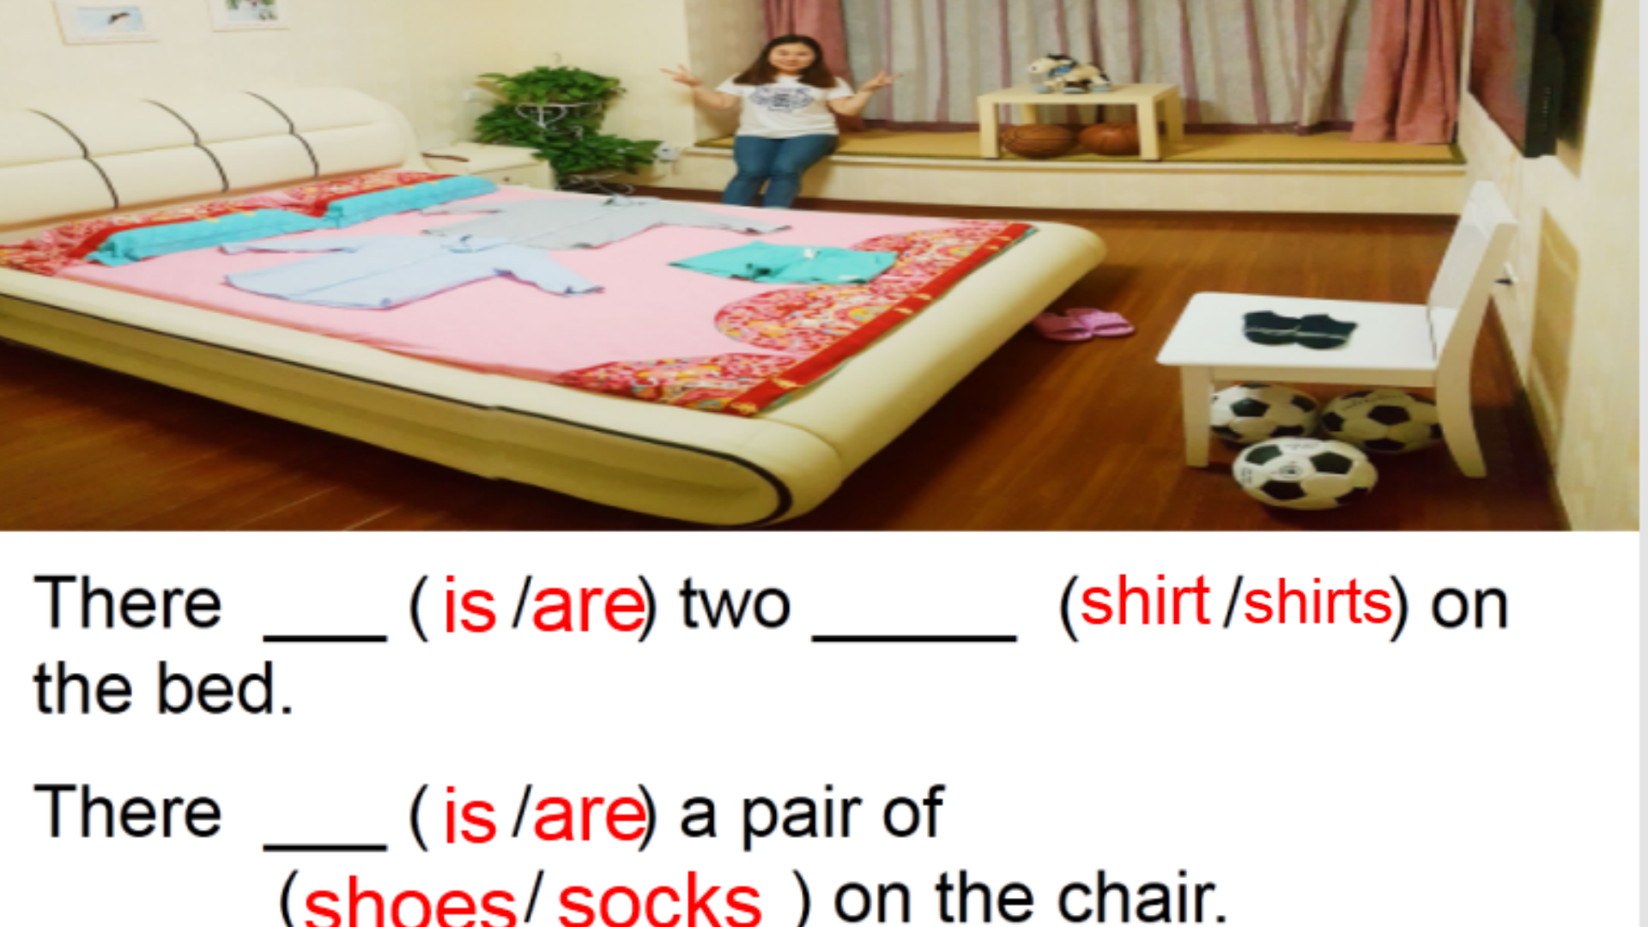
are
shirts
are
socks

Slide 39
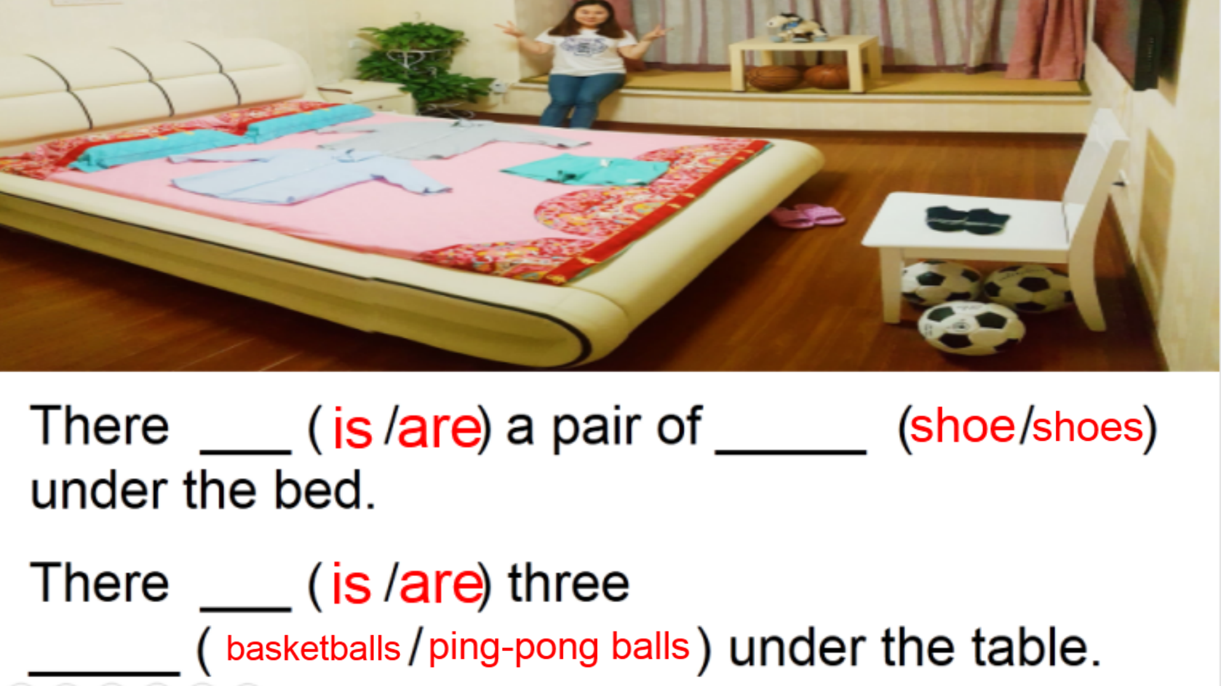
are
shoes
are
basketballs

Slide 40
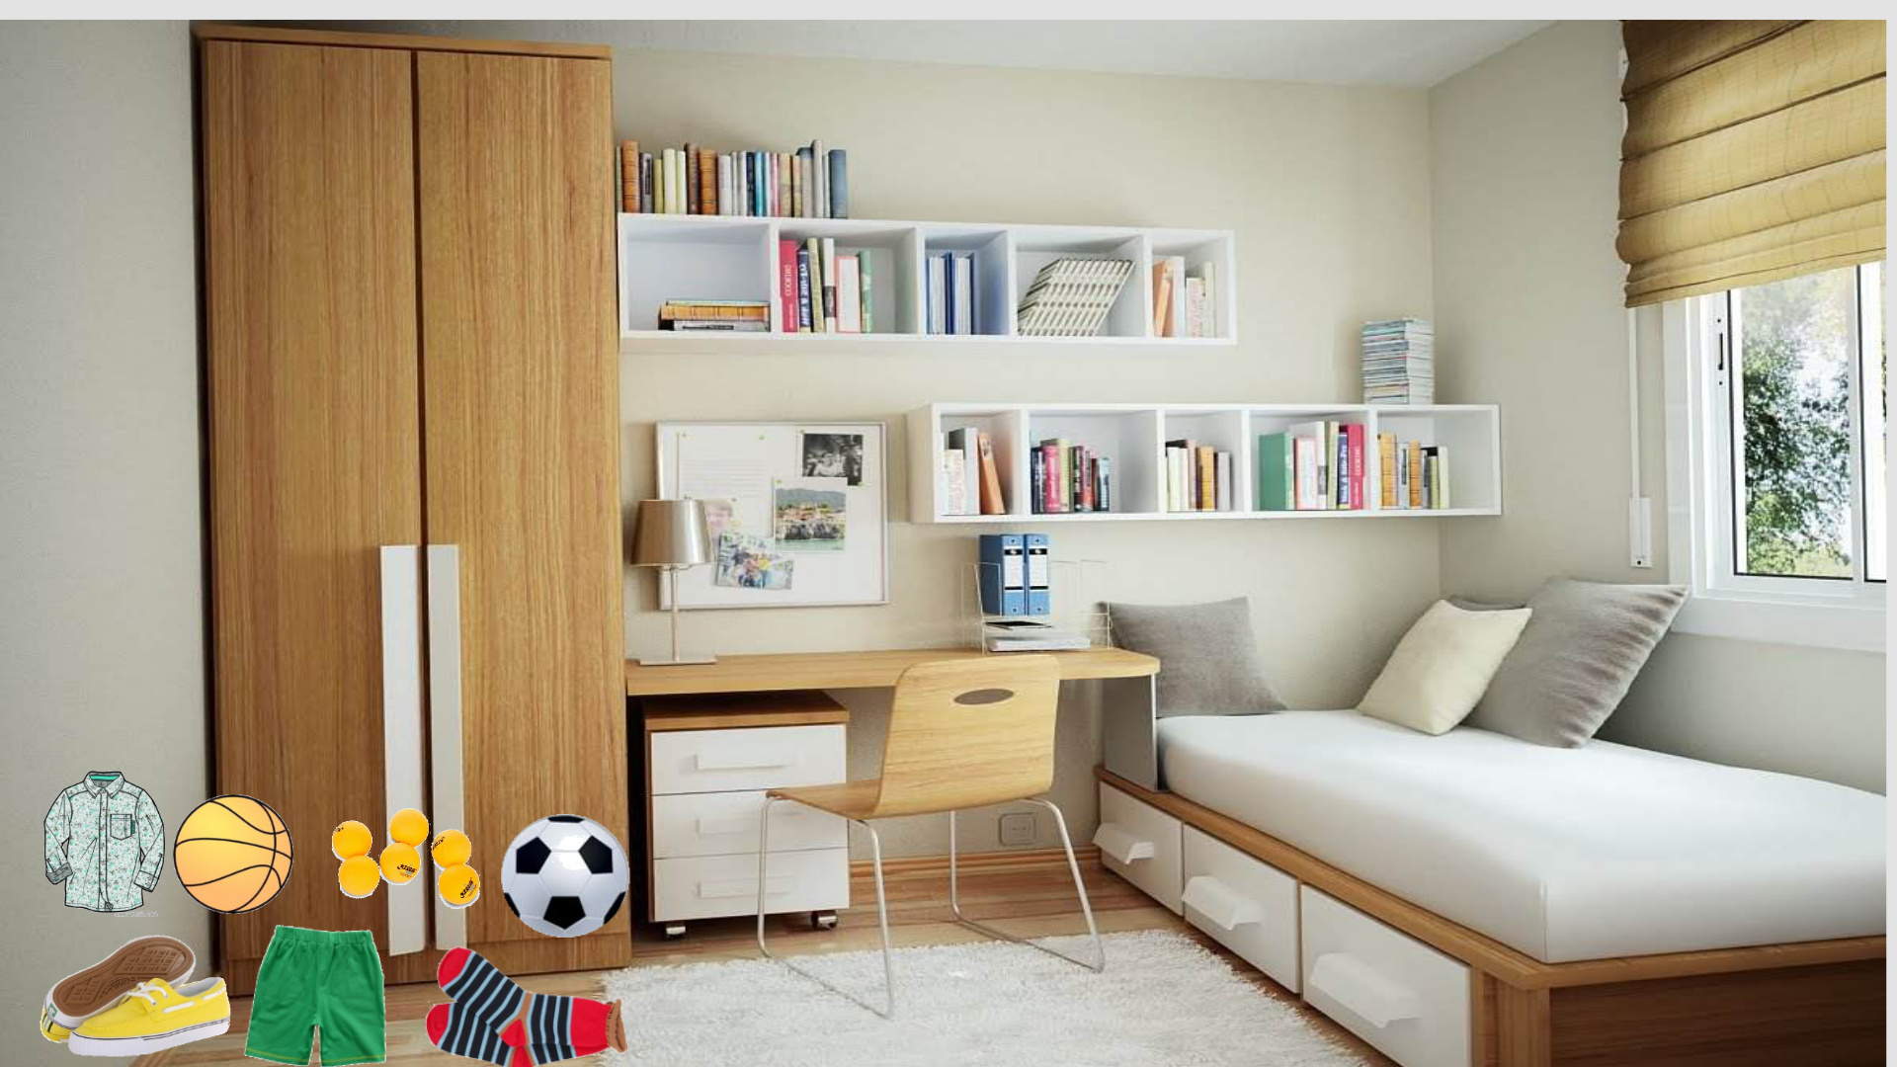

Slide 41
