Slide 1


Learn to Be Flexible

Slide 2


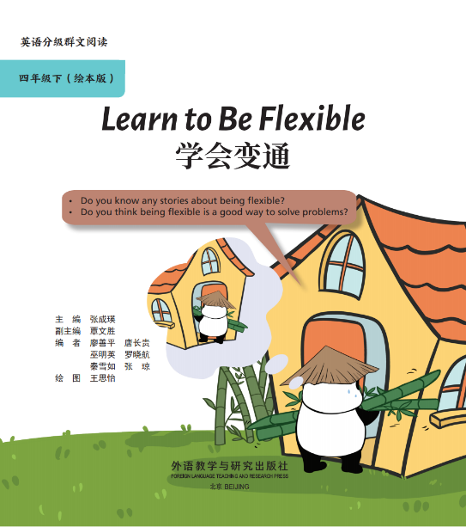
Before Reading

Slide 3
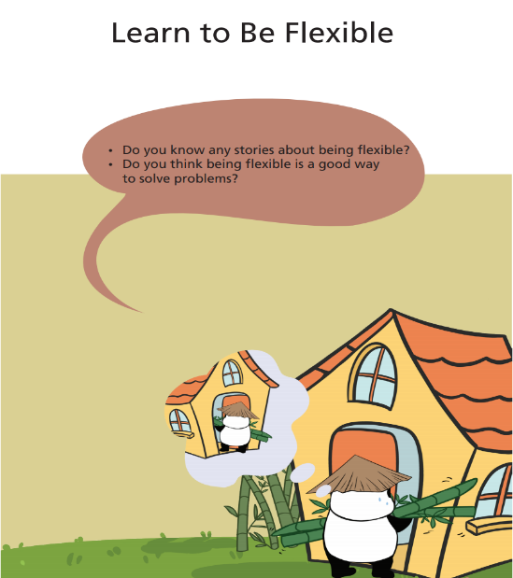

Theme
Free Talk

Slide 4
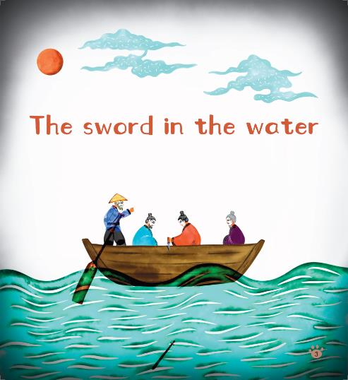

Have Ss read the title, writer, and illustrator.
Talk about the pictures on the cover.
Book Intro
Illustrator
王思怡
Illustrator
邓 磊

Slide 5

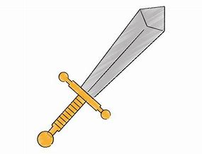
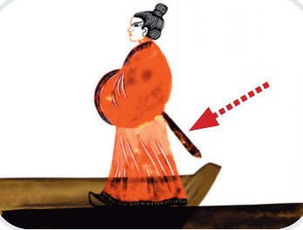
Blocking Words
Read, explain and TPR.
sword

Slide 6
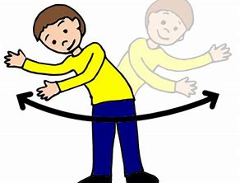
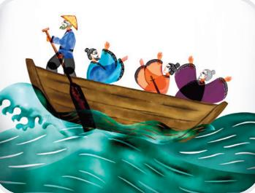
Blocking Words
Read, explain and TPR.
sway

Slide 7
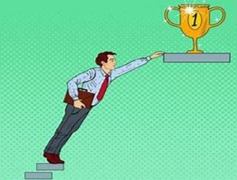
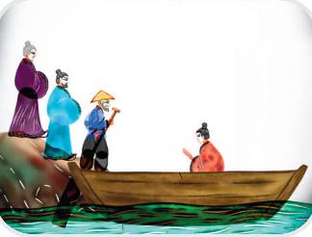
Blocking Words
Read, explain and TPR.
reach

Slide 8
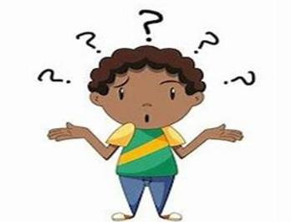
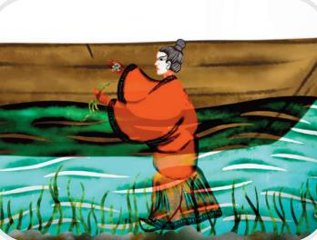
Blocking Words
Read, explain and TPR.
puzzled

Slide 9

Blocking Words
s
w
o
r
d
s
w
a
y

Slide 10

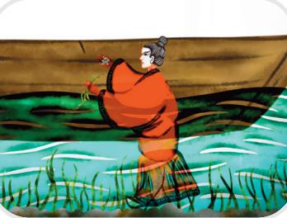
Blocking Words
r
e
a
c
h
p
u
z
z
l
e
d

Slide 11


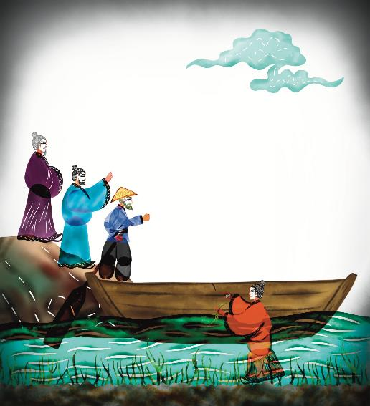
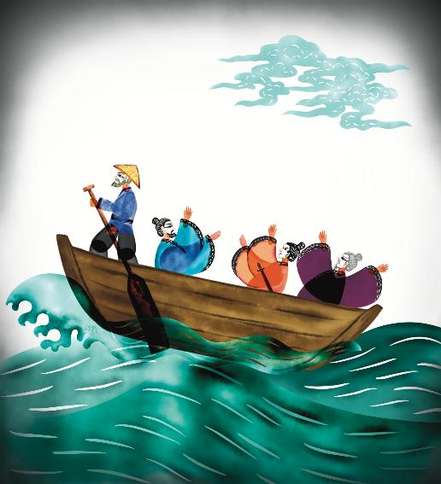
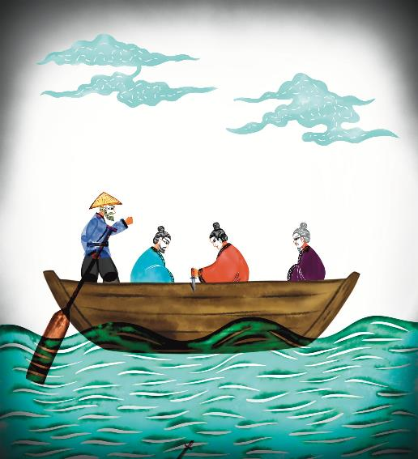
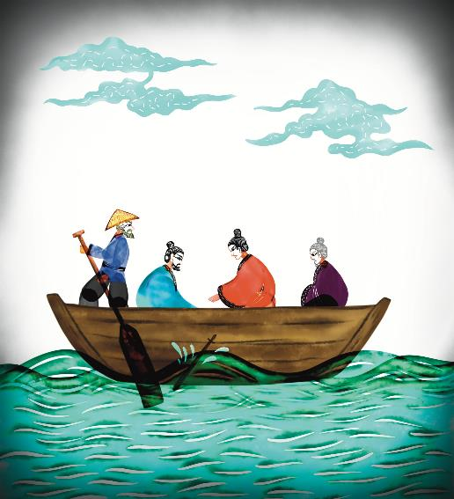
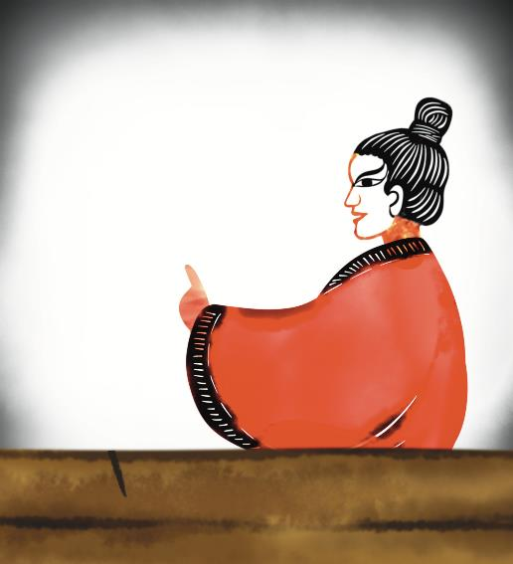
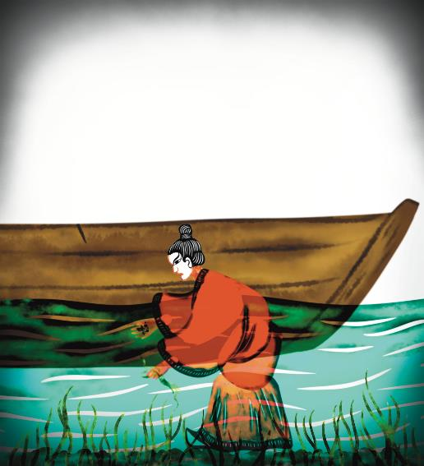
First Reading
Put the pictures in the correct order.
5
1
3
2
4
6

Slide 12

Read and finish the worksheet.
Work in Group
Beginning:
Setting:
(Where does the story happen?)
see his friend
cross a river
A man wanted to . He needed to .
He got on . Suddenly突然 a came.
The boat from left to right.
People on the boat , too. His fell into the water.
a boat
wave
on the boat
1:
swayed
at the other side of the river
moved about
sword
2:
Middle:
go and get it
He didn’t the boat. He didn’t at once立刻.
He on the side of the boat with用 .
He worried. Because he thought认为 his sword will be
right刚好below在..下方 the .
stop
cut a mark
a small knife
Main Character:
(Who is in the story)
wasn’t
mark
Ending:
other side of the river
A Man and some people
The boat reached到达 the .
The man his sleeves袖口, the water
and right below the mark标记.
But there was .
The man looked and people .
rolled up
jumped into
searched
no sword
puzzled
laughed

Slide 13

Read on Own
Look at the picture on title page.
1. How did the man go to see his friend?
2. What happened to the man on the way?
3. Why did the man cut a mark on the side of the boat?
4. What did the man do when the boat reached the other side of the river?
5. Why can’t the man find his sword?

Slide 14
Before Reading

Slide 15
Theme
Free Talk

Slide 16
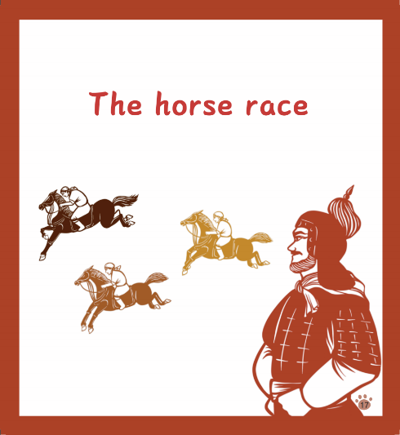
Have Ss read the title, writer, and illustrator.
Talk about the pictures on the cover.
Book Intro
Illustrator
王思怡
Illustrator
邓 磊

Slide 17
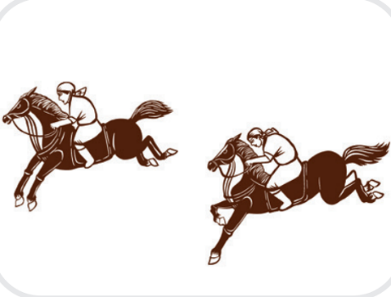
Blocking Words
Read, explain and TPR.
round

Slide 18
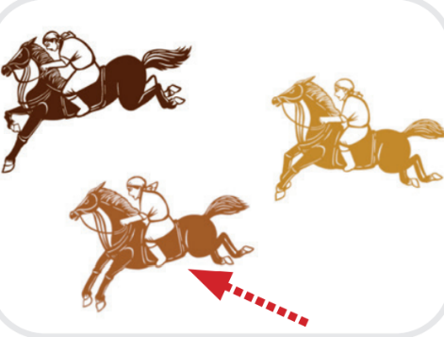
Blocking Words
Read, explain and TPR.
average

Slide 19
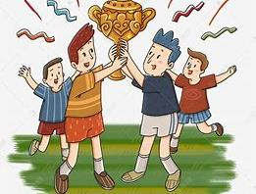
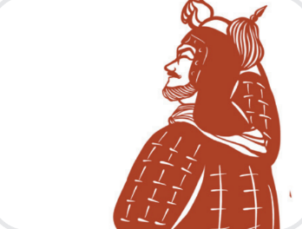
Blocking Words
Read, explain and TPR.
victory

Slide 20


Blocking Words
r
o
u
n
d
a
v
e
r
a
g
e

Slide 21
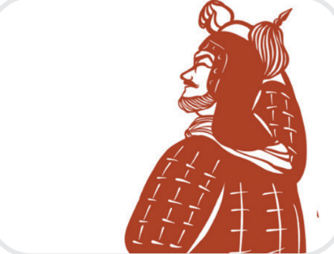
Blocking Words
v
i
c
t
o
r
y

Slide 22

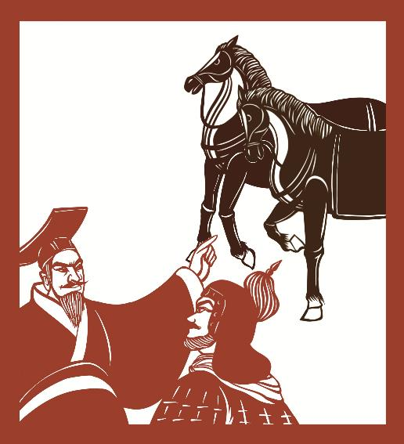
Read and find
Read and finish on worksheet
How was the first race?
In the first race: 第一次比赛
Round one was for the horse.
won.
Round two was for the horse.
The king yet again.
Round three was for the horse.
was still the winner.
best
The king
average
won
weakest
The king

Slide 23
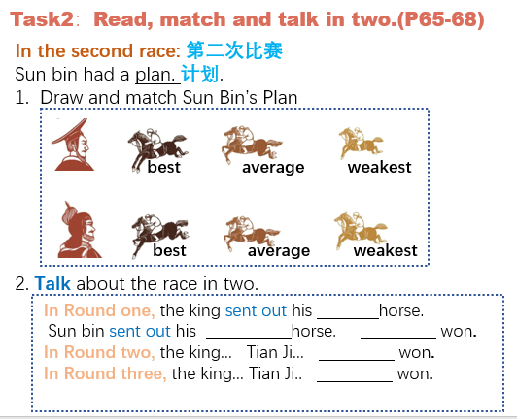
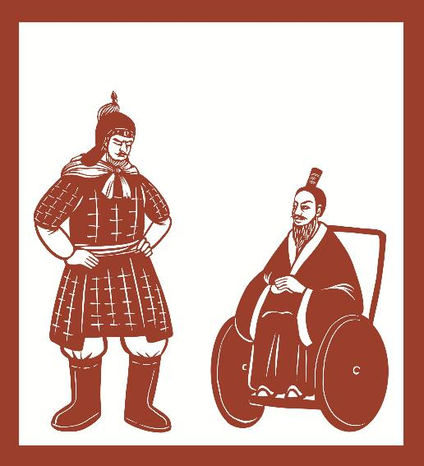
Read, match and say
What’s the plan for the second race?
Who win the second race?

Slide 24




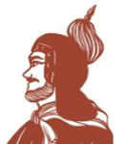



Read, draw and say
How was the second race?
Round1
In the second race: 第二次比赛
Sun bin had a plan 计划.
Round2
best
average
weakest
sent out…
…won
Round3
best
average
weakest
Who win the second race?
A. Tian Ji had won the second race.
Sun Bin
B. The king won the second race.
What do you think of Sun Bin’s plan?

Slide 25
Read on Own
Look at the picture on title page.
1. What did Tian Ji love to do?
2. How did the race go the first time?
3. Who won the first race?
4. Who helped Tian Ji?
5. Who won the second race?

Slide 26
The End

