Slide 1


Does It Fit?

Slide 2


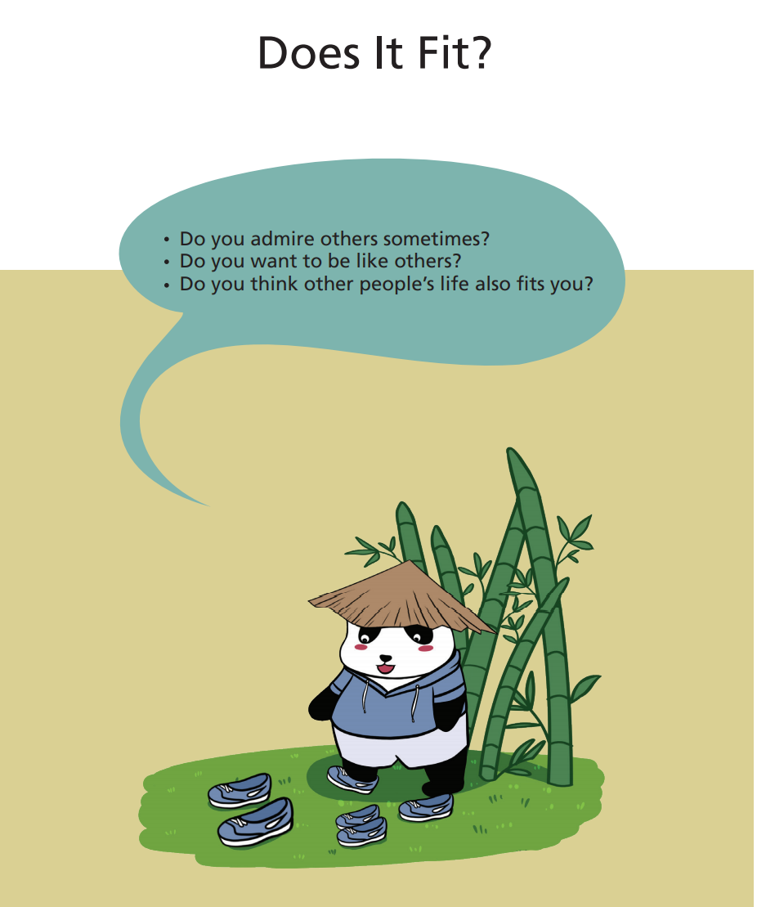

Theme
Free Talk

Slide 3


Have Ss read the title, writer, and illustrator.
Talk about the pictures on the cover.
Book Intro
Illustrator
王思怡
Illustrator
邓 磊

Slide 4
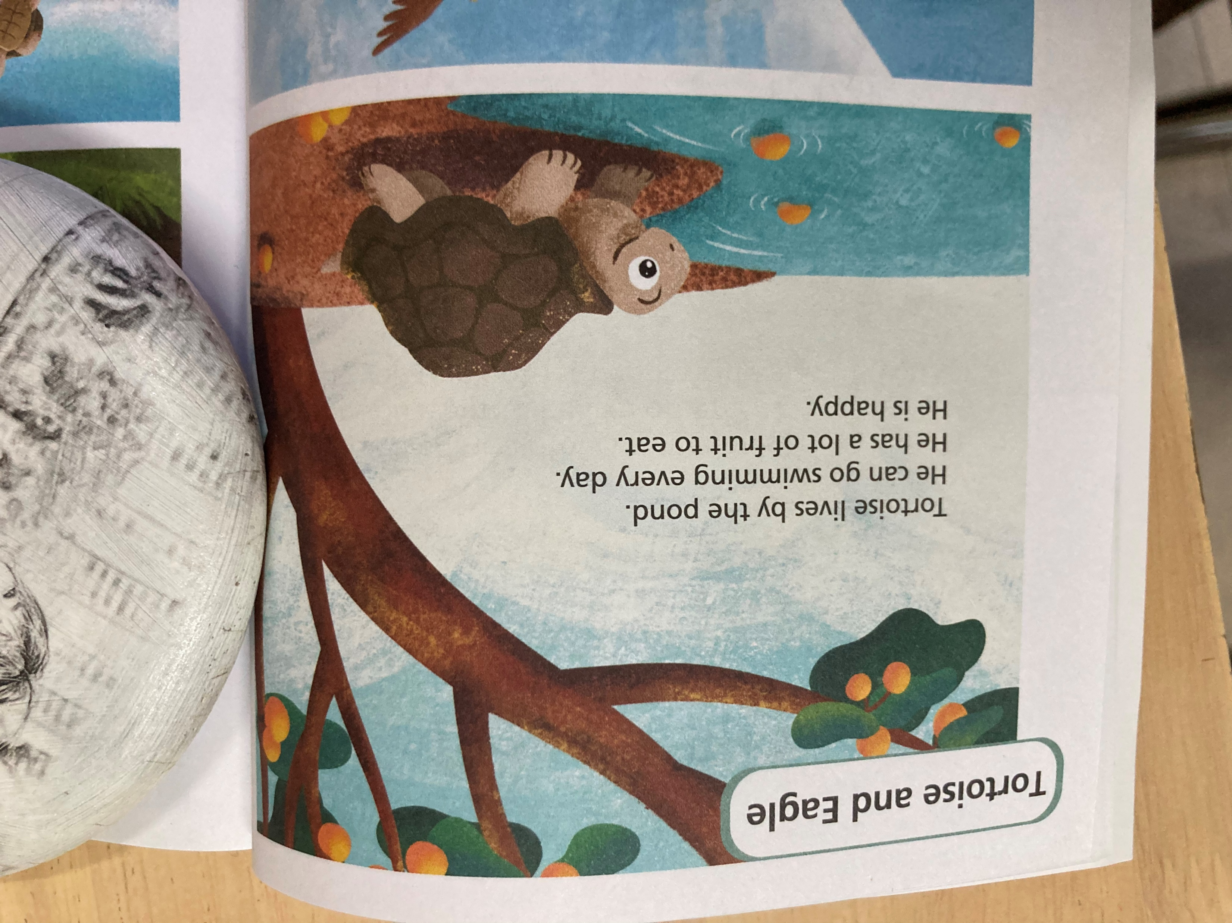
What do you know about tortoise?
It lives…
It is…
It has…
It can…
…

Slide 5
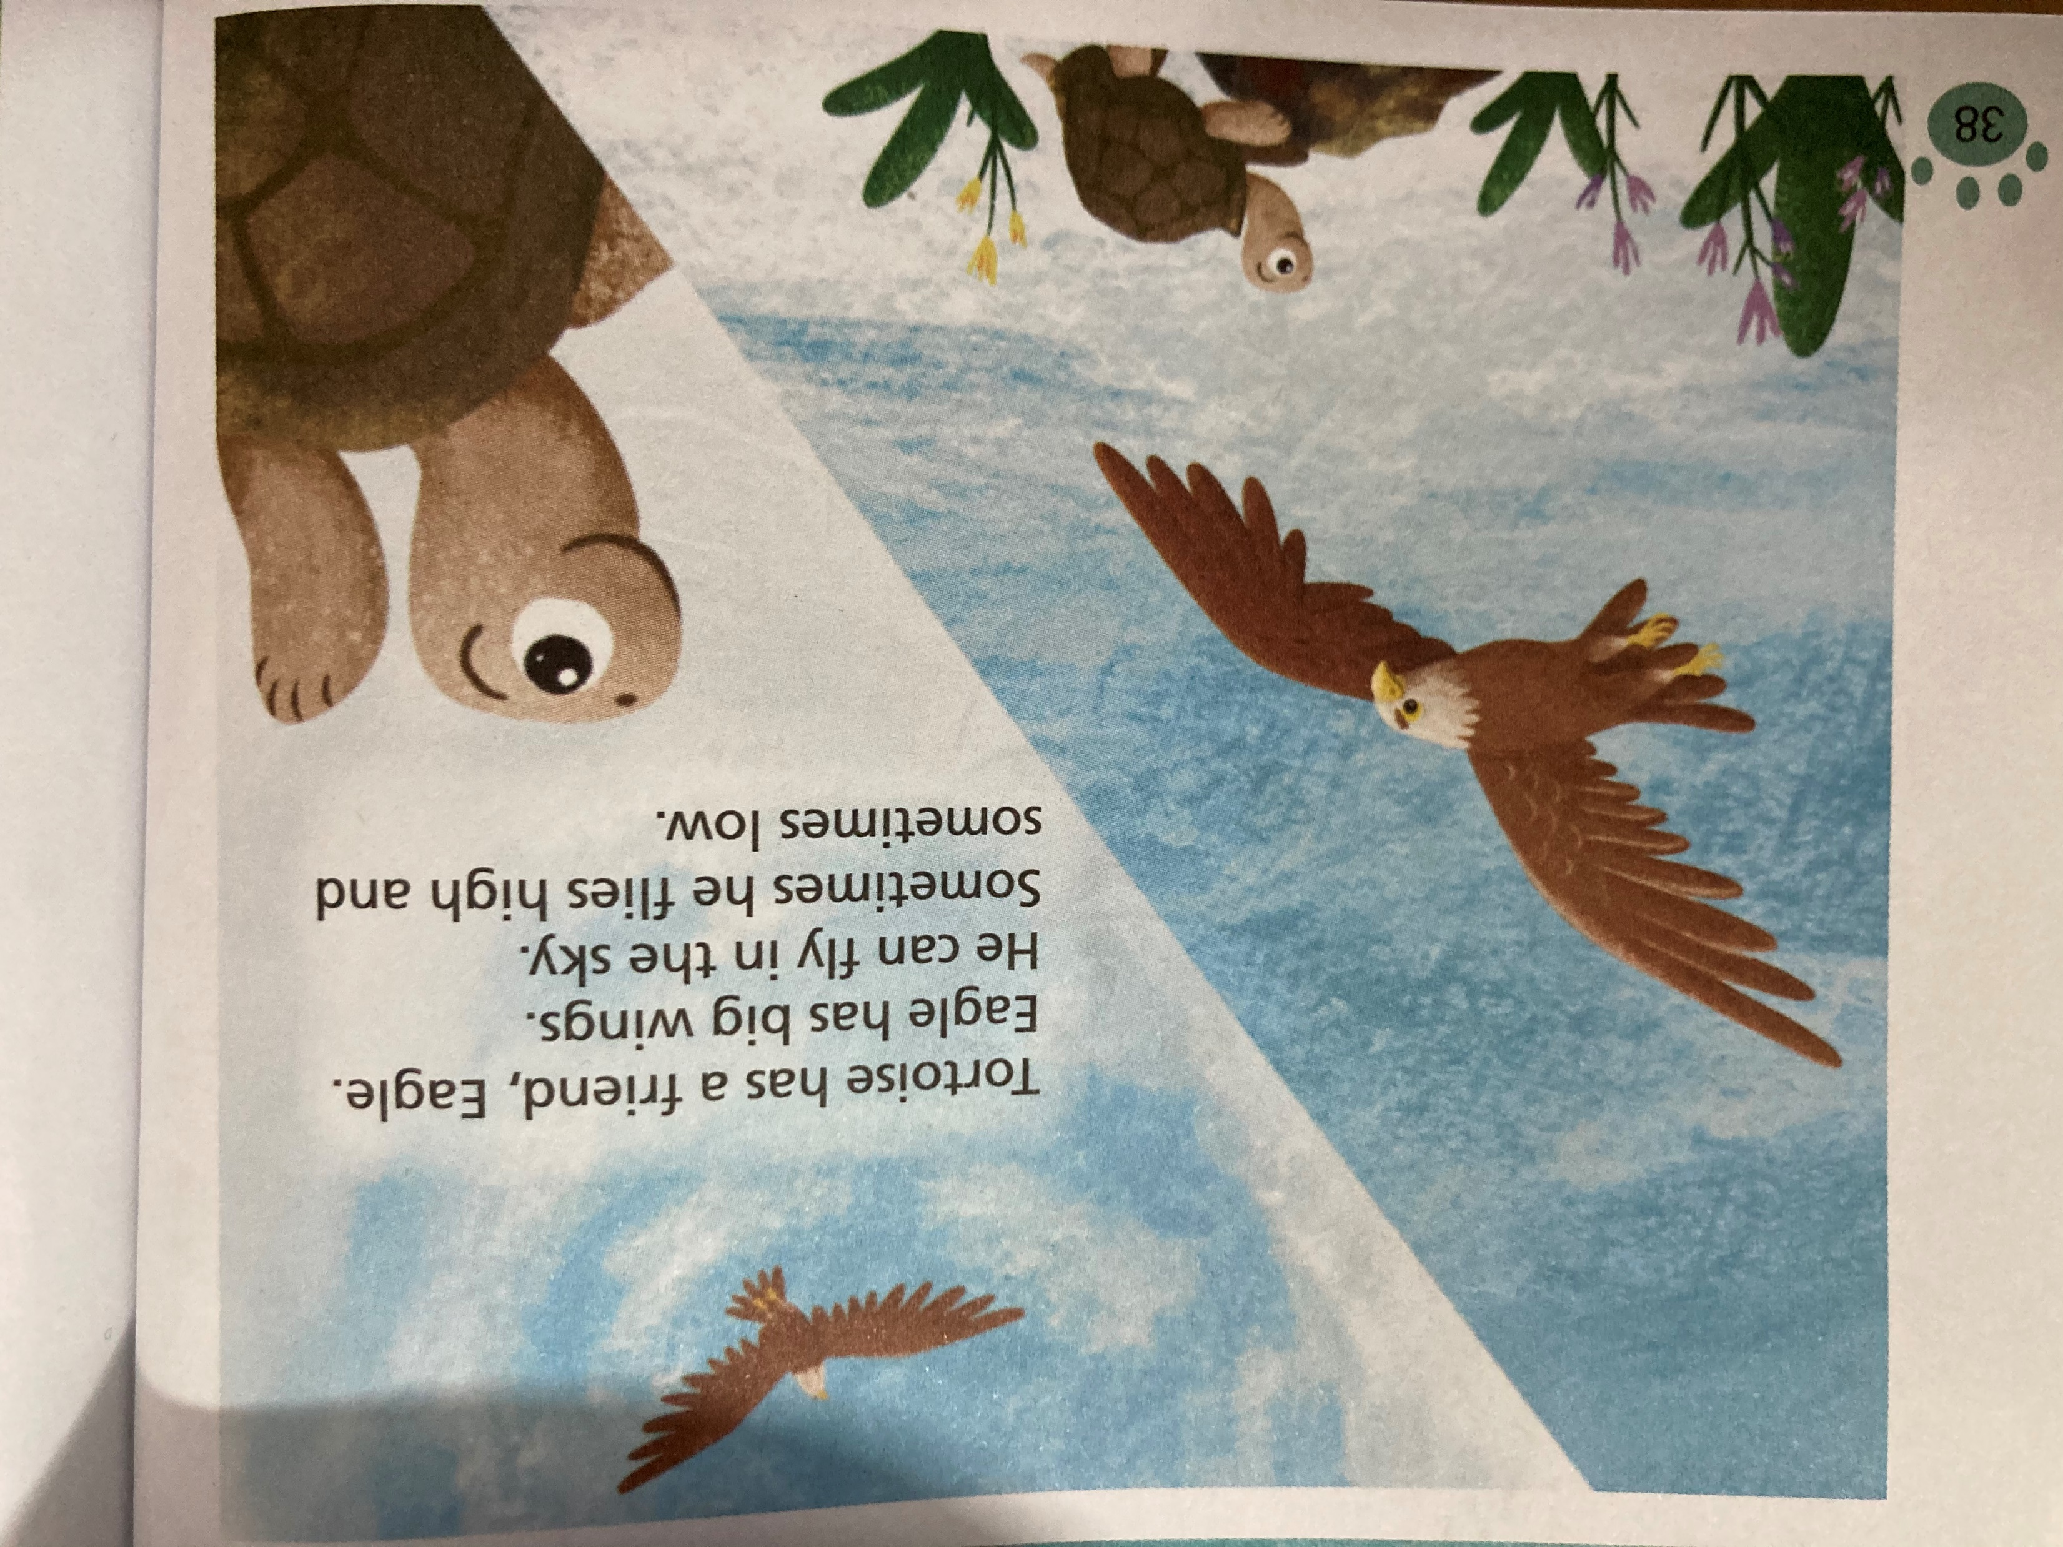
What do you know about eagle?
It is…
It has…
It can…
…

Slide 7
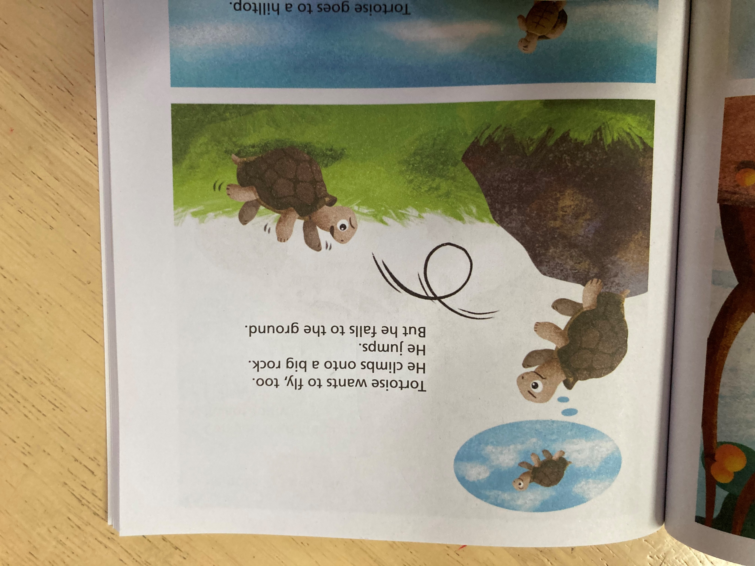
What does Tortoise want to do?

Slide 8
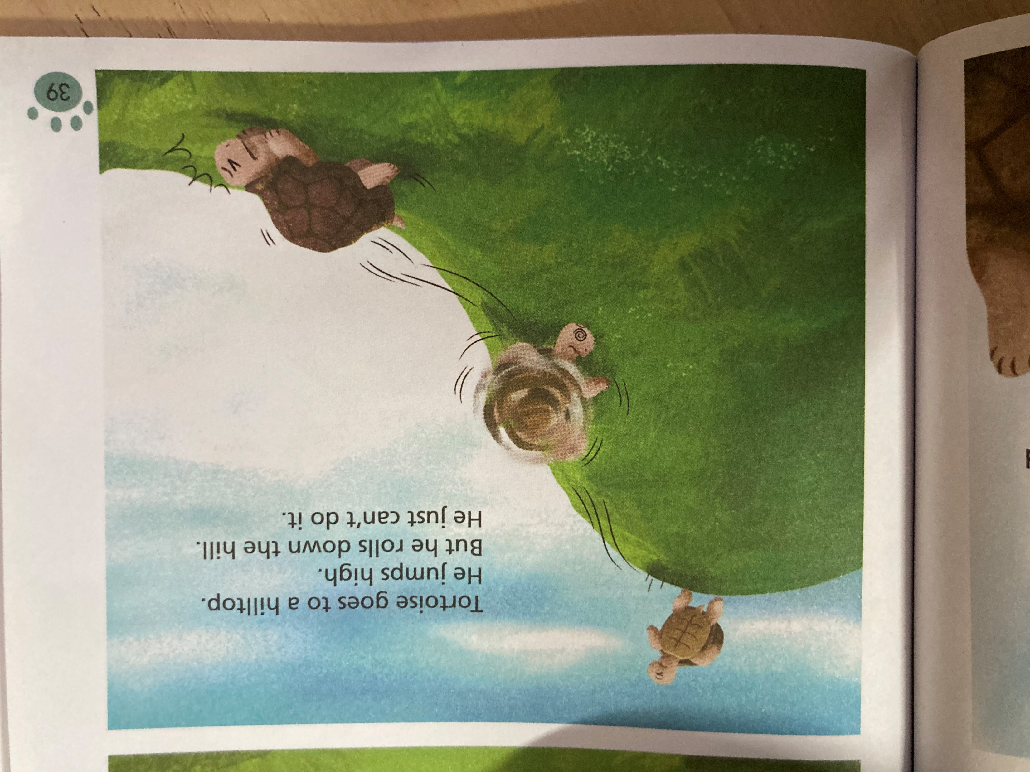
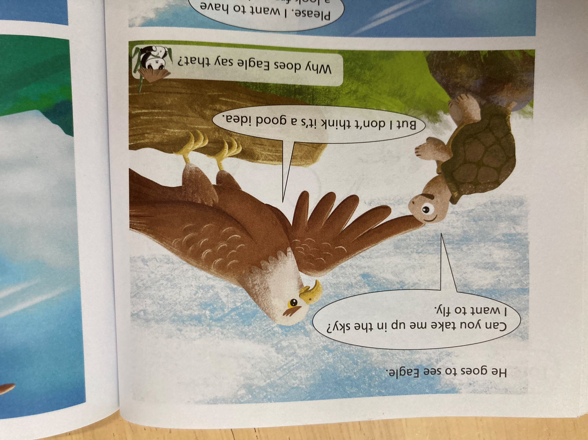
Read P39-40
What does Tortoise do?

Slide 11
He asks Eagle for help.

Slide 12
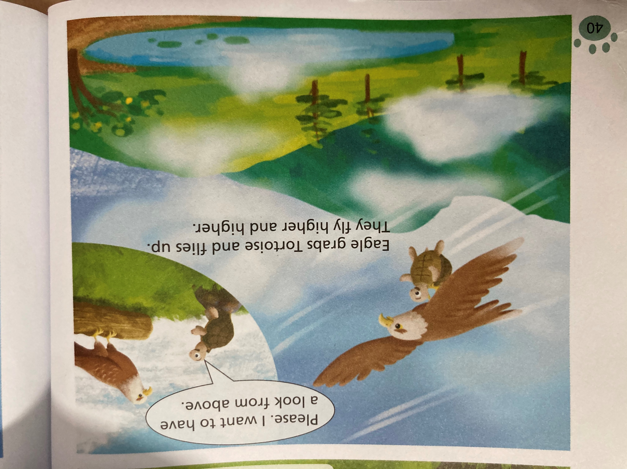
What do they say ?

Slide 14
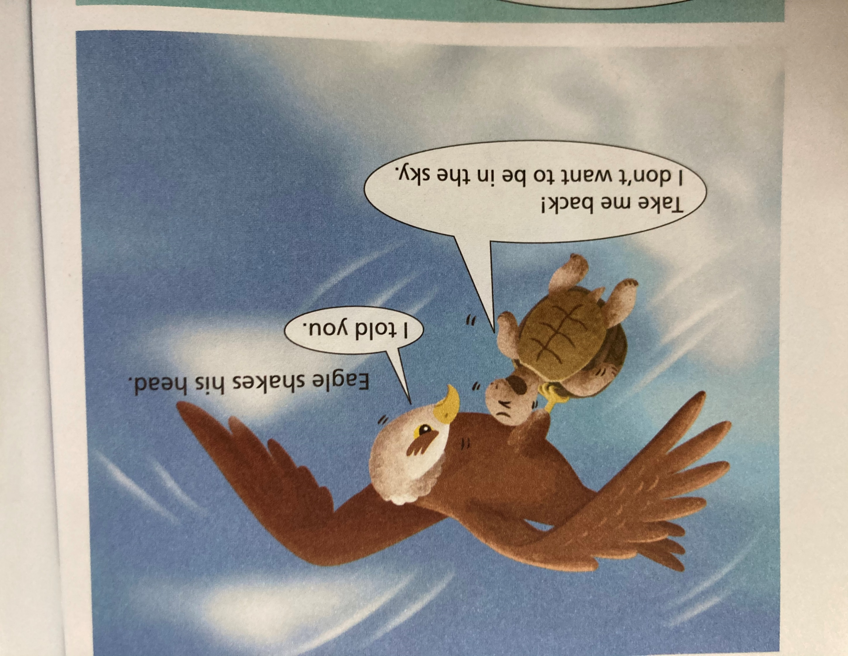
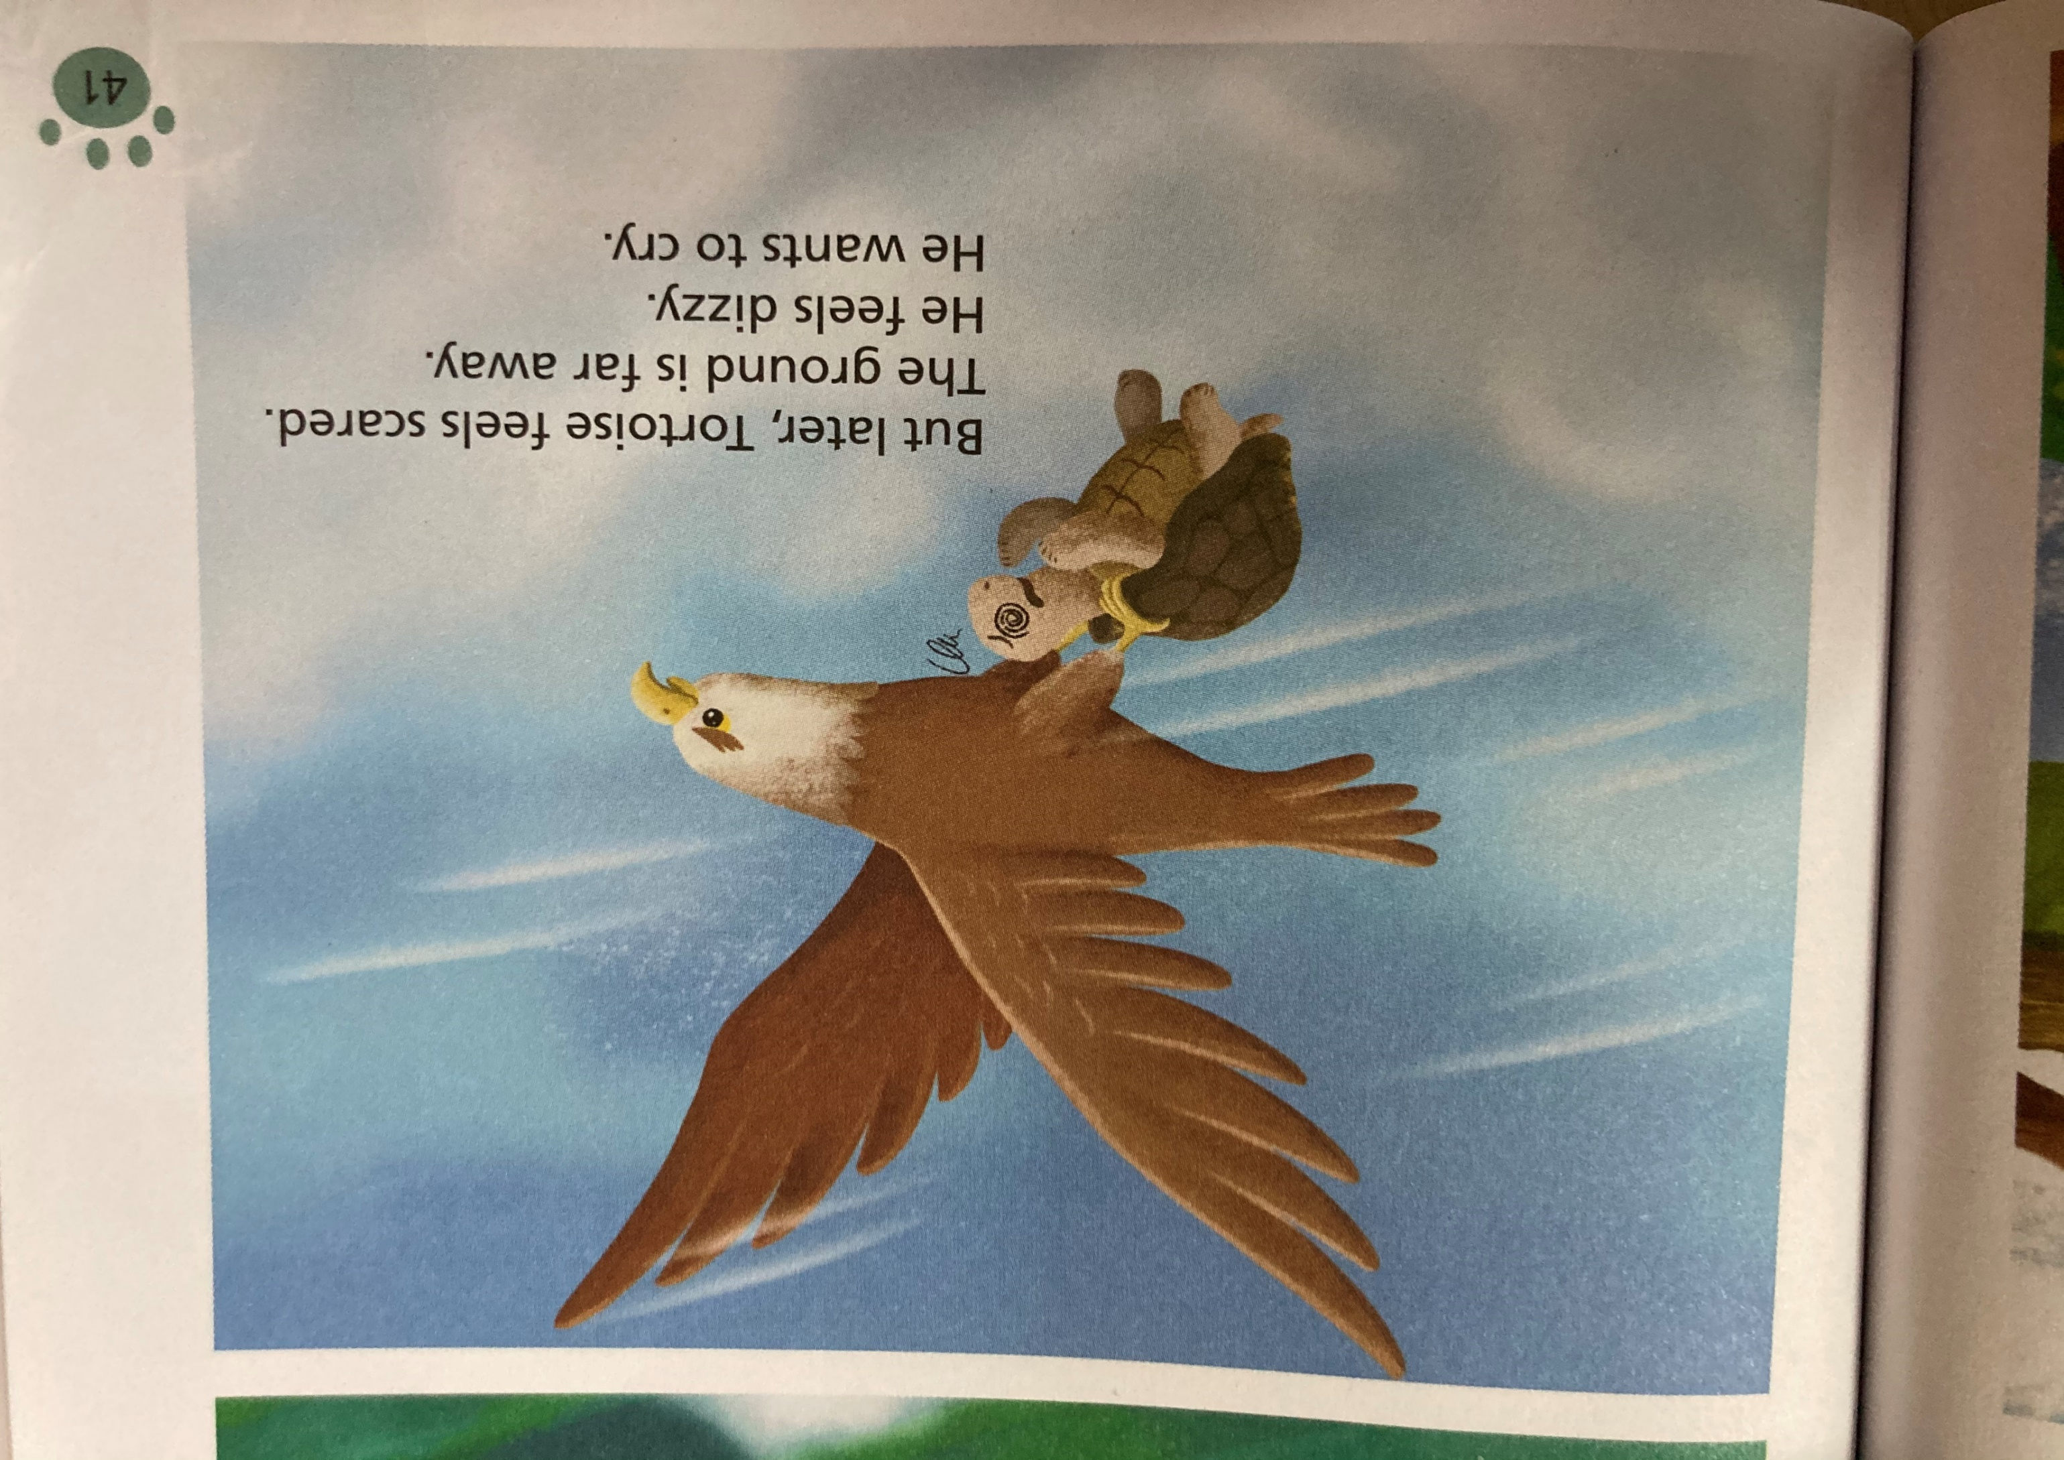
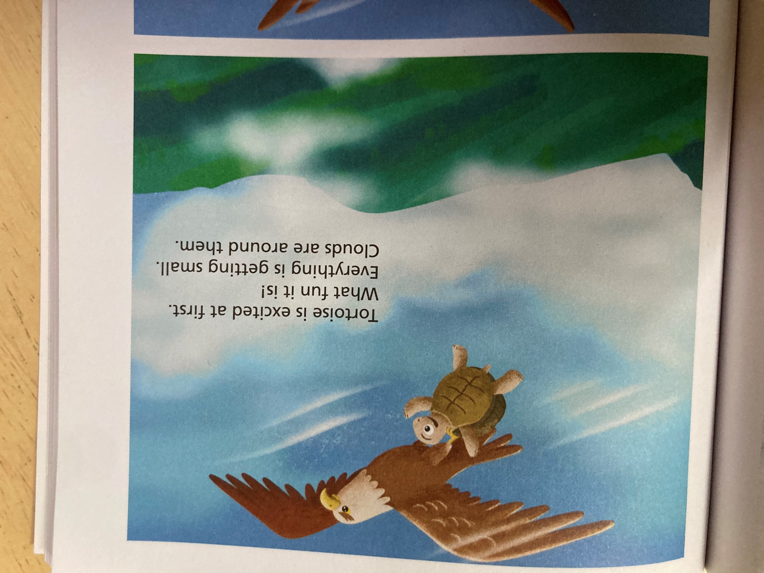
How does the tortoise feel?
Read P41-42

Slide 15
Tortoise is excited at first . What fun it is ! Everything is getting small.Clouds are around them.

Slide 16


Slide 17

What does Tortoise say?

Slide 18
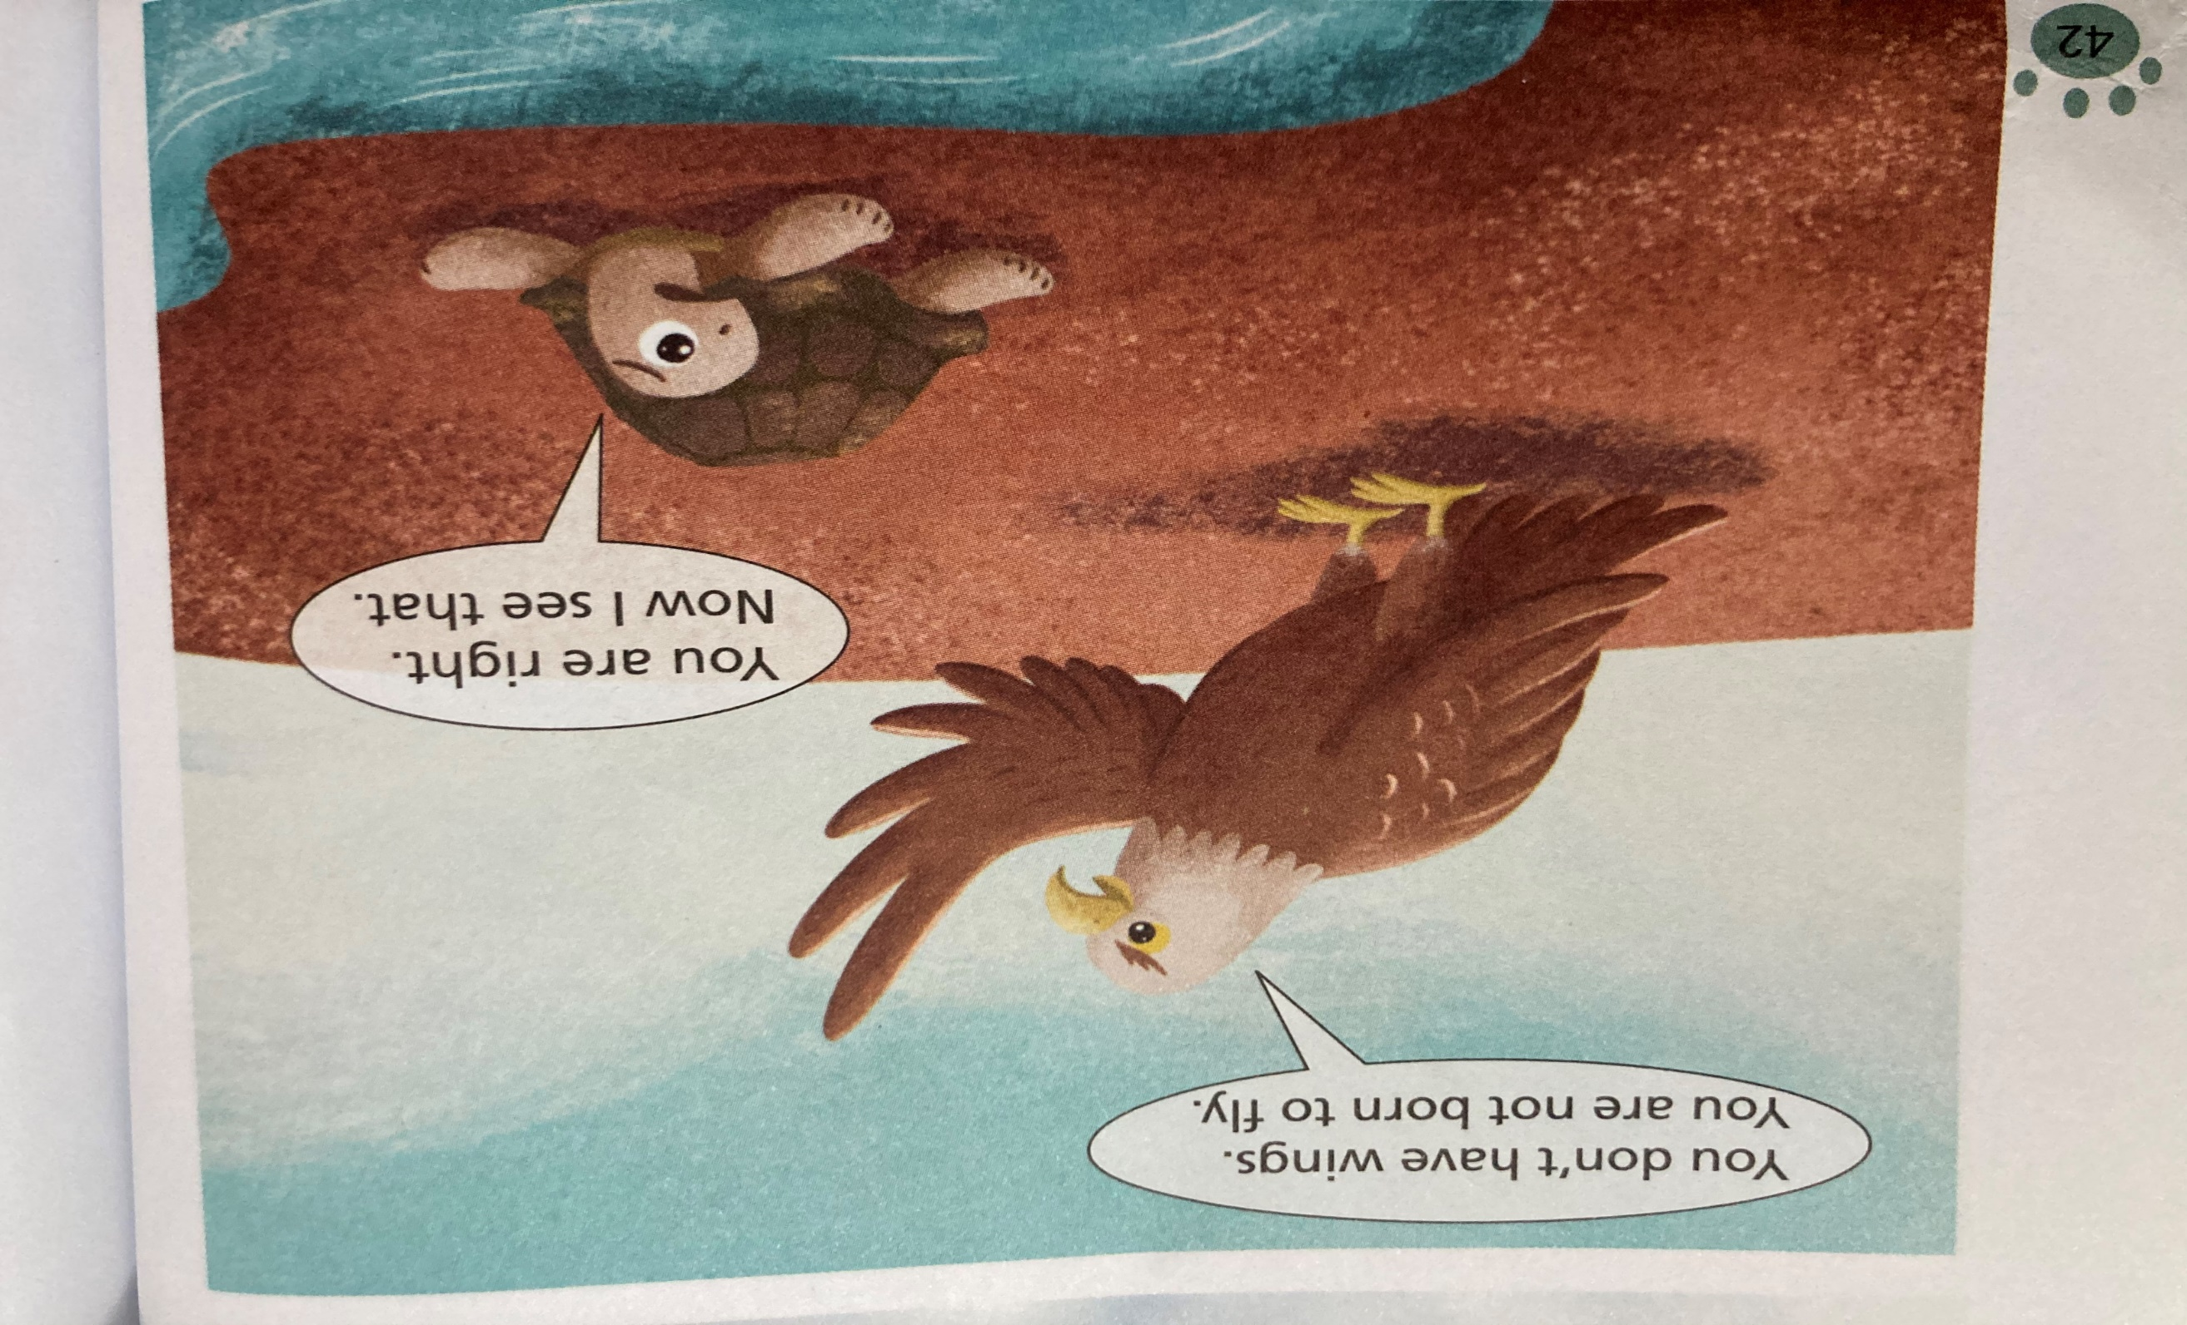

Slide 19
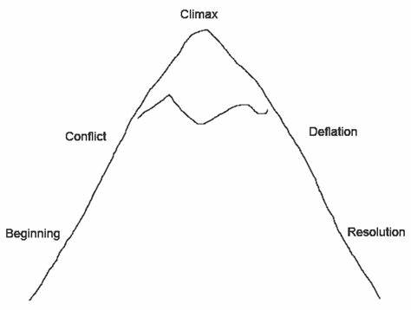
Title: __________________
Main Characters: __________________

Slide 20
Guided questions
1. What can Tortoise do every day?
He can go swimming every day .
2. Why does Tortoise climb onto the big rock?
Because he wants to fly ,too.
3. How does Eagle help Tortoise?
Eagle grabs Tortoise and flies up .
4. How does Tortoise feel when he is high in the sky at first?
He feels excited.
5. What does Eagle say to Tortoise in the end?
You don’t have wings .You are not born to fly .

