Slide 1
Module 5
Unit 2 What are the kids playing?

Slide 2
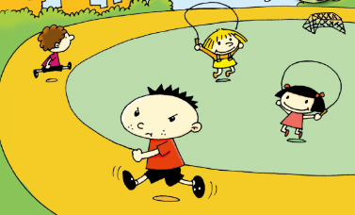
Warming-up
Let’s chant
We’re playing in the playground.
Some are running.
Some are skipping.
Some are playing catch.
Some are playing football together in a match.

Slide 3
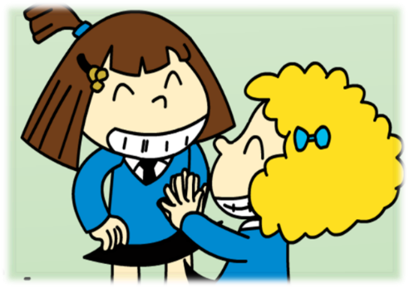
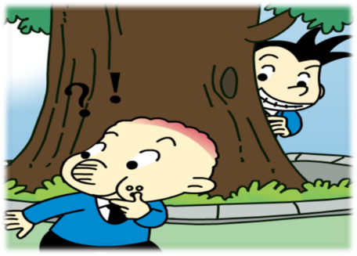
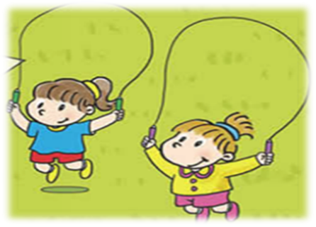
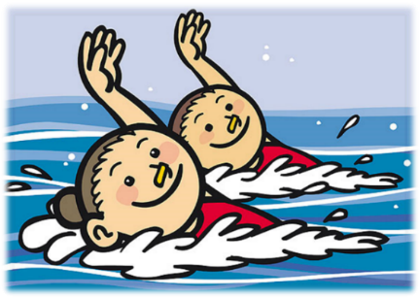
Warming-up
Let’s look, do and say
They’re playing clapping games.
They’re playing hide-and-seek.
They’re skipping.
They’re swimming.

Slide 4
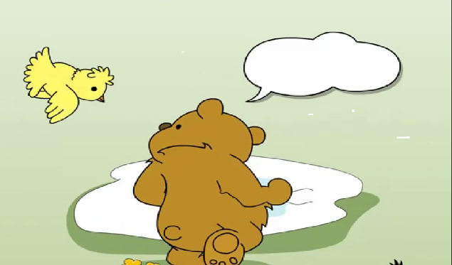
Presentation
Look and say
1. What are they doing?
They are running.
2. Is the bear catching them?
Yes, it is.

Slide 5
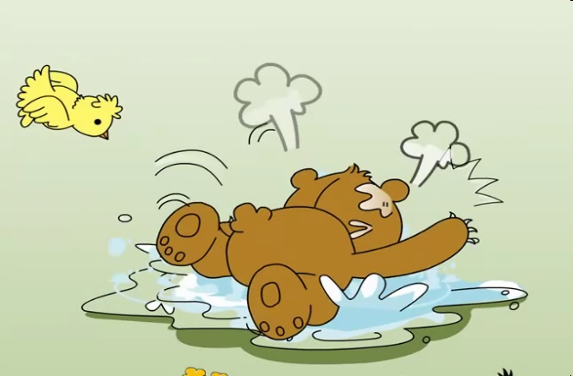
Presentation
Listen and fill
I’m _______ ______.
catching them
Oh, you’re not
catching them.
You’re _________!
swimming

Slide 6
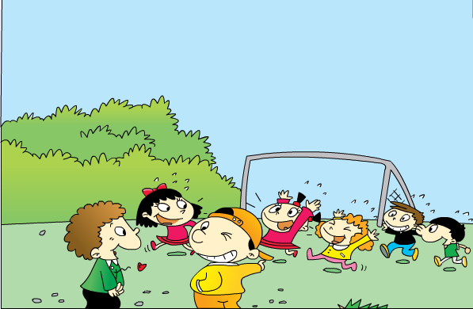
Presentation
Look and think
1. What are the kids doing?
kids
kid
kid
2. What are the girls doing?
3. What are the boys doing?

Slide 7
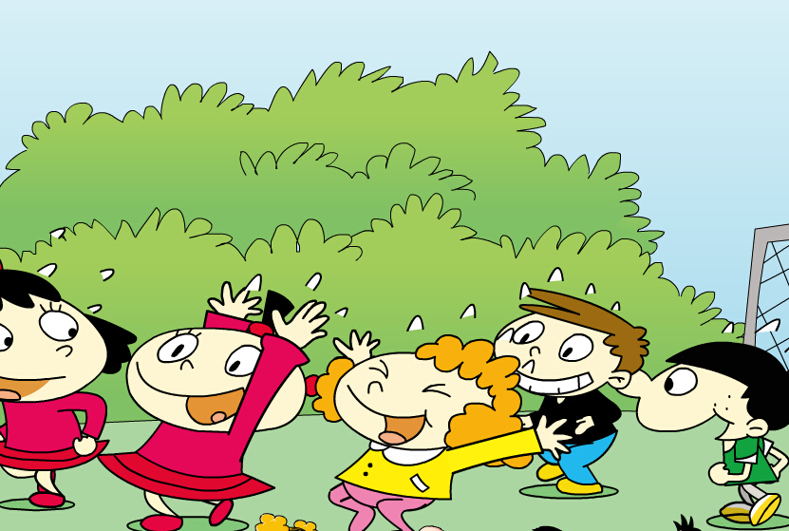
Presentation
Listen and say
1. What are the kids doing?
They’re playing catch.
2. What are the girls doing?
They are running.
3. What are the boys doing?
They are catching them.

Slide 8
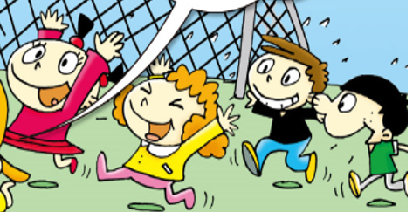
Presentation
Let’s learn
1. What are the kids doing?
They’re playing catch.
n. 追人游戏

Slide 9
Presentation
Let’s learn
2. What are the girls doing?
They are running.
run — running

Slide 10
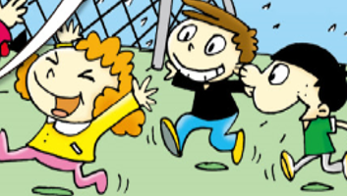
Presentation
Let’s learn
3. What are the boys doing?
They are catching them.
catch v. 抓，捉

Slide 11
Presentation
Listen and follow

Slide 12
Practice
Role-play
Read the text in roles and act it out.

Slide 13
Practice
Look and say
What are the zebras (斑马) doing?
running
They are ________.
What is the lion doing?
catching
It is _________.

Slide 14
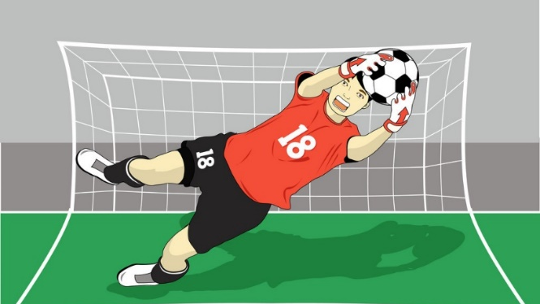
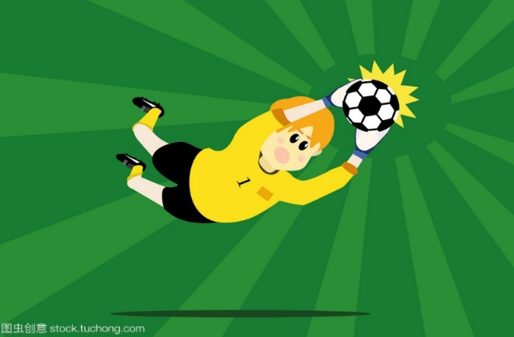
Practice
Look and say
What are they doing?
catching
They are ________ balls.

Slide 15
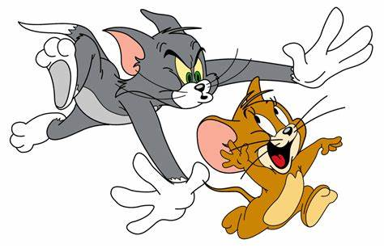
Practice
Look and say
What are they doing?
They’re playing _______.
catch
Jerry is __________.
Tom is __________.
running
catching

Slide 16
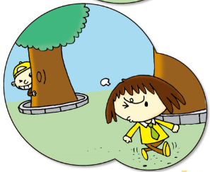
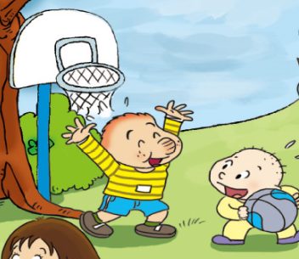
Practice
Ask and answer
A: What are they playing?
B: They’re playing...
A: Can I play with them?
B: Of course, you can.

Slide 17
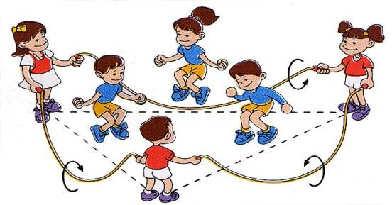
Practice
Let’s guess
What are the kids playing?
They’re skipping.

Slide 18
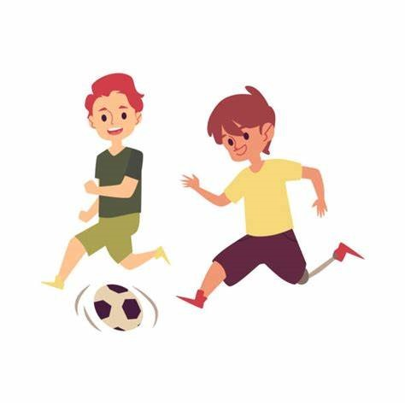
Practice
Let’s guess
What are the kids playing?
They’re playing football.

Slide 19
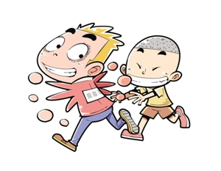
Practice
Let’s guess
What are the kids playing?
They’re playing catch.

Slide 20
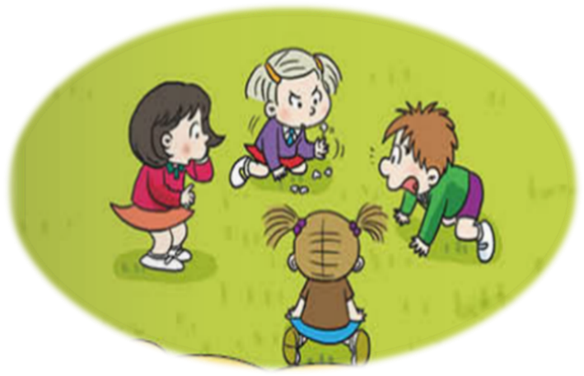
Practice
Let’s guess
What are the kids playing?
They’re playing five-stones.

Slide 21
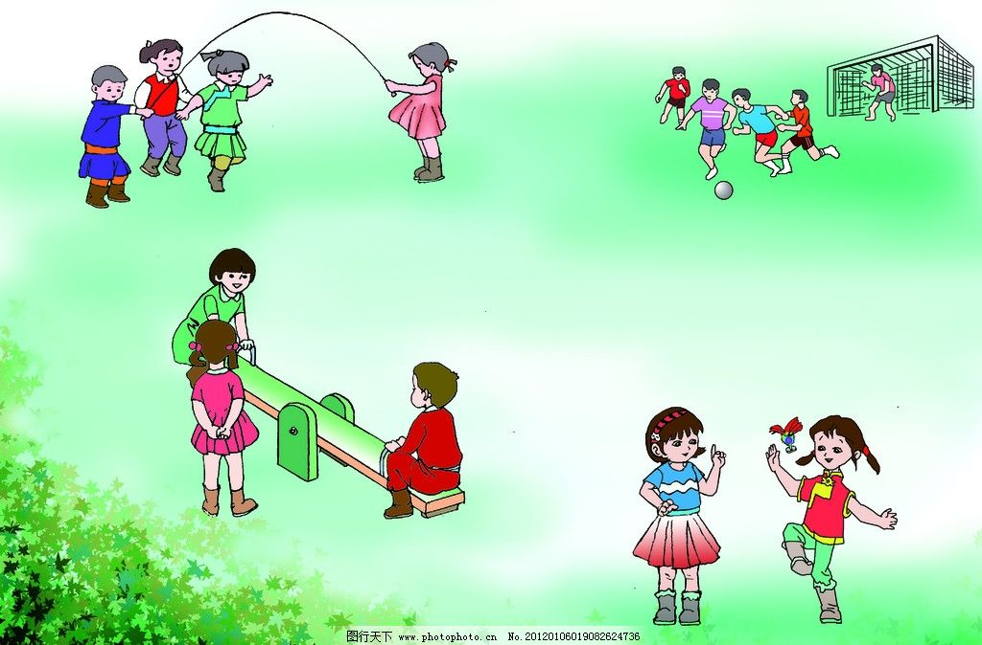
Production
Live news
Act as a reporter and introduce the activities in the school.
Good morning, boys and girls. I’m… from School TV .
Now, let me introduce what’s happening at the playground. Look! The boys are...

Slide 22
Summary
Words:
kid, catch, of course
Sentences:
— What are the kids playing?
— They’re...

Slide 23
Homework
1. Listen and repeat P29 for five times.
2. Talk about your break time with your friends.

Slide 24
Thanks!
Thank you!

