Slide 1

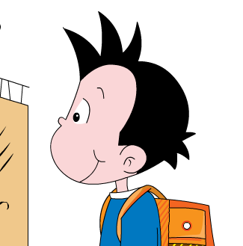
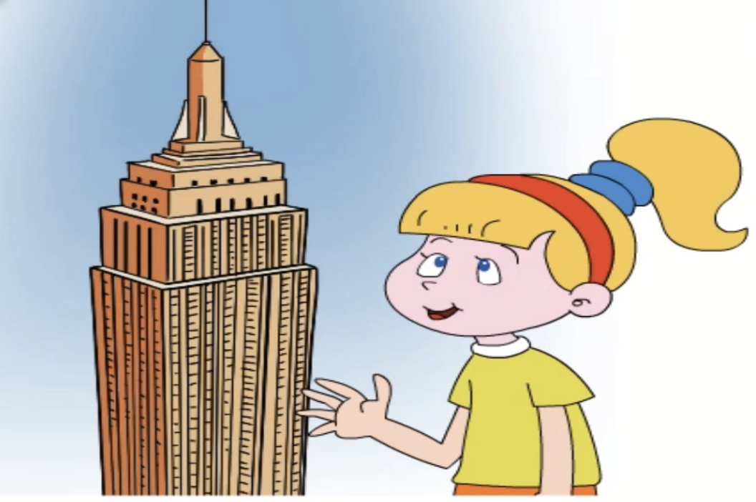


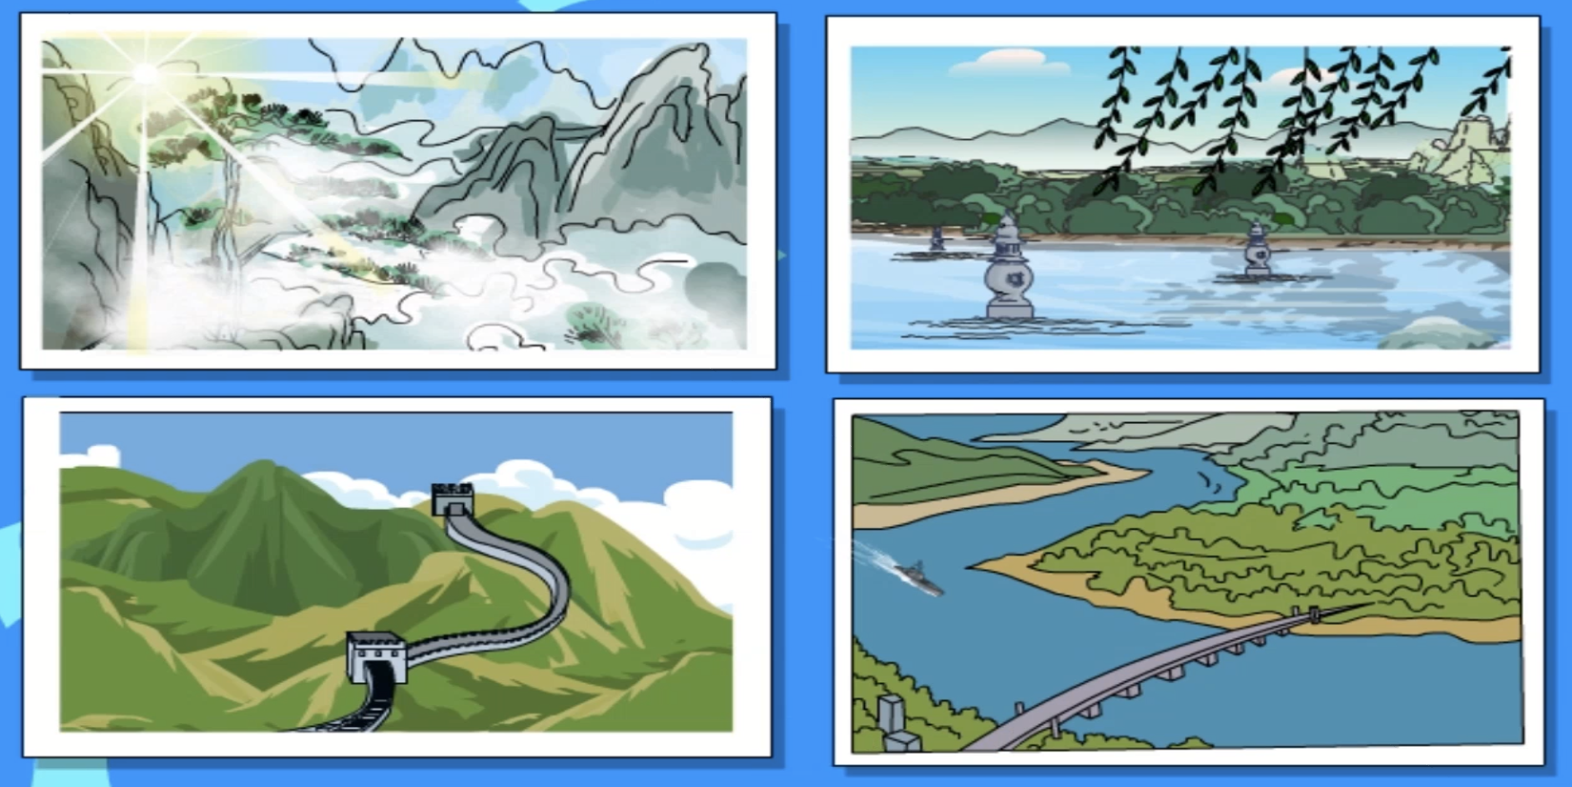

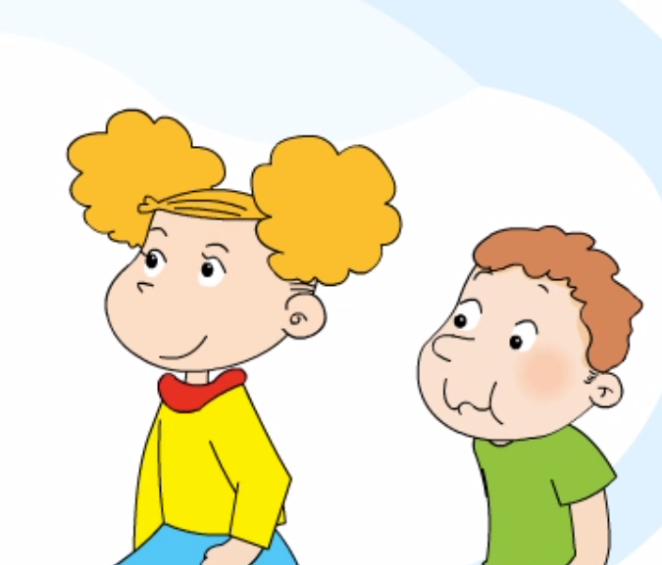
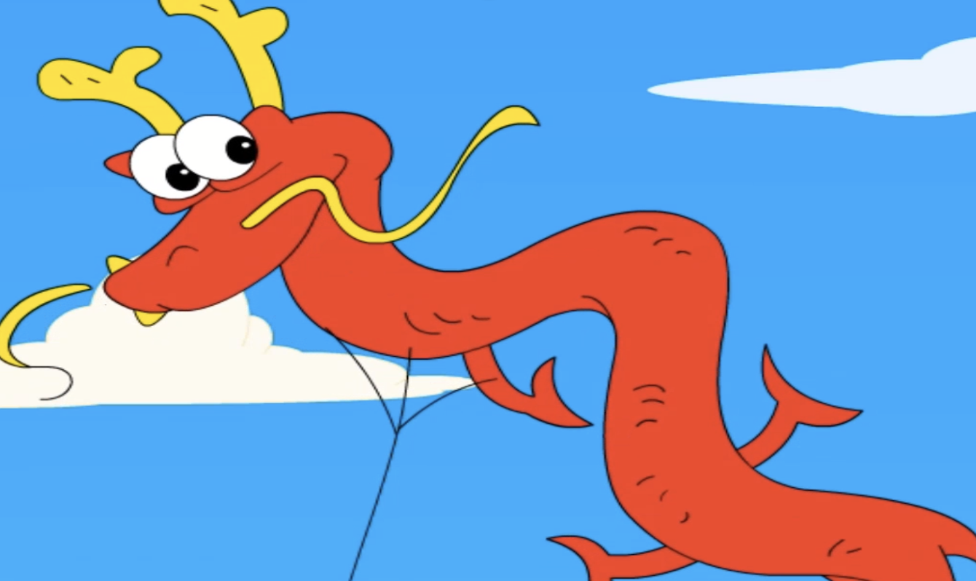

Greeting
Dear Sam and Amy,
You’ve got a letter from New York.
I am …
I am from …
I live in …
Do you ..?
I want to…
Body
…has got …
We often …
It’s …
want to be friend
Have you got…?
Please write to me!
设计意图：
看板书复述
呈现回信可用句型
Best,
Laura
Signature

Slide 2
Dear Laura，
Part 1: introduce yourself 介绍自己
We are _______________. We live in _______________. We are happy to get your letter.
Part 2: share your life 分享生活
collecting stamps
playing games
riding a bike
...
have a special meal
eat dumplings
hang lanterns
...
We like ____________. We have got ______((( .
We often . ____ _______________ __
Part 3: answer Laura’s questions 回答问题
Yes, we like China very much. We like _______________in China. _______________
About the book, we ______(((((have/haven’t) got one. Thank you.
Part 4: make an invitation 发出邀请
We want to be your pen friends. Please ______(((us soon.
Best,
Sam and Amy

Slide 3
Dear Laura，
Part 1: About us 我们的基本信息
We are _______________. We live in _______________. We are happy to get your letter.
Part 2: our story and answer 我们的生活以及回答
Yes, we like China very much. We like _______________in China. _______________
About the book, we ______(((((have/haven’t) got one. Thank you.
We have got ______((( . We often . ____ _______________ __
Part 3: our invitation 我们的邀请
Check it
Spelling 拼写
Grammar 语法
Organization 结构
We want to be your pen friends. Please write to us soon.
Best,
Sam and Amy

