Slide 1
Module 4 unit 1
We’ll pick fruit.

Slide 2
1. One 2. two 3. three
4. four 5. five 6. six
7. seven 8. eight 9. nine
10. ten

Slide 3
11. eleven 12. twelve
13. thirteen 14. fourteen
15. fifteen 16. sixteen
17. seventeen 18. eighteen
19.nineteen
7 seven 8 eight 9 nine
10 ten

Slide 4
20. twenty 21. twenty-one
22. twenty-two
23. twenty-three
24. twenty- four
25. twenty- five
26.twenty- six
…

Slide 5
Guess:
Q: Is it a …?
A: Yes, it is.
No, it isn’t.

Slide 6
Q: What can we see in the fruit farm?
A: We can see… in the fruit farm.

Slide 7
Q: What will you do in the fruit farm?
A: We ‘ll … in the fruit farm.

Slide 8
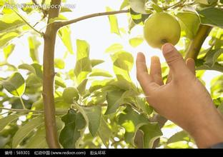
pick

Slide 9
Q: What other fruit will you pick?
A: I ‘ll pick … s/es.

Slide 10
Discuss:
Q: How many fruit will you pick?
A: I ‘ll pick thirteen peaches.

Slide 11
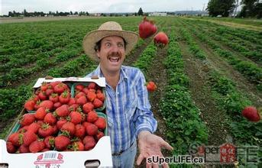
strawberry--strawberries

Slide 12
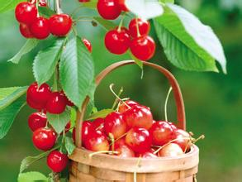
cherry--cherries

Slide 13
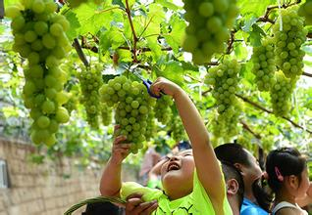
grapes

Slide 14
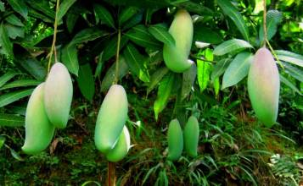
mango--mangoes

Slide 15
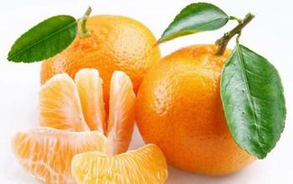
tangerines
oranges

Slide 16
Discuss:
Q: How many fruit will you pick?
A: I ‘ll pick thirteen peaches.

Slide 17
PK

