Slide 1
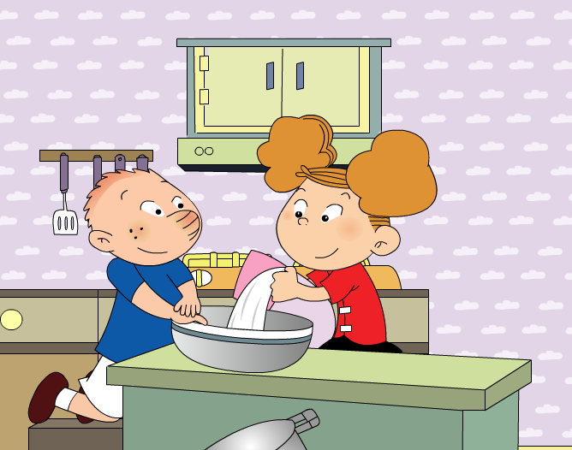
We’re making a cake. Module 2 Unit 2

Slide 2
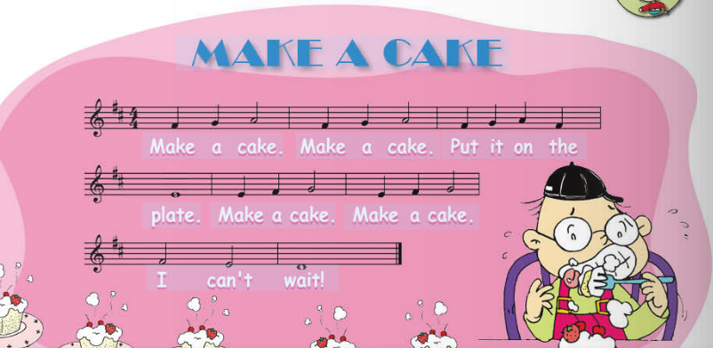

Slide 3
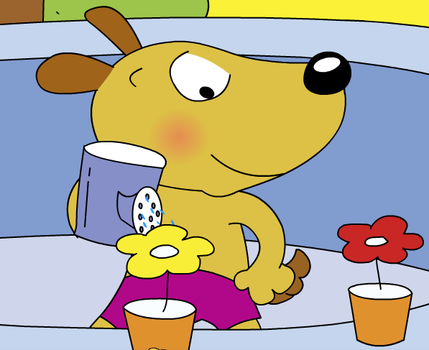
Bob is_______________.
What is Bob doing?
watering the flower

Slide 4
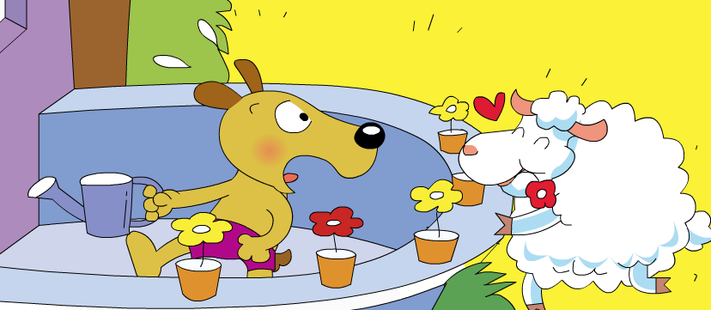
The sheep is_______________.
What is the sheep doing?
eating the flower

Slide 5
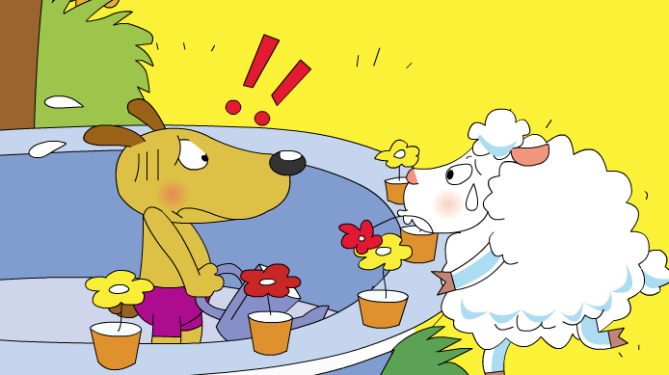
What do they say?
..?
..?

Slide 6
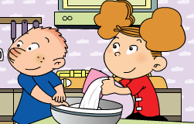
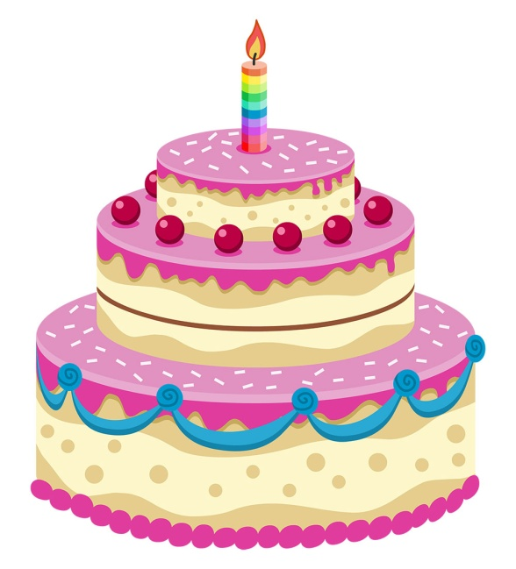
They can ____________ now!
eat the cake

Slide 7
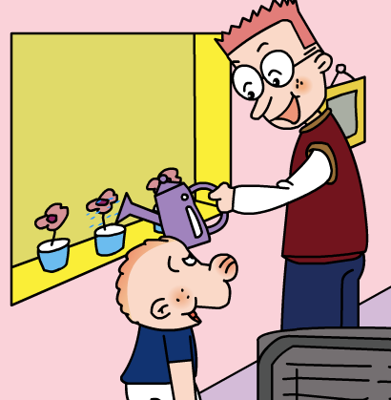
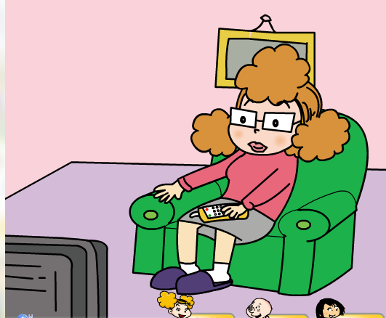
What are Mum and Dad doing?
watering the flower
watching TV

Slide 8
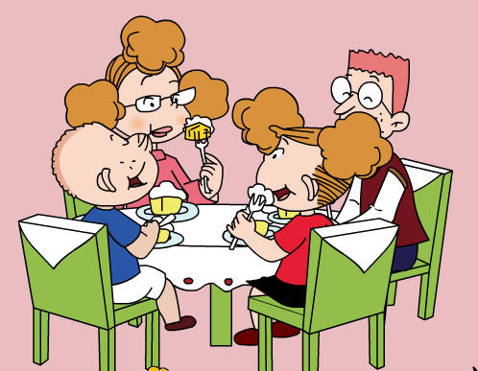
Do Mum and Dad love the cake?

Slide 9
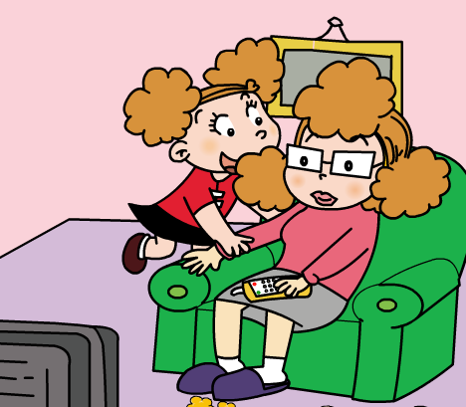
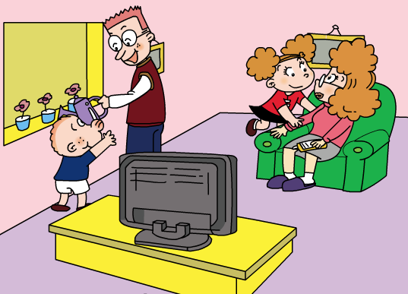
watching TV
watering the flower
lovely
Thank you
come and eat

Slide 10
What are you doing, Mum?
I am________.
watching TV

Slide 11
What are you doing, Dad?
I am________.
浇花
watering the flowers

Slide 12
________, children.
Thank you
Aah. It’s _____.
lovely
可爱的
I am________.
Please ___________________now!
come and eat the cake

Slide 13
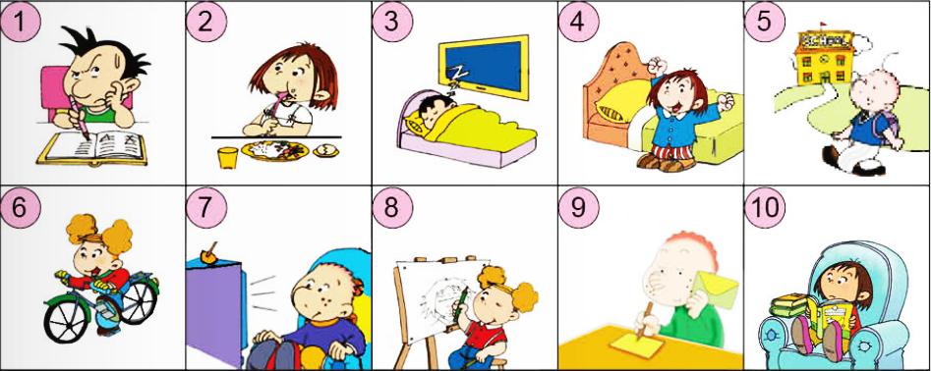
--What’s he doing? --He is doing his homework.

Slide 14
+1

Slide 15
-2

Slide 16
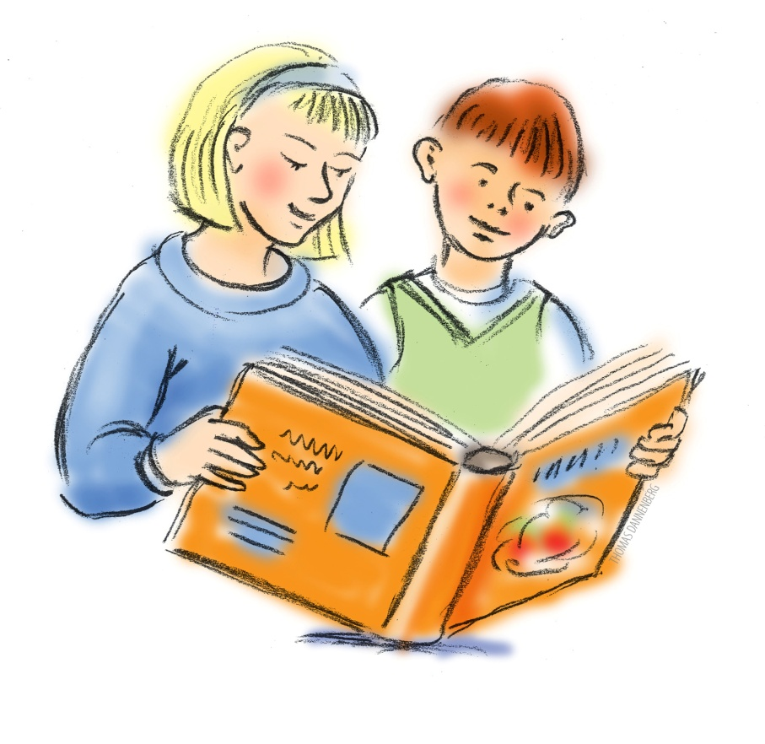
+2

Slide 17
-1

Slide 18
Back to the beginning

Slide 19
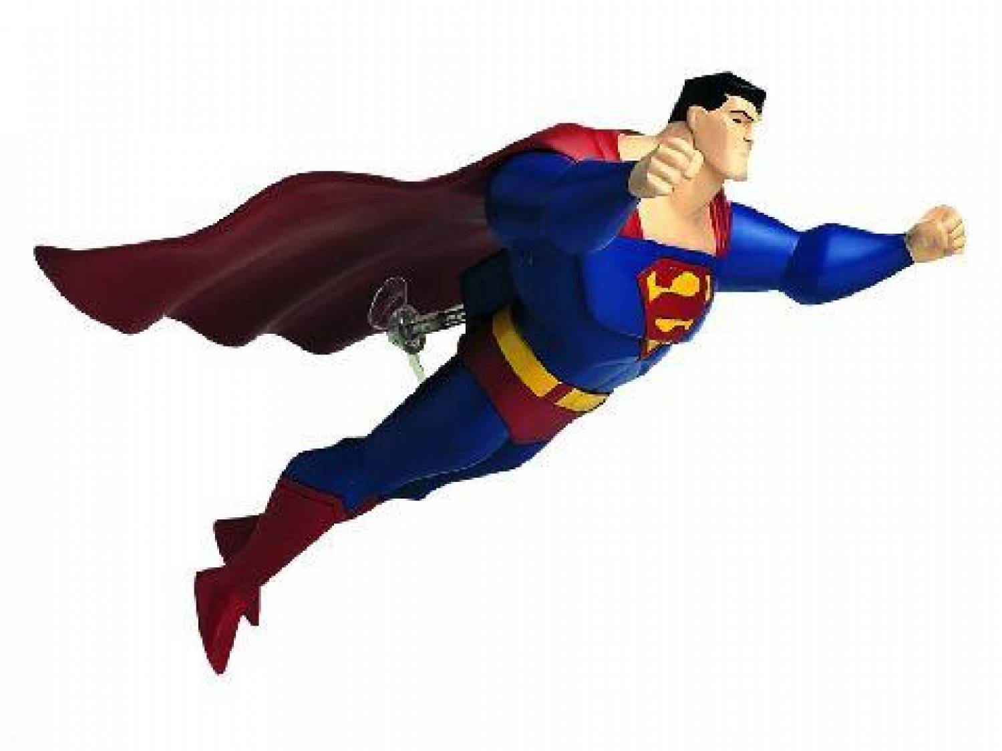
Fly to the top

Slide 20
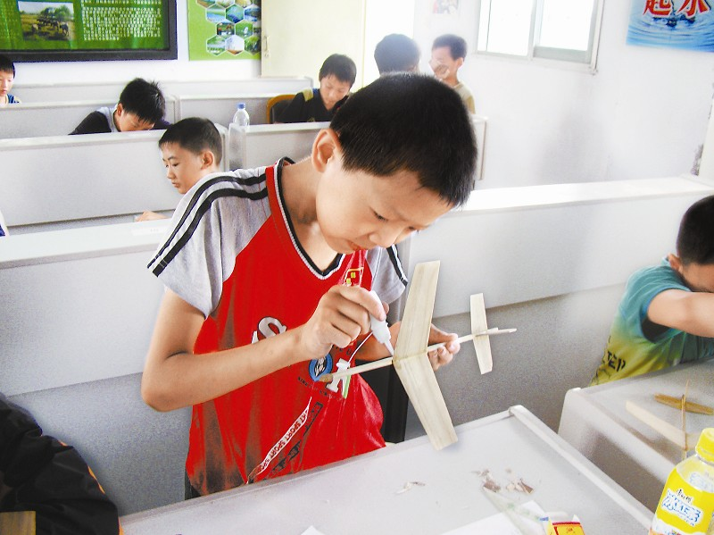
+4

Slide 21
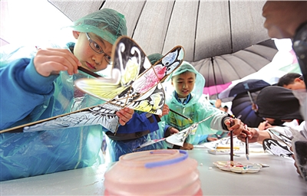
+5

Slide 22
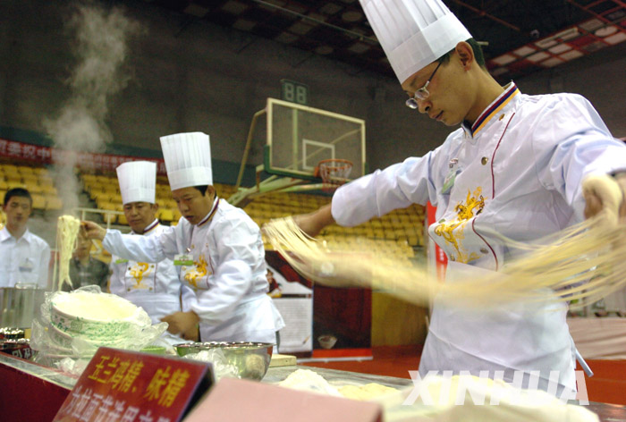
+6

Slide 23
stop

Slide 24
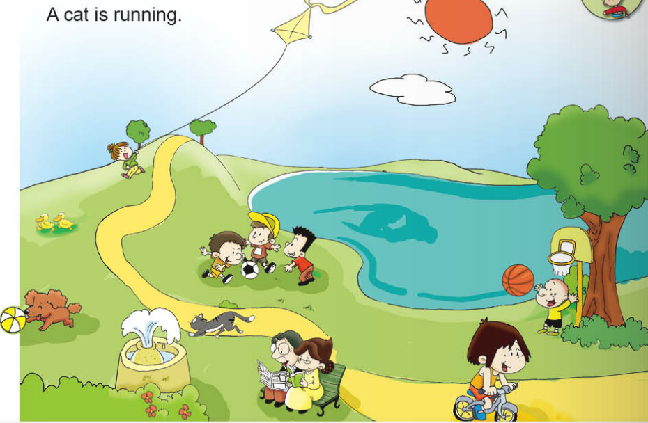
PK
The boys are playing football.
fountain

Slide 25
What can we make with a paper?

Slide 26
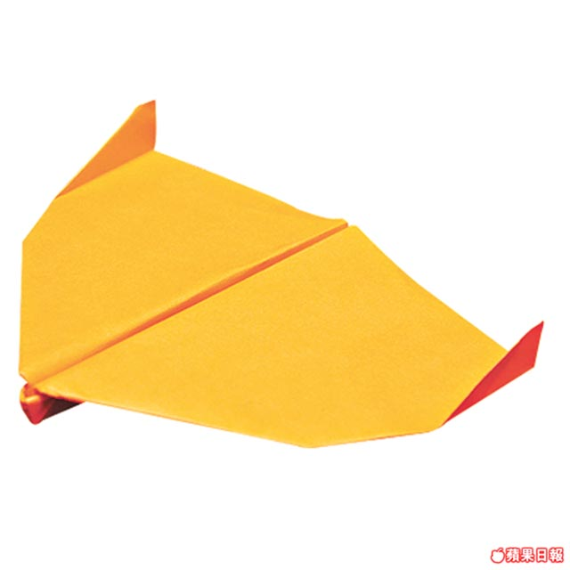
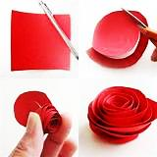
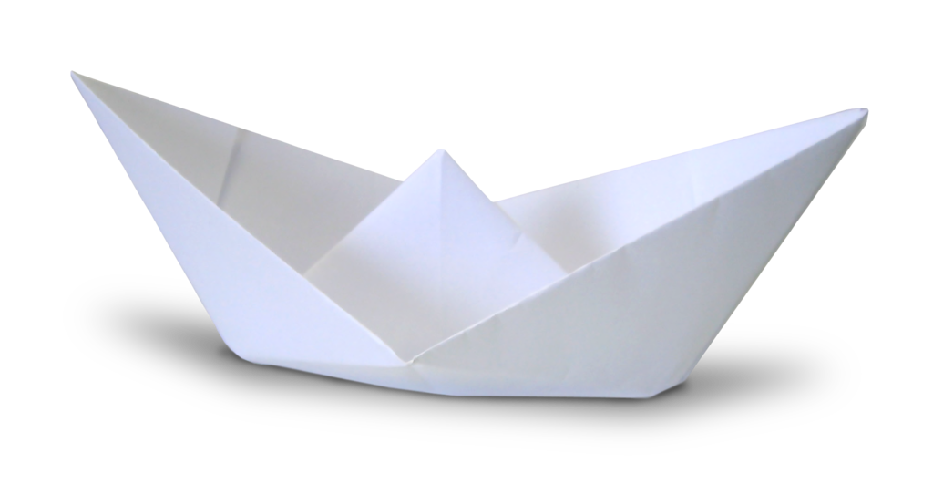
paper works

Slide 27
Survey: --What are you doing? --I am making______.
Name | plane | flower | boat | kite
Lily
√

Slide 28
现在分词
V-ing

Slide 29
1.直接在末尾加ing

Slide 30
2.去掉不发音的e再加ing
ride+ing=riding
write+ing=writing
3. “辅+元+辅”结构的单词，双写末尾字母再加ing
get+ting=getting

Slide 31
将下列单词变为ing形式
1.ride
2.do
3.get
4.walk
5.draw
riding
doing
getting
walking
drawing
6.sleep
7.eat
8.write
9.go
10.run
11.read
sleeping
eating
writing
going
running
reading

