Slide 1
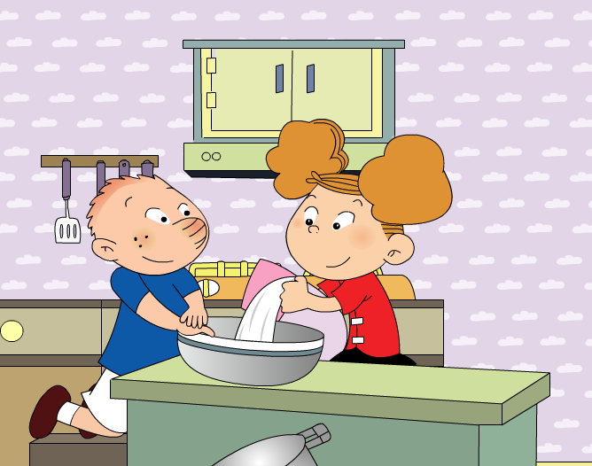
We’re making a cake. Module 2 Unit 2

Slide 2
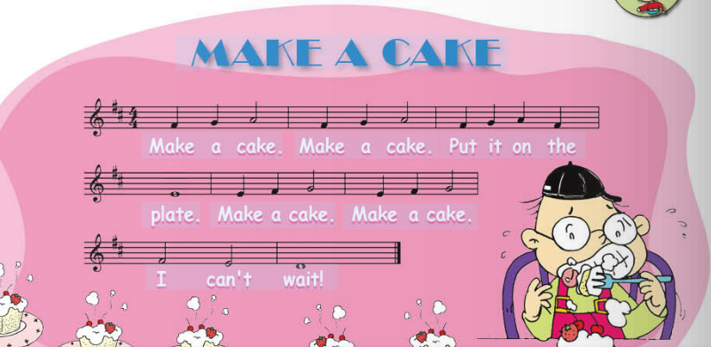

Slide 3
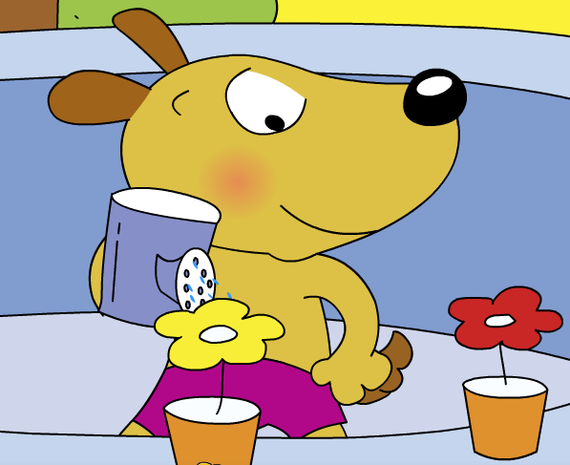
Bob is_______________.
What is Bob doing?
watering the flower

Slide 4
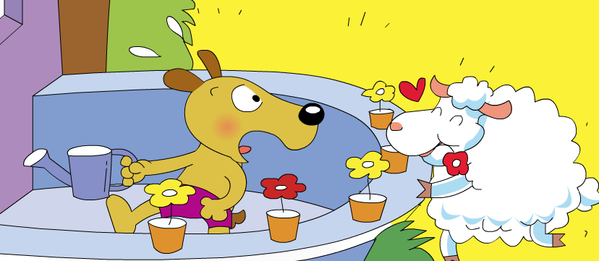
The sheep is_______________.
What is the sheep doing?
eating the flower

Slide 5
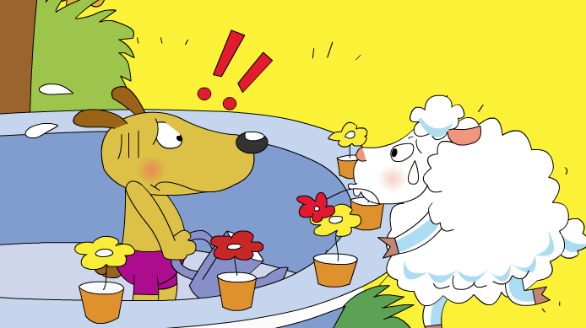
What do they say?
..?
..?

Slide 6
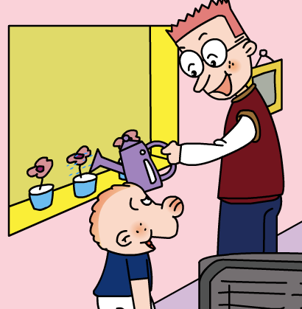
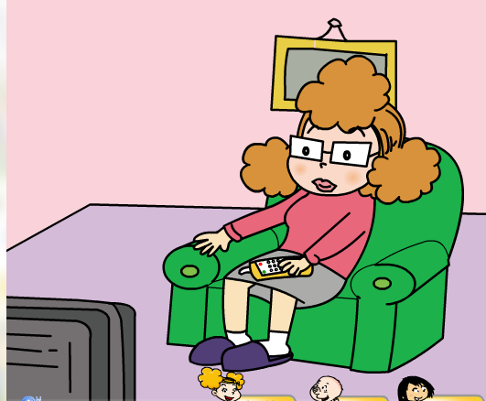
What are Mum and Dad doing?
watering the flower
watching TV

Slide 7
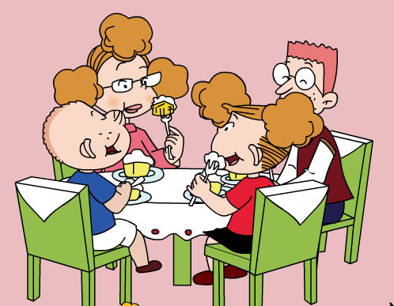
Do Mum and Dad love the cake?

Slide 8
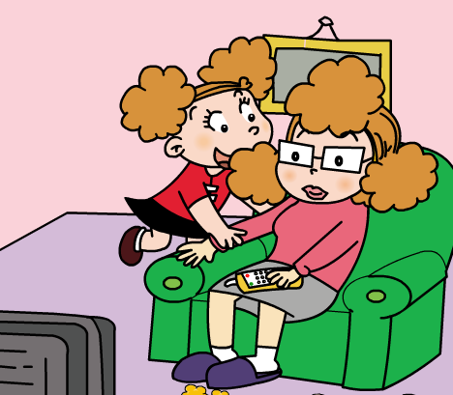
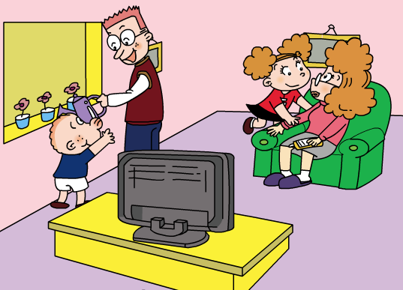
watching TV
watering the flower
lovely
Thank you
come and eat

Slide 9
What are you doing, Mum?
I am________.
watching TV

Slide 10
What are you doing, Dad?
I am________.
浇花
watering the flowers

Slide 11
________, children.
Thank you
Aah. It’s _____.
lovely
可爱的
I am________.
Please ___________________now!
come and eat the cake

Slide 12
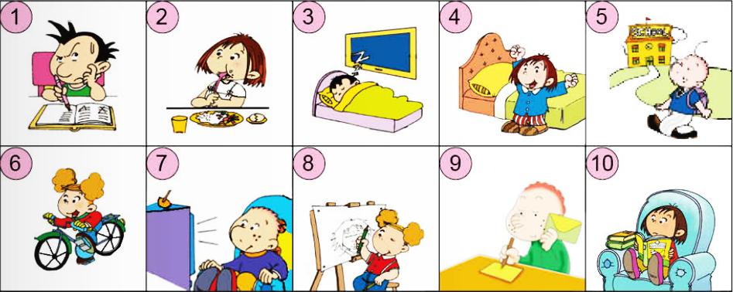
--What’s he doing? --He is doing his homework.

Slide 13
+1

Slide 14
-2

Slide 15
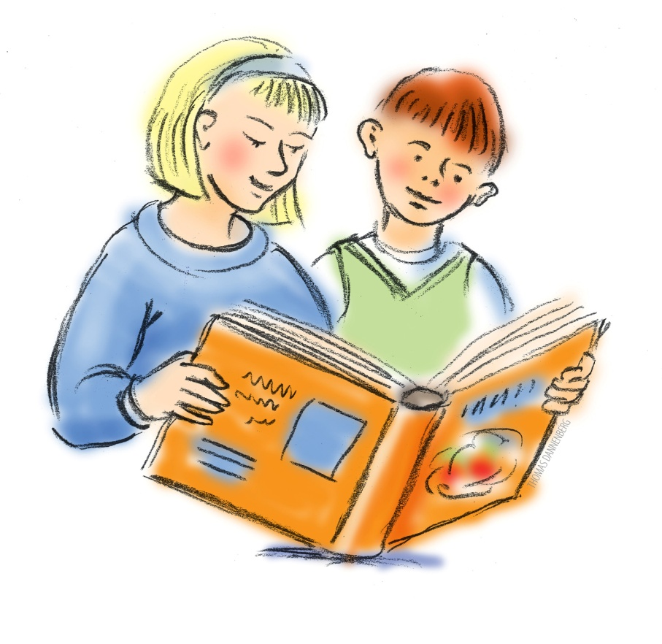
+2

Slide 16
-1

Slide 17
+2

Slide 18
-3

Slide 19
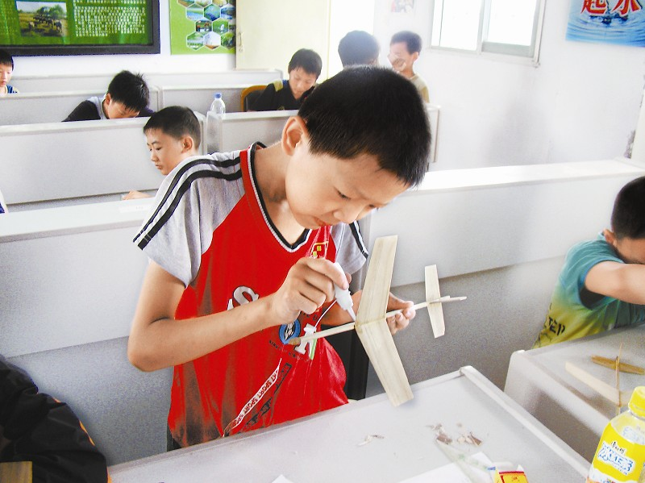
+4

Slide 20
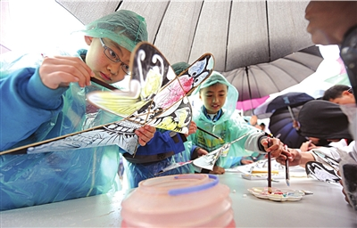
+5

Slide 21
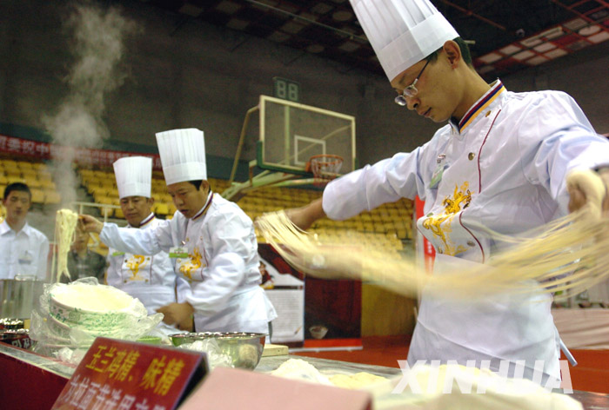
+3

Slide 22
+3

Slide 23
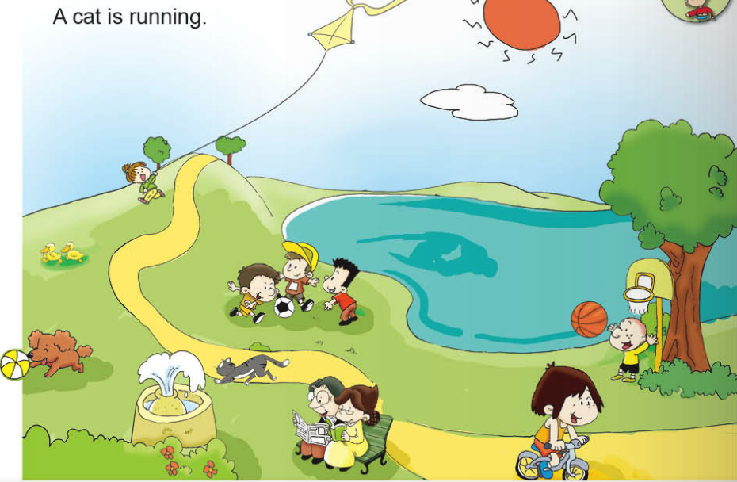
PK
The boys are playing football.
fountain

Slide 24
paper

Slide 25
What can you make with paper?

Slide 26
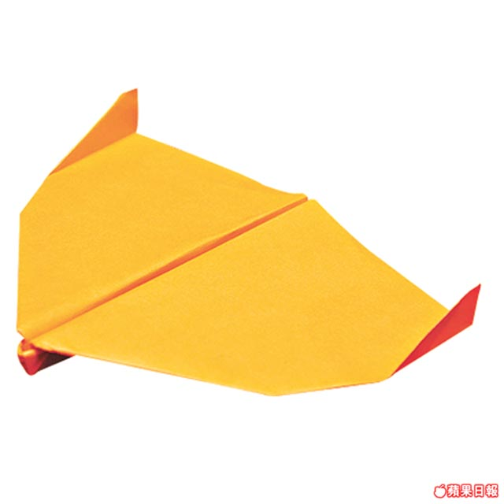
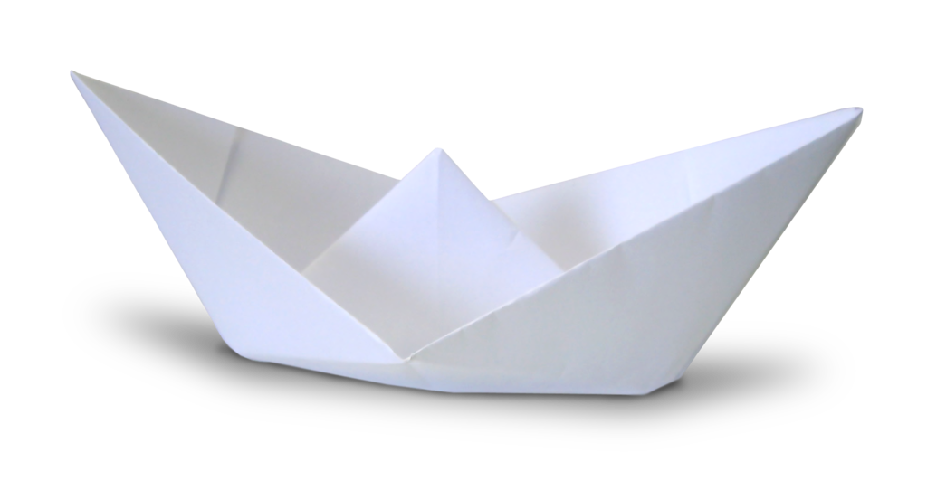
paper boat
paper plane

Slide 27
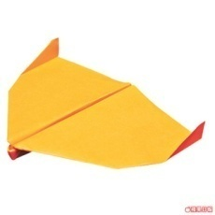
Survey: --What are you doing? --I am making______.
Name | plane | flower | boat | kite
Lily
√

Slide 28
现在分词
V-ing

Slide 29
1.直接在末尾加ing

Slide 30
2.去掉不发音的e再加ing
ride+ing=riding
write+ing=writing
3. “辅+元+辅”结构的单词，双写末尾字母再加ing
get+ting=getting

Slide 31
将下列单词变为ing形式
1.ride
2.do
3.get
4.walk
5.draw
riding
doing
getting
walking
drawing
6.sleep
7.eat
8.write
9.go
10.run
11.read
sleeping
eating
writing
going
running
reading

