Slide 1
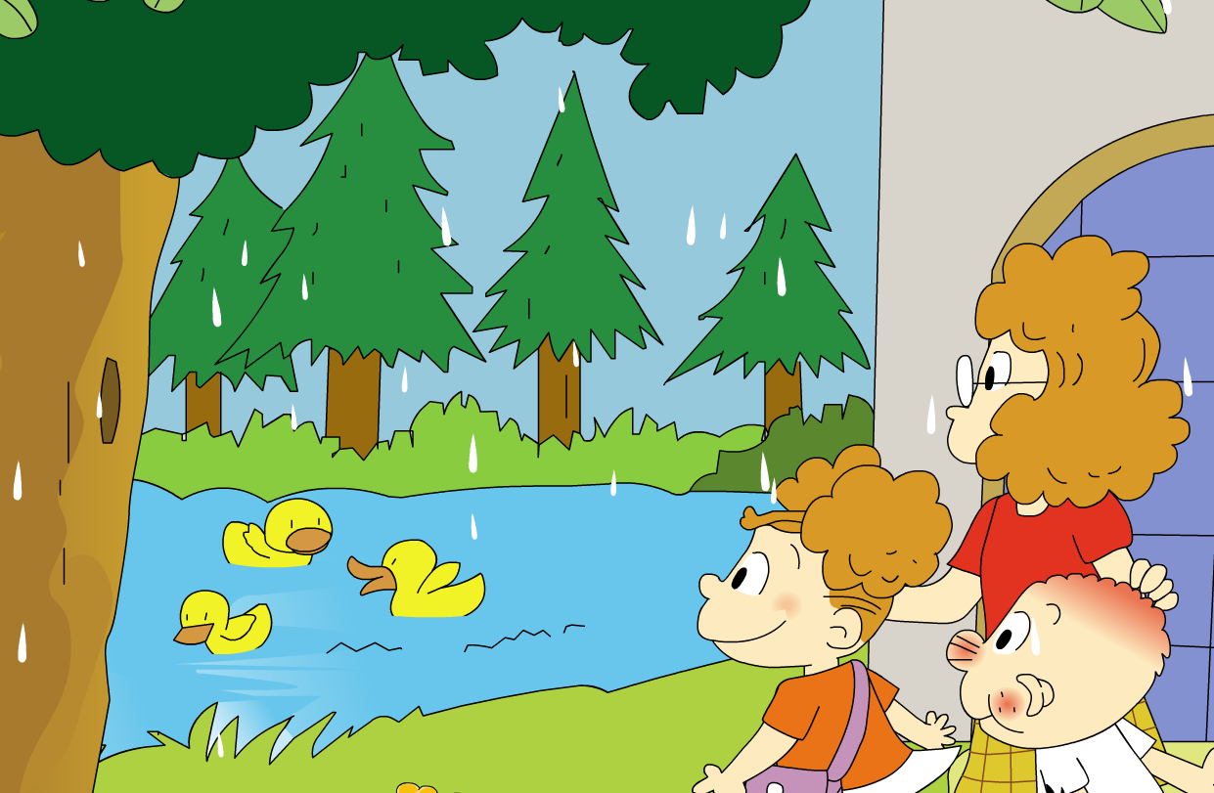
The ducks are playing in the rain.
Module 3 Unit 2

Slide 2
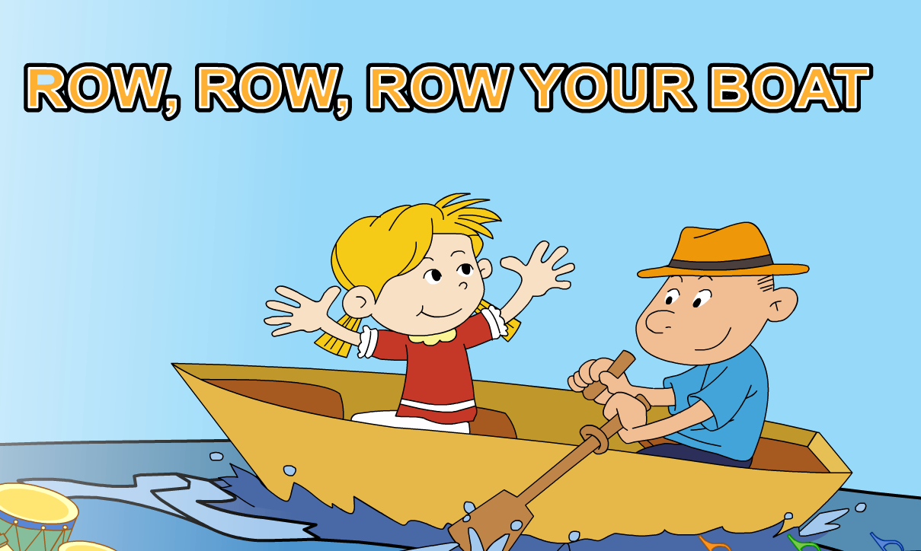

Slide 3
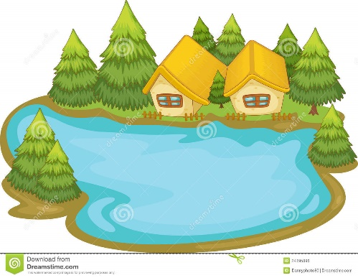
Let’s go to the lake!

Slide 4
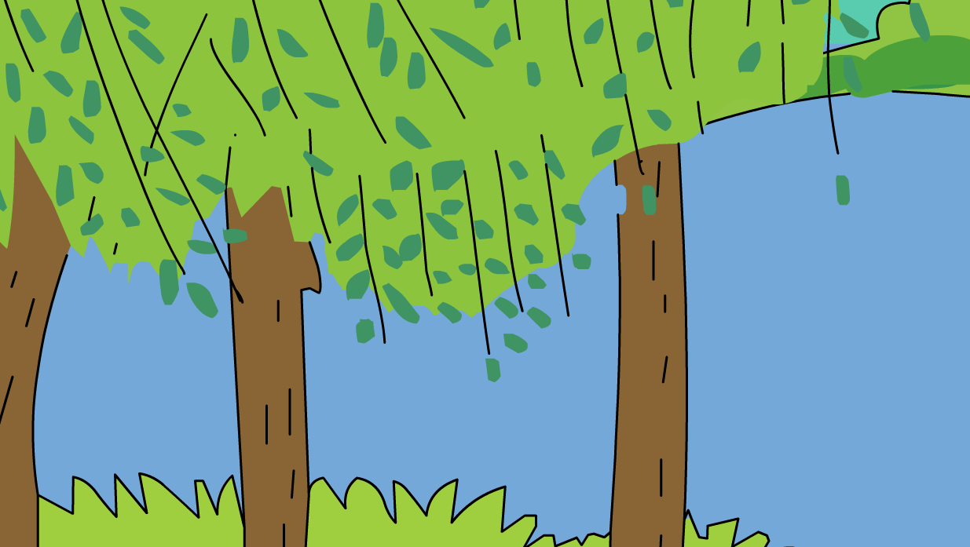
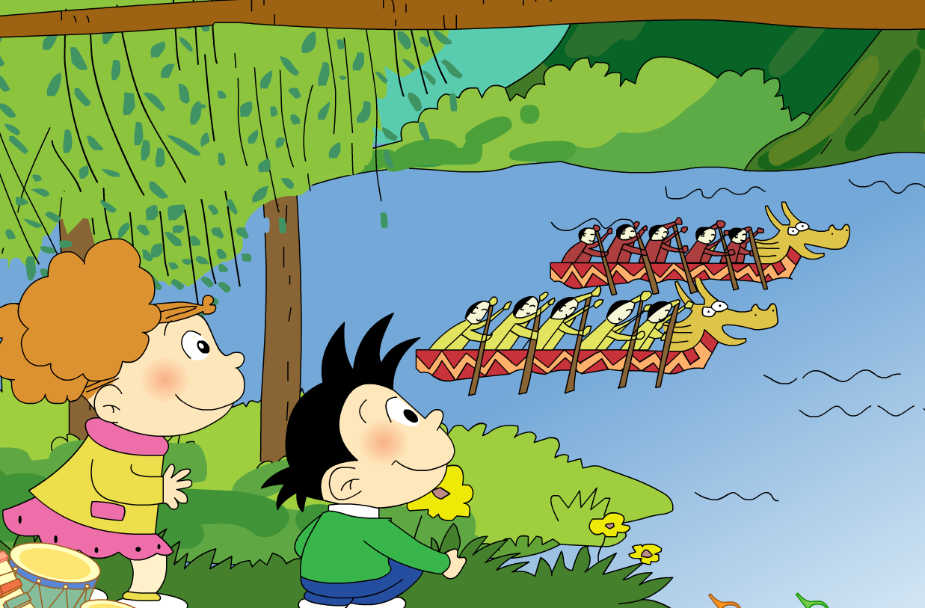
What are these?

Slide 5
Listen and chant:
What are those?
What are they doing?

Slide 6
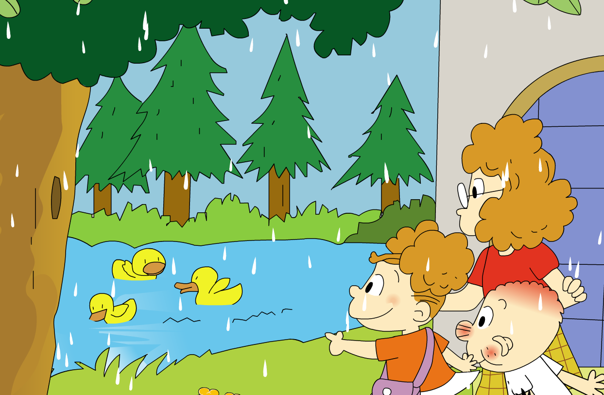
What are the ducks doing?
What game are they playing?

Slide 7
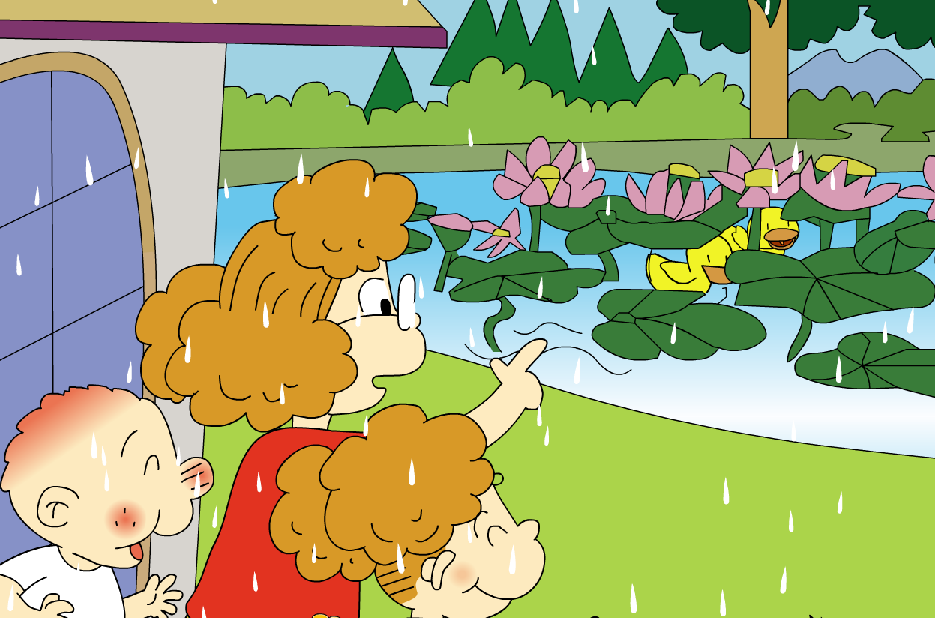
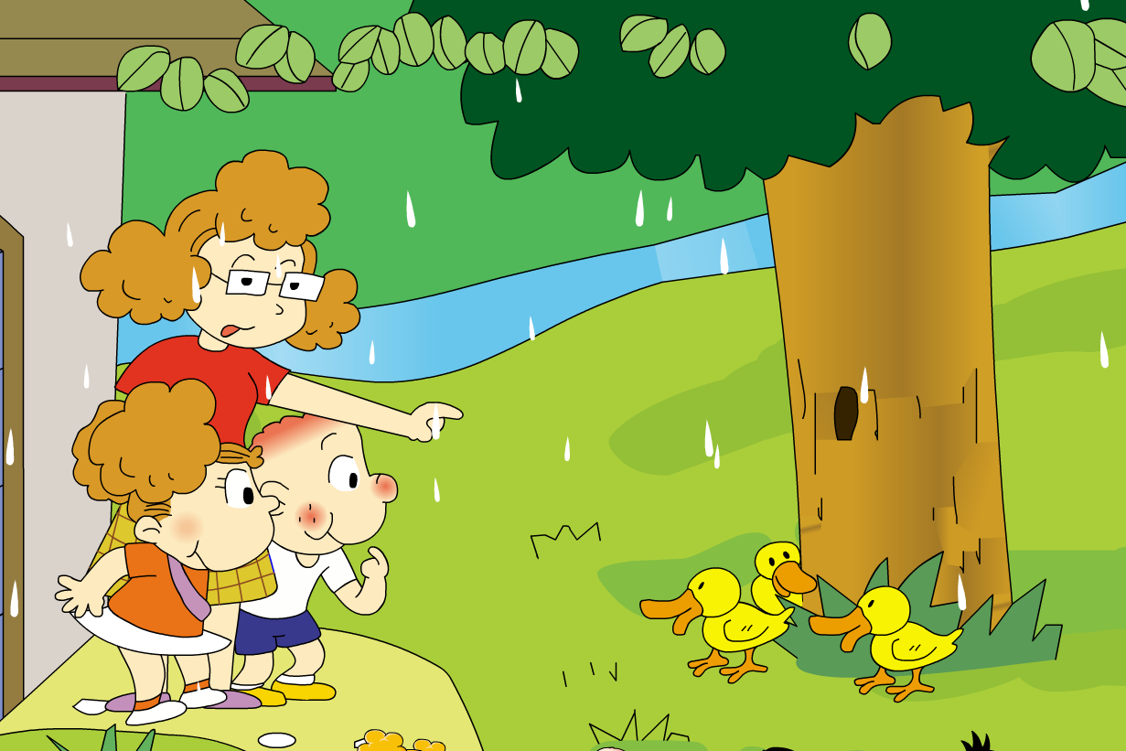
What are these ducks doing?
What are those ducks doing?

Slide 8
They are playing hide-and-seek!
捉迷藏

Slide 9
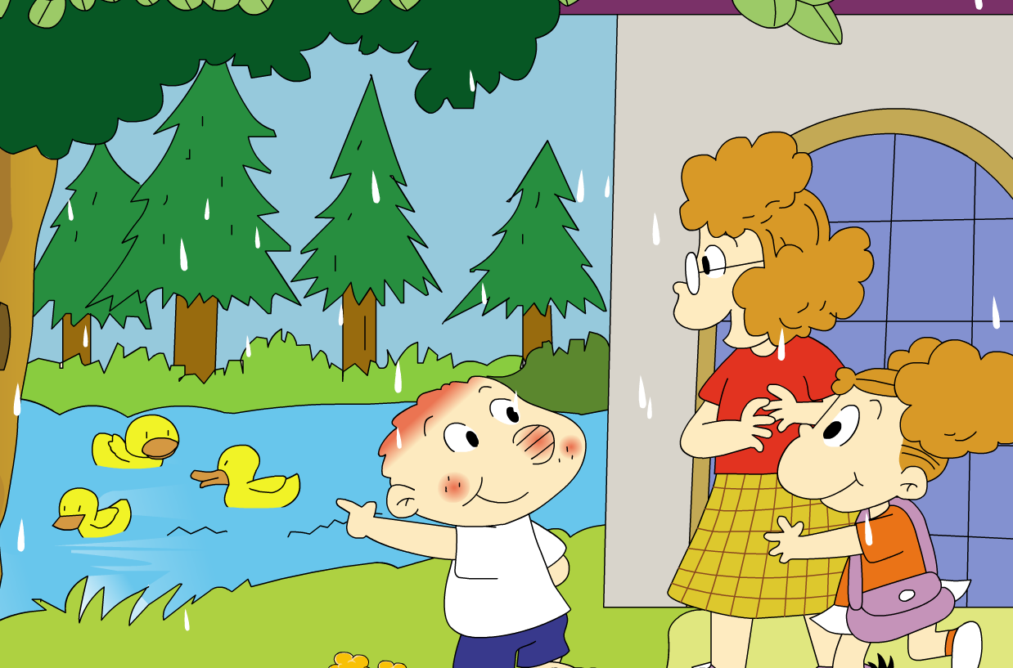
Look! The ducks are…
What are…?
They are playing…
Those are hiding…
These are hiding…

Slide 10

Let’s go to the zoo!

Slide 11
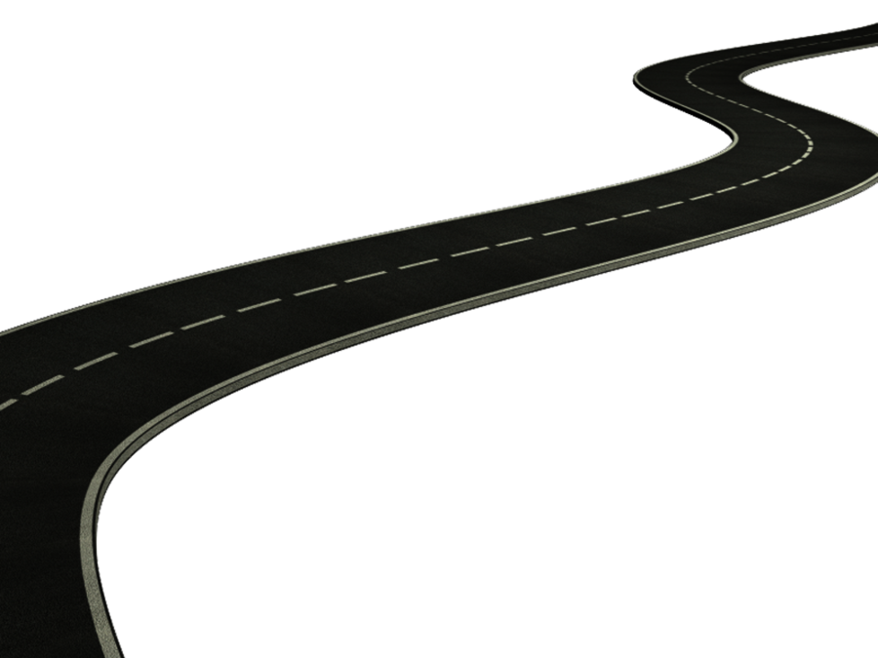
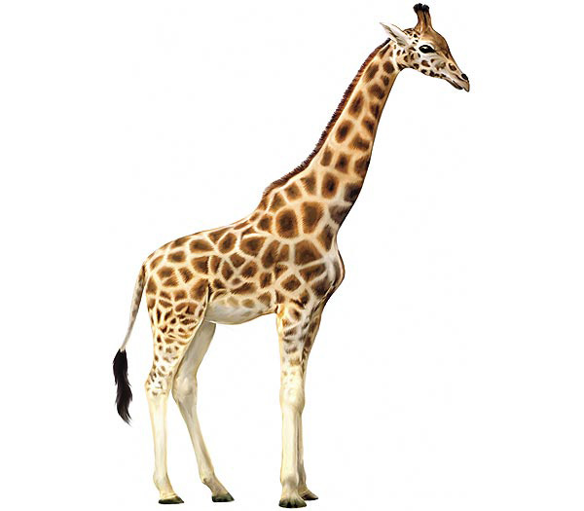
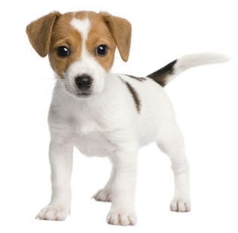

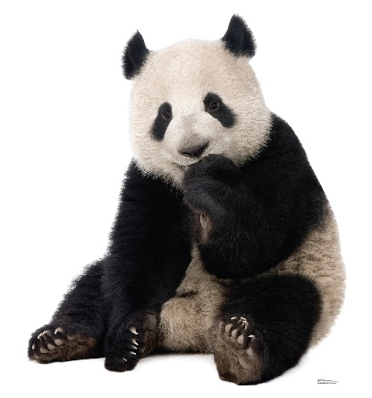
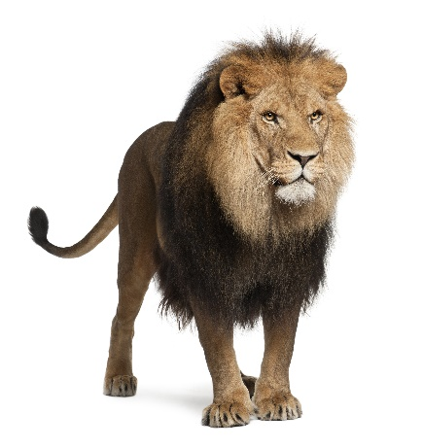
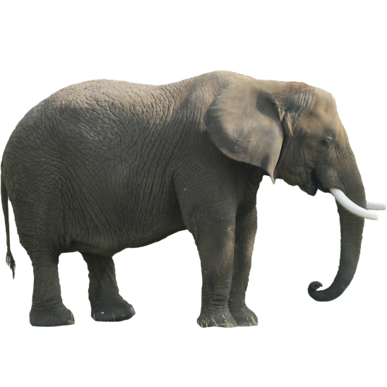
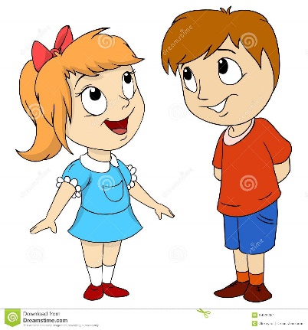
What are these/those?
They are…

Slide 12
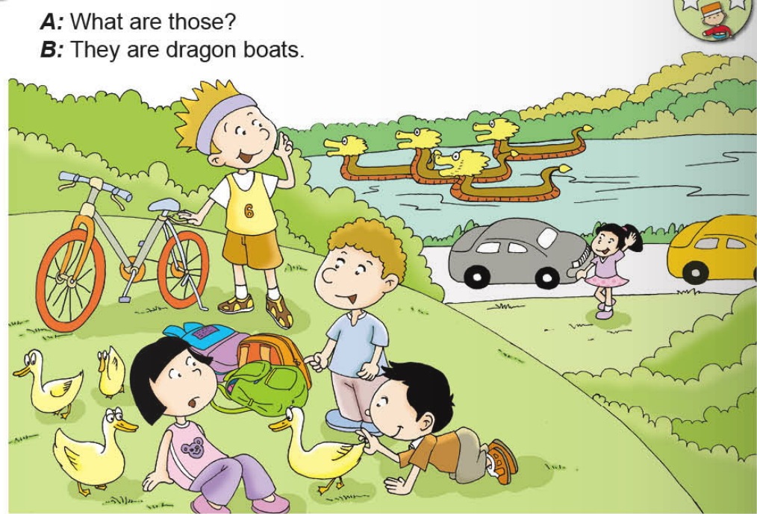


Slide 13
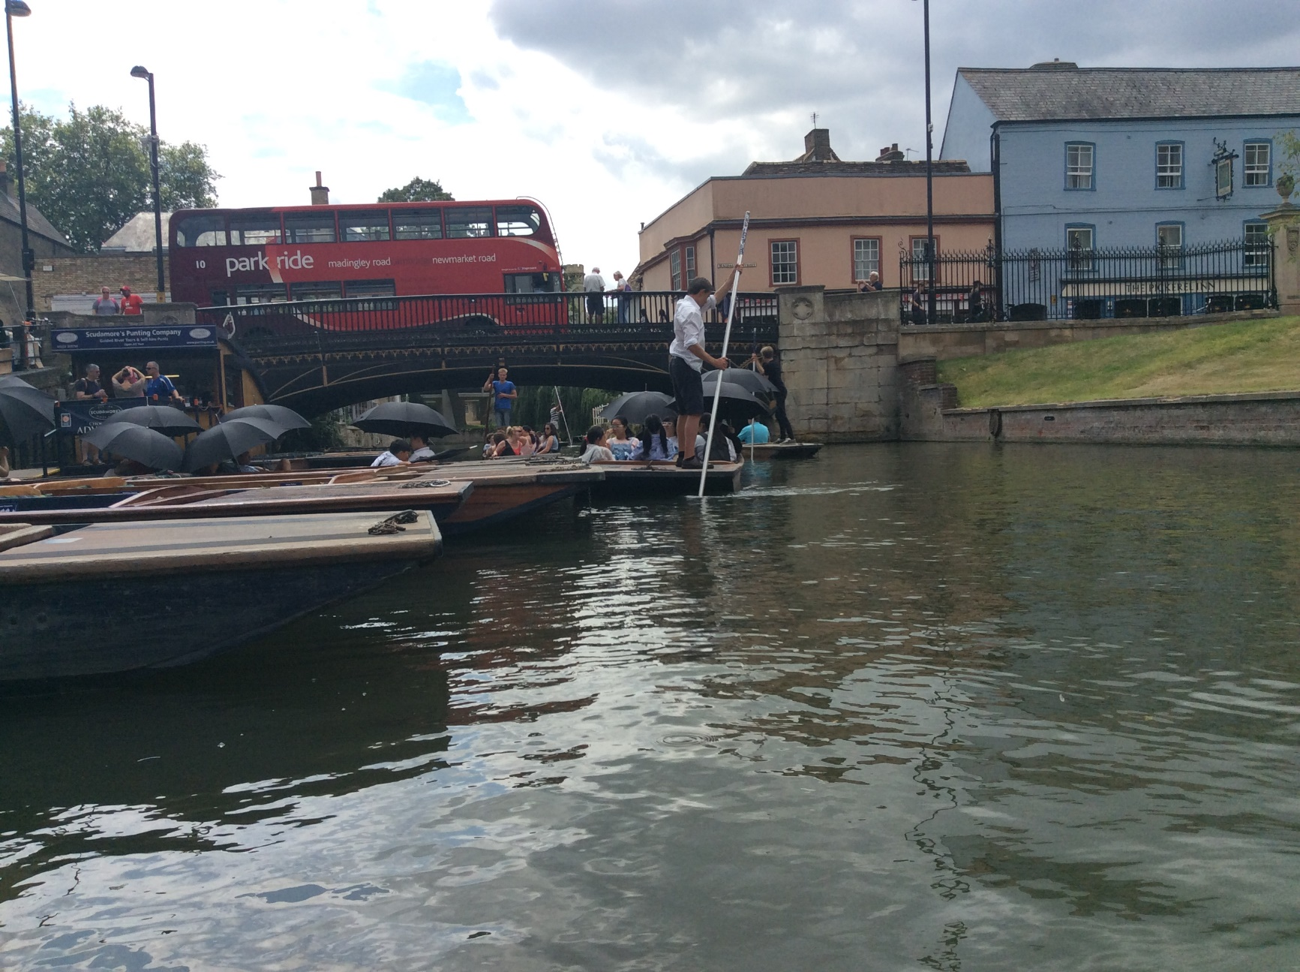
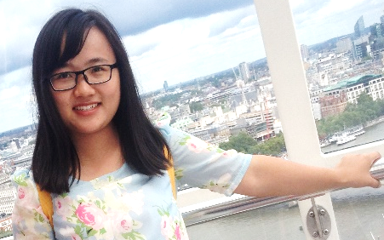

This is Cambridge.
That is a bus.
That is a boatman.
Those are children.
These are boats.

Slide 14
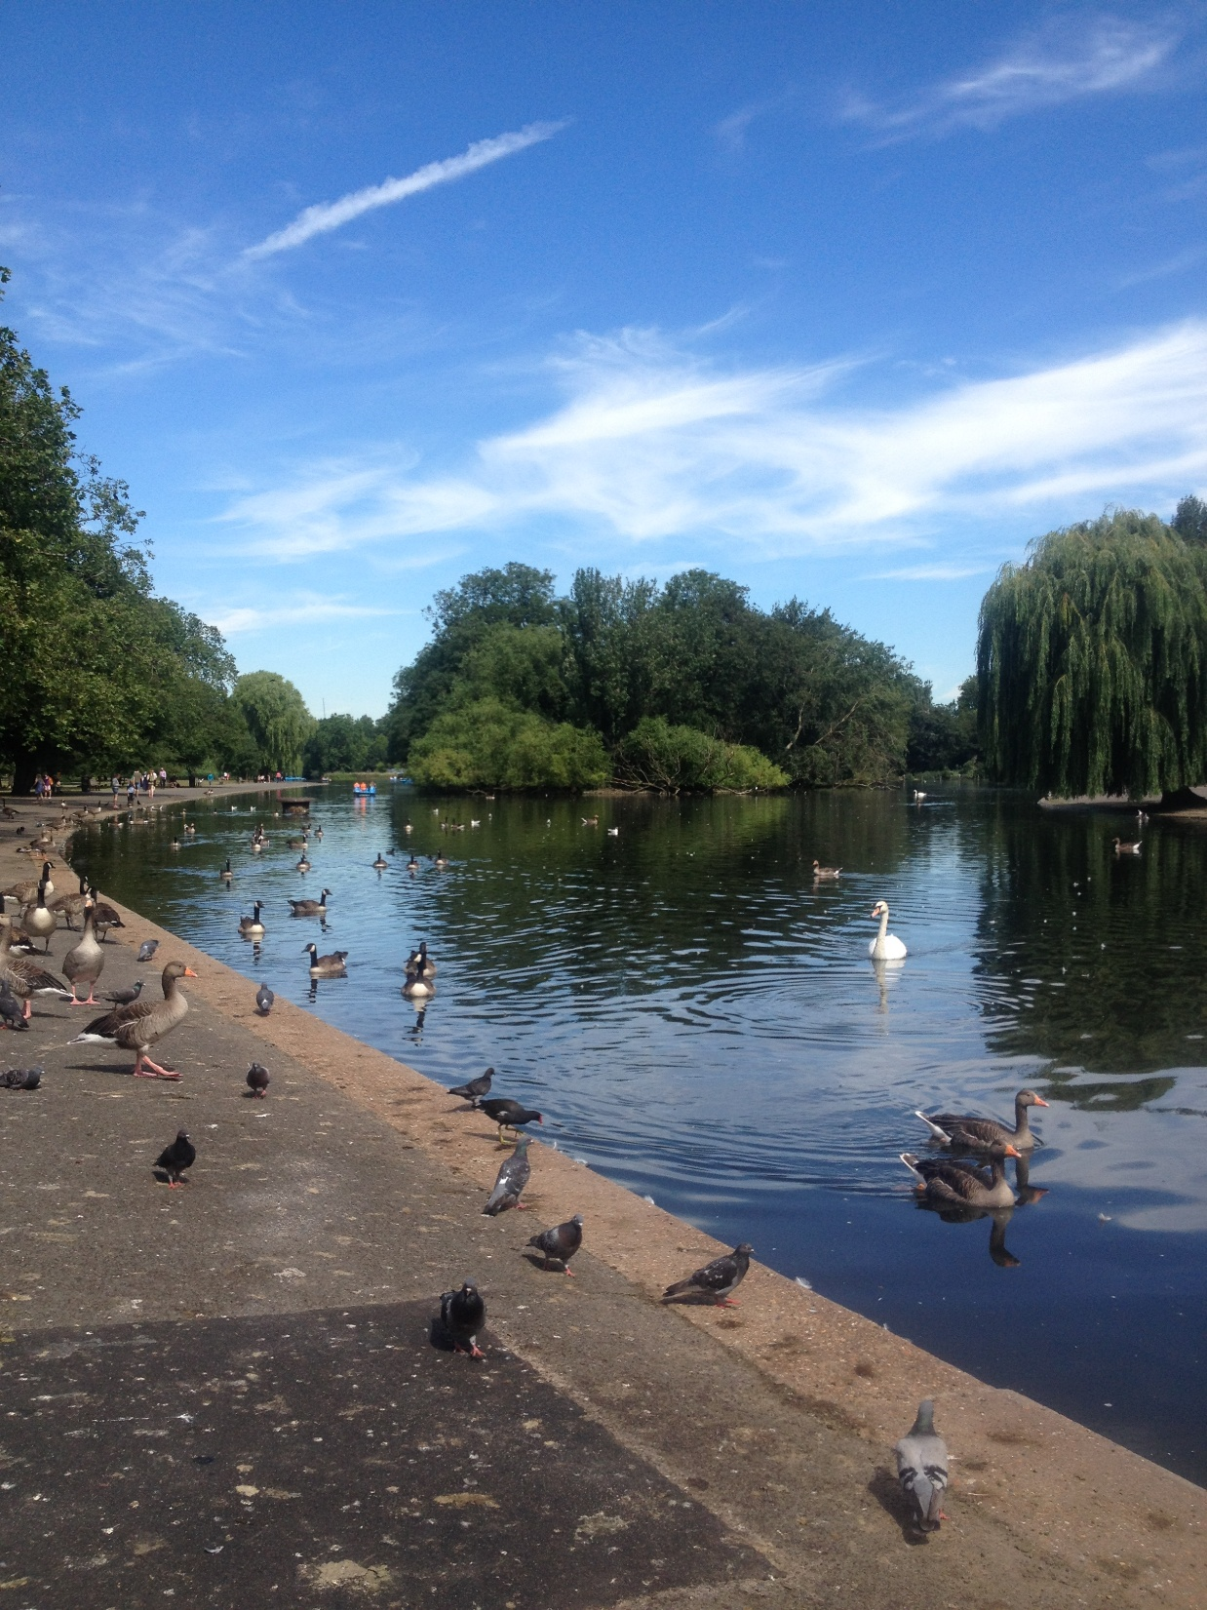
This is London.
trees
geese
pigeons

Slide 15
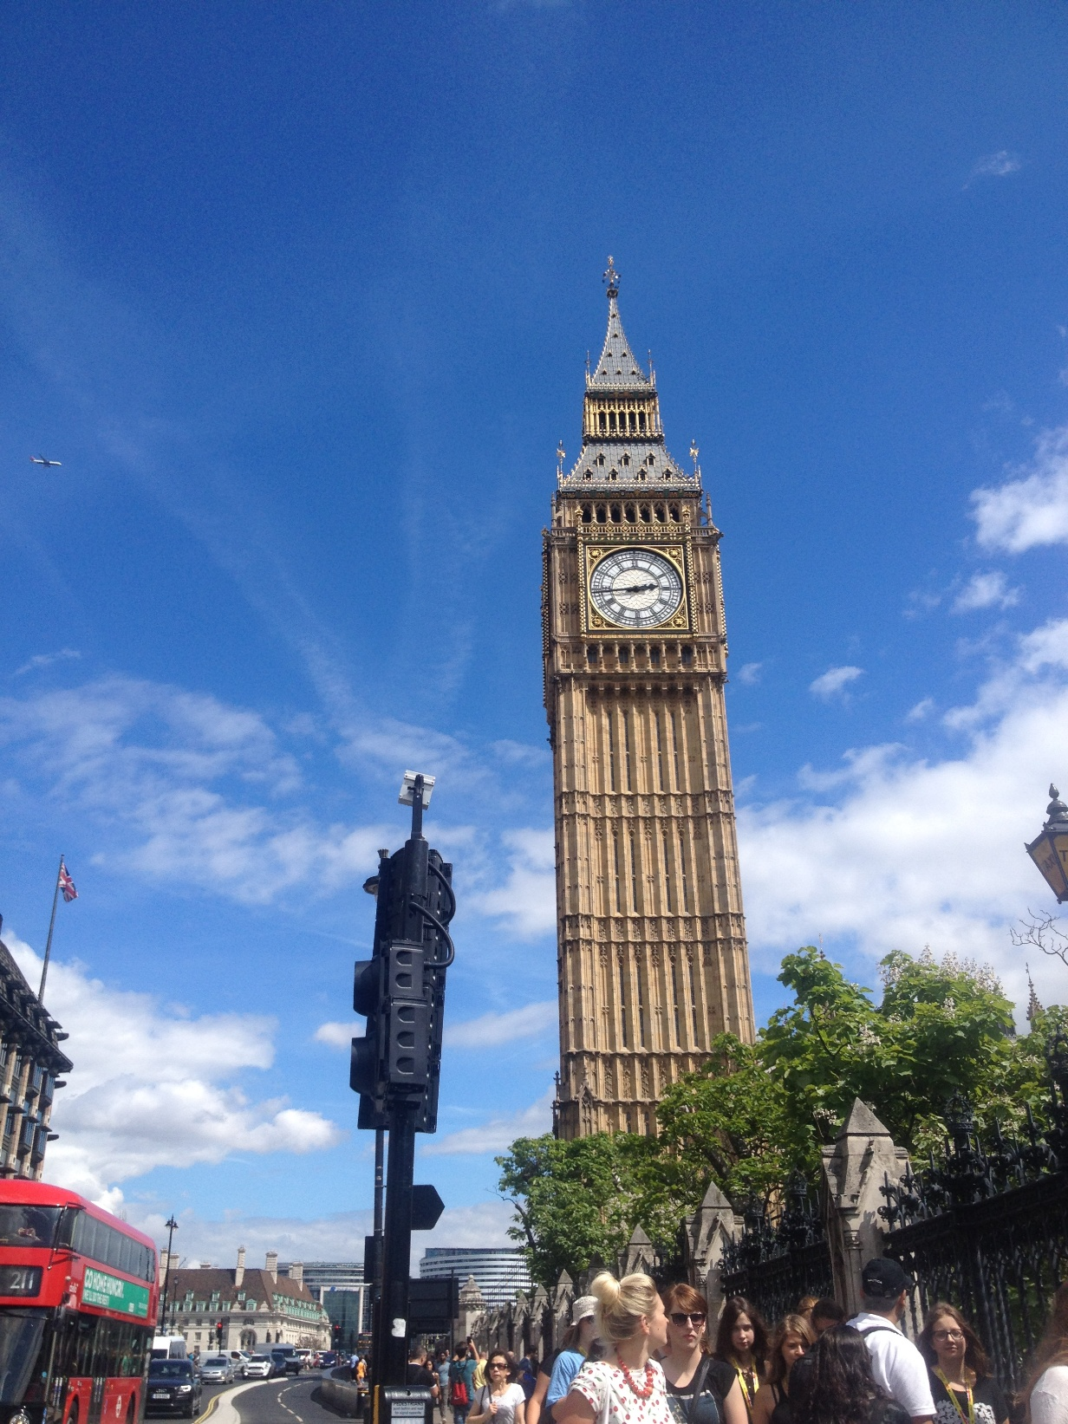
This is London.
Big Ben
light
trees
bus
people

Slide 16
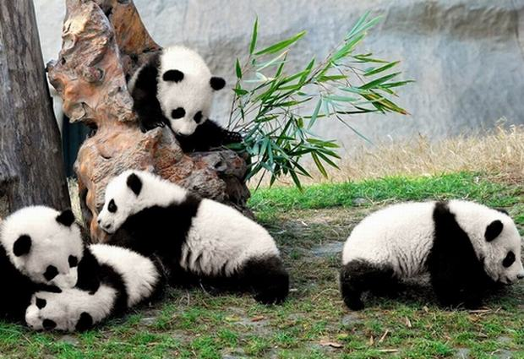
This is panda base.
stone
tree
bamboos
pandas
grasses

Slide 17
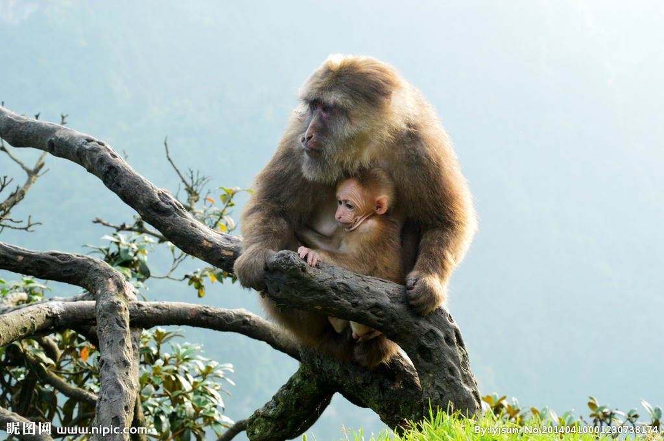
This is Emei mountain.
trees
monkeys
grasses

Slide 18
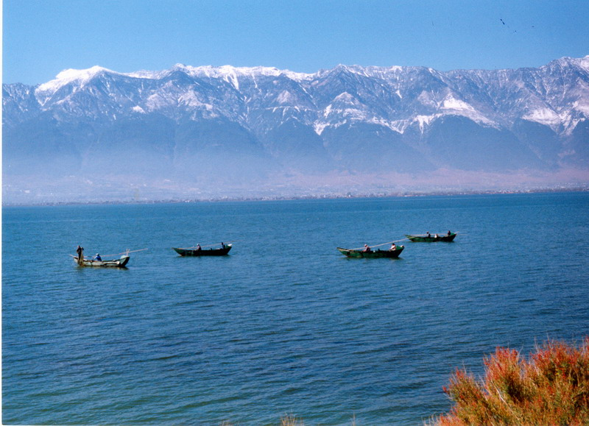
This is Erhai Lake.
mountains
boats
grasses
lake

Slide 19
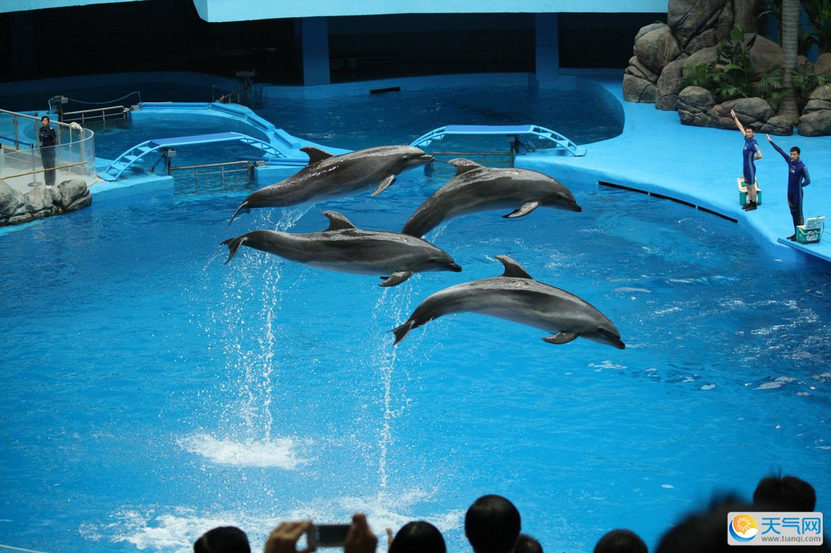
This is Haichang polar ocean world.
trainers
pool
dolphins
people

Slide 20
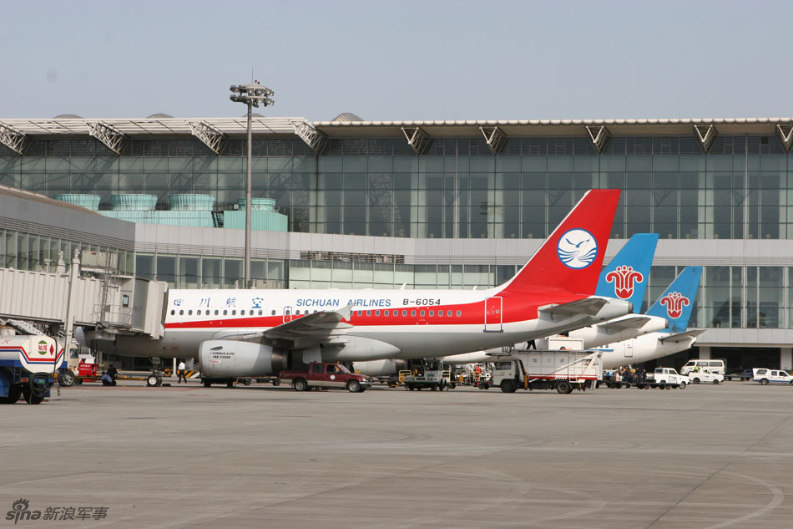
This is Shuangliu Airport.
lights
planes
trucks
cars

Slide 21
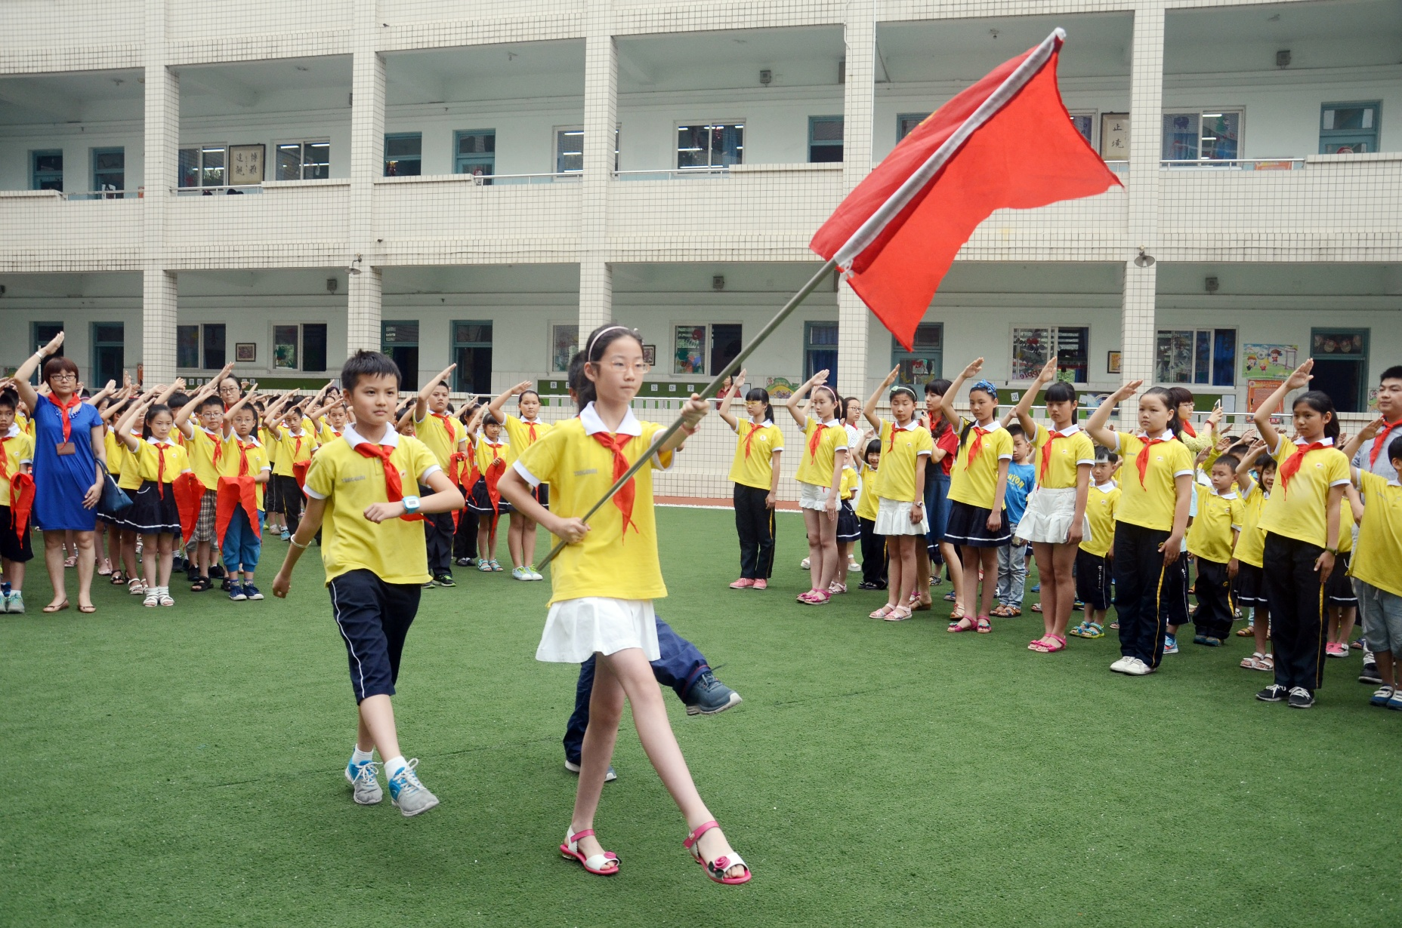
This is Tangwai Primary School.
classrooms
flag
teacher
children

