Slide 1
These ducks are very naughty! Module 3 Unit 1

Slide 3
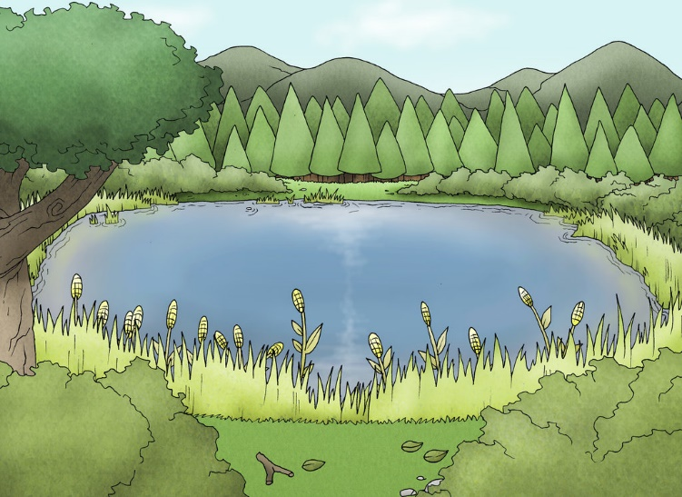
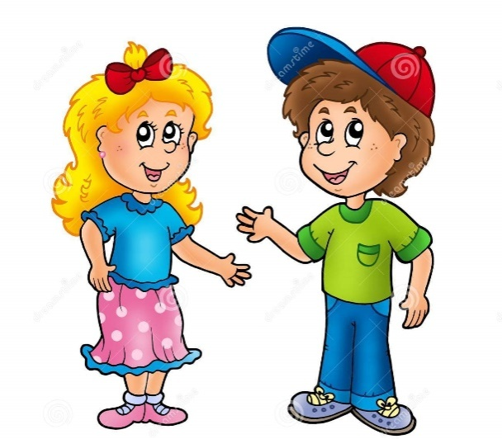
trees
dragon boat
What is this?
What are those?
boat
What is that?
What are these?
flowers

Slide 4
those远指，表示“那些”
that 远指，表示“那个”
this 近指，表示“这个”
these 近指，表示“这些”

Slide 5
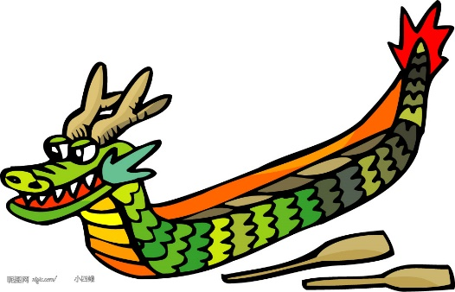
b*oat=boat
dr*agon=dragon boat
r*ow=row
fl*ower=flower
l*ake=lake

Slide 6
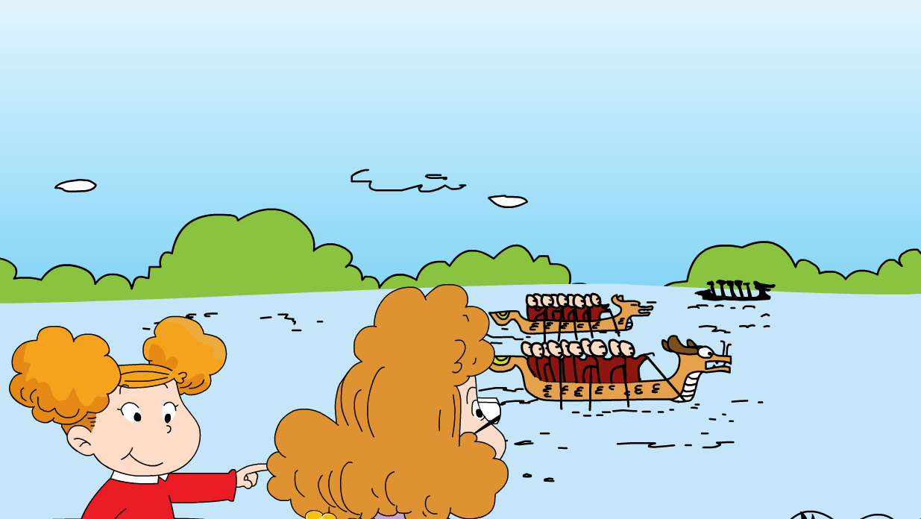
Where are they?
What are those?

Slide 7
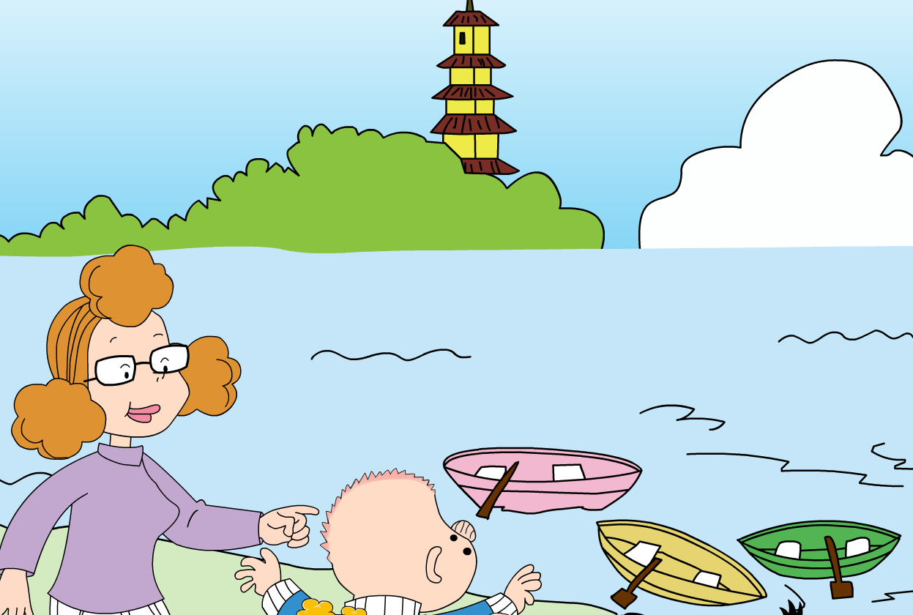
What dose Sam say?
…?

Slide 8
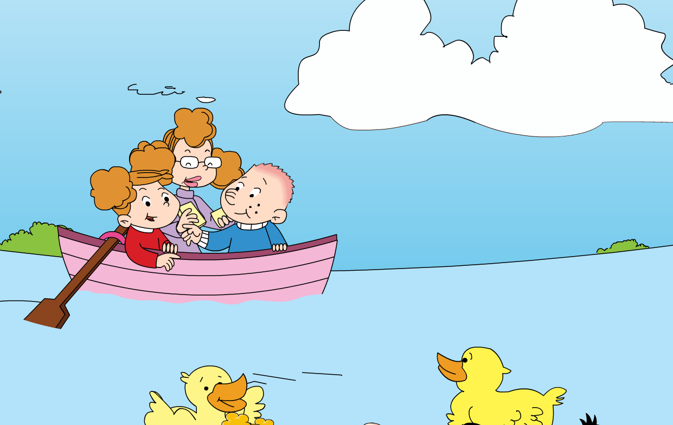
What are those?
Let’s feed the ducks.

Slide 9
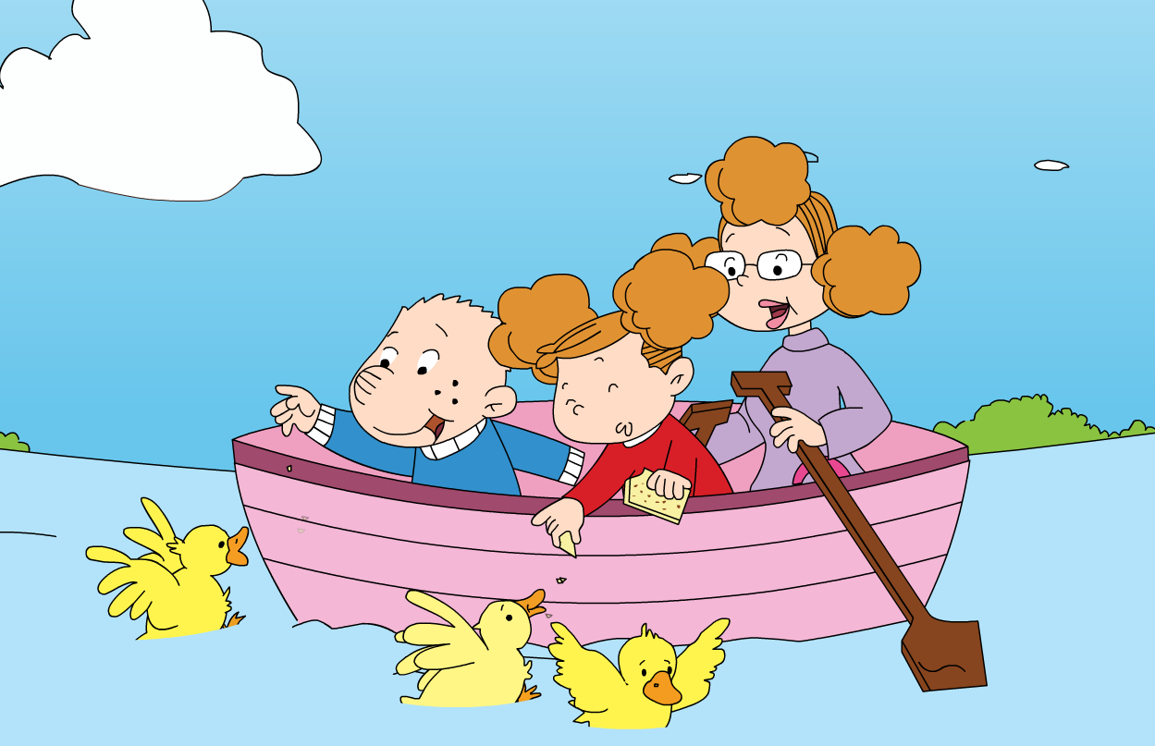
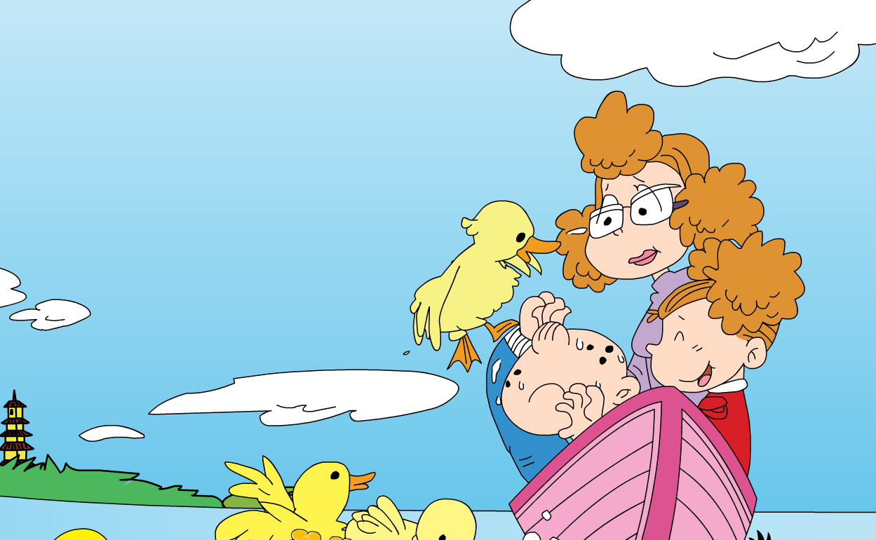
The ducks are very______.

Slide 10
Those dragon boats
row on this lake
naughty
get out
feed ducks bread
coming naughty

Slide 11
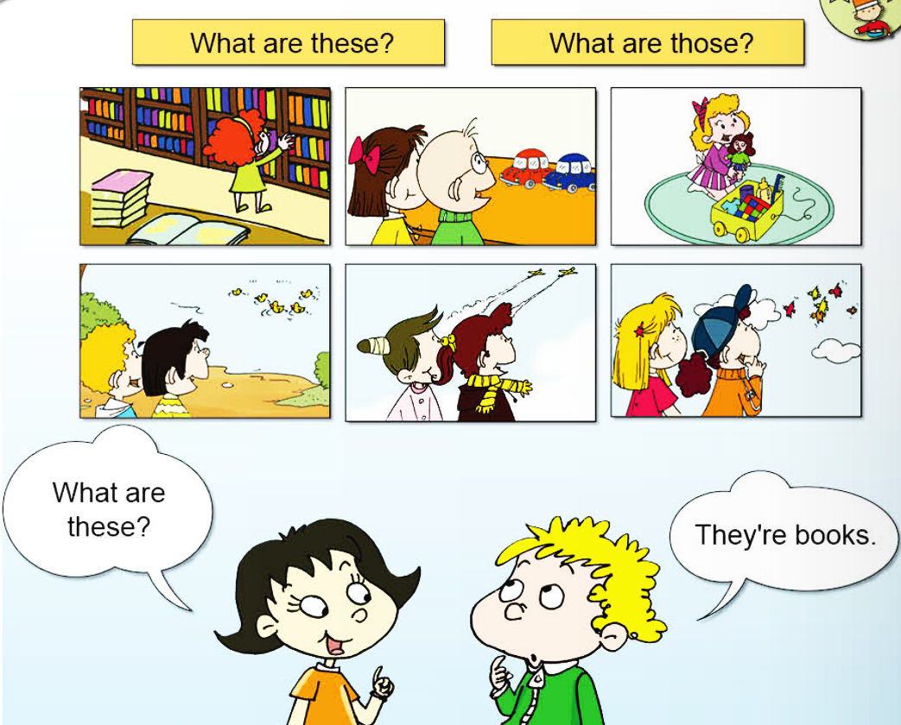
these
books
cars
toys
those
birds
ducks
planes

Slide 12
They are_____.
What are ______?
books
these

Slide 13
They are_____.
What are ______?
ducks
those

Slide 14
They are_____.
What are ______?
cars
these

Slide 15
They are_____.
What are ______?
planes
those

Slide 16
They are_____.
What are ______?
toys
these

Slide 17
They are_____.
What are ______?
birds
those

