Slide 1
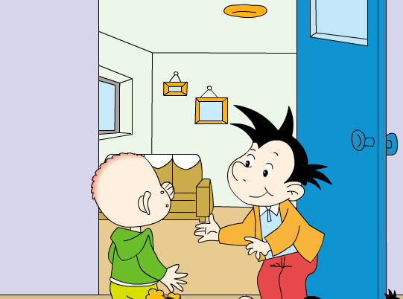
Module 5 Unit2 Can I come in?

Slide 3
Let’s guess !

Slide 4
Listen, read and think.
表示“能力”
表示“许可”

Slide 5
They are in_________________.
Daming’s small library
…
Can I come in?

Slide 6
This is Daming’s library .

Slide 7
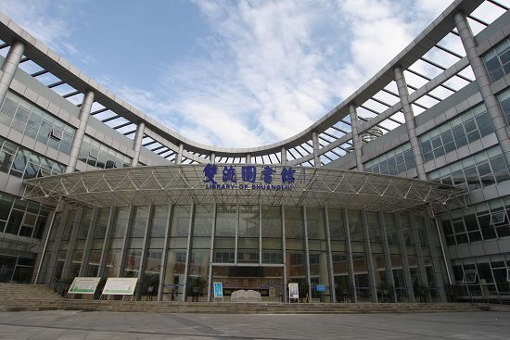
This is Shuangliu library .

Slide 8
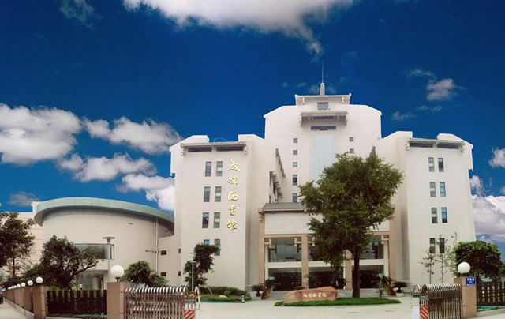
This is Chengdu library .

Slide 9
This is Daming’s library .
Can I read this book?
…

Slide 10
Oh no! I’m…

Slide 11
What does Daming say?
…

Slide 12
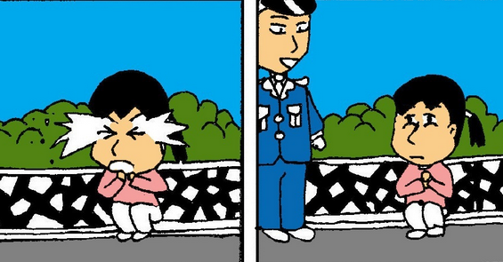
What does the policeman say ?
Don’t worry !不用着急

Slide 13
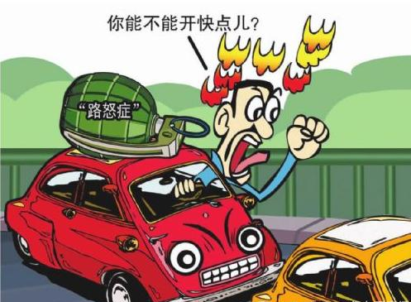
What do you want to say to this man ?

Slide 14
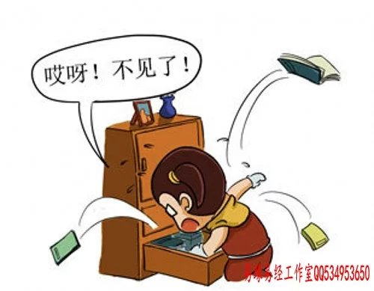
What do you want to say to this girl ?

Slide 15
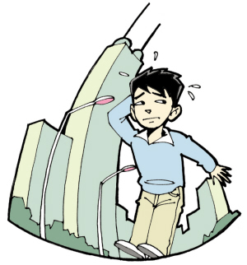
What do you want to say to this boy ?

Slide 16
Listen and find out.
Can I come in?
______________
Yes, please.
Can I read this book?
Yes, you can.
______________

Slide 17
Yes, please. This is my…
Yes, you…
Can I …?
Can I come in?
Don’t worry! You can …Ha ha…
Oh, no! I’m…

Slide 18
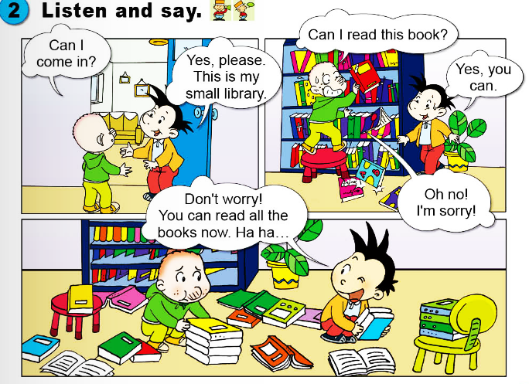
寻求许可，“可以…吗”
寻求许可，“可以…吗”
“可以，能”
“可以，能”

Slide 19
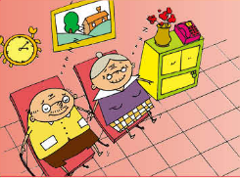
Let’s visit three places.
1
2
3

Slide 20
Grandma and grandpa are sleeping.
Can I watch TV?
No, you can’t.

Slide 21
It’s snowing.
Can I wear coat?
Yes, you can.

Slide 22
It’s the school library.
Can I ______?
________.

Slide 23
librarian

Slide 24
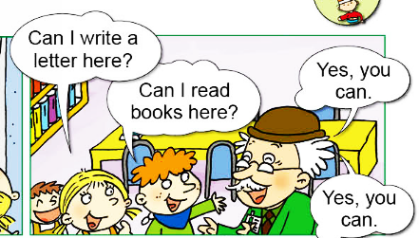

Slide 25
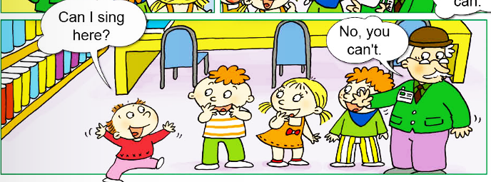

Slide 26
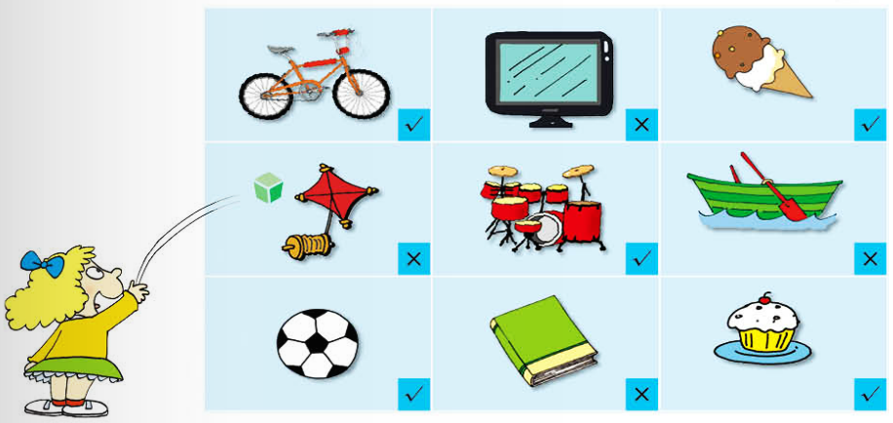
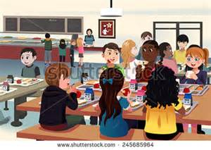
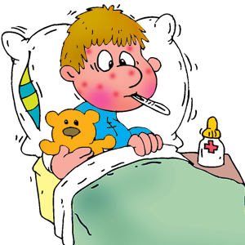
Throw and say!
1
2
3
4
5
6
7
8
9

