Slide 1
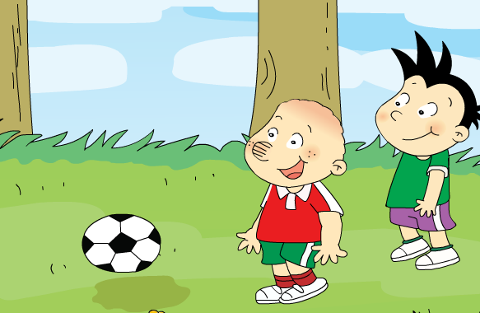
Module 6 Unit 1 I’ve got new shorts and new shoes.

Slide 2
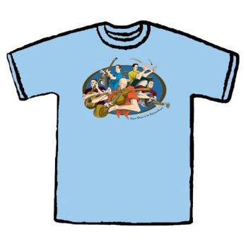
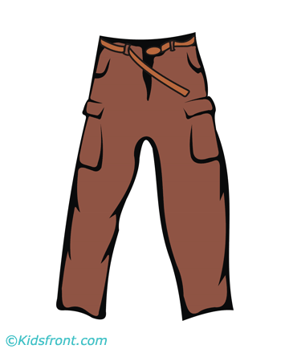
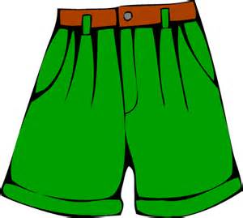
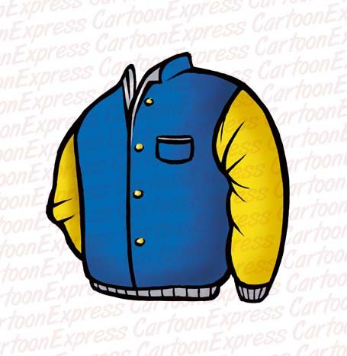
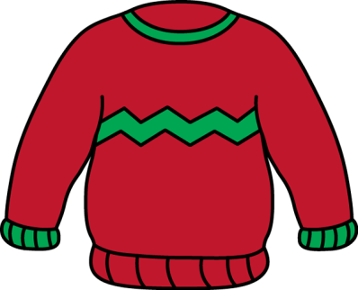
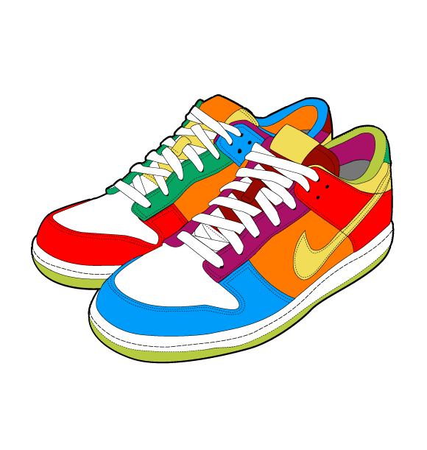
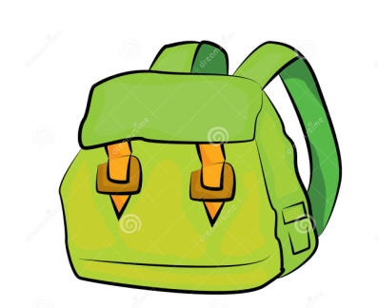
dress
T-shirt
May’s Wardrobe
trousers
shorts
coat
jacket
sweater
schoolbag
football
shoes

Slide 3
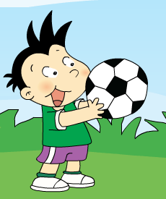
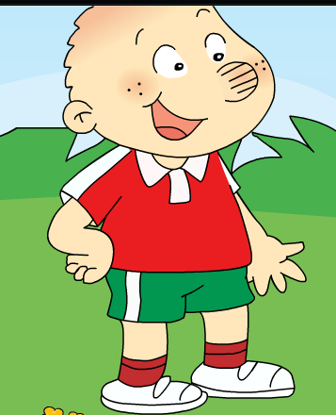
What have they got?
I’ve got a new______.
I’ve got new ______.
?
?

Slide 4
Listen and find:
I’ve got a new______.
I’ve got new _______________.
football
shorts and new shoes
Word bank
football
T-shirt
shoes
shorts
?
?

Slide 5
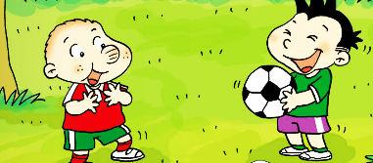
Predict
Can I play with you?
…

Slide 6
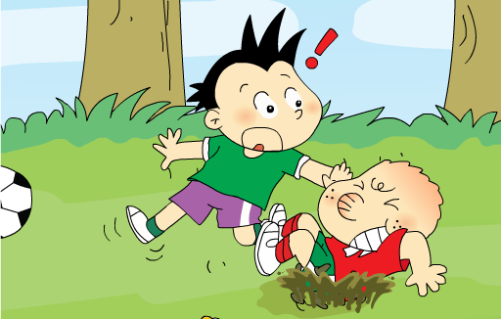
Be careful!

Slide 7
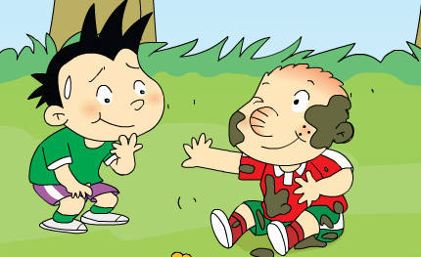
I’m sorry.
…

Slide 8
Listen and find out.
Can I play with you?
______________
Ok.
Don’t worry.
I can wash them.
______________________________
I’m sorry.

Slide 9
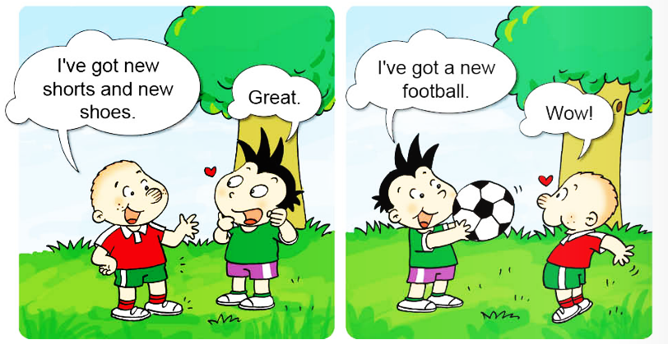
Read and circle “I’ve got…”
have got 表示 “某人某物 ”

Slide 10
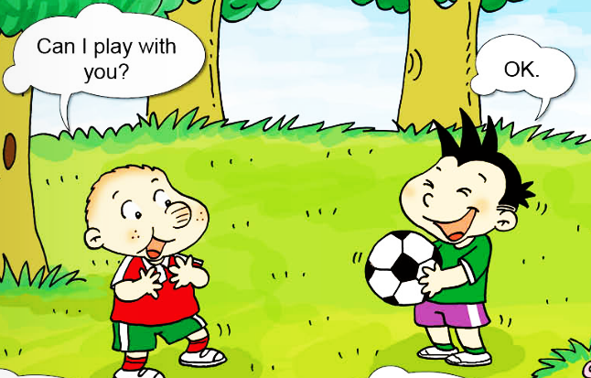
Read and circle “can…”
表示”寻求许可”

Slide 11
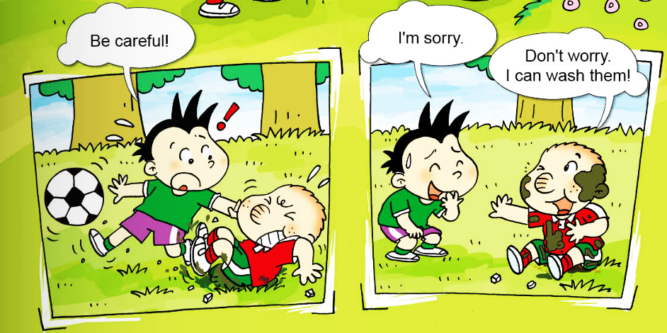
表示”可以，能”

Slide 12
Retell &Role-play
I’ve got____.
Great.
I’ve got____.
Wow!
Can I ____?
OK.

Slide 13
Be careful!
Don’t worry.
I can____.
I’m sorry.

Slide 14
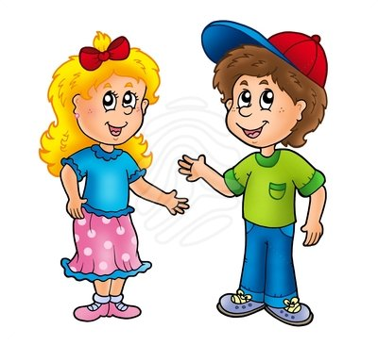
I’ve got____.
Great/Wow/…!
Great/Wow/..!
I’ve got____.

