Slide 1
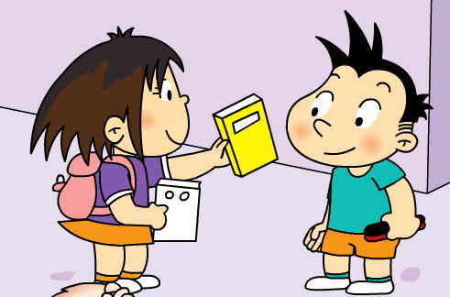
Module 8 Unit 1
This is Sam’s book.

Slide 2
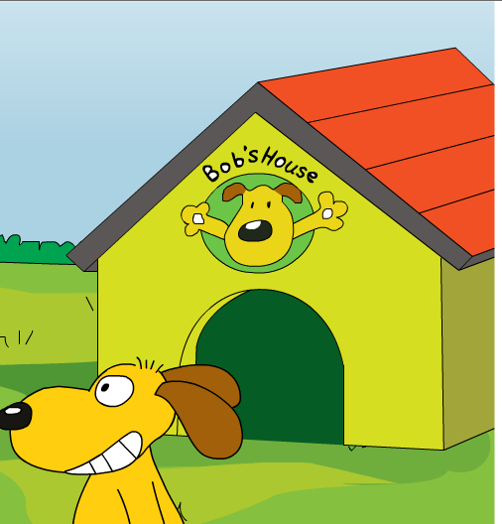
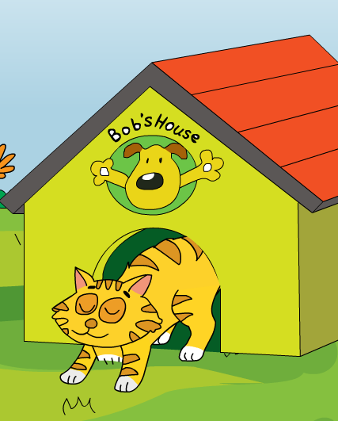
Listen and find: This is _____’s house.

Slide 3
Bob
Listen and find: This is _____’s house.

Slide 4
为什们猫在Bob的房子里呢？
Why is the cat in Bob’s house?
How do you think of the cat ?
你认为这只猫是是只什么样的猫？
The cat is so careless粗心的.

Slide 5
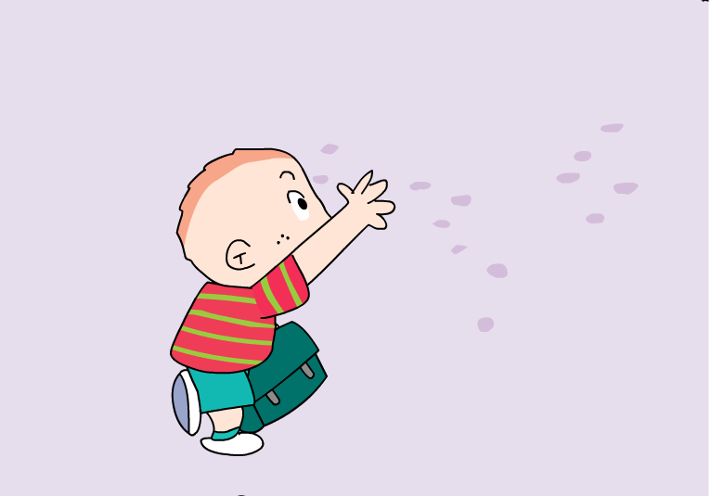
Sam is careless ,too .

Slide 6
Listen: What’s the matter with Sam?

Slide 7
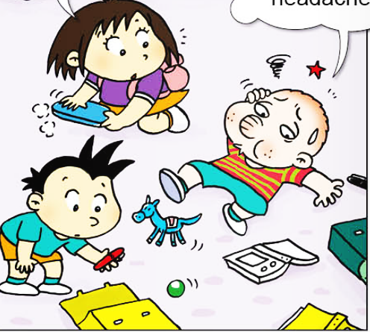
Sam has got a headache .

Slide 8
What can you see on the ground ?

Slide 9
Who help Sam and Daming ?

Slide 10
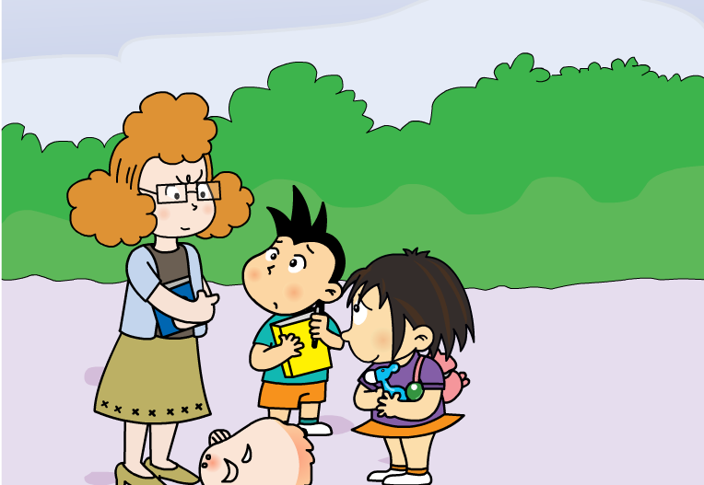
Why is she so angry ?

Slide 11
Ms Smart thinks Lingling brings toys to school .

Slide 12
spring
ring
bring

Slide 13
What can’t you bring to school ?
I can’t bring ……

Slide 14
Is Ms Smart right正确 ?

Slide 15
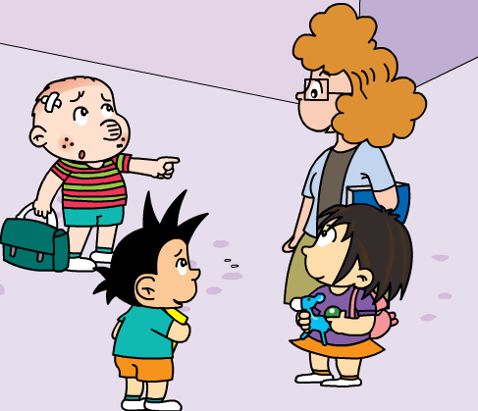
How do Daming and Sam do ?
Daming 和Sam是怎么做的？

Slide 16
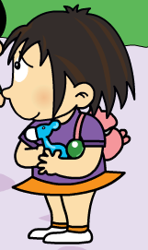
How do you think of Lingling ？

Slide 17
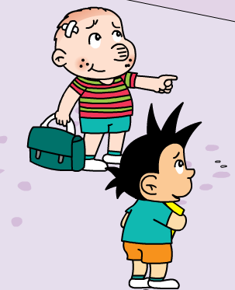
How do you think of Sam and Daming ？

Slide 18

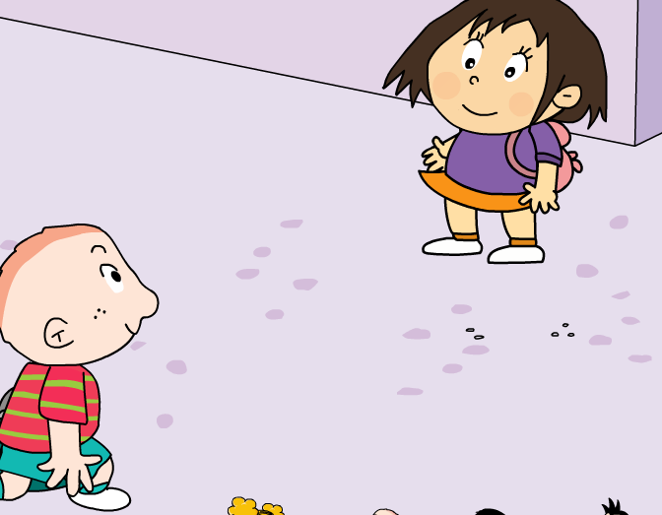
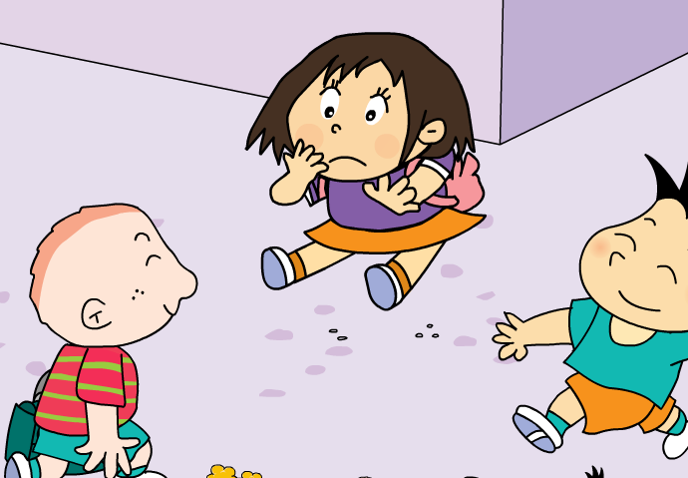
Listen again and answer:
Be careful, Sam!
late
Hello, Lingling. I’m____.

Slide 19
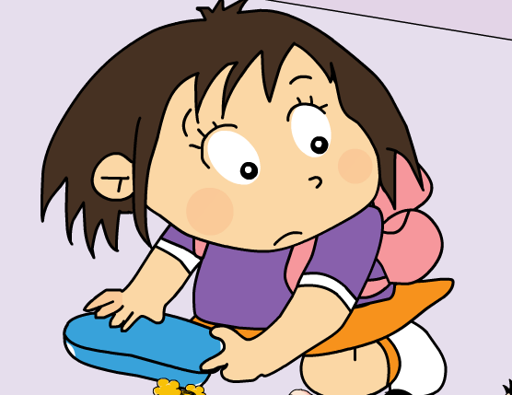
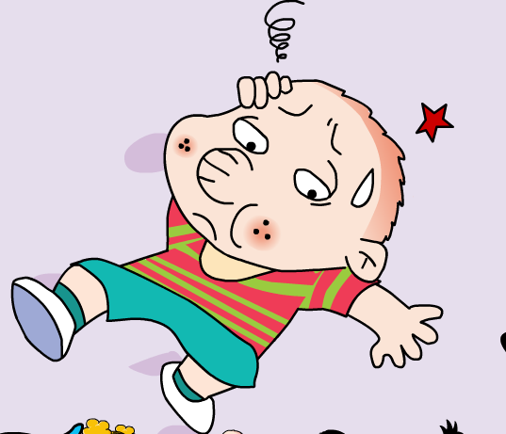
Listen again and answer:
Are you ok, Sam?
headache
I’ve got a _________.

Slide 20
Listen again and answer:
your
Daming
This is ______ book,______.
And this is ______’s book.
Sam
Thank you.

Slide 21
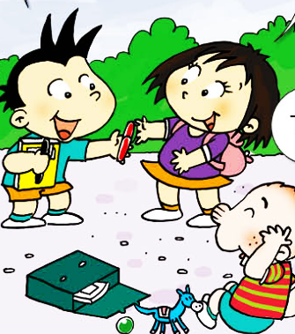
Listen again and answer:
my
This is ______ black pen.
And this is ______’s red pen.
Sam
Thank you, Daming.
Thank you.

Slide 22
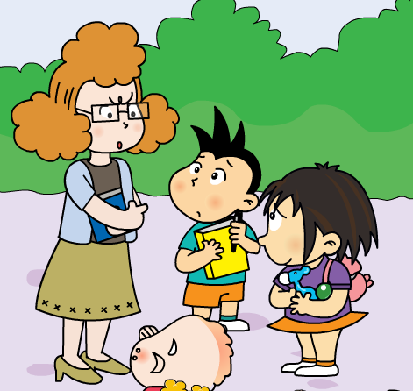
Listen again and answer:
I can see a _______ and a _____. You can’t bring_____ to school, Lingling!
toy horse
ball
toys

Slide 23
Listen again and answer:
Lingling
They are not _______’s toys.
That is ____ toy horse.
And that is _______’s ball.
my
Daming
We are very sorry.

Slide 24

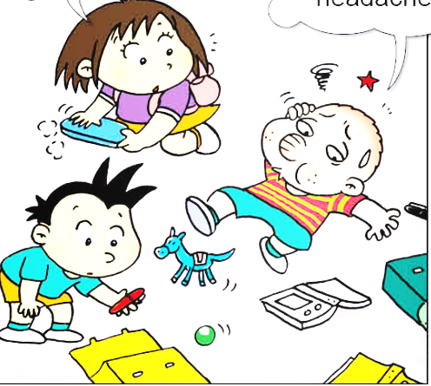

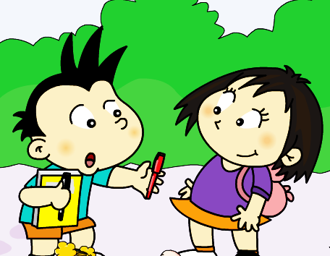
This is Daming’s book.

Slide 25
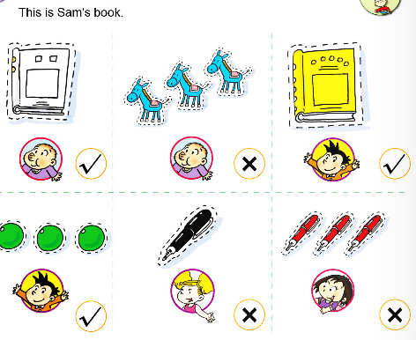

Slide 26
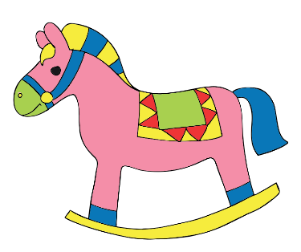



This is Daming’s book. This is my ball.
This is my book.
This is Daming’s book. This is Amy’s ball.
This is Sam’s book.
This is my toy horse.
This is Daming’s book.
This is Amy’s ball. This is my book.

Slide 27
This is my toy horse.
This is your book.
This is Daming’s book. This is Amy’s ball.
This is Sam’s book.
They are not Lingling’s toys.
我的 | 你的 | 她的 | 他的 | 它的 | 他们的 | 我们的
my
your
her
his
its
their
our
Mr. Wang’s
This is ________ pencil. ( Mr. Wang)
This is _______ book. ( teacher)
They are not ______ pens. ( she)
teacher’s
her

Slide 28
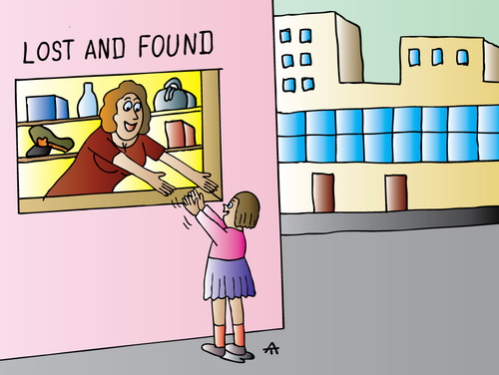

Slide 29




ball
toy horse
red pen
black pen
book
？
Whose _____ is this?

