Slide 1
Module 7 Unit 1 I don’t believe it!
棠外附小 马健梅May

Slide 2
believe, snake, DVD, together, lucky, bamboo, come out of, flute, frightened, get, its, body;
①… like/likes… ②… don‘t/doesn’t like… ③ Do/Does…like..?
words and sentences
About the class
Content
Aims
Important and difficult points
Teaching and learning methods
Students
Preparation
simple present
animal facts
Knowledge
Blank paper
Emotional
PPT
Capability
Abbreviated
Independent
Grade 6
Instructions
Cooperative
Mistakes
Task-based
Simple present
Animal facts

Slide 3
Guess!
live on the farm
have horns
body
home
have white fur
?
food
like grass

Slide 4
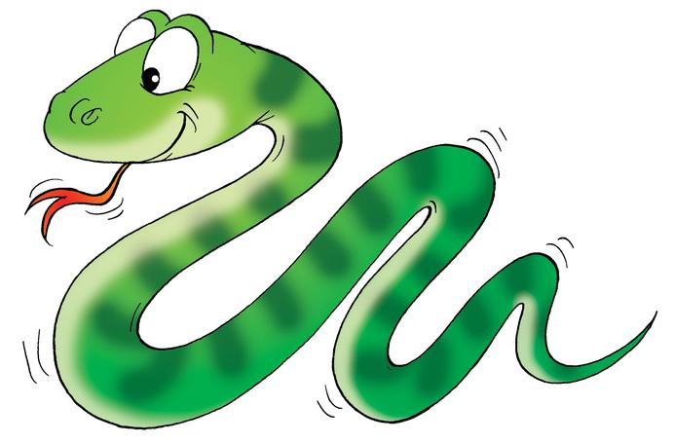
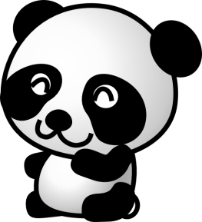
?
?
?
?
Animals
?
?
?
?
?
?

Slide 5
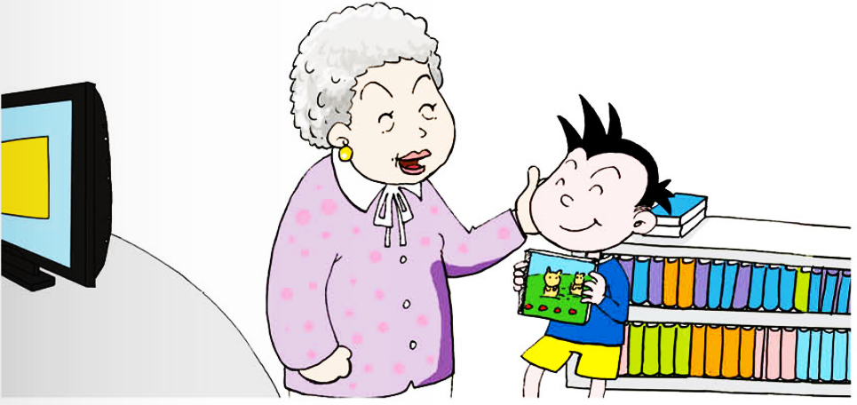
Grandma gives Daming a present. It’s a DVD. It’s about animal facts.
What animals is the DVD about?
?

Slide 6
1.Look, listen and find out:
What animals is the DVD about?
?

Slide 7
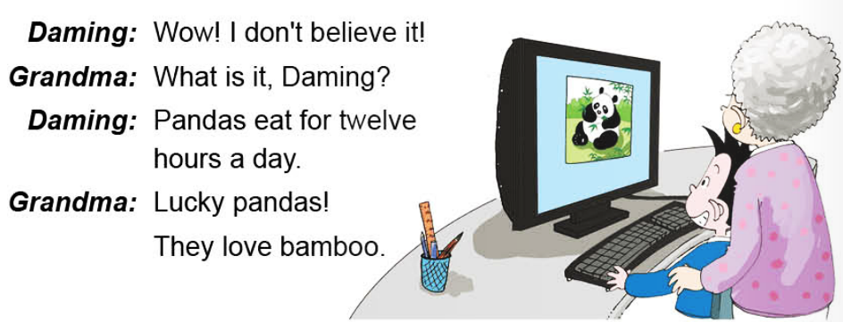
2. Read and underline the facts about pandas and snakes.

Slide 8
2. Read and underline the facts about pandas and snakes.

Slide 9
Retell and draw.
eat for twelve hours a day
love bamboo
food
pandas
habits
body

Slide 10
Retell and draw.
use it’s body to dance
can’t hear
body
the snake
food
emotion
gets frightened
thinks the flute is dangerous

Slide 11
Role-play
Daming: Well, I don’t believe it!
Grandma: What is it Daming?
Daming: Pandas …
….
Grandma: What an interesting DVD!
Daming: It’s a fantastic present. Grandma, Thank you again.
Grandma: You’re welcome, Daming.

Slide 12
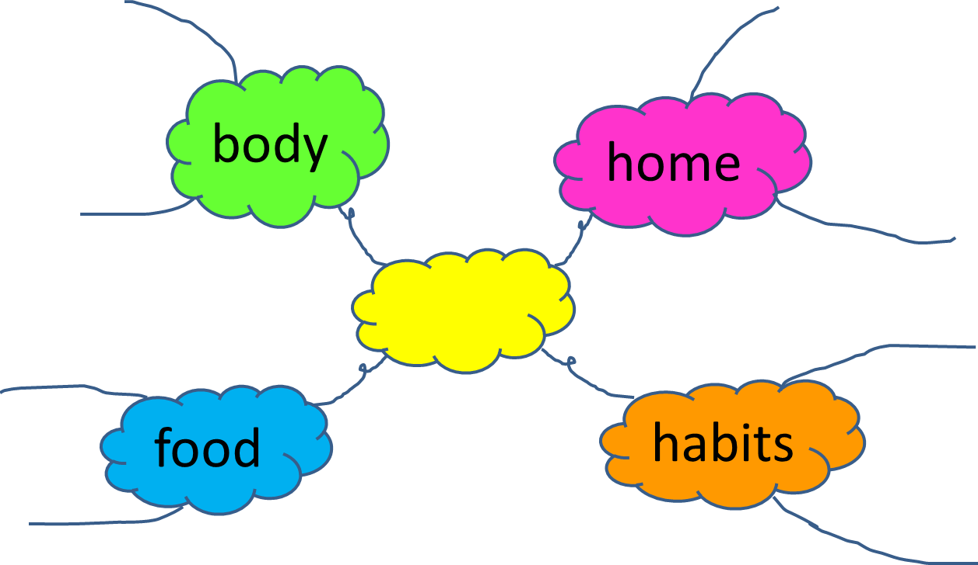
Task
1. Choose an animal you like best.
2. Make an information card for it.
3. Here is the word bank.
Word bank
hear, body, dance, music, dangerous, frightened, grass, meat, fish, insect, river, land, dessert, sea, mountain, fly, climb, walk, jump, run, crawl

Slide 13
Introduce the animal you like.
I like…
They have…
They live in/on…
They love…

Slide 14
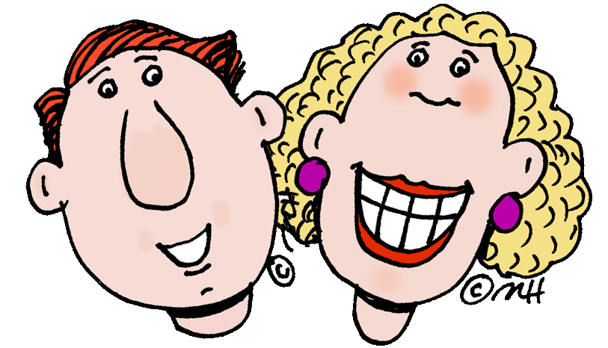
Homework
Listen and read part 2;
Search for more information about the animal you like. Add the information on your mind-map.
Tools:

