Slide 1
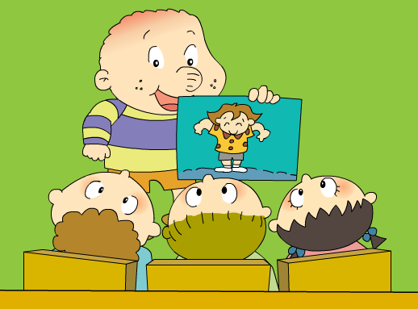
Module 6 Unit 2 He’s got a new shirt.

Slide 2
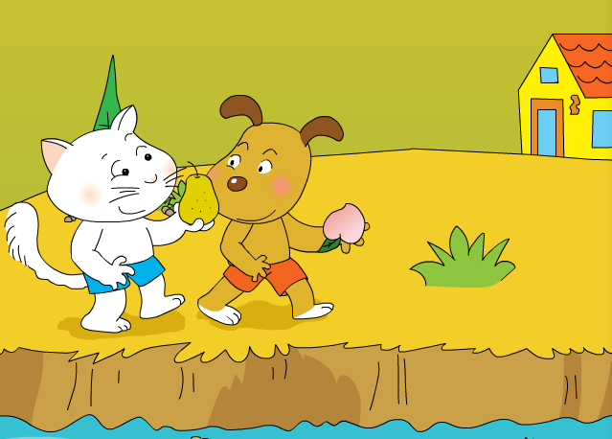
What have they got?
I’ve got a ____.
pear
I’ve got a ____.
peach

Slide 3
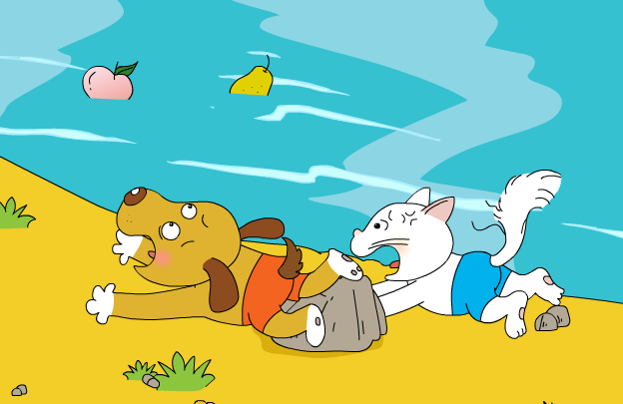
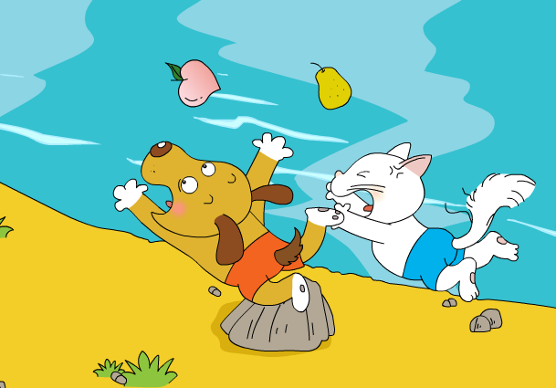
Be careful!

Slide 4
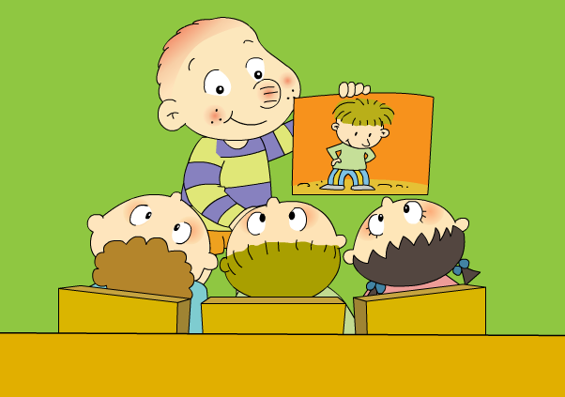
This is Zhang Jie. What has he got?
He’s got ____.

Slide 5
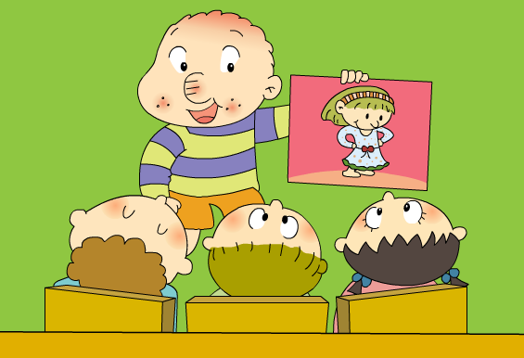
This is Qiqi. What has she got?
She’s got a____.

Slide 6
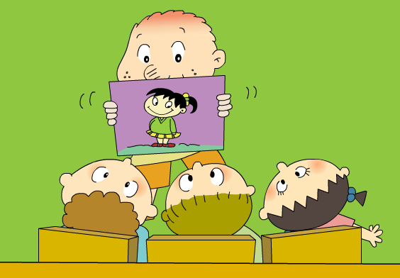
This is Jiang Fei. What has she got?
She’s got ____.

Slide 7
This is Xiaoxiao. What has she got?
He’s got a____.

Slide 8
This is Zhang Jie. What has he got?
Listen and find:
He’s got ___________.
new trousers

Slide 9
This is Qiqi. What has she got?
She’s got ___________.
a new dress

Slide 10
This is Jiang Fei. What has she got?
She’s got ___________.
new shoes

Slide 11
This is Xiaoxiao. What has she got?
He’s got ___________.
a new shirt

Slide 12
This is______.
He’s got ____.
Retell
This is______.
She’s got a____.
This is______.
She’s got ____.
This is______.
He’s got a____.

Slide 14
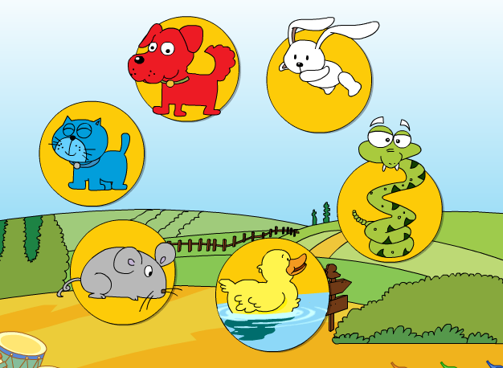
Who’s got the animals?
You
I
?
He
She

Slide 15
Listen and find. Then chant.
I’ve got a _______.
You’ve got a ________.
He’s got a _______.
Look at that!
I’ve got a _______.
You’ve got a ________.
She’s got a _______.
There in the lake!

Slide 16
Guess: What is it?
long ears
run
?
It’s got long ears.
It can run.

Slide 17
Guess: What is it?
long nose
big
?
It’s got long nose.
It is big.

Slide 18
Guess: What is it?
green eyes
black
?
It’s got green eyes.
It is black.

Slide 19
Guess: What is it?
two legs
fly
?
It’s got two legs.
It can fly.

Slide 20
Make your guessing mind-map
…
…
?
It’s got _________.
It can/is ________.

Slide 21
Do you know?
I’ve got a pear.
You’ve got a peach.
She’s got a dog.
He’s got a cat.
It’s got long nose.
I’ve got= I have got
某人某物+has/have got
表示“某人某物有…”
You’ve got= You have got
She’s got= She has got
He’s got= He has got
It’s got= It has got

