Slide 1
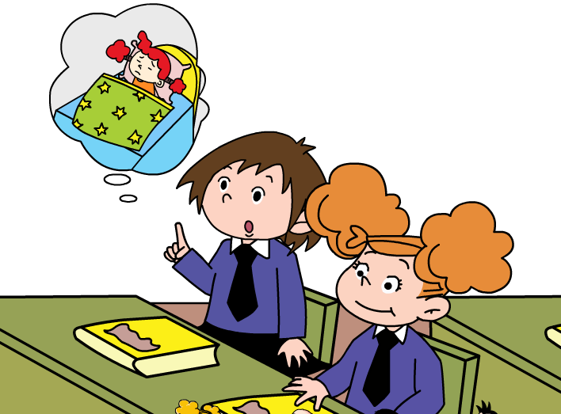
Module 7 Unit 2
She’s got a cold.

Slide 2
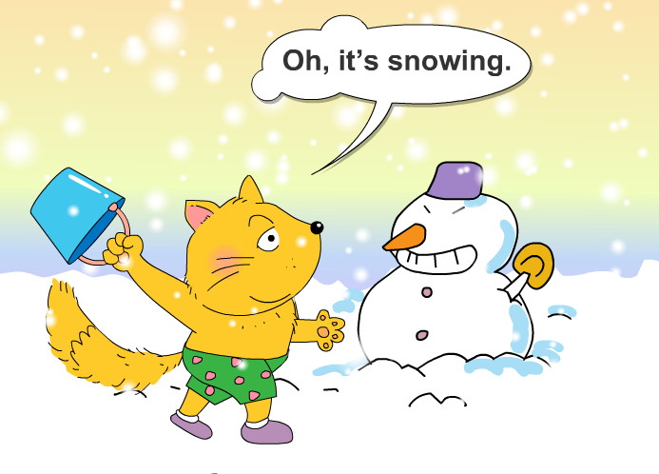

Slide 3
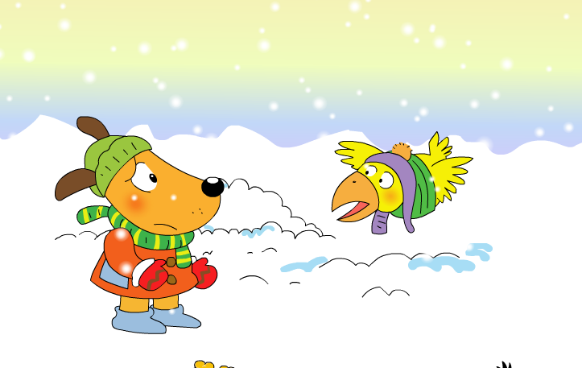
He’s…
He’s got…
Where’s the cat?

Slide 4
Listen and Repeat

Slide 5
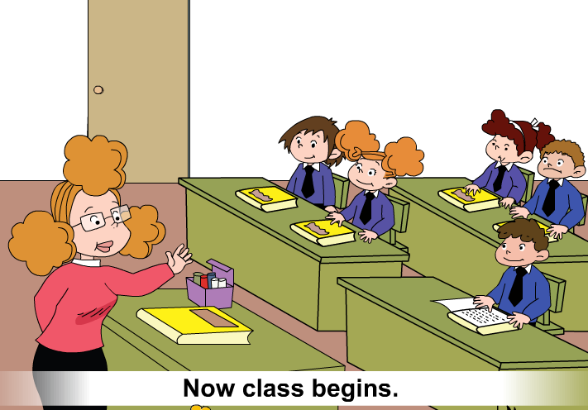
Where’s Jake, Sarah and Daming?

Slide 6
Look, listen and find:
What’s the matter with Jake, Sarah and Daming?

Slide 7

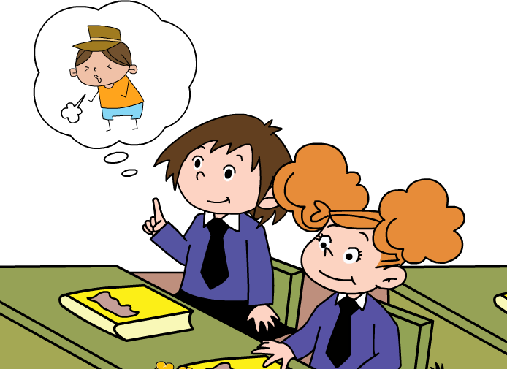
Listen again and find:
1. Has Jake got a cough?
Yes, he has.

Slide 8
2. Has Sarah got a cough, too?
No, she hasn’t. She’s got a cold.

Slide 9
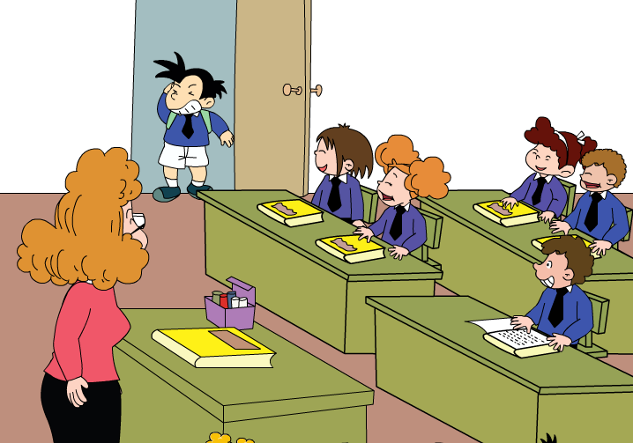
3. Has Daming got a cold, too?
No, he hasn’t.

Slide 10
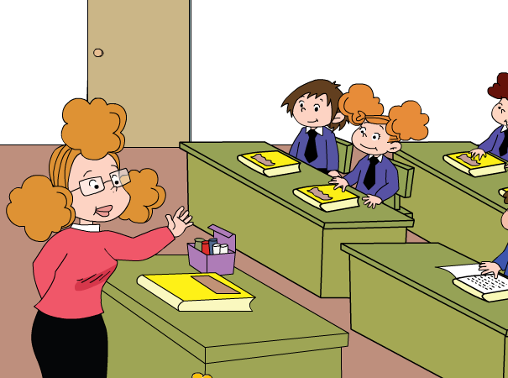
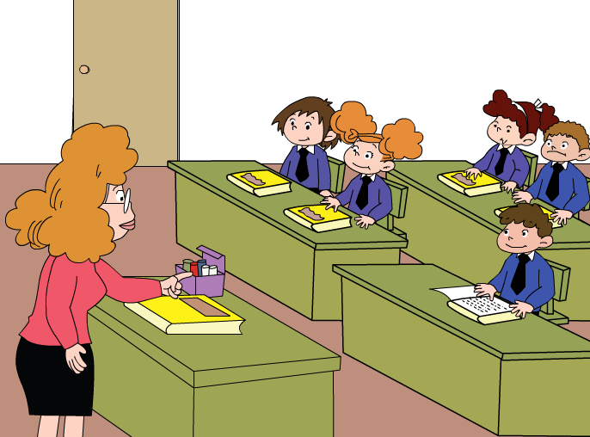
Retell
Has Sarah got…?
Now class begins.
Where’s Jake?
He’s… He’s got…
No, she…She’s got..

Slide 11
Sorry, I’m…
Ha ha...
Has Daming got…?

Slide 12
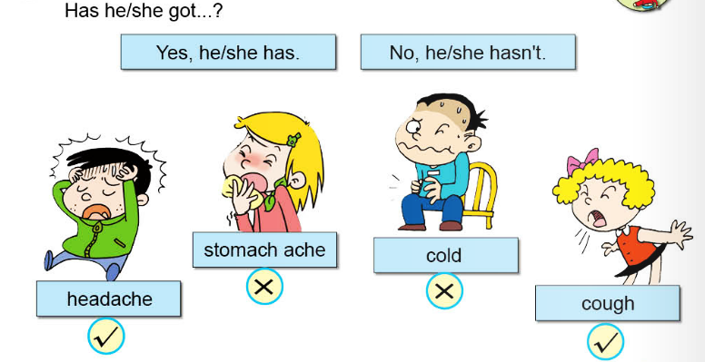
Ask and Answer

Slide 13
Listen and Sing

Slide 14
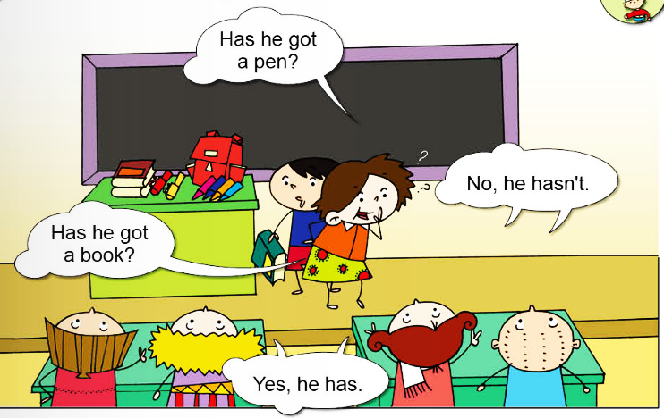
Guess and Say

Slide 15
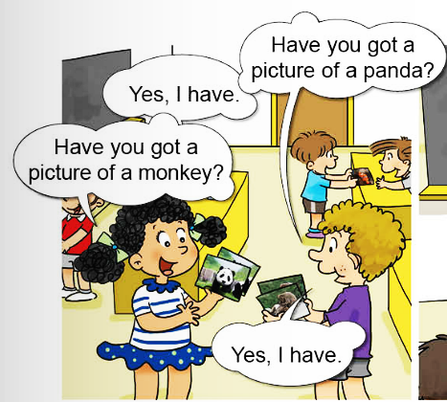
Find Someone Who…
Name | Panda | Monkey
Lily
Tom
…
√
√

Slide 16
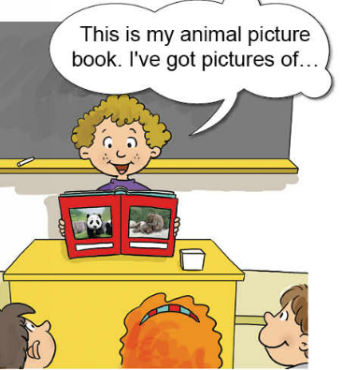
This is our animal picture book. I have got a picture of…
Lily has got a picture of...
Tom has got a picture of...

Slide 17
I have got a headache?
Have you got a headache?
She has got a cold?
____________a cold?
He has got a stomachache.
____________a stomachache?
Do you know?
Has she got
Has he got

