Slide 1
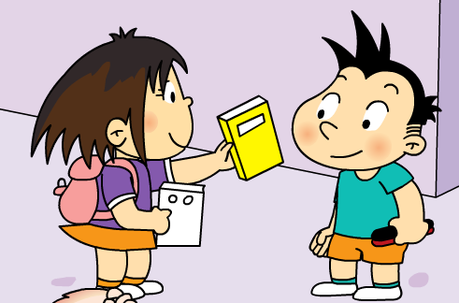
Module 8 Unit 1 This is Sam’s book.

Slide 2
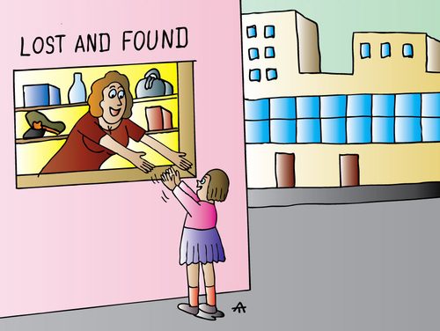

Slide 3
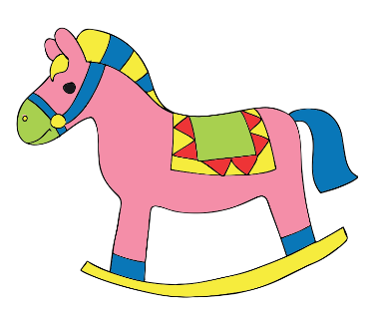
ball
toy horse
red pen
black pen
book
？
Whose _____ is this?

Slide 4
Bob
Listen and find: This is _____’s house.

Slide 5
Listen: What’s the matter with Sam?

Slide 6
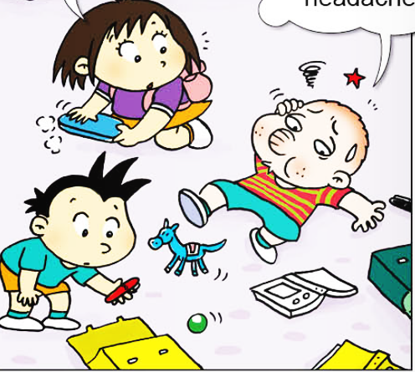

Slide 7
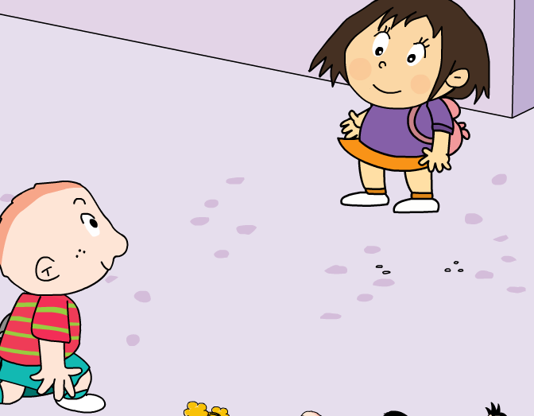
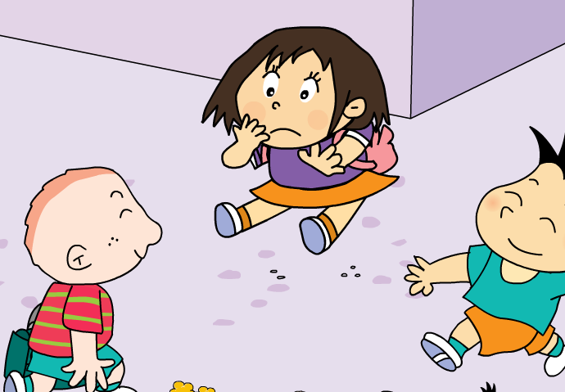
Listen again and answer:
Be careful, Sam!
late
Hello, Lingling. I’m____.

Slide 8
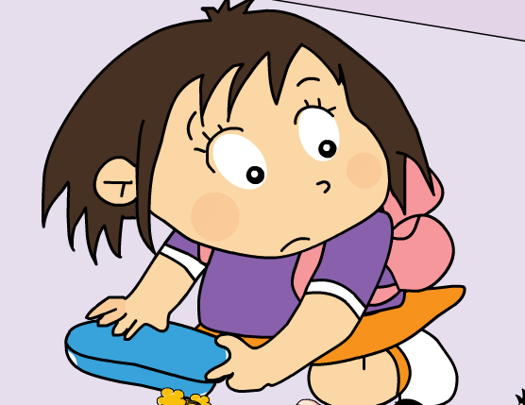
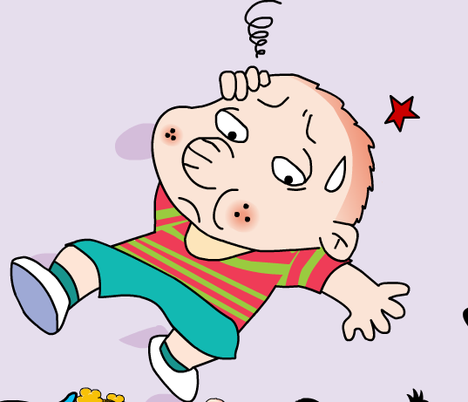
Listen again and answer:
Are you ok, Sam?
headache
I’ve got a _________.

Slide 9
Listen again and answer:
your
Daming
This is ______ book,______.
And this is ______’s book.
Sam
Thank you.

Slide 10
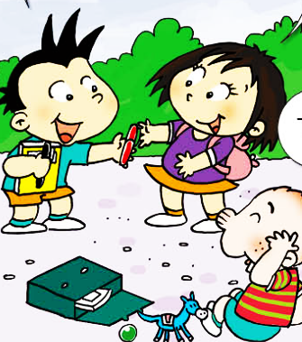
Listen again and answer:
my
This is ______ black pen.
And this is ______’s red pen.
Sam
Thank you, Daming.
Thank you.

Slide 11
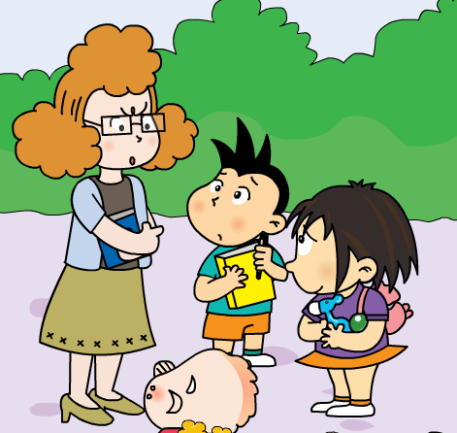
Listen again and answer:
I can see a _______ and a _____. You can’t bring_____ to school, Lingling!
toy horse
ball
toys

Slide 12
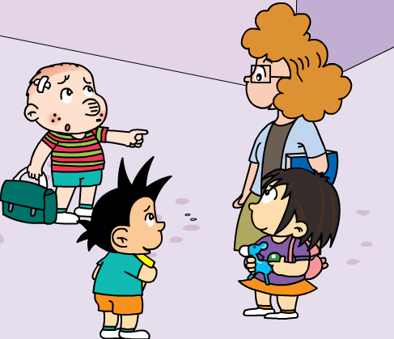
Listen again and answer:
Lingling
They are not _______’s toys.
That is ____ toy horse.
And that is _______’s ball.
my
Daming
We are very sorry.

Slide 13
This is Daming’s book.

Slide 14
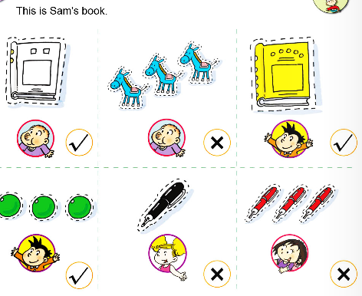

Slide 15
This is Daming’s book. This is my ball.
This is my book.
This is Daming’s book. This is Amy’s ball.
This is Sam’s book.
This is my toy horse.
This is Daming’s book.
This is Amy’s ball. This is my book.

Slide 16
This is my toy horse.
This is your book.
This is Daming’s book. This is Amy’s ball.
This is Sam’s book.
They are not Lingling’s toys.
我的 | 你的 | 她的 | 他的 | 它的 | 他们的 | 我们的
my
your
her
his
its
their
our
Mr. Wang’s
This is ________ pencil. ( Mr. Wang)
This is _______ book. ( teacher)
They are not ______ pens. ( she)
teacher’s
her

