Slide 1
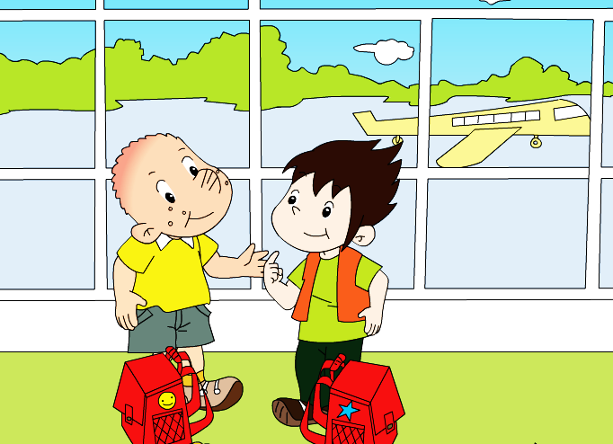
Module 10 Unit 1
Are you going to Hong Kong?

Slide 2
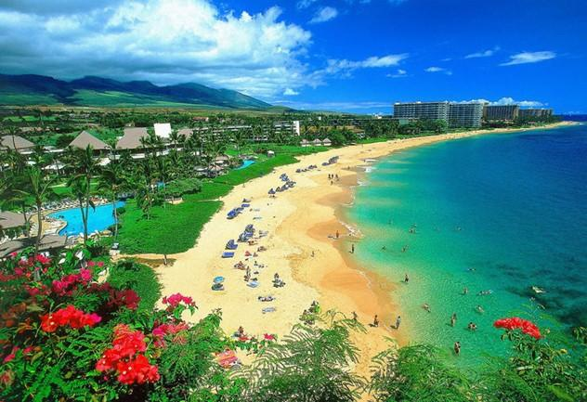
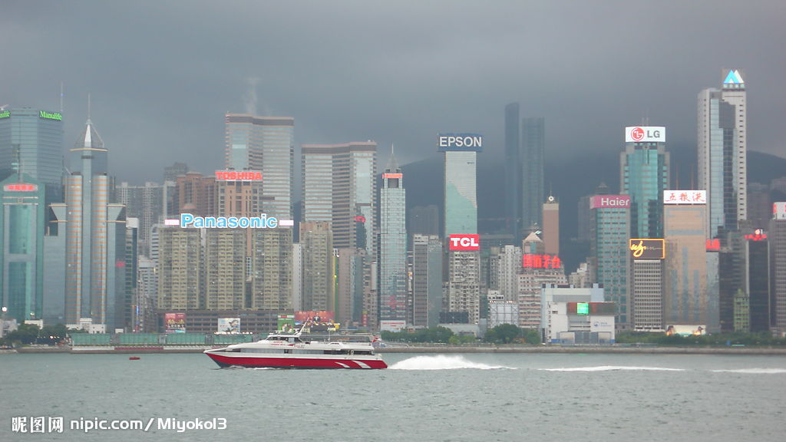
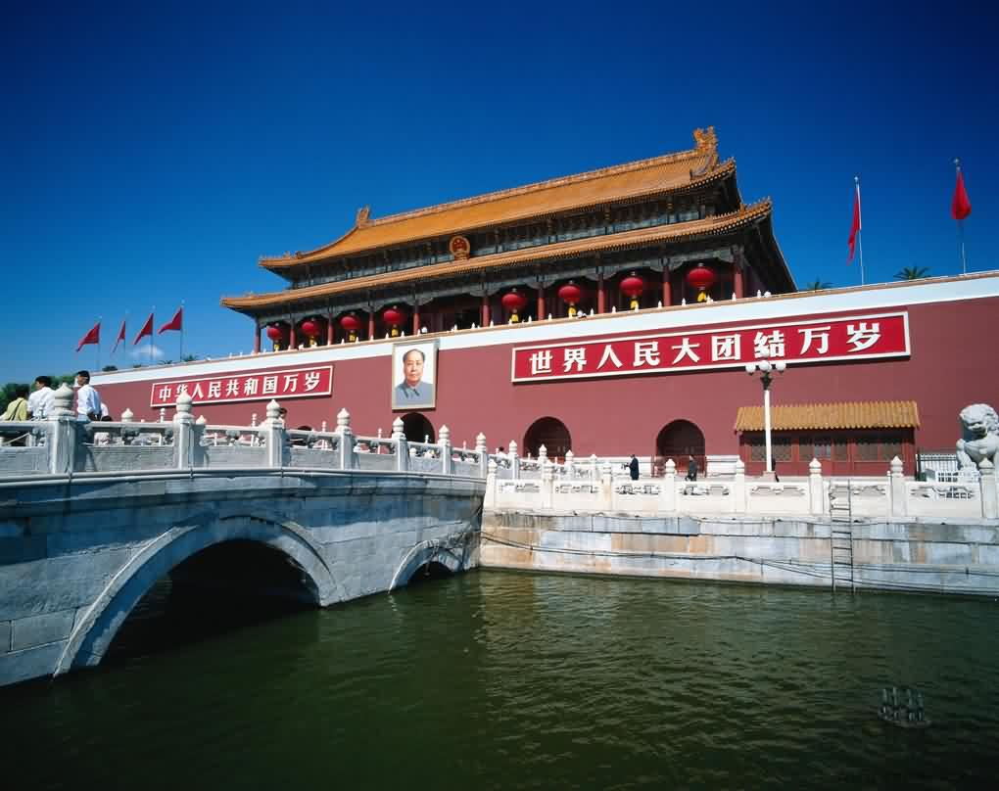
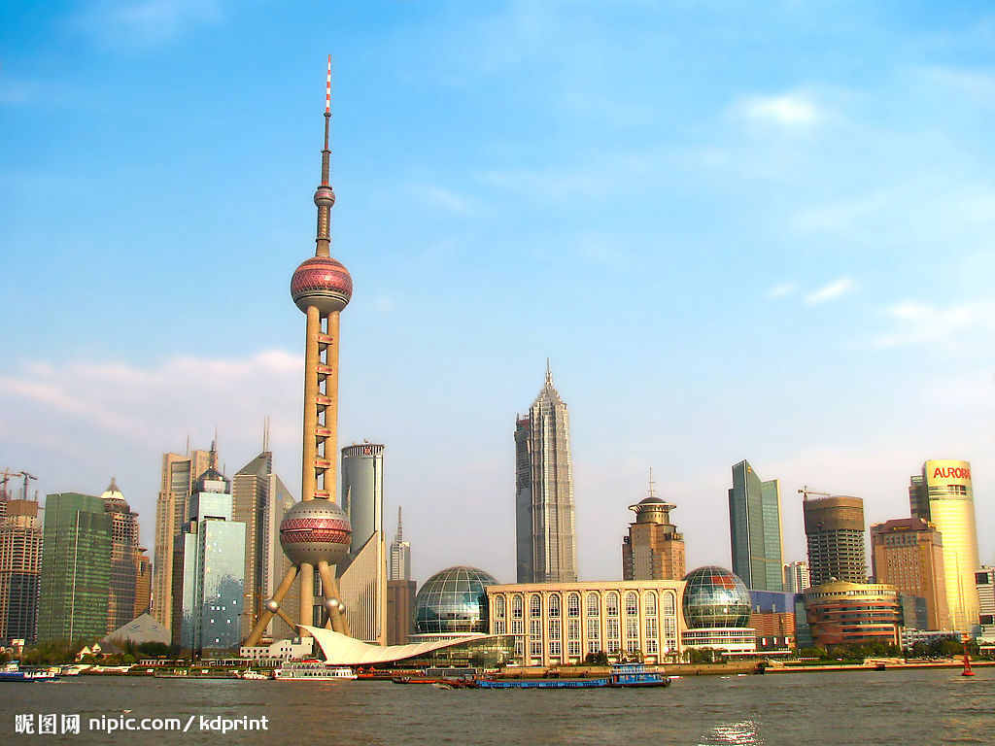
Where are you going this winter holiday?
寒假
Hainan
Hong Kong
（香港）
Beijing
Shanghai

Slide 3
Where am I going ?
Play a guessing game !
Are you going to _______?
Yes , I am ./No, I’m not .

Slide 4
Beijing
Bob is going to ________.
The alien is going to ________.
Beijing

Slide 5
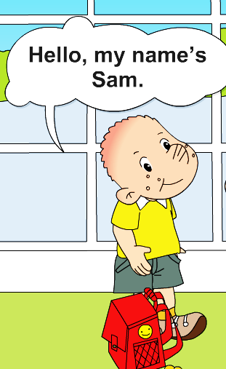
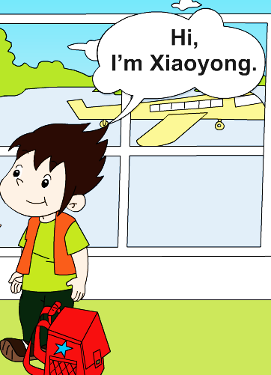

Who are there?

Slide 6
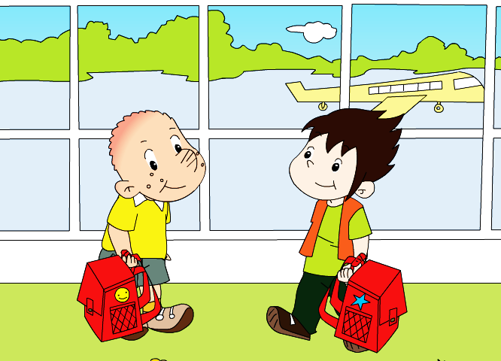
At the airport .
Where are they?

Slide 7
Look and listen: Where are they going?

Slide 8

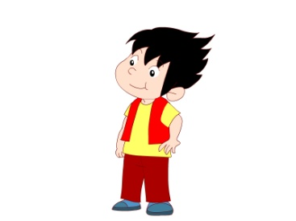
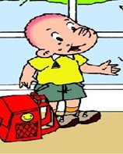
☆
1. Where is Xiaoyong going ?
Xiao yong
He is going to ________.
Hong Kong
☆
2. Where is Sam going ?
He is going to ________.
Hainan

Slide 9
☆
3. What is Sam going to do?
swim
sea
He is going to _____in the ____.

Slide 10
Listen and repeat:

Slide 11

My winter holiday plan
1. Fill in your suitcase!
2. Make your to-do list!
To-do list
1.
2.
3.
…

Slide 12
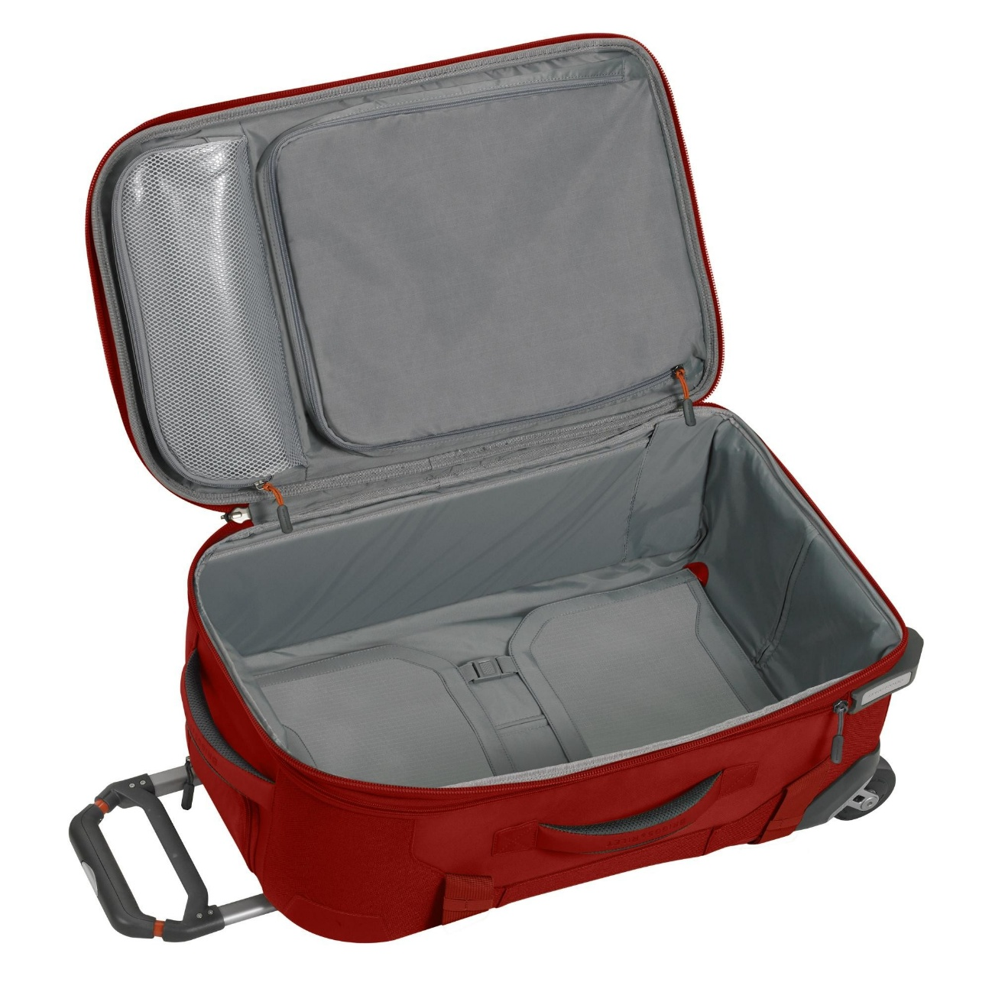
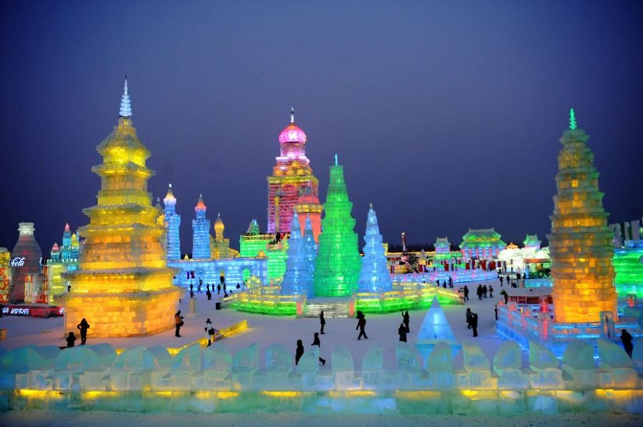
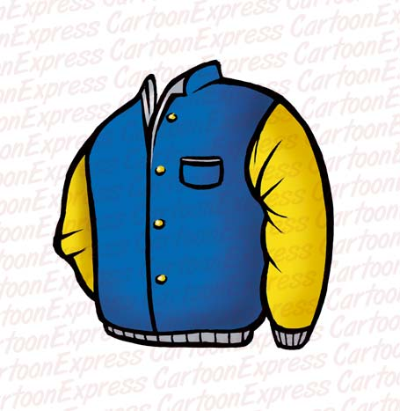
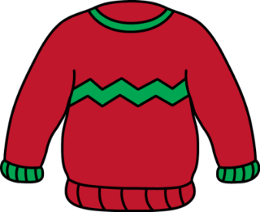







Are you going to _______?
I am going to_______.
What are you going to do?
Yes, I am.
/No, I am not.

Slide 13

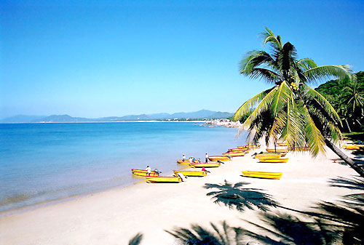

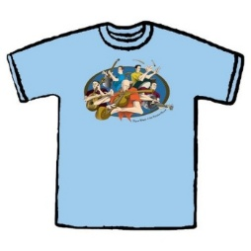
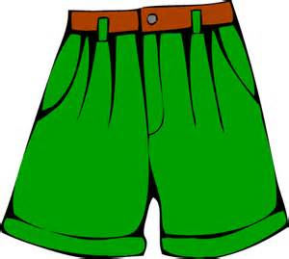

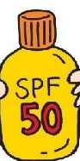

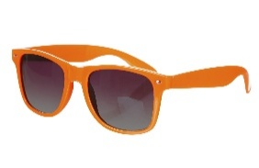
Are you going to _______?
I am going to_______.
What are you going to do?
Yes, I am.
/No, I am not.

Slide 14
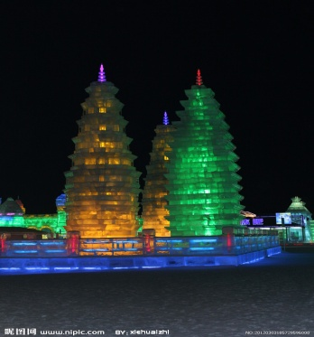
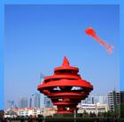
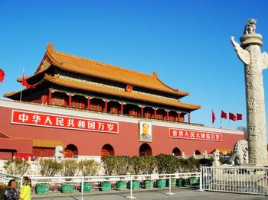

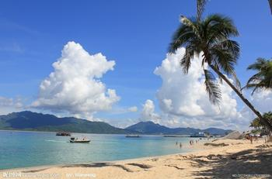
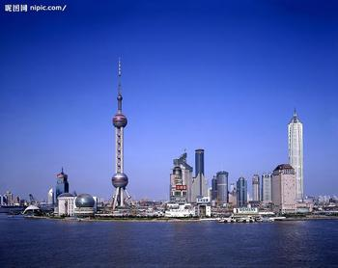
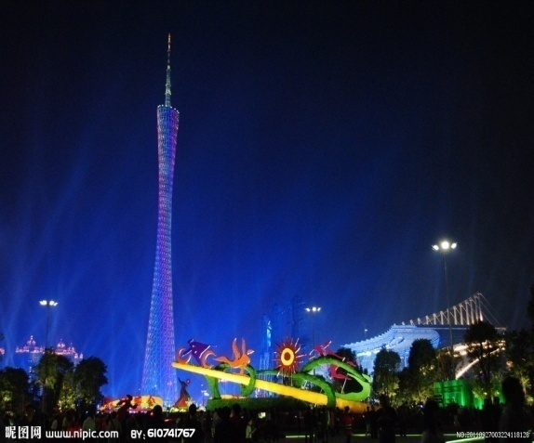
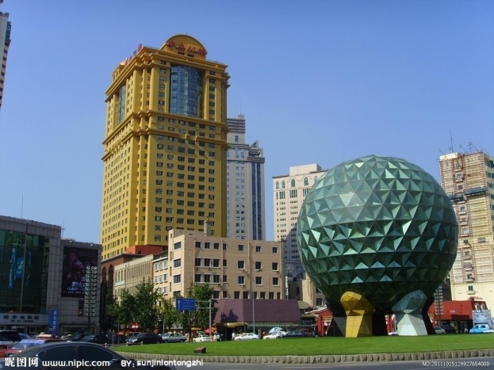
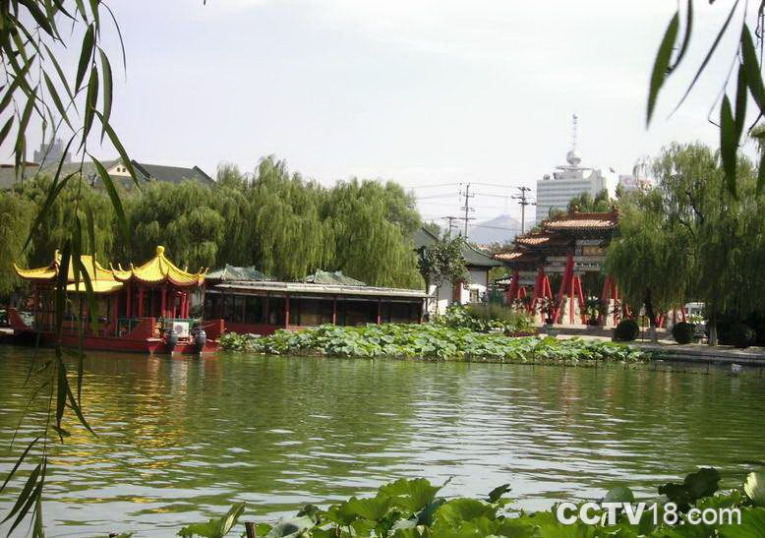
Group work :Ask and answer.
Qingdao
Haerbin哈尔滨
A: Are you going to___?
B: Yes ,I am./ No, I’m not.
Hainan
Shanghai
Dalian大连
Jinan济南
Guangzhou广州

Slide 15
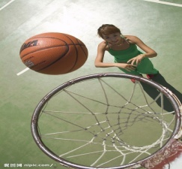
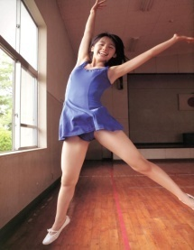
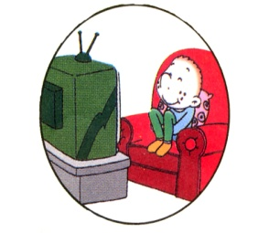

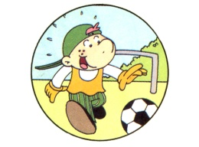
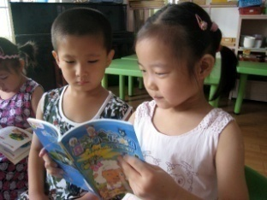

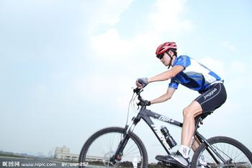

Practise（练习）
play basketball
listen to music
play football
dance
watch TV
swim
read books
sing
ride a bike
What are you going to do ?
I’m going to …

Slide 16

Listen ,point and circle “going to…”.
☆
☆

Slide 18
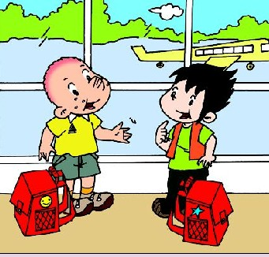
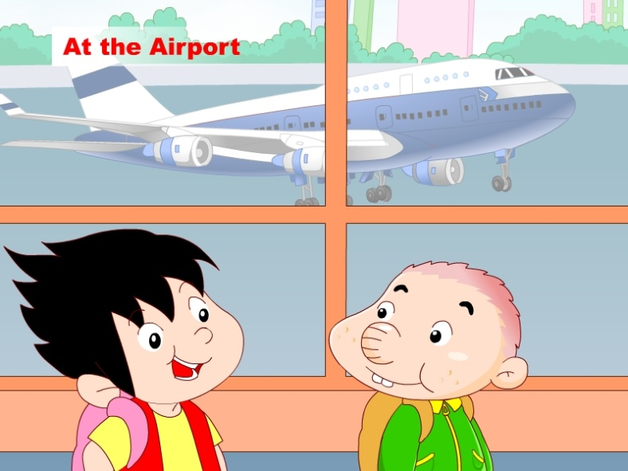
Listen ,point and circle “going to…”.
☆
☆
At the Airport
Hi ,
I’m Xiaoyong.
Hello ,my name’s
Sam.
Where are you going?
I’m going to go to Hong Kong. My grandma lives there.

Slide 19
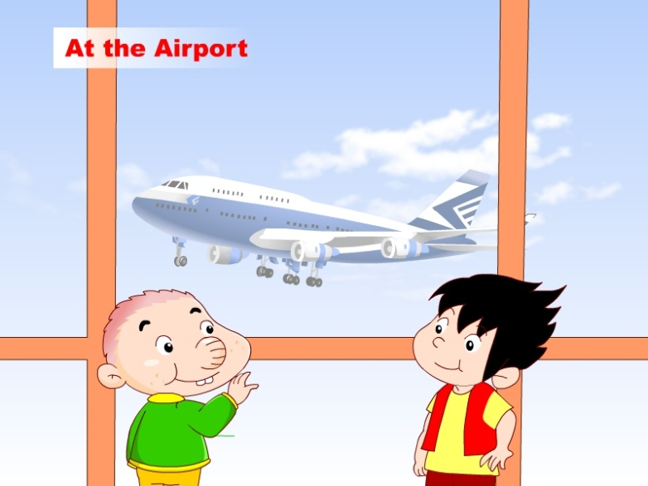
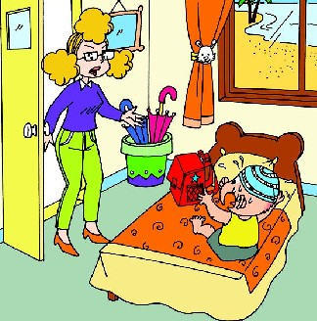
Listen ,point and circle “going to…”.
☆
☆
Are you going to go to Hong Kong?
What are you going to do, Sam?
No, I’m not. We’re going to go to Hainan.
In Hainan
I’m going to swim in the sea.
Oh no ! This is Xiaoyong’s bag !

Slide 20
Listen and repeat

Slide 21

Listen and find:

Slide 22
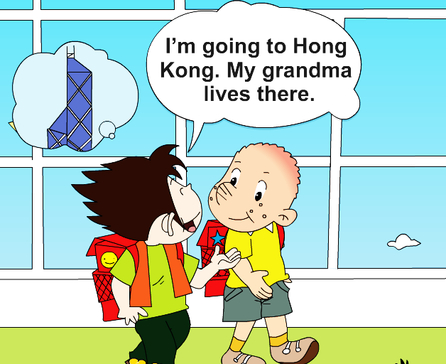
Where are you going?

Slide 23
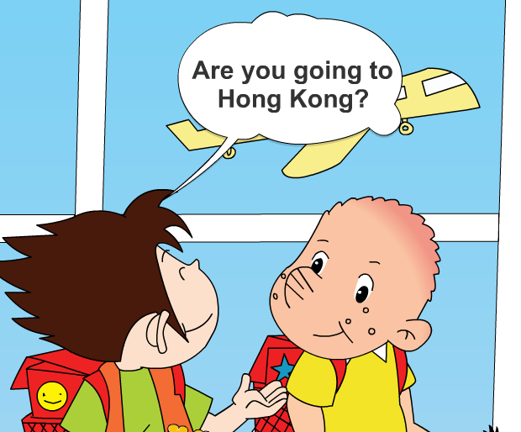
No. I’m going to_______.
Hainan

Slide 24
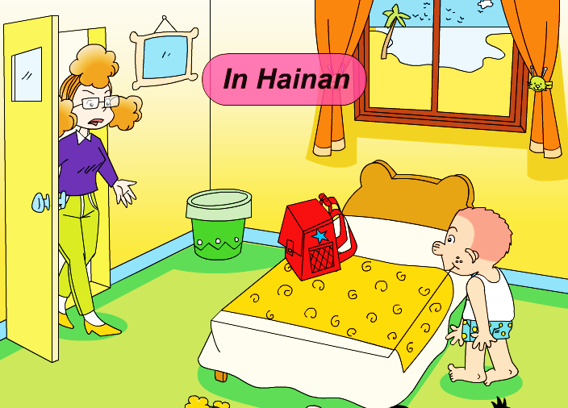
What are you going to do, Sam?
I’m going to _____________. Oh no! This is __________ bag!
swim in the sea
Xiaoyong’s

Slide 25
Listen and read

Slide 26
Retell and role-play

Slide 27
Where are you going?

Slide 28
No. I’m going to_______.

Slide 29
What are you going to do, Sam?
I’m going to ____in the _____. Oh no! This is ______’s bag!

Slide 30
1. Where is Xiaoyong going ?
☆
Xiao yong
A Hong Kong B Beijing
√
☆
2. Where is Sam going ?
A.Hong Kong B.Hainan
√

