Slide 1
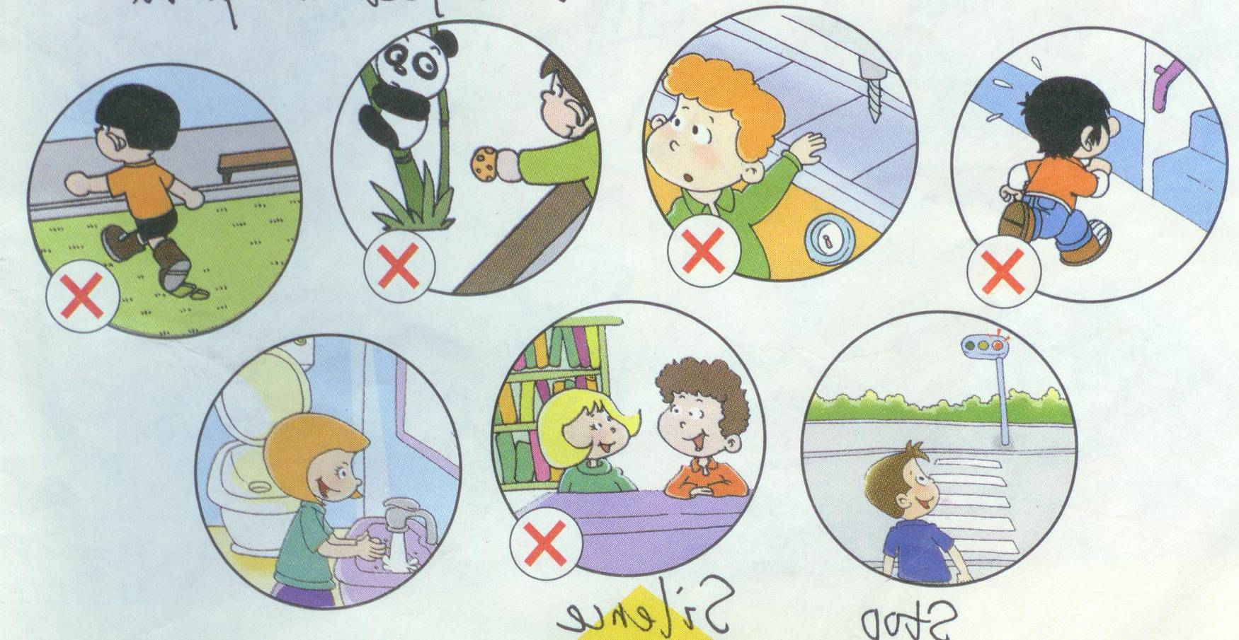
Module 1
Unit 1 Don’t touch the machines, please!
新标准英语
一年级起点四年级下册

Slide 2
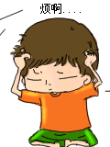
What does your mother often say to you?
妈妈经常对你说的话是什么？
S1: Don’t run, baby. Go home early!
S2: Don’t touch the dog.
S3: Eat the fruit!
S4: Eat the bread!
S5: And drink the milk, baby!
S6: Don’t watch TV!
S7: Don’t play computer game!

Slide 3

A song for our dear mother
《梦中的额吉》

Slide 4

What do you want to do
for your dear mother?

Slide 5
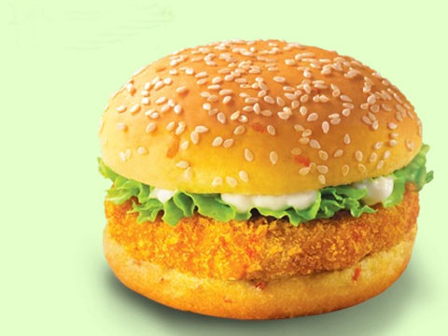
hamburger

Slide 6
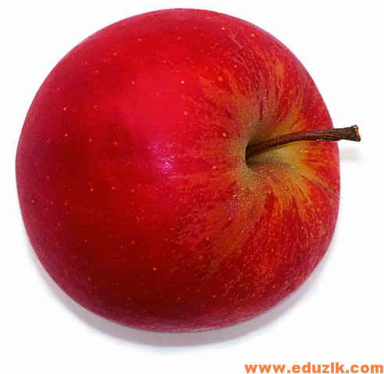

apple
Eat the apple, dear mum!

Slide 7
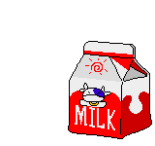
milk
Drink the milk, dear mother!

Slide 8
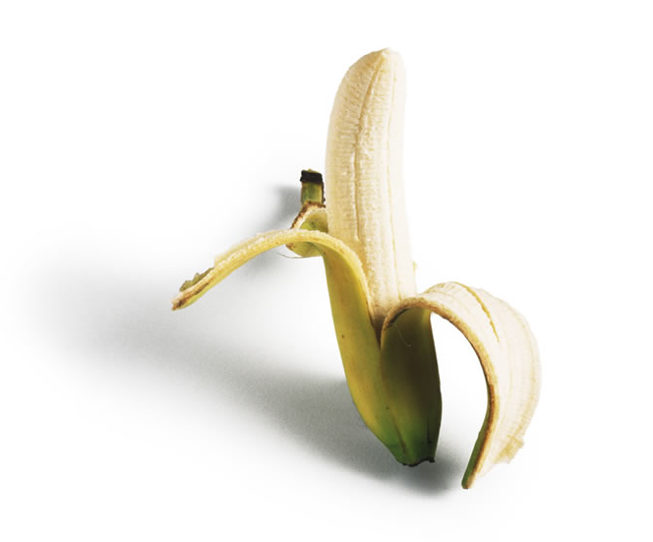
Eat a banana. It’s healthy!

Slide 9
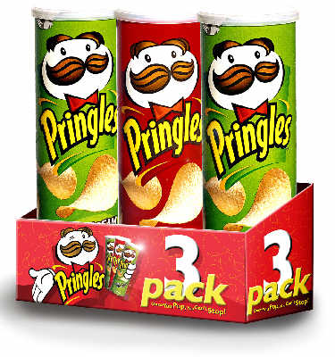
Eat the crisps,
It’s nice,
dear mum.

Slide 10
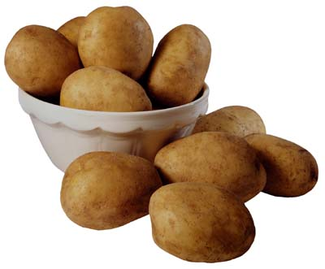
potatoes

Slide 11
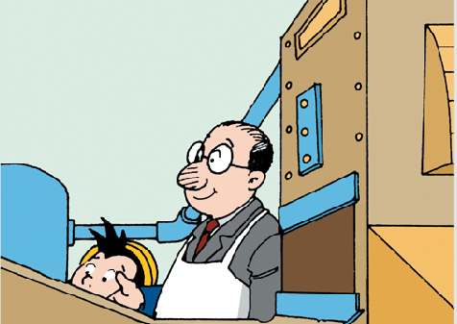
Sir.

Slide 12
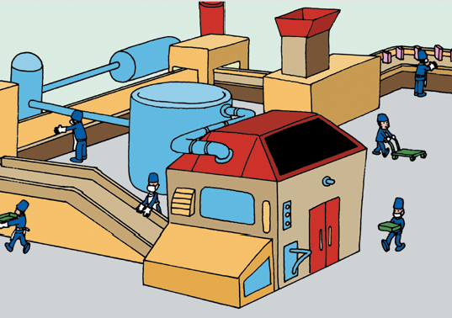
factory

Slide 13
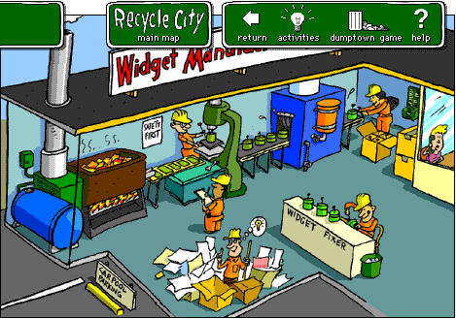
factory
machines

Slide 14
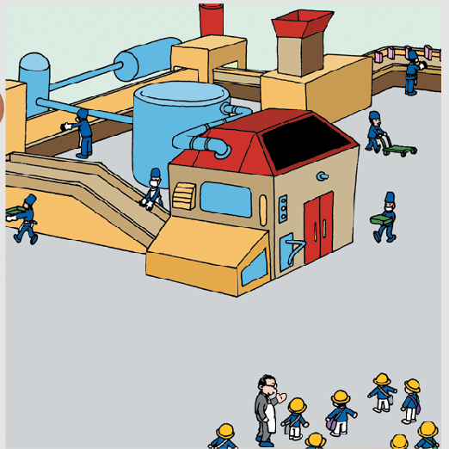
machine
factory

Slide 15
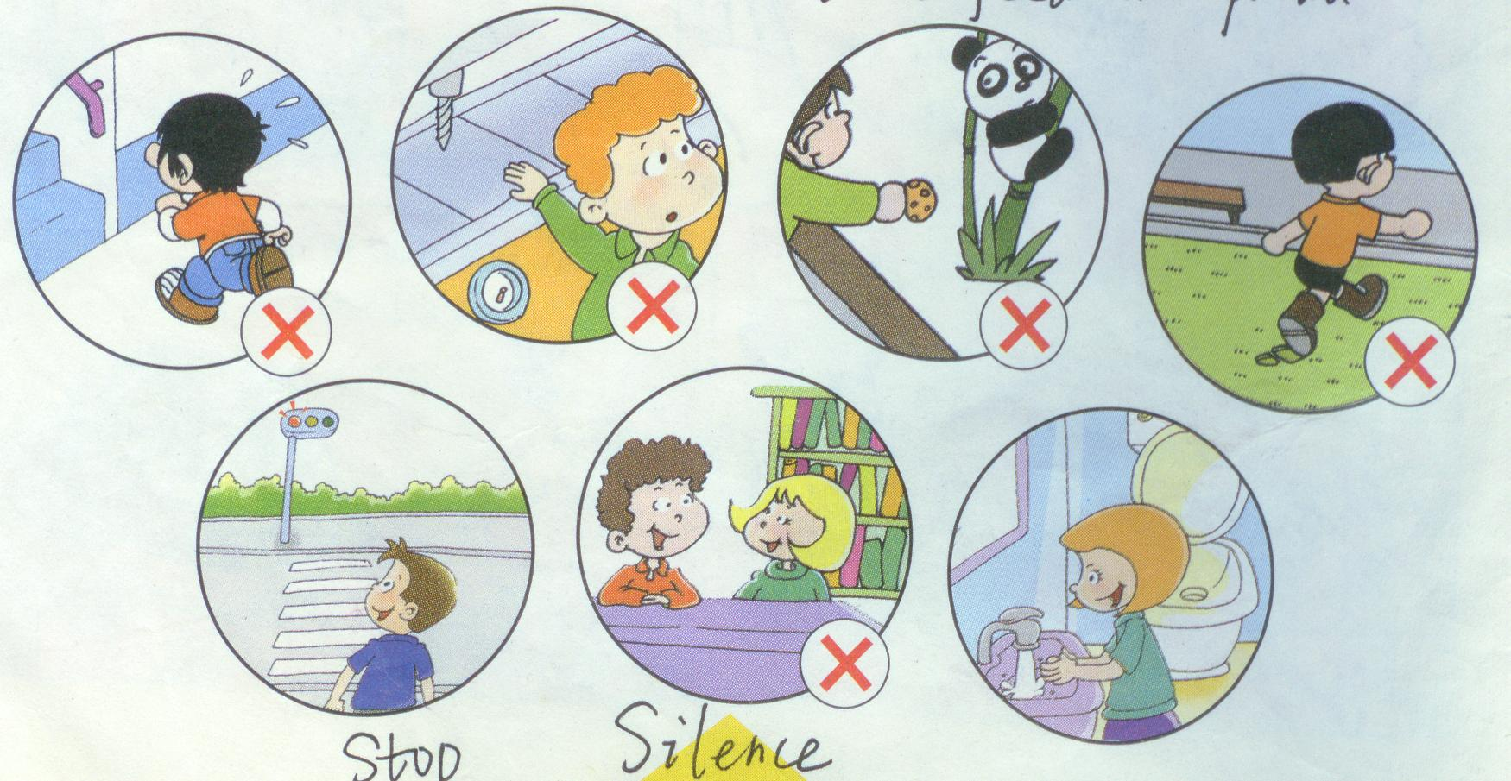
Don’t touch the machine!

Slide 16
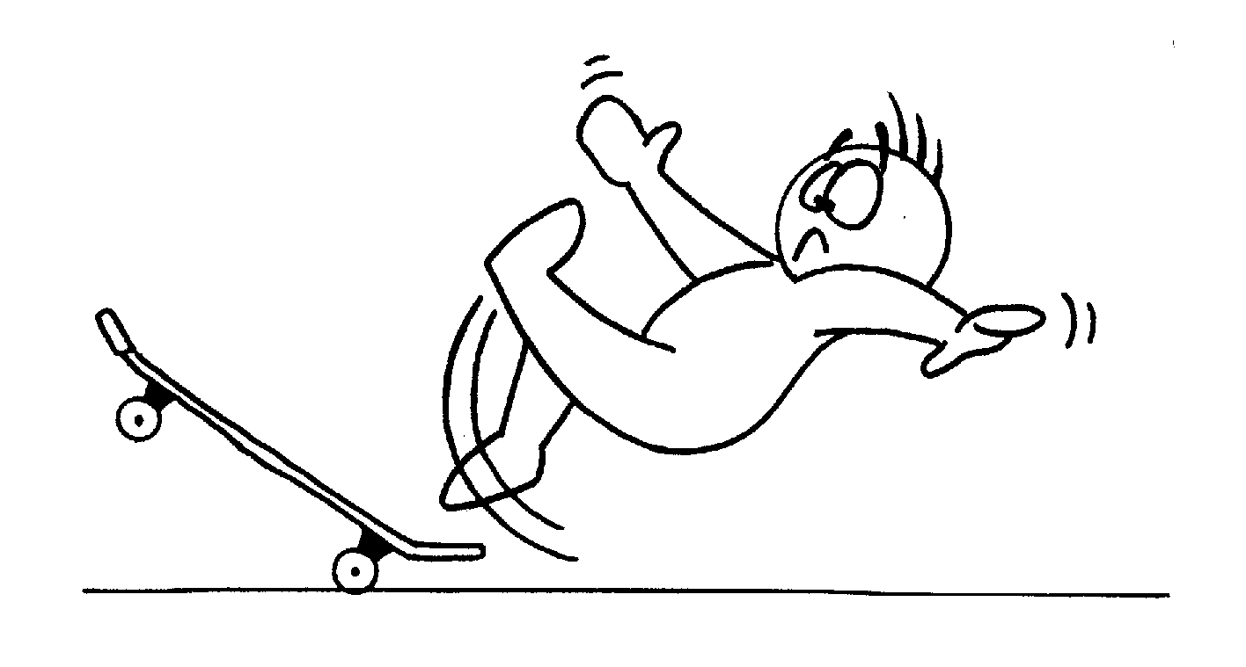
dangerous

Slide 17
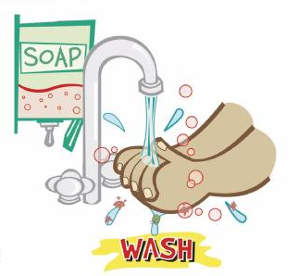
wash

Slide 18
Wash your hands!

Slide 19
It washes the potatoes.

Slide 20
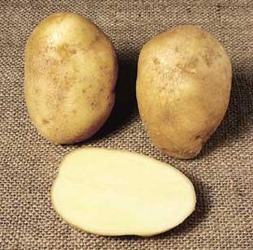
cut the potatoes

Slide 21
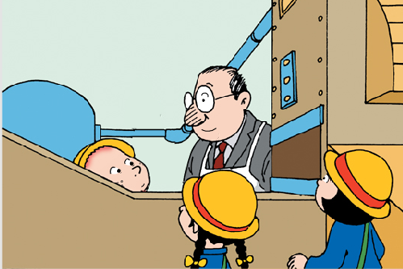
It cuts the potatoes.

Slide 22
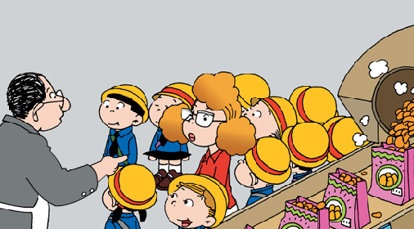
?
It puts the crisps in bags.

Slide 23
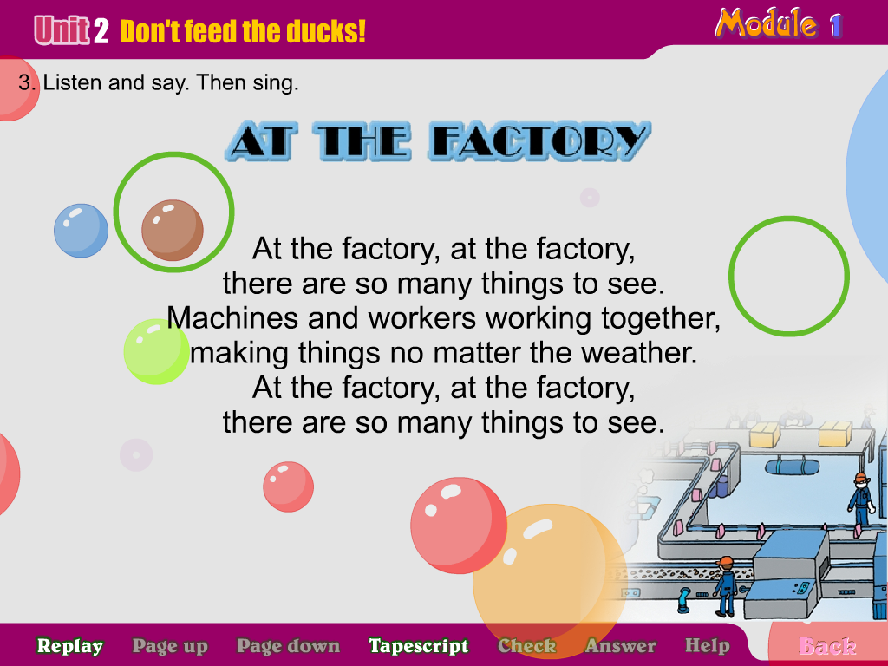
Crisps are OK!

Slide 24
Don’t touch the machine!

Slide 25
dangerous

Slide 26
大闯关
Practice
Practice
Texts
Text
Phrases
Phrases
words
Words

Slide 27
1.machine
9.put
2.sir
English
to
Chinese
8.crisps
3.potato
7.factory
4.dangerous
6.welcome
5.touch

Slide 28

Watch my lips,
Say English or Chinese.
火眼金睛读唇语

Slide 29
Listen to the recording,
and imitate.
金口才，读课文

Slide 30

Think it over . 聪明小脑瓜
1. This machine is very .
So ______ _____ the machine.
2.What should we do in the factory?
3.What shouldn’t we do in the factory?
4.Can we touch the machine ?
5.Can we run in the factory?
6.How to make the potatoes into crisps?

