Slide 1
Module 3
Unit 2 You can use the computers.
新标准英语
一年级起点五年级下册

Slide 2
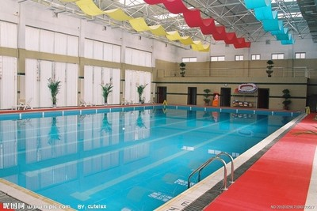

Slide 3
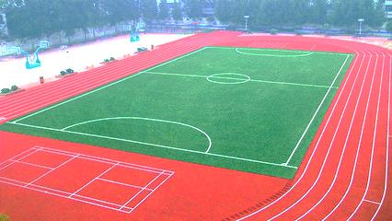

Slide 4
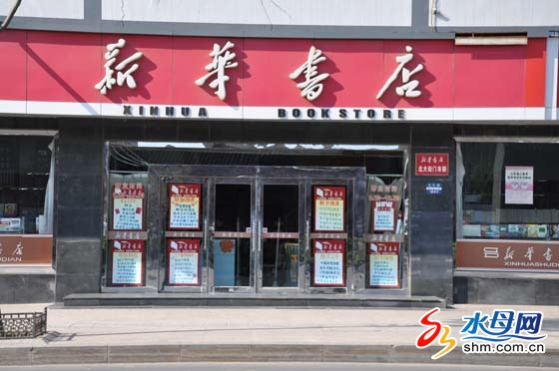

Slide 5
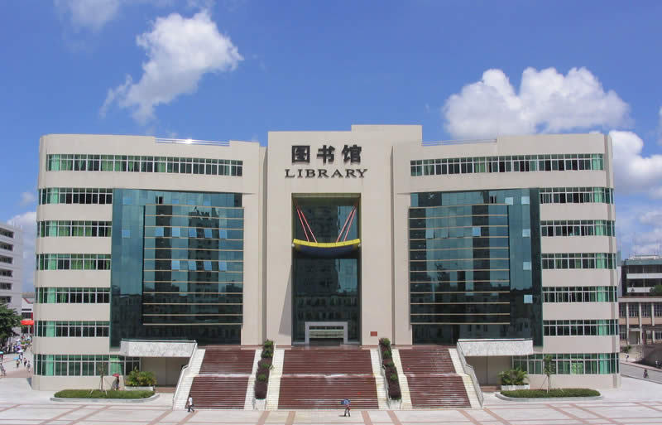

Slide 6
True or False.
Library Rules
You can borrow books, CDs and DVDs.
You can speak.
You can read books.
You can run.
You can use the computers.
You can do your homework.
You can watch TV.

Slide 7
Let’s read.
Library Rules
You can borrow books, CDs and DVDs.
You can’t speak.
You can read books.
You can’t run.
You can use the computers.
You can do your homework.
You can’t watch TV.

Slide 8
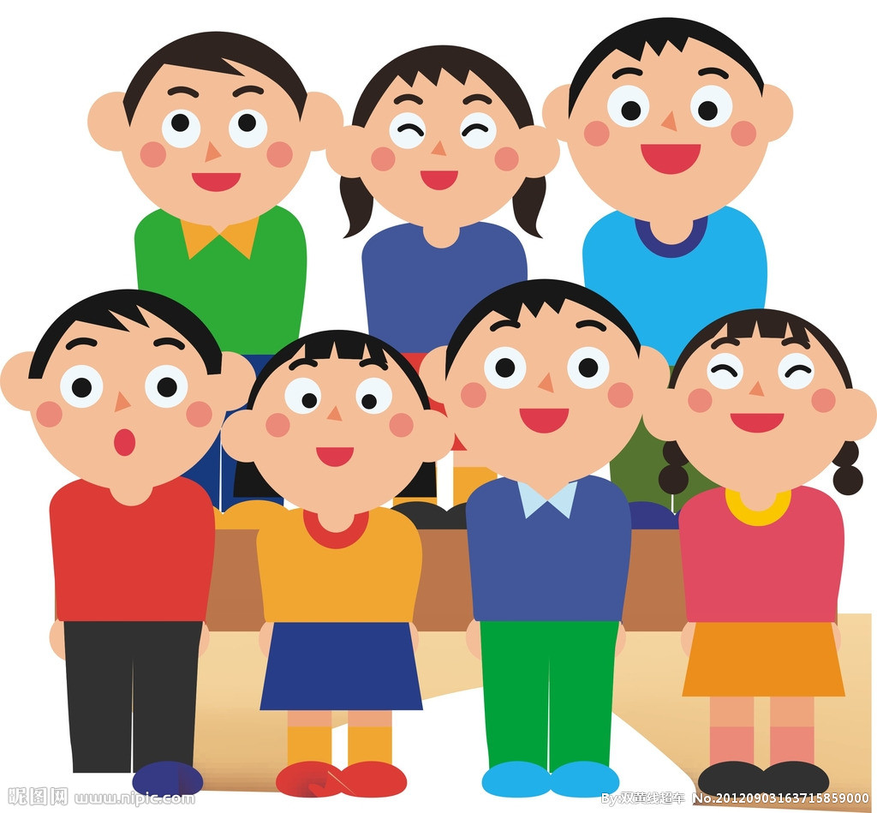
Group work

Slide 9
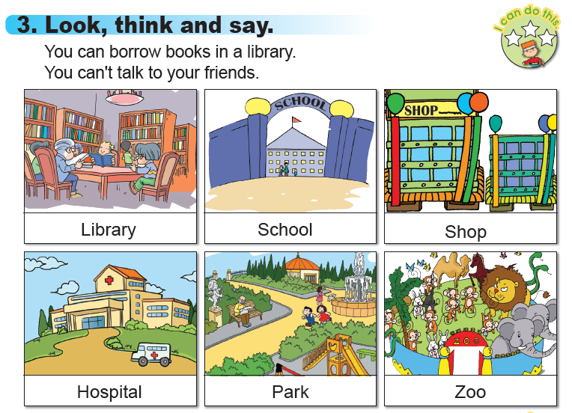

Slide 10
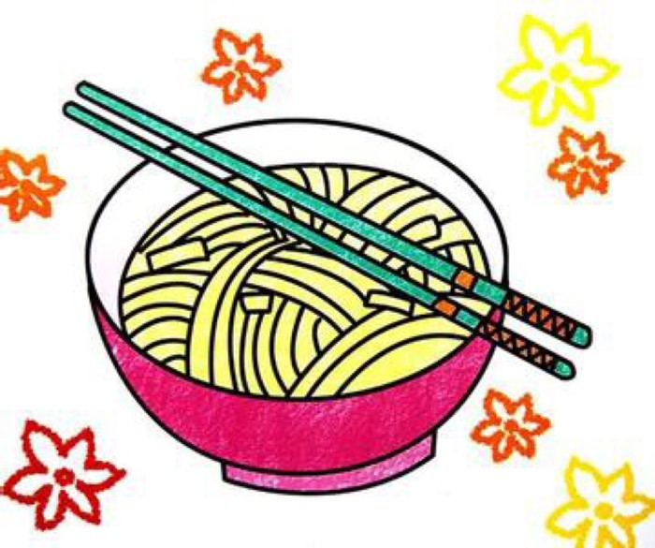

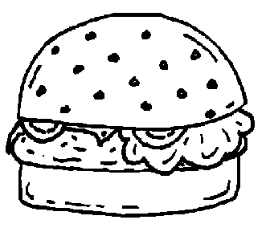


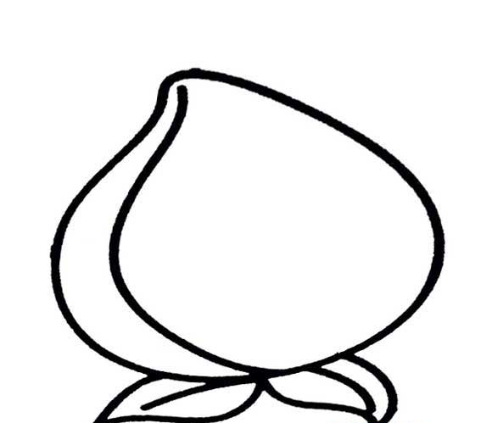
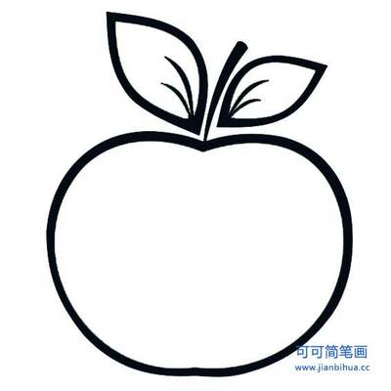



Slide 11


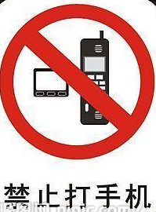
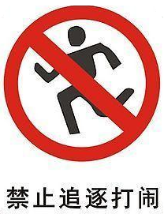





Slide 12
Class Rules
You can …
You can’t …

Slide 13
Homework
结合照片或图画，和爸爸妈妈讨论制作一份
“Family Rules（家规）”。

