Slide 1
Module 2
Unit 1 It’s cheap.
新标准英语
一年级起点四年级下册

Slide 2
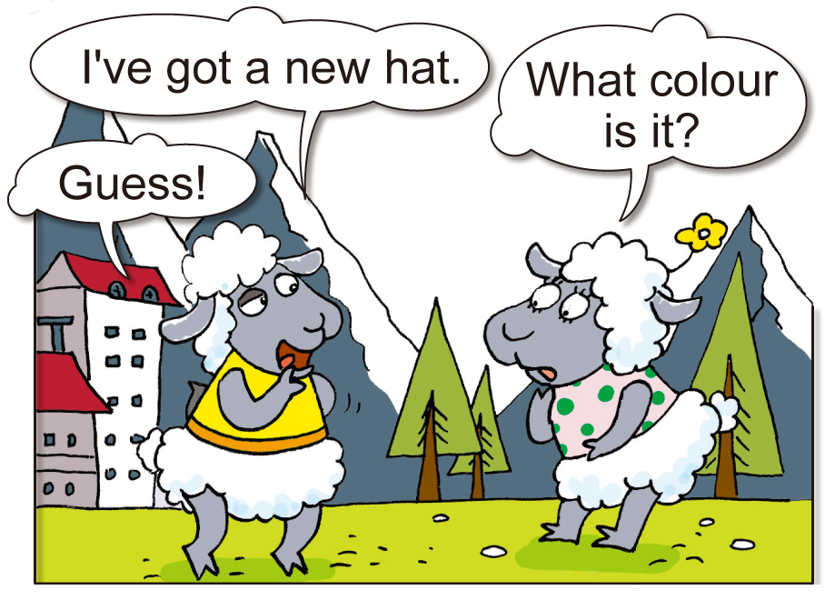
Look and say.

Slide 3
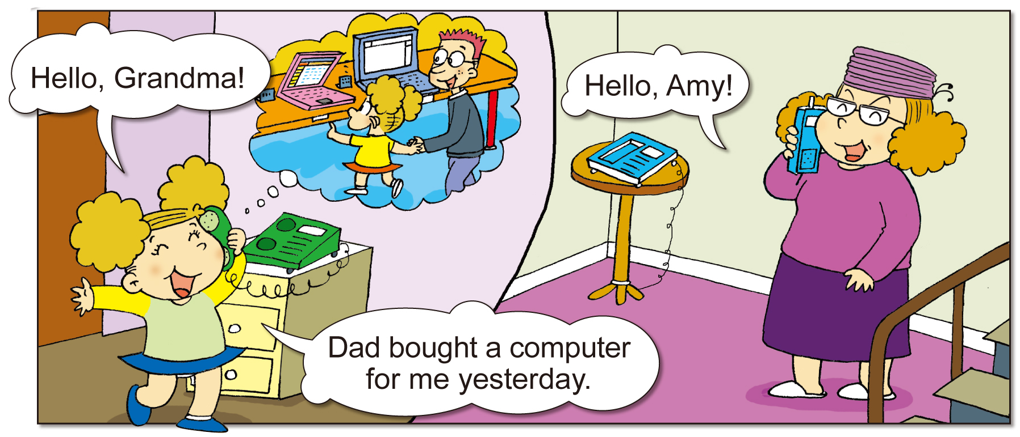
Look and say.

Slide 4
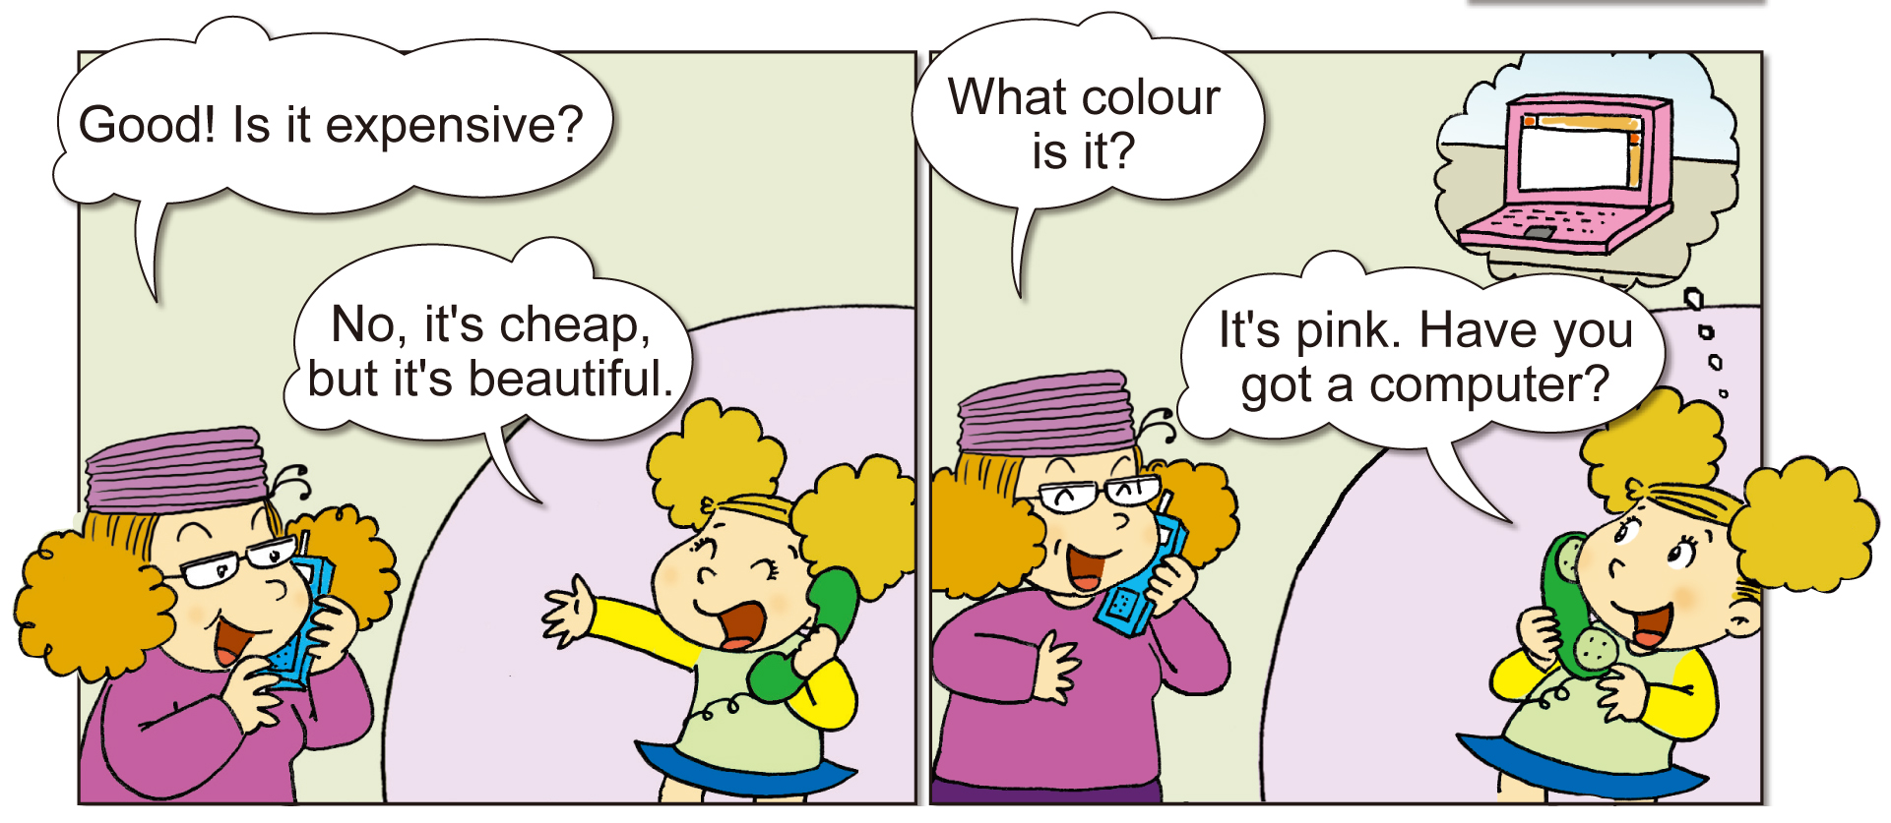
Look and say.

Slide 5

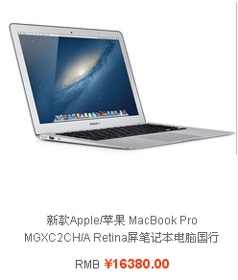
The computer is expensive.

Slide 6
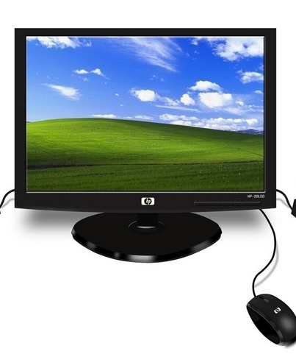
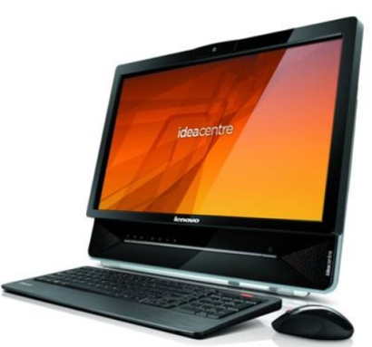

big
small
￥2,000
￥6,000
The _____computer is expensive.
big

Slide 7
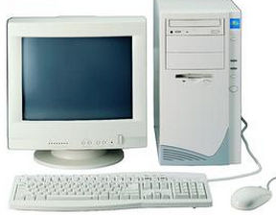
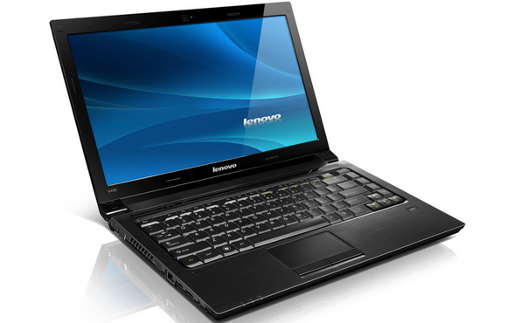
new
old
￥100
￥5,000
The _____ computer is expensive.
new

Slide 8
Look and say.

Slide 9
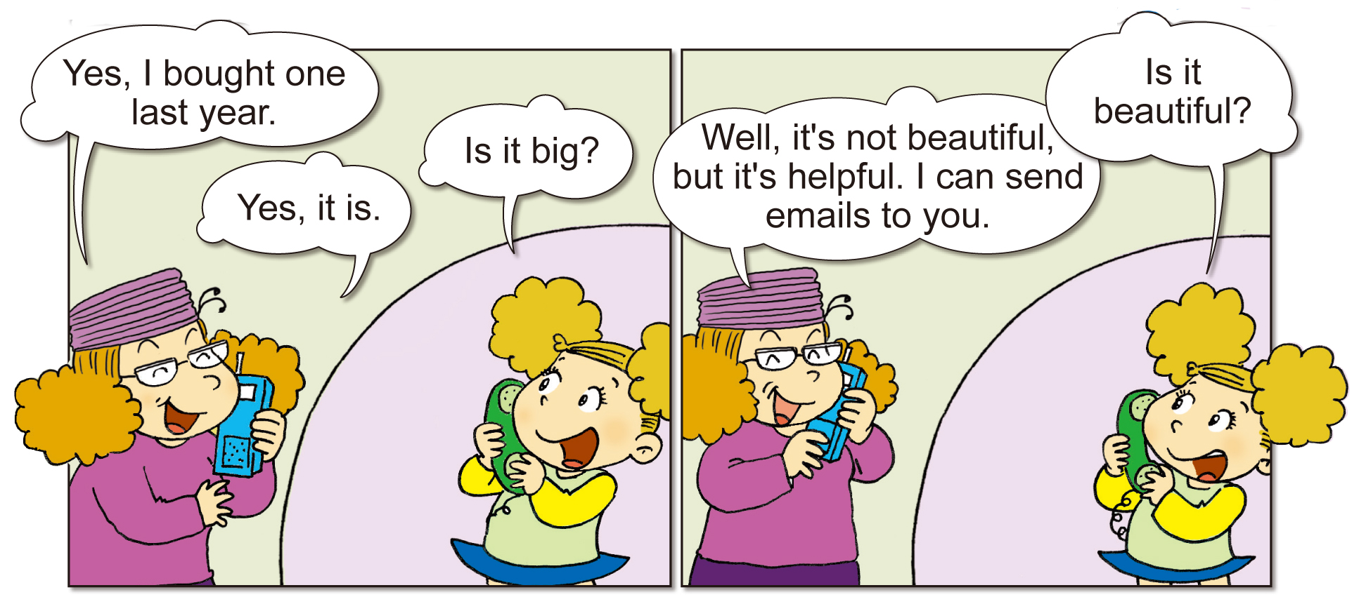
?
?

Slide 10
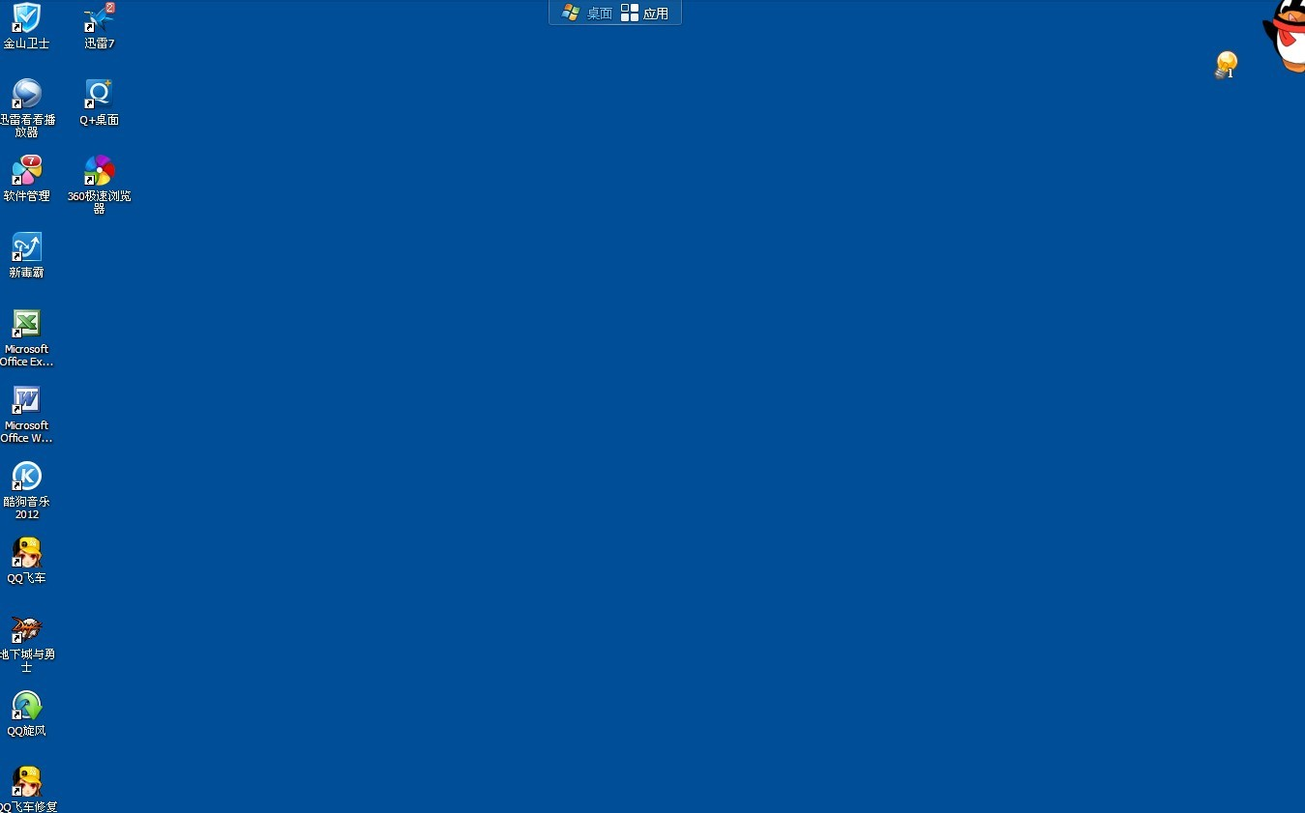
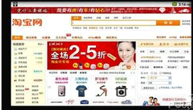
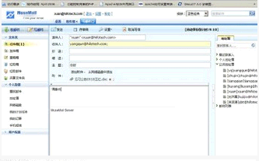
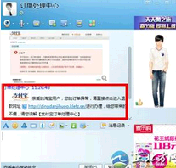
Think and say.
Buy…
Talk…
It’s helpful.
I can send emails to you.

Slide 11
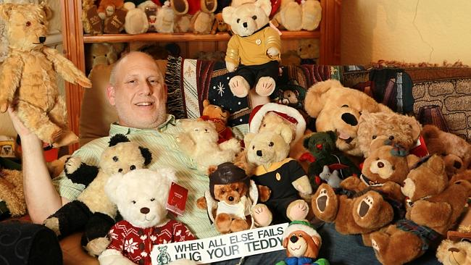
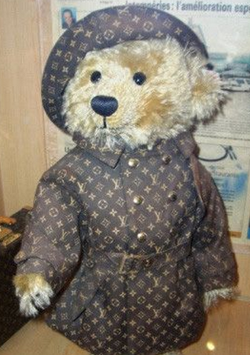
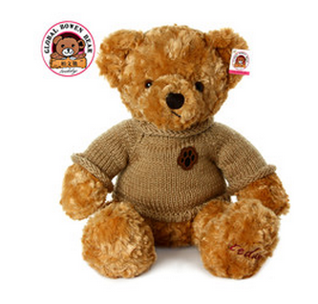
Look and guess.
￥1,400,000
￥68
The ___ Teddy bear is expensive.
old

Slide 12

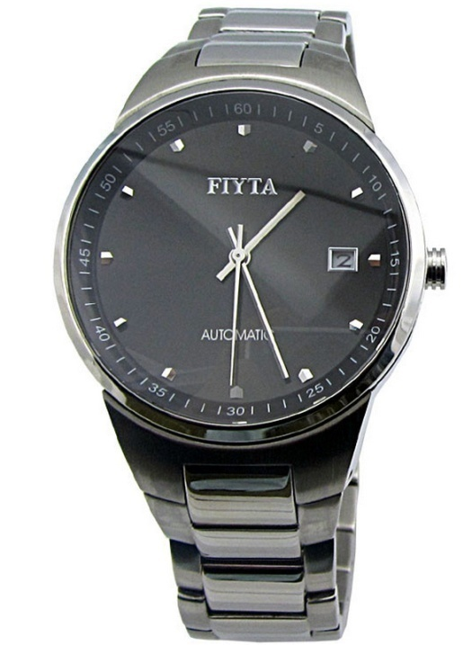

Look and guess.
Is it…?
￥300

Slide 13


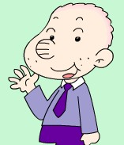
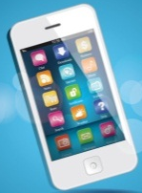


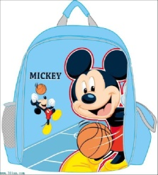
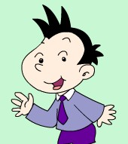


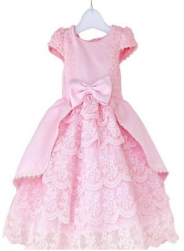
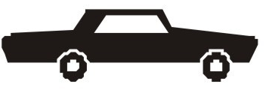
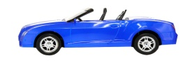
Read and talk.
Ms Smart bought a phone last week.
It is new. It’s white and beautiful.
It’s expensive. It’s helpful.
She can book（预定） a taxi on the phone.
Sam bought a school bag on Sunday.
It’s big and blue. It’s not expensive, but it’s helpful.
He can put many books in it.
Daming bought a toy car yesterday.
It is blue and big.
It’s cheap, it’s cool.
The car can run fast.
Dad bought a dress for Lingling.
It is long. It’s pink and beautiful.
It’s not cheap.
Lingling likes it very much.

Slide 14

Group Work
Step1 Choose a card, read it silently.

Slide 15
Group Work
Step2 Ask and fill the blanks on the paper.

Slide 16


Ask and fill.
Ms Smart bought a phone.
Ms Smart bought a phone________.
It is ____. It’s ____ and _______.
It’s _______. It’s ______.
She can _________
_____ on the phone.
When …? Is it…? What color…? What can it / she do?
It’s …/ I don’t know./ …
Tips:
When? last…, yesterday,…
What is it like? beautiful, small / big, tall / short, long / short, old / new…;
color…;
Price（价值） expensive-cheap;
What can it do? helpful…

Slide 17








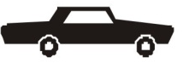

Ms Smart bought a phone________.
It is ____. It’s ____ and _______.
It’s _______. It’s ______.
She can _________ on the phone.
Sam bought a school bag on ______.
It’s ___ and ___. It’s ___________, but it’s ______.
He can ________.
…bought a …
When …? Is it…?
What color…? What can it / she do?
Daming bought a toy car _______.
It is ____ and ___.
It’s ___, it’s cool.
The car can _____.
Dad bought a dress for Lingling.
It is ____. It’s ____ and _______.
It’s _______.
Lingling likes it very much.
It’s …/
I don’t know./ …
Tips:
When? last…, yesterday,…
What is it like? beautiful, small / big, tall / short, long / short, old / new…;
color…;
Price（价值） expensive-cheap;
What can it do? helpful…

Slide 18

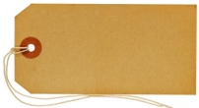
Read and check.
Ms Smart bought a phone last week.
It is new. It’s white and beautiful.
It’s expensive. It’s helpful.
She can book（预定） a taxi on the phone.
Sam bought a school bag on Sunday.
It’s big and blue. It’s not expensive, but it’s helpful.
He can put many books in it.
￥3,500
￥49
Daming bought a toy car yesterday.
It is blue and big.
It’s cheap, it’s cool.
The car can run fast.
Dad bought a dress for Lingling.
It is long. It’s pink and beautiful.
It’s not cheap.
Lingling likes it very much.
￥25
￥289

Slide 19


Pair Work
I’ve got …/ … bought …
When …? Is it…? What color…? What can it / you do?
Tips:
When? last…, yesterday,…
What is it like? beautiful, small / big, tall / short, long / short, old / new…;
color…;
Price（价值） expensive-cheap;
What can it do? helpful…

Slide 20
Look and think.
Observe carefully, you will find more.
仔细观察，你会发现更多……
expensive
beautiful
big
cheap
helpful

Slide 21
Homework:
1. Read the dialogue.
2. Draw and describe more things you have got.

