Slide 1
Module 3
Unit 2 She went into a shop.
新标准英语
一年级起点四年级下册

Slide 2
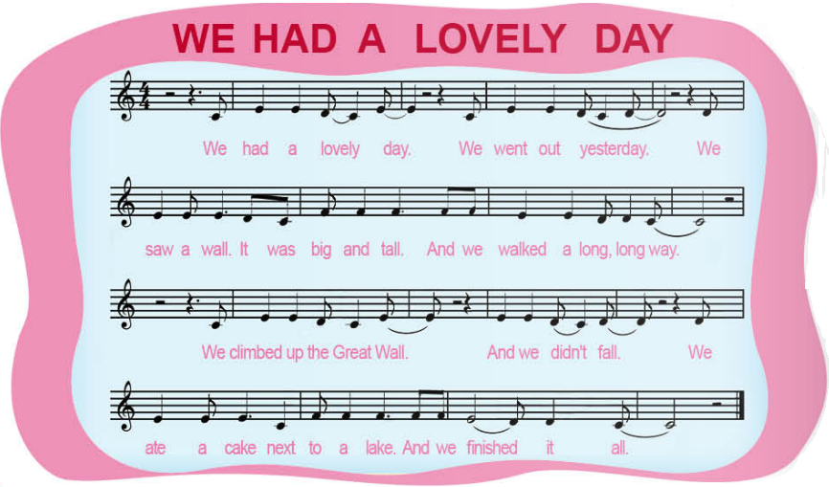

Slide 3
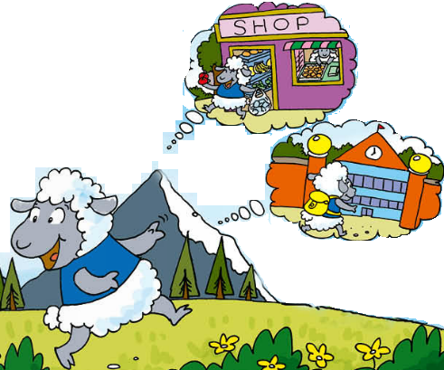
Listen, look and answer.
What did the sheep do yesterday?
went to the shop
She ______________________________.
bought some apples and ate two
She ______________________________.
went to school
She __________________________then.

Slide 4
go
went
buy
bought
eat
ate

Slide 5
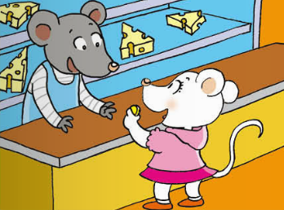
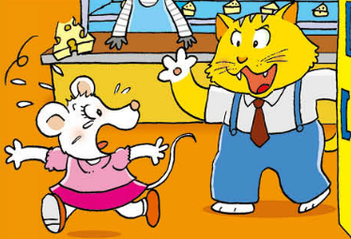
Look, guess and say.
Whose shop is it?

Slide 6
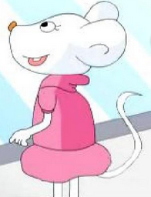
Listen and answer.
What’s it?
It’s a mouse.
What’s her name?
Tilly.

Slide 7
Where did she go?
She went into a shop.
What did she do there?
She bought some cheese and she ate it.

Slide 8
What happened then?
She saw a cat in the shop.
She was scared and ran away.

Slide 9

看图，用所给的词简述课文
go into, buy, eat, see, be scared, run away

Slide 10

Yesterday, I went skating.
It was cold. I had got a cold. / I had got a fever.
I went to the hospital. / I went to see a doctor.
Then I took some medicine at home.

Slide 11

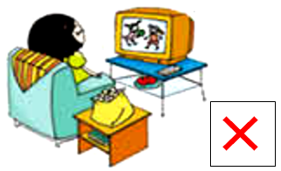
He played football yesterday.
√
She didn’t watch TV yesterday.

Slide 12
