Slide 1
Module 4
Unit 1 Dad played the erhu.
新标准英语
一年级起点四年级下册

Slide 2
Let 's sing

Slide 3


Activity 4 Listen and say. Then sing.
活动 4 听录音并说一说，然后唱一唱。
I SAW THE MUSICIAN
I saw the musician.
He came from far away.
And he played.
What did he play?
He played the violin.
Vio-vio-violin, violin, violin.
He played the drums.
Drum, drum, drum. He played the piano.
Pia-pia-piano, piano, piano.

Slide 4



Let's talk
What did you do yesterday？

Slide 5

violin

Slide 6
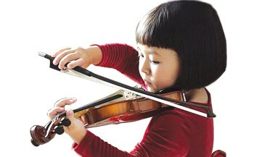
What did ________?
She____________.
she play
played the violin.
violin

Slide 7

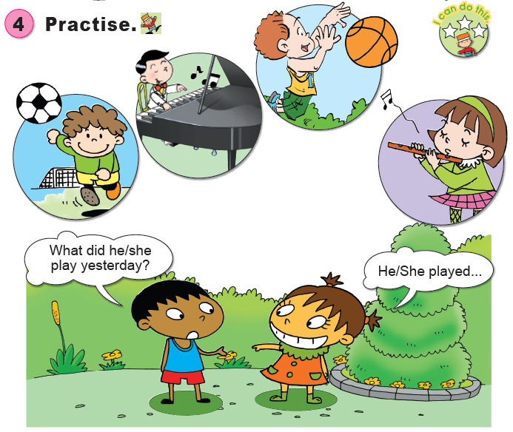

What did he play?
He played _____.

Slide 8
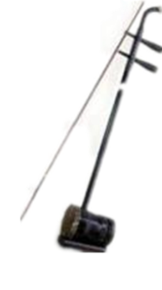
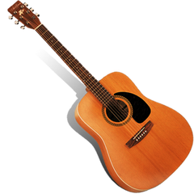

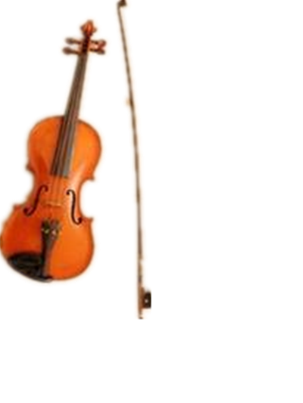
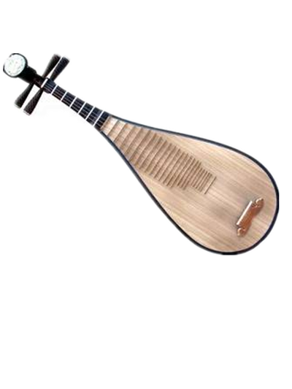
Listen to the music and guess.
What ’s this?
guitar
erhu
pipa
violin

Slide 9
Listen to the music and number.
(2)
(1)
(4)
(3)

Slide 10
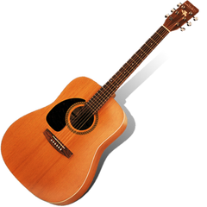
The pipa looks like a guitar.

Slide 11
The pipa looks like a guitar.

Slide 12
The pipa looks like a guitar.

Slide 13
The pipa looks like a guitar.

Slide 14
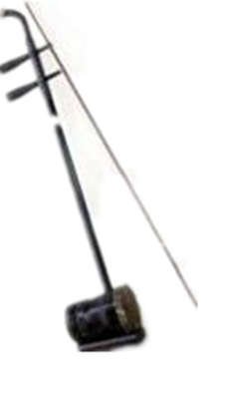
The erhu looks like a volin.

Slide 15
The erhu looks like a volin.

Slide 16
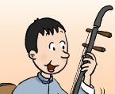
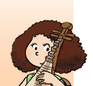
Who is he?
Who is she?
He is Lingling's dad.
She is Lingling's mum.
火眼金睛快速识人

Slide 17
我行我秀金口才
What did he play?
What did she play?
He played the erhu.
She played the pipa.

Slide 18
我行我秀金口才
Where did he play the erhu?
Where did she play the pipa?
In the concert.
In the concert.

Slide 19

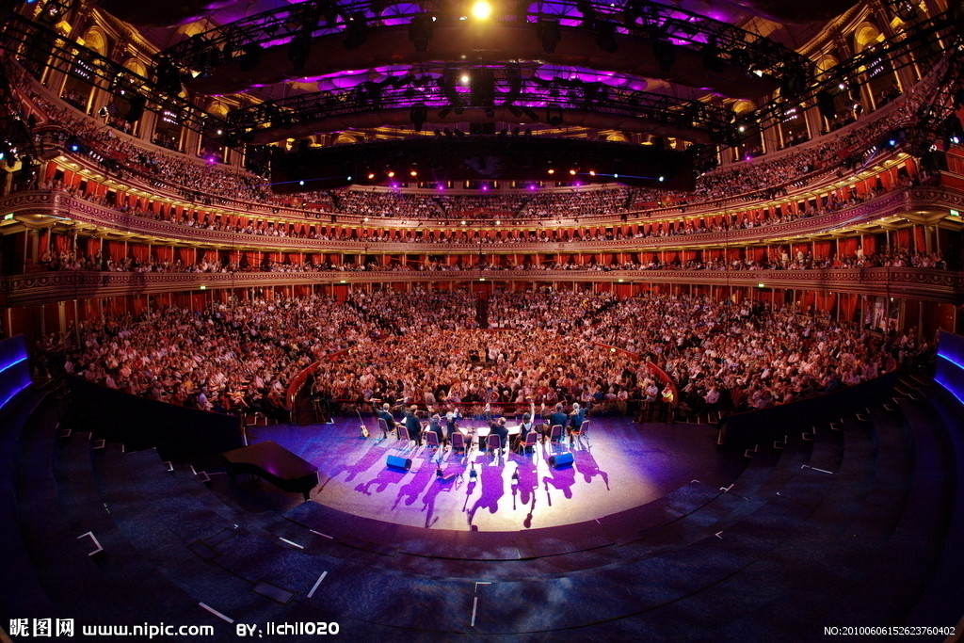

Slide 20
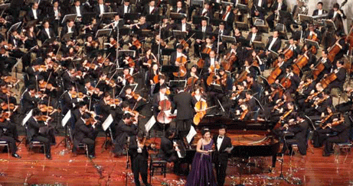
concert

Slide 21

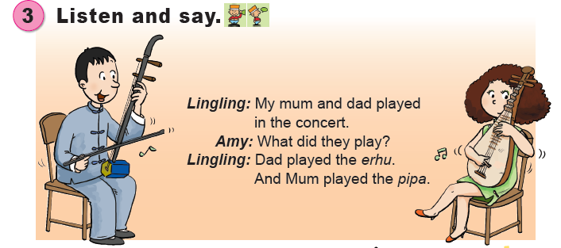

Slide 22

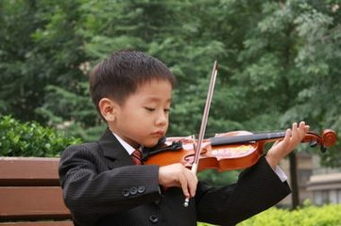
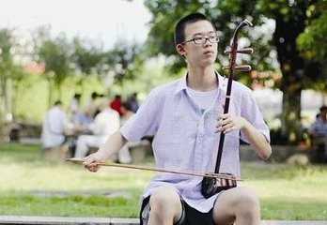
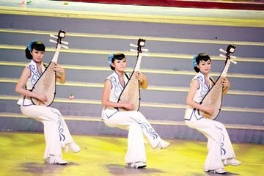
What did ____ play?
___ played the____.

Slide 23
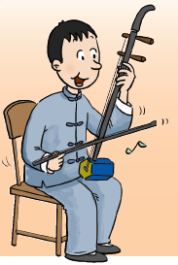
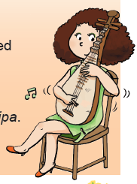
What did____ play?
___ played the____.

Slide 24


1. Was Amy in the concert?
2. Was Lingling in the concert?
3. Was Lingling’s mum in the concert?
4. Who were in the concert?
5. What did Lingling’s Dad play?
6. What did Lingling’s Mum play?
7. What did Lingling do?
疑难问题辨辩辨

Slide 25
Homework
Follow the E-pen and repeat the text.
2. Talk about the special concert in English.
3. Ask and answer the activity 3,4 in pairs.

