Slide 1
Module 3 Unit 1
The sun is shining.
棠外附小 金永迪

Slide 3
Dear Lingling,
How are you? I had a very __________ day on Saturday.
We had a _______ in the park. I ___________ you some
________.
I miss________ in China. Please write to me soon.
Love,
Daming
interesting
picnic
am sending
photos
everyone

Slide 4
This story is really interesting
Amy is interested in telling story
interesting:描述事物
interested: 描述人

Slide 5
Dear Lingling,
How are you? I had a very __________ day on Saturday.
We had a _______ in the park. I ___________ you some
________.
I miss________ in China. Please write to me soon.
Love,
Daming
interesting
picnic
am sending
photos
everyone

Slide 6
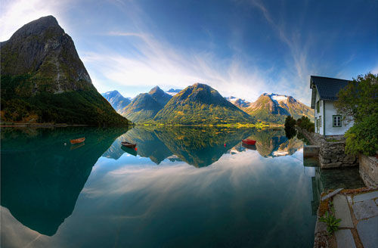
photo
photos

Slide 7
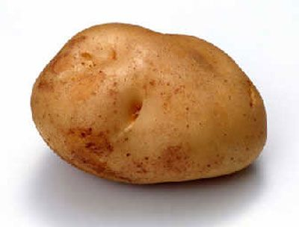
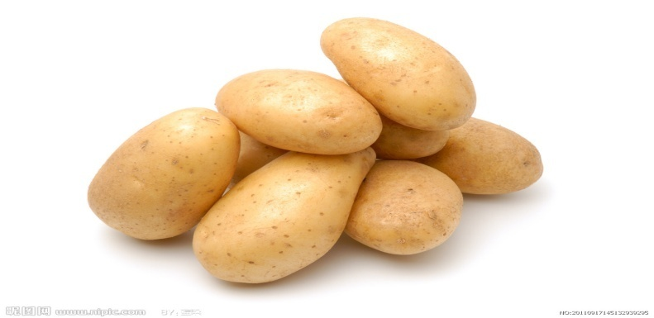
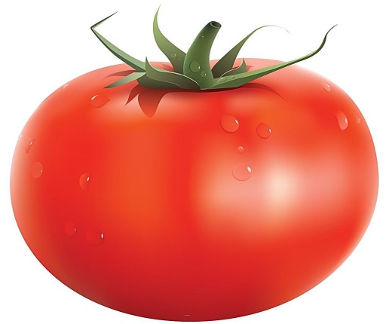
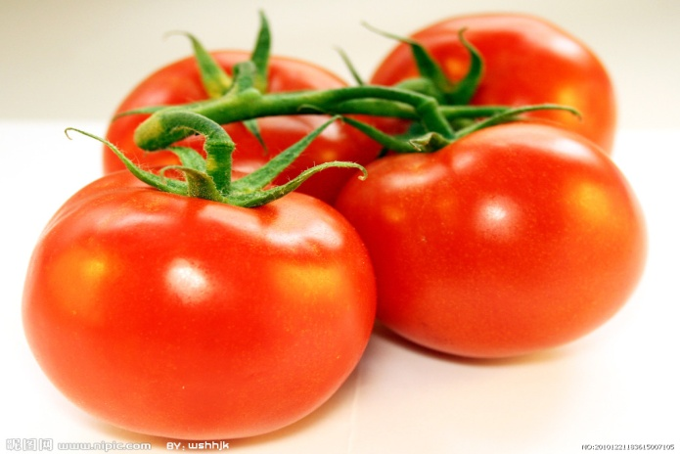
potato
potatoes
tomato
tomatoes

Slide 8
单数
复数
photo
photos
potato
potatoes
tomato
tomatoes

Slide 9
Dear Lingling,
How are you? I had a very __________ day on Saturday.
We had a _______ in the park. I ___________ you some
________.
I miss________ in China. Please write to me soon.
Love,
Daming
interesting
picnic
am sending
photos
everyone

Slide 10
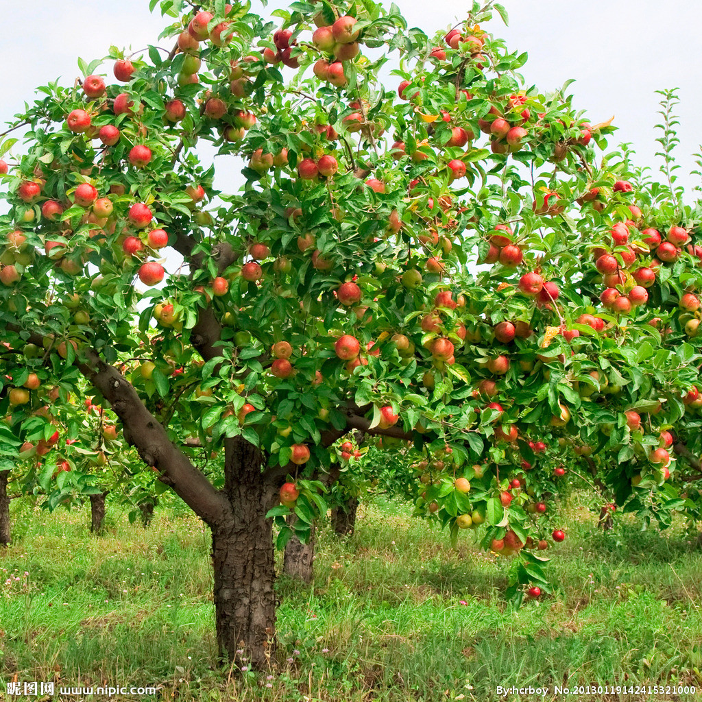
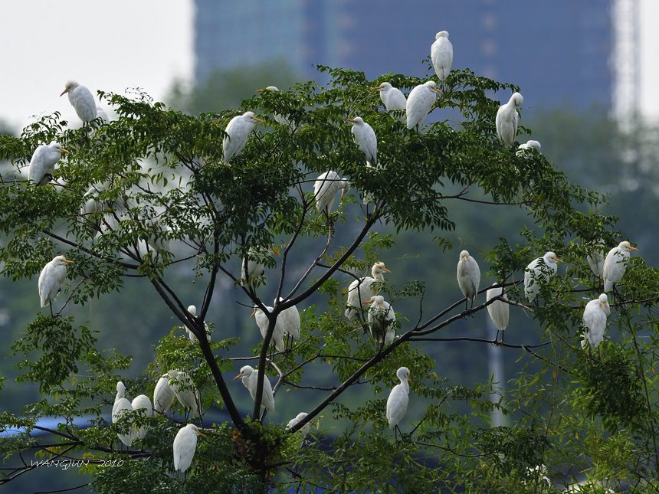
There are many birds in the tree.
There are many apples on the tree

Slide 11
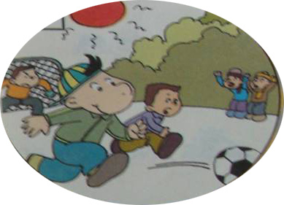
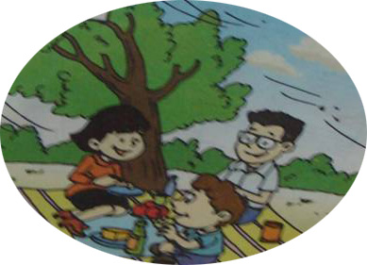
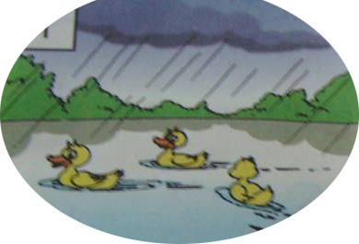
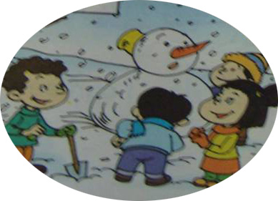
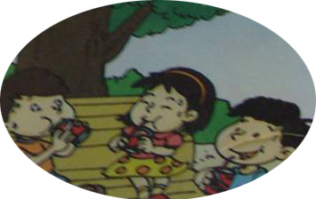
Talk about the pictures
A: In this photo, it’s raining.
B: No. 1 .
The ducks are swimming in the water.
1
2
3
4
5

Slide 12
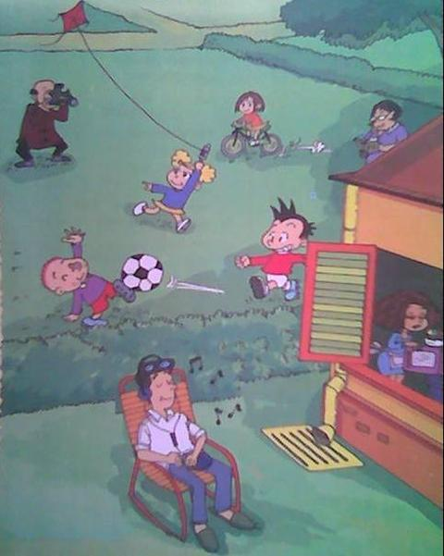
Look! What are they doing?

Slide 13
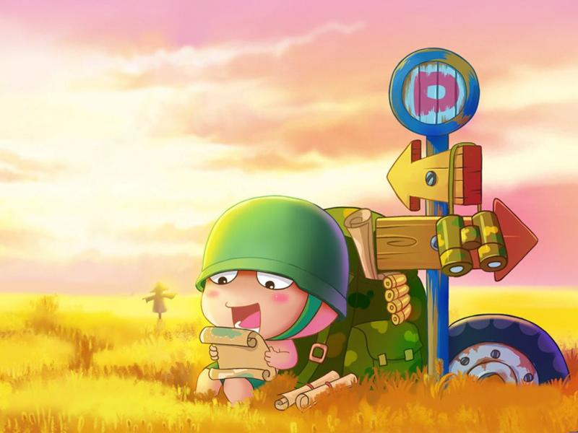
Thank you!

