Slide 1
Module 8
Unit1 Why do you have cups
on your heads?
新标准英语
一年级起点六年级下册

Slide 2
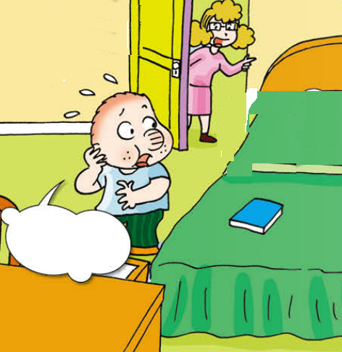
Listen and answer.
Where’s Sam’s bag?

Slide 3
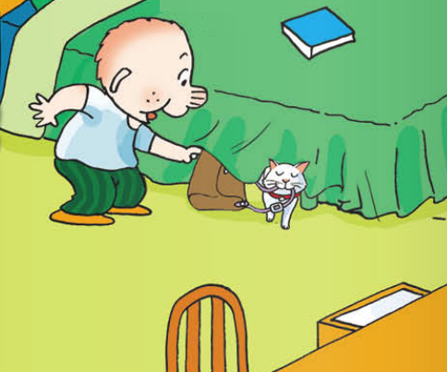
Where’s Sam’s bag?
It’s under his bed.

Slide 4
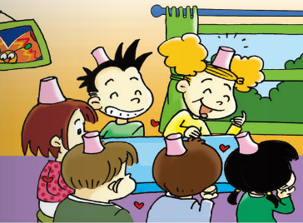
Listen and answer.
What did Sam’s friend have
on their heads?
They had cups on their heads.

Slide 5
看动画，回答更多问题。
2. Why did the children laugh?
Because Amy asked Lingling to bring some
caps. But Lingling brought some cups. And
they put the cups on their heads.
3. What did Sam bring for his friends?
He brought some baseball caps for them.

Slide 6
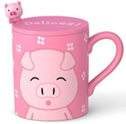
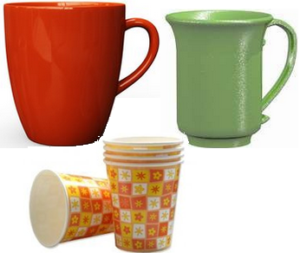
1. What did Sam’s friend have on their heads?
a cup
cups
cups
They had ______ on their heads.

Slide 7

找个好邻居
cup —
cap
bad —
bed
duck—
dark
ship —
sheep
horse —
house

Slide 8
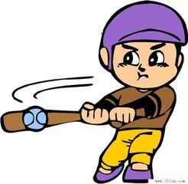
What’s he doing?
He is playing baseball.
He’s wearing a baseball cap.

Slide 9
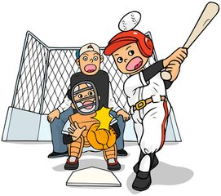
What are they doing?
They are playing a baseball game.

Slide 10
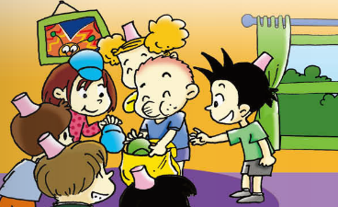
What did Sam bring?
He brought some caps for the game.

Slide 11

与众不同（一）
我们过去很相似
brought
bring --
buy --
think--
bought
thought

Slide 12
与众不同（二）
我们过去很相似
catch---
teach---
caught
taught

Slide 13
我们各不相同（三）
go --
do --
say --
see --
come --
have --
make --
went
did
said
saw
came
had
made

Slide 14
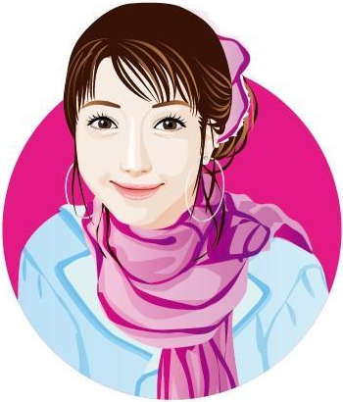


The girl is smiling.

Slide 15
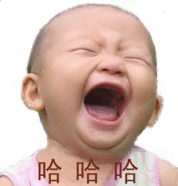
Ask and answer.
laugh
happy
A:What are you doing?
B: I’m laughing.
A:Why are you laughing?
B: Because I’m happy.

Slide 16
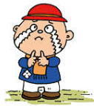
A:Why are you crying?
B: Because I’m sad.
cry
sad

Slide 17

A:Why are you shouting?
B: Because I’m angry.
shout
angry

Slide 18
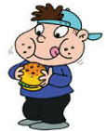
A:Why are you eating?
B: Because I’m hungry.
eat
hungry

Slide 19
Homework
1. 熟读课文。
2. 看图简述故事。（选做）
3. 同桌合作。一人做一动作或表情，同桌运用“Why...？”提问，做动作或表情的同学运用“Because ...回答。

