Slide 1
Module 8 Unit2
Why are you wearing a hat?
新标准英语
一年级起点六年级下册

Slide 2
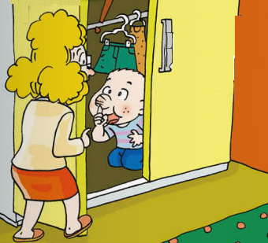
Guess and say.
where, what, why

Slide 3
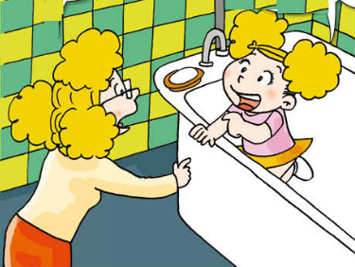
where, what, why

Slide 4
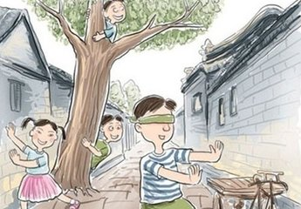
Talk about the picture.

Slide 5
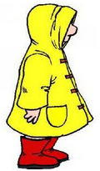

a raincoat, rain
A: Why …?
A: Why are you wearing
a raincoat?
B: Because it’s going to rain.
B: Because ….

Slide 6


hat, hot
A: Why______?
B: Because_____.

Slide 7
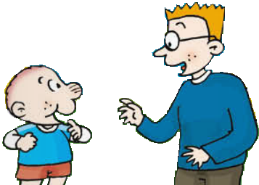
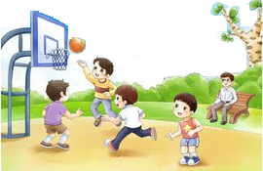
T-shirt, basketball

Slide 8
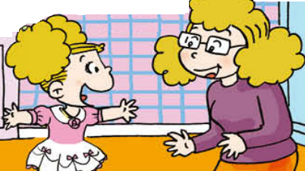

dress, theatre

Slide 9

A: Why…?
B: Because….

Slide 10
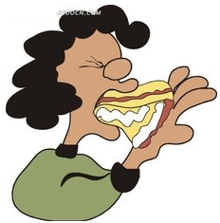
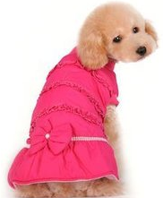



Slide 11
Homework
1. 熟读文中对话。
2. 小组讨论后，各自续写出故事结尾（不少于5句）。

