Slide 2
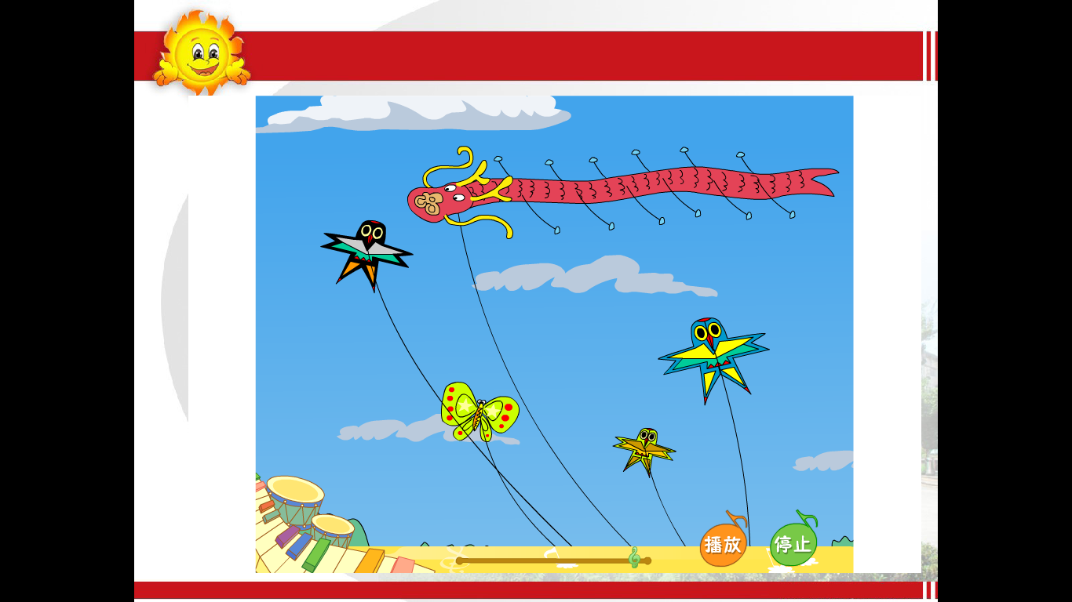

Slide 5
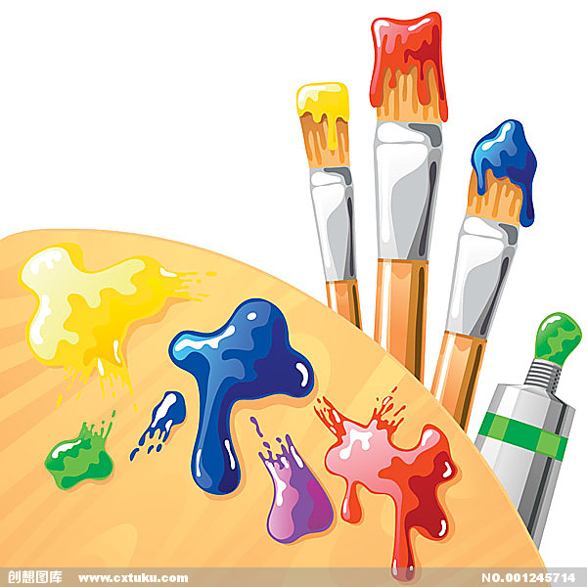

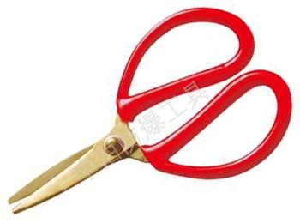
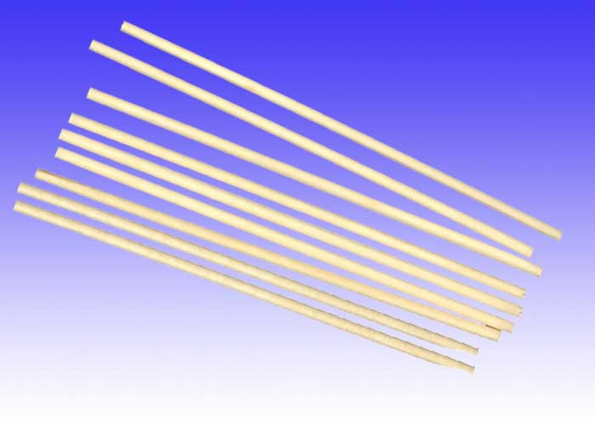
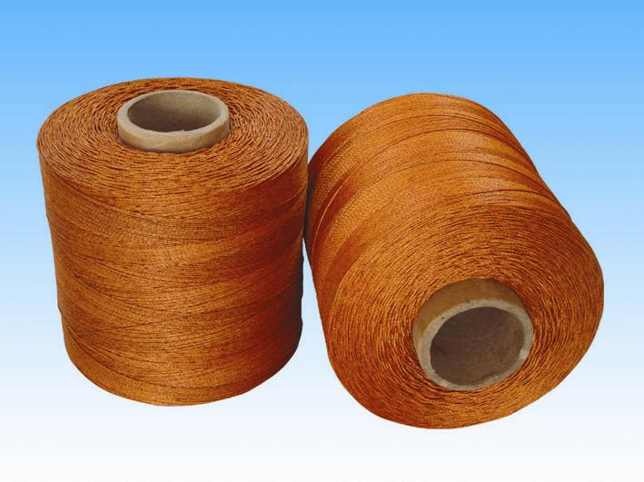
What materials(材料) do we need?
scissors
pencil and paper
paintbrush
sticks
strings

Slide 6
How to make a kite?
First
Next
Then
At last

Slide 7
How many steps?

Slide 9
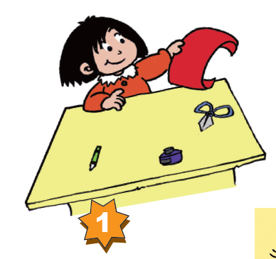

What did she do?
Notes:
（三）课文学习

Slide 10
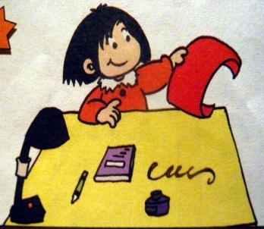
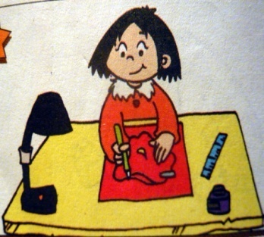
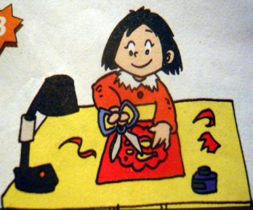
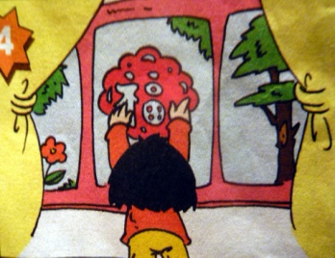
How did Lingling make the paper-cut?
She cut _______.
She had _______.
She drew __________.
She sticked ______on the _____.
Notes:
（四）拓展运用

Slide 11
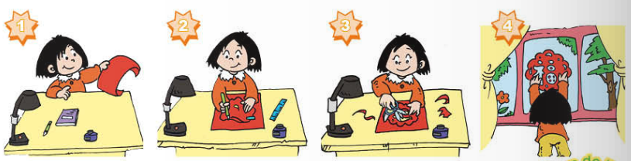
First, she had a piece of paper.
Next, She drew a picture on the paper.
Then, She cut the paper.
At last, She sticked it on the window.

Slide 12
Make a paper-cut
First, she took a piece of paper.
Next, She drew a picture on the paper.
Then, She cut the paper.
At last, She sticked it on the window.

Slide 13
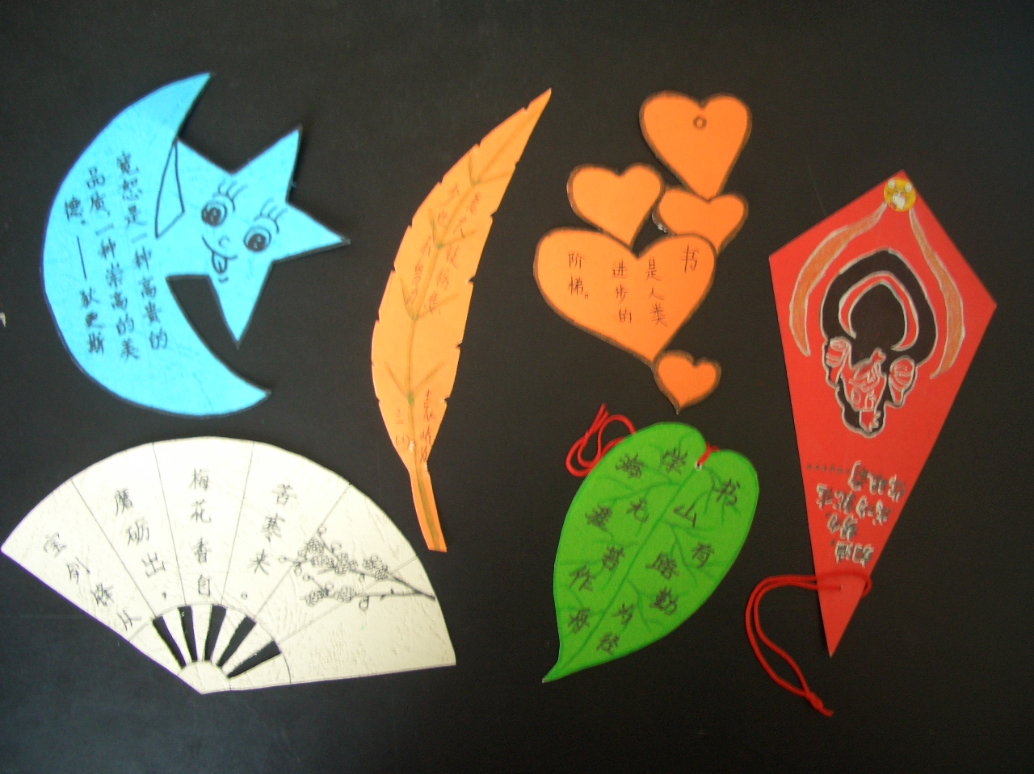
I made the bookmark.
1. I drew ____on a piece of paper .
2. I painted it.
3.I wrote_____.
3. I cut the paper.
4.I tied strings on it.
Notes:
（四）拓展运用

