Slide 1
Module 5 Lingling is skipping.
第一PPT模板网-WWW.1PPT.COM

Slide 2
It’s playtime.

Slide 3
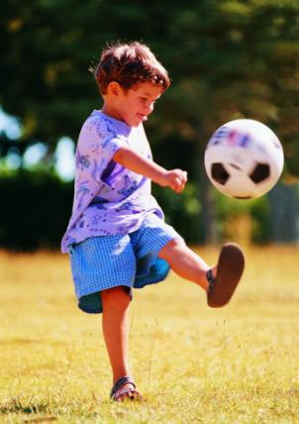
He is playing football.

Slide 4
She is swimming.

Slide 5
PPT模板：www.1ppt.com/moban/ PPT素材：www.1ppt.com/sucai/
PPT背景：www.1ppt.com/beijing/ PPT图表：www.1ppt.com/tubiao/
PPT下载：www.1ppt.com/xiazai/ PPT教程： www.1ppt.com/powerpoint/
资料下载：www.1ppt.com/ziliao/ 范文下载：www.1ppt.com/fanwen/
试卷下载：www.1ppt.com/shiti/ 教案下载：www.1ppt.com/jiaoan/
PPT论坛：www.1ppt.cn PPT课件：www.1ppt.com/kejian/
语文课件：www.1ppt.com/kejian/yuwen/ 数学课件：www.1ppt.com/kejian/shuxue/
英语课件：www.1ppt.com/kejian/yingyu/ 美术课件：www.1ppt.com/kejian/meishu/
科学课件：www.1ppt.com/kejian/kexue/ 物理课件：www.1ppt.com/kejian/wuli/
化学课件：www.1ppt.com/kejian/huaxue/ 生物课件：www.1ppt.com/kejian/shengwu/
地理课件：www.1ppt.com/kejian/dili/ 历史课件：www.1ppt.com/kejian/lishi/
He is drawing a picture.
Notes:
PPT模板：www.1ppt.com/moban/ PPT素材：www.1ppt.com/sucai/
PPT背景：www.1ppt.com/beijing/ PPT图表：www.1ppt.com/tubiao/
PPT下载：www.1ppt.com/xiazai/ PPT教程： www.1ppt.com/powerpoint/
资料下载：www.1ppt.com/ziliao/ 范文下载：www.1ppt.com/fanwen/
试卷下载：www.1ppt.com/shiti/ 教案下载：www.1ppt.com/jiaoan/
PPT论坛：www.1ppt.cn PPT课件：www.1ppt.com/kejian/
语文课件：www.1ppt.com/kejian/yuwen/ 数学课件：www.1ppt.com/kejian/shuxue/
英语课件：www.1ppt.com/kejian/yingyu/ 美术课件：www.1ppt.com/kejian/meishu/
科学课件：www.1ppt.com/kejian/kexue/ 物理课件：www.1ppt.com/kejian/wuli/
化学课件：www.1ppt.com/kejian/huaxue/ 生物课件：www.1ppt.com/kejian/shengwu/
地理课件：www.1ppt.com/kejian/dili/ 历史课件：www.1ppt.com/kejian/lishi/

Slide 6
say the “–ing” tense
play--- talk---
read --- come---
take--- write---
run--- swim---
playing
talking
reading
coming
taking
writing
running
swimming
加油!

Slide 7
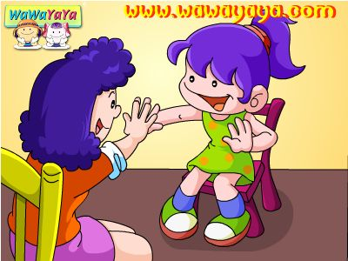
They are playing clapping game .

Slide 8
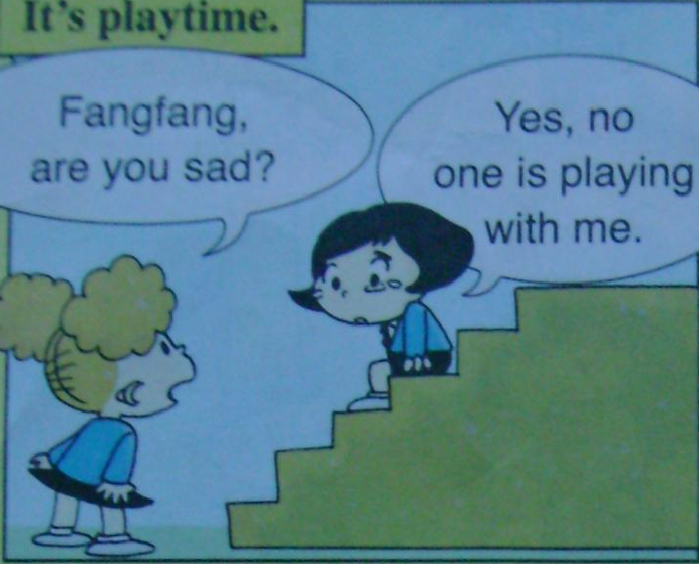

Slide 9
No one is playing with me

Slide 10
Answer the question
1.What is lingling doing?
Lingling is skipping.
2. What are Daming and Sam doing ?
Daming and Sam are playing hide and seek.
3.What are those girls doing?
Those grils are playing clapping game.

Slide 11
clap -
clapping
swim -
swimming
skip -
skipping

Slide 12
What are Daming and Sam doing ?
Daming and Sam are playing
hide - and - seek.
Daming is hiding and Sam is
seekings.

Slide 13
.
What are those girls doing?
Those grils are playing clapping game.

Slide 14
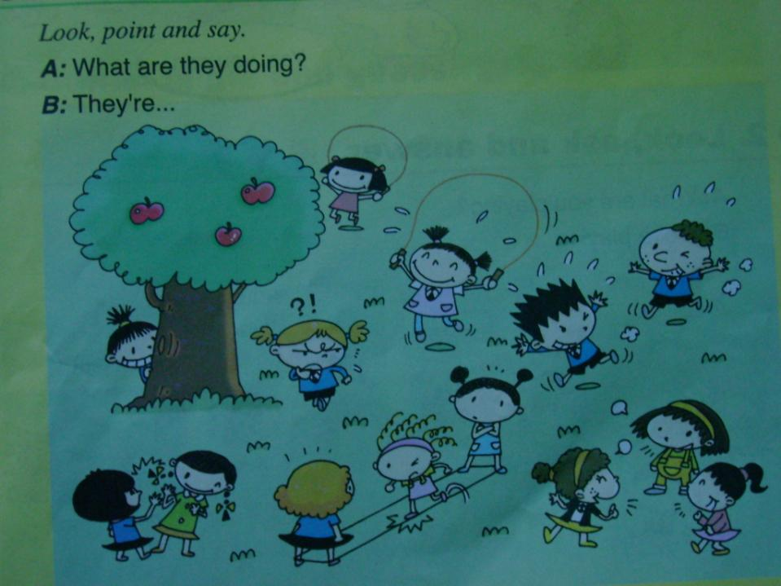

Slide 15
今天的知识
单词部分
skip playtime sad
hide seek me
no one hurry up

Slide 16
句子部分
Daming and Sam are playing hide and
seek.
Daming is hiding and Sam is seeking.
Those girls are playing clapping
game.

Slide 17
Goodbye!
Thank you!

Slide 18
可以在下列情况使用
不限次数的用于您个人/公司、企业的商业演示。
拷贝模板中的内容用于其它幻灯片母版中使用。
不可以在以下情况使用
用于任何形式的在线付费下载。
收集整理我们发布的免费资源后，刻录光碟销售。
PPT模板下载：www.1ppt.com/moban/ 行业PPT模板：www.1ppt.com/hangye/
节日PPT模板：www.1ppt.com/jieri/ PPT素材下载：www.1ppt.com/sucai/
PPT背景图片：www.1ppt.com/beijing/ PPT图表下载：www.1ppt.com/tubiao/
优秀PPT下载：www.1ppt.com/xiazai/ PPT教程： www.1ppt.com/powerpoint/
Word教程： www.1ppt.com/word/ Excel教程： www.1ppt.com/excel/
资料下载： www.1ppt.com/ziliao/ PPT课件下载：www.1ppt.com/kejian/
范文下载： www.1ppt.com/fanwen/ 试卷下载： www.1ppt.com/shiti/
教案下载： www.1ppt.com/jiaoan/ PPT论坛： www.1ppt.cn

