Slide 1
外研版（一起）二年级英语下册
Module 6 Unit 1
I usually play basketball
第一PPT模板网-WWW.1PPT.COM

Slide 2

What’s the weather like today.
It’s sunny.（晴天） chua chua chua
What’s the weather like today.
It’s windy.(有风) hu hu hu
What’s the weather like today.
It’s rainny.（下雨） hua la la la
What’s the weather like today.
It’s cloudy.（阴天） dong dong dong

Slide 3

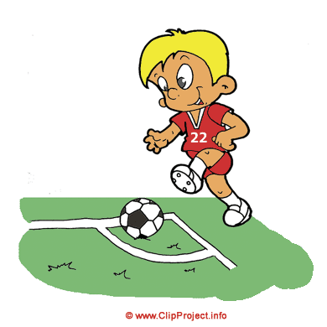
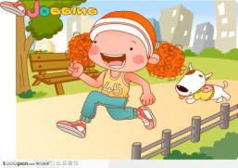

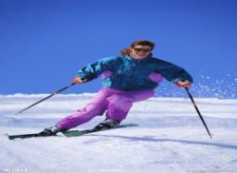

swimming
playing football
running
rowing a boat
skiing
playing basketball

Slide 4


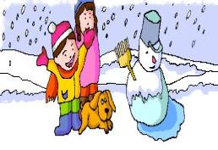
Speaking
PPT模板：www.1ppt.com/moban/ PPT素材：www.1ppt.com/sucai/
PPT背景：www.1ppt.com/beijing/ PPT图表：www.1ppt.com/tubiao/
PPT下载：www.1ppt.com/xiazai/ PPT教程： www.1ppt.com/powerpoint/
资料下载：www.1ppt.com/ziliao/ 范文下载：www.1ppt.com/fanwen/
试卷下载：www.1ppt.com/shiti/ 教案下载：www.1ppt.com/jiaoan/
PPT论坛：www.1ppt.cn PPT课件：www.1ppt.com/kejian/
语文课件：www.1ppt.com/kejian/yuwen/ 数学课件：www.1ppt.com/kejian/shuxue/
英语课件：www.1ppt.com/kejian/yingyu/ 美术课件：www.1ppt.com/kejian/meishu/
科学课件：www.1ppt.com/kejian/kexue/ 物理课件：www.1ppt.com/kejian/wuli/
化学课件：www.1ppt.com/kejian/huaxue/ 生物课件：www.1ppt.com/kejian/shengwu/
地理课件：www.1ppt.com/kejian/dili/ 历史课件：www.1ppt.com/kejian/lishi/
1.sunny
2.rainning
3.windy
4.snowy

Slide 5
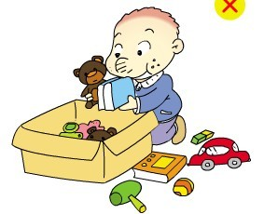
tidying room
Notes:
PPT模板：www.1ppt.com/moban/ PPT素材：www.1ppt.com/sucai/
PPT背景：www.1ppt.com/beijing/ PPT图表：www.1ppt.com/tubiao/
PPT下载：www.1ppt.com/xiazai/ PPT教程： www.1ppt.com/powerpoint/
资料下载：www.1ppt.com/ziliao/ 范文下载：www.1ppt.com/fanwen/
试卷下载：www.1ppt.com/shiti/ 教案下载：www.1ppt.com/jiaoan/
PPT论坛：www.1ppt.cn PPT课件：www.1ppt.com/kejian/
语文课件：www.1ppt.com/kejian/yuwen/ 数学课件：www.1ppt.com/kejian/shuxue/
英语课件：www.1ppt.com/kejian/yingyu/ 美术课件：www.1ppt.com/kejian/meishu/
科学课件：www.1ppt.com/kejian/kexue/ 物理课件：www.1ppt.com/kejian/wuli/
化学课件：www.1ppt.com/kejian/huaxue/ 生物课件：www.1ppt.com/kejian/shengwu/
地理课件：www.1ppt.com/kejian/dili/ 历史课件：www.1ppt.com/kejian/lishi/

Slide 6
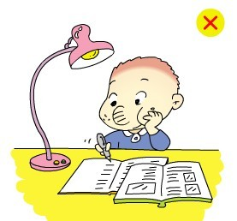
doing homework

Slide 7
Have a chant !
do your homework
do my homework
do his homework
do her homework
tidy your room
tidy my room
tidy his room
tidy her room

Slide 8
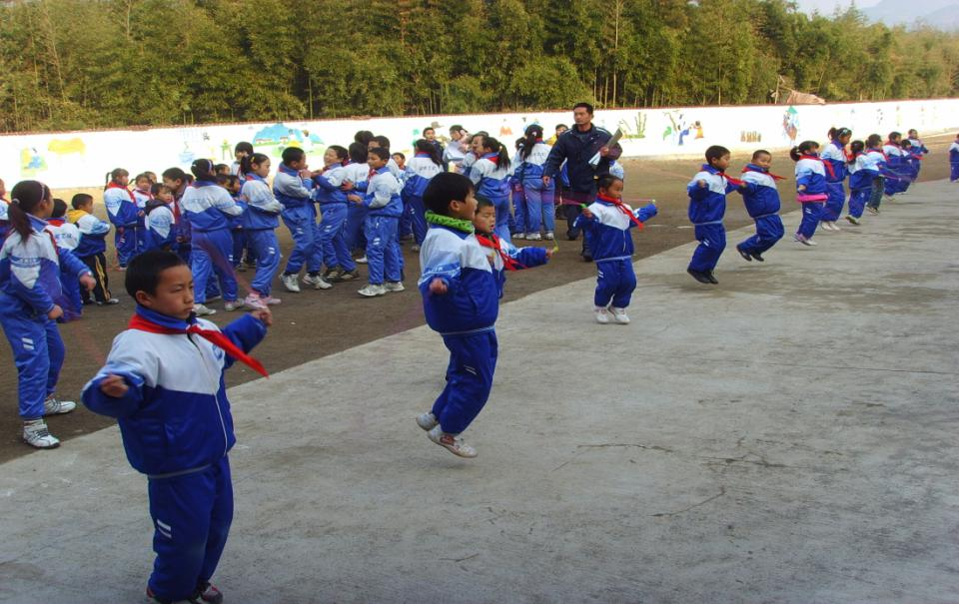
skip 跳绳

Slide 9
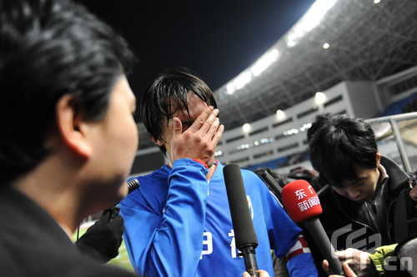
sad 伤心

Slide 10

playtime 游戏时间

Slide 11
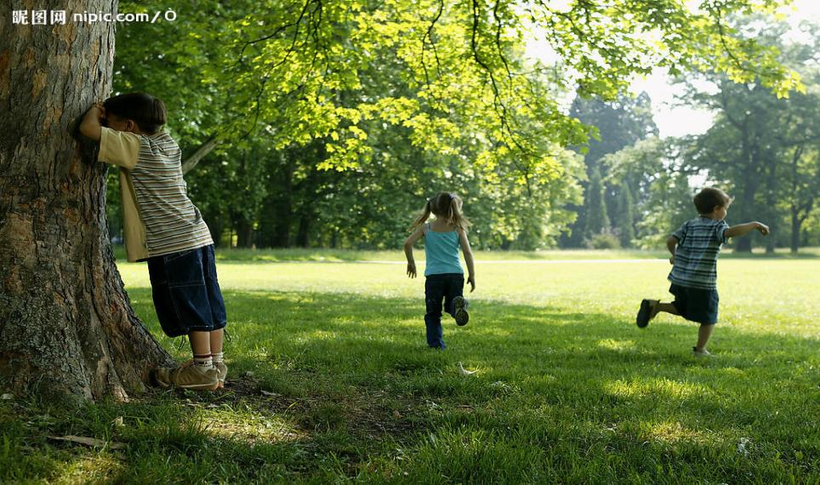
hide-and-seek 抓迷藏

Slide 12
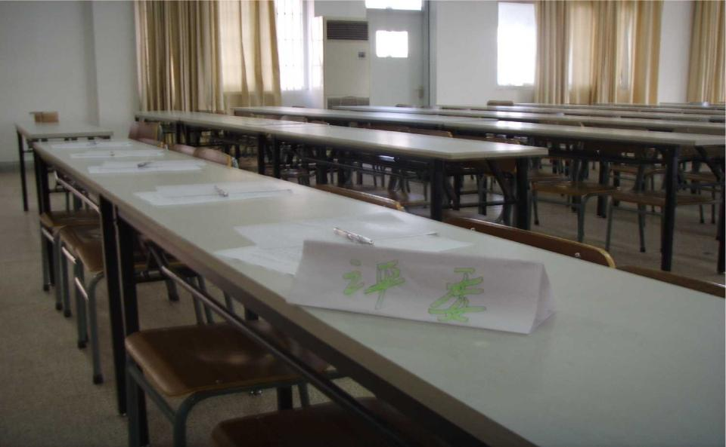
no one 没有人

Slide 13
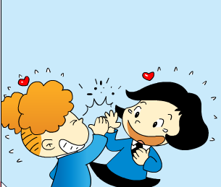

clapping games

Slide 14
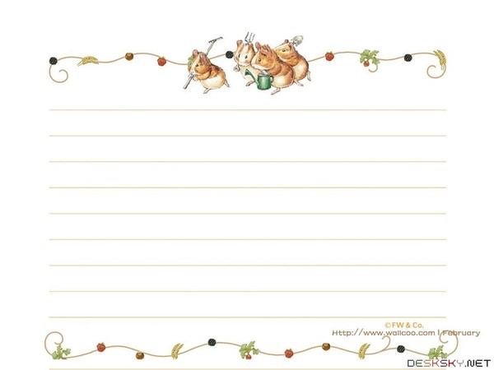
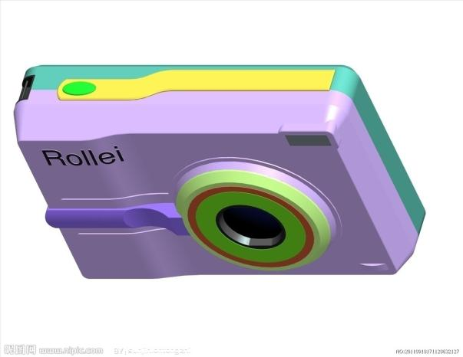
camera

Slide 15

smile

Slide 16

dancing.

Slide 17
My name is Tom. I’m ten years old.

Slide 18
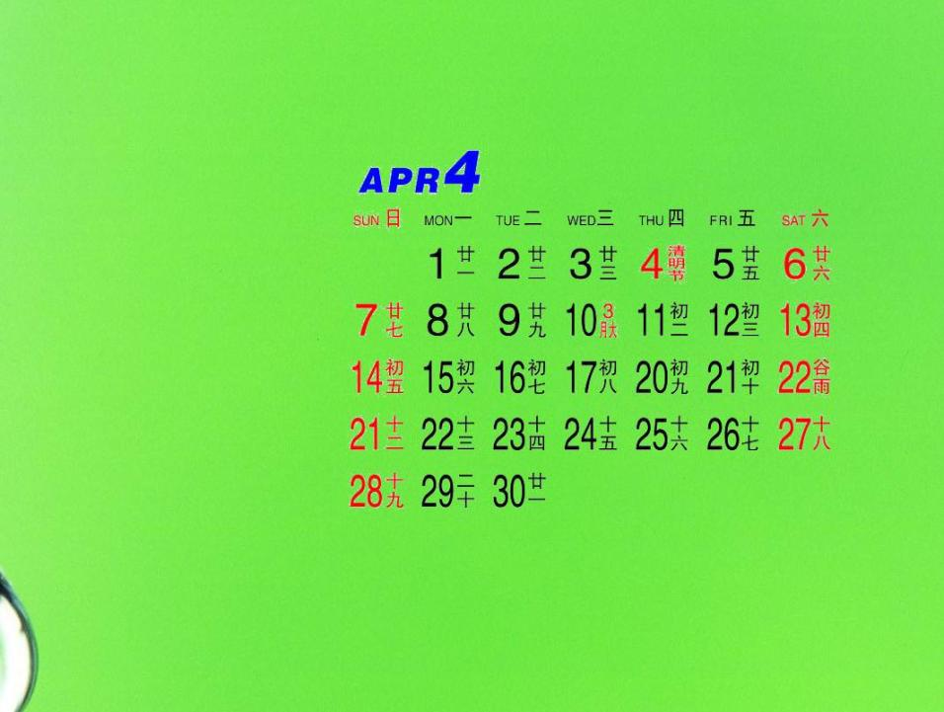
On Sundays
Sunday
星期天
Sundays

Slide 19



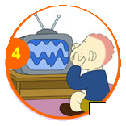

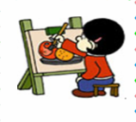


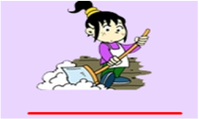



do homework
listen to the radio
play football
watch TV
play the drums
play basketball
colour the picture
ride a bike
tidy the room
go swimming
write a letter
read a book

Slide 20




He’s not doing these things.

Slide 21
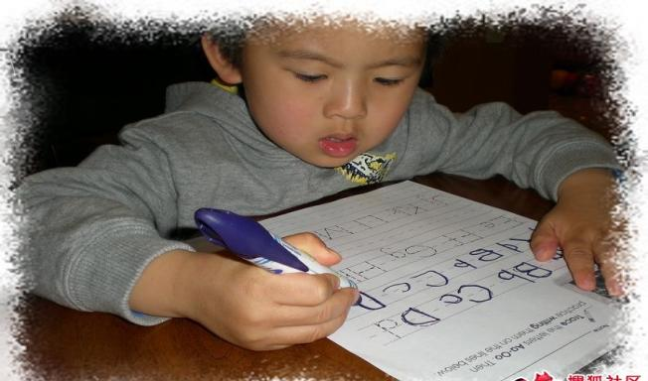
do my homework

Slide 22
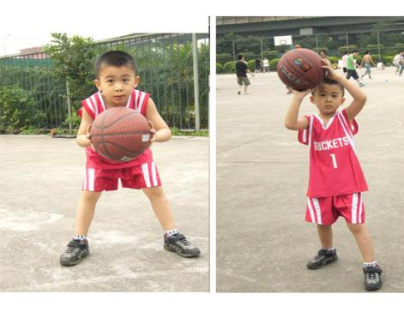
I usually play basketball , But I’m not playing basketball.
usually
通常
Play basketball.

Slide 23
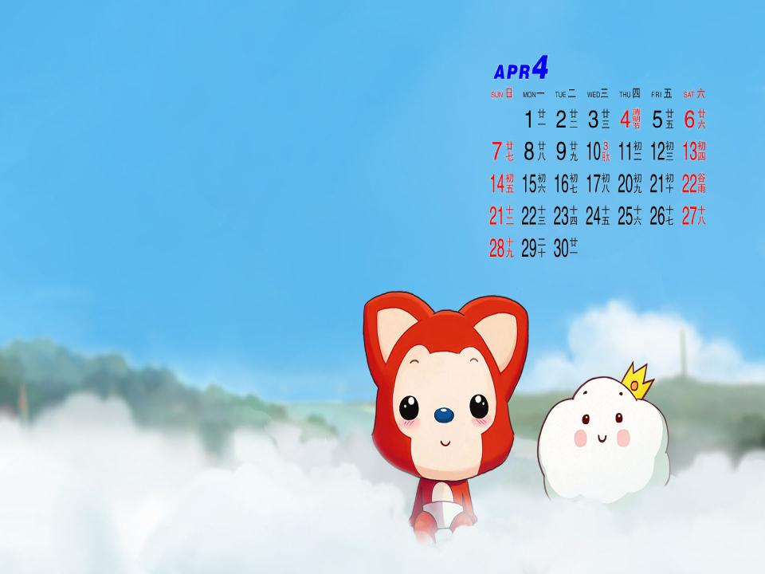
What do you usually do on Sundays?
I usually...
usually
通常

Slide 24

区别：
“usually” and “动词+ing”

Slide 25
usually 用来描述通常所做的事情
We usually have English class in our classroom.
动词+ing 用来描述正在发生的事情
Now we are having English class here.

Slide 26

do my homework
I usually do my homewooek.
but I’m not doing my homework now.

Slide 27

play basketball.
I usually
help my father.
ride my bike.
do my homework.

Slide 28
playing basketball.
helping his father.
But
he’s not
riding his bike.
doing his homework.

Slide 29
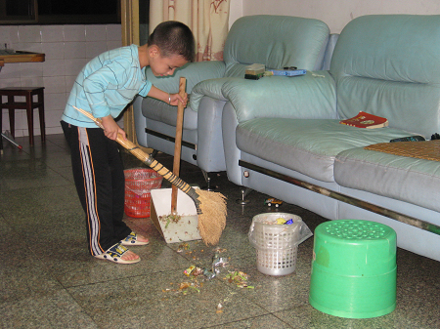
I usually help my father. But I’m not helping my father.
help my father

Slide 30

ride my bike
I usually ride my bike. But I’m not riding it today.

Slide 31


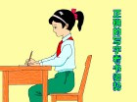
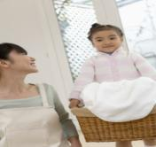

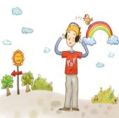
I usually+(动作的原型)。
But I’m not +(Ving) today/now.
Usually
You’re +ving
Now

Slide 32

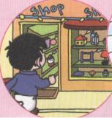
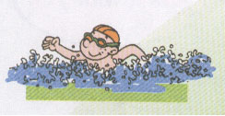
go shopping.
A: I usually_______________
But I’m not _____________ today.
going shopping
swimming
B: You’re______________.

Slide 33
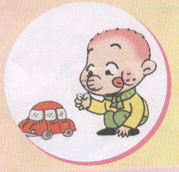
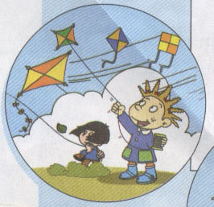
play with car
A: I usually_______________
But I’m not _____________ today.
playing with car
flying kite
B: You’re______________.

Slide 34
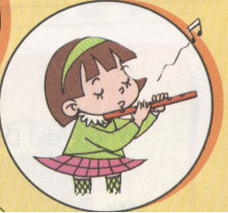

play the flute.
A: I usually_______________
But I’m not _____________ today.
playing the flute
running
B: You’re______________.

Slide 35
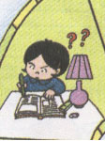
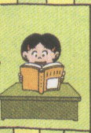
do homework
A: I usually_______________
But I’m not _____________ today.
doing homework
reading books
B: You’re______________.

Slide 36

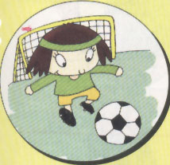
play the drums
A: I usually_______________
But I’m not _____________ today.
playing the drums
playing football
B: You’re______________.

Slide 37
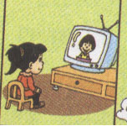
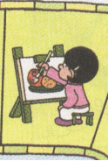
watch TV
A: I usually_______________
But I’m not _____________ today.
watching TV
colouring picture
B: You’re______________.

Slide 38



可以在下列情况使用
不限次数的用于您个人/公司、企业的商业演示。
拷贝模板中的内容用于其它幻灯片母版中使用。
不可以在以下情况使用
用于任何形式的在线付费下载。
收集整理我们发布的免费资源后，刻录光碟销售。
PPT模板下载：www.1ppt.com/moban/ 行业PPT模板：www.1ppt.com/hangye/
节日PPT模板：www.1ppt.com/jieri/ PPT素材下载：www.1ppt.com/sucai/
PPT背景图片：www.1ppt.com/beijing/ PPT图表下载：www.1ppt.com/tubiao/
优秀PPT下载：www.1ppt.com/xiazai/ PPT教程： www.1ppt.com/powerpoint/
Word教程： www.1ppt.com/word/ Excel教程： www.1ppt.com/excel/
资料下载： www.1ppt.com/ziliao/ PPT课件下载：www.1ppt.com/kejian/
范文下载： www.1ppt.com/fanwen/ 试卷下载： www.1ppt.com/shiti/
教案下载： www.1ppt.com/jiaoan/ PPT论坛： www.1ppt.cn

