Slide 1
Module 6 Unit 2
My grandma usually cooks
第一PPT模板网-WWW.1PPT.COM

Slide 2
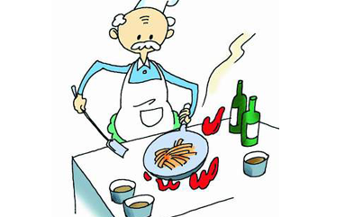
He usually cooks.

Slide 3
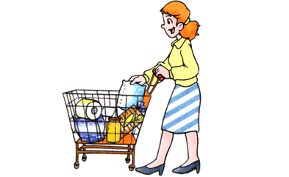
She usually goes shopping.

Slide 4
人称代词
第一人称 |  | 第二人称 |  | 第三人称
单数 | 复数 | 单数 | 复数 | 单数 |  |  | 复数
I | we | you | you | he | she | it | they
我 | 我们 | 你 | 你们 | 他 | 她 | 它 | 他(她/它)们

Slide 5
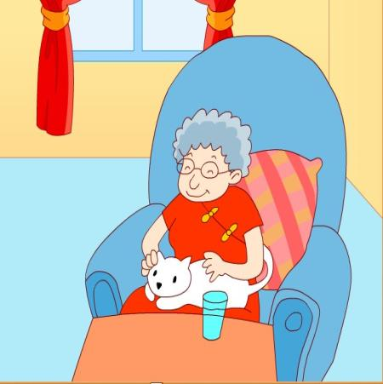
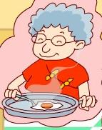
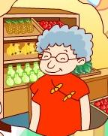
cook
go shopping
My grandma usually cooks.
And she usually goes shopping.

Slide 6
But today she isn’t doing these things.
PPT模板：www.1ppt.com/moban/ PPT素材：www.1ppt.com/sucai/
PPT背景：www.1ppt.com/beijing/ PPT图表：www.1ppt.com/tubiao/
PPT下载：www.1ppt.com/xiazai/ PPT教程： www.1ppt.com/powerpoint/
资料下载：www.1ppt.com/ziliao/ 范文下载：www.1ppt.com/fanwen/
试卷下载：www.1ppt.com/shiti/ 教案下载：www.1ppt.com/jiaoan/
PPT论坛：www.1ppt.cn PPT课件：www.1ppt.com/kejian/
语文课件：www.1ppt.com/kejian/yuwen/ 数学课件：www.1ppt.com/kejian/shuxue/
英语课件：www.1ppt.com/kejian/yingyu/ 美术课件：www.1ppt.com/kejian/meishu/
科学课件：www.1ppt.com/kejian/kexue/ 物理课件：www.1ppt.com/kejian/wuli/
化学课件：www.1ppt.com/kejian/huaxue/ 生物课件：www.1ppt.com/kejian/shengwu/
地理课件：www.1ppt.com/kejian/dili/ 历史课件：www.1ppt.com/kejian/lishi/
Notes:
PPT模板：www.1ppt.com/moban/ PPT素材：www.1ppt.com/sucai/
PPT背景：www.1ppt.com/beijing/ PPT图表：www.1ppt.com/tubiao/
PPT下载：www.1ppt.com/xiazai/ PPT教程： www.1ppt.com/powerpoint/
资料下载：www.1ppt.com/ziliao/ 范文下载：www.1ppt.com/fanwen/
试卷下载：www.1ppt.com/shiti/ 教案下载：www.1ppt.com/jiaoan/
PPT论坛：www.1ppt.cn PPT课件：www.1ppt.com/kejian/
语文课件：www.1ppt.com/kejian/yuwen/ 数学课件：www.1ppt.com/kejian/shuxue/
英语课件：www.1ppt.com/kejian/yingyu/ 美术课件：www.1ppt.com/kejian/meishu/
科学课件：www.1ppt.com/kejian/kexue/ 物理课件：www.1ppt.com/kejian/wuli/
化学课件：www.1ppt.com/kejian/huaxue/ 生物课件：www.1ppt.com/kejian/shengwu/
地理课件：www.1ppt.com/kejian/dili/ 历史课件：www.1ppt.com/kejian/lishi/

Slide 7
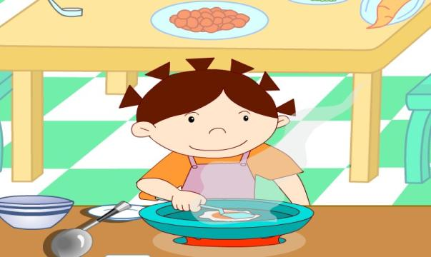
Today I’m in the kitchen and I am cooking.

Slide 8
And my father is going shopping.

Slide 9
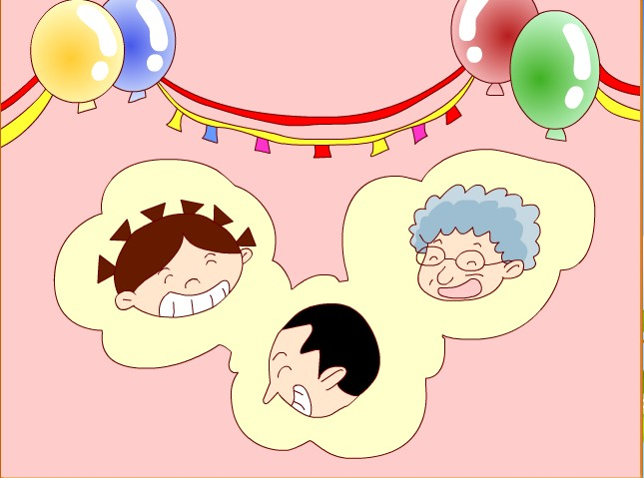
Today is Grandma’s birthday .

Slide 10
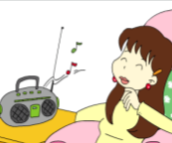
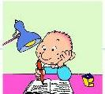
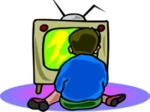
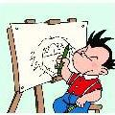
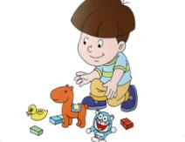
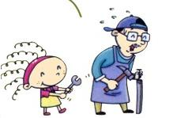
He / She usually … on Sundays.
watches TV
reads books
listens to the radio
does his homework
draws a picture
tidies his room
rides her bike
helps her father

Slide 11
I usually… But now I’m…
Usually
Now
I usually ride my bike.
But now I’m reading a book.

Slide 12
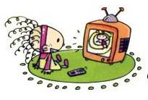
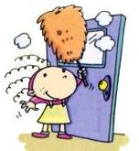
I usually… But now I’m…
Usually
Now
I usually watch TV.
But now I’m tidying my room.

Slide 13
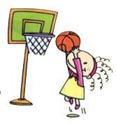
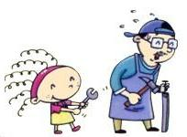
I usually… But now I’m…
Usually
Now
I usually play football.
But now I’m helping my father.

Slide 14
I usually… But now I’m…
Usually
Now
I usually listen to music.
But now I’m writing a letter.

Slide 15
填写单词的正确形式。
I usually ___________（帮助）my father.
But I’m not ___________（帮助）him today.
2. My grandma usually ____________（烧菜）.
But today I am ____________（烧菜。）
help
helping
cooks
cooking

Slide 16
可以在下列情况使用
不限次数的用于您个人/公司、企业的商业演示。
拷贝模板中的内容用于其它幻灯片母版中使用。
不可以在以下情况使用
用于任何形式的在线付费下载。
收集整理我们发布的免费资源后，刻录光碟销售。
PPT模板下载：www.1ppt.com/moban/ 行业PPT模板：www.1ppt.com/hangye/
节日PPT模板：www.1ppt.com/jieri/ PPT素材下载：www.1ppt.com/sucai/
PPT背景图片：www.1ppt.com/beijing/ PPT图表下载：www.1ppt.com/tubiao/
优秀PPT下载：www.1ppt.com/xiazai/ PPT教程： www.1ppt.com/powerpoint/
Word教程： www.1ppt.com/word/ Excel教程： www.1ppt.com/excel/
资料下载： www.1ppt.com/ziliao/ PPT课件下载：www.1ppt.com/kejian/
范文下载： www.1ppt.com/fanwen/ 试卷下载： www.1ppt.com/shiti/
教案下载： www.1ppt.com/jiaoan/ PPT论坛： www.1ppt.cn

