Slide 1
Unit 1
Module 6
These snakes are short.

Slide 2
Let’s go to the zoo.

Slide 3
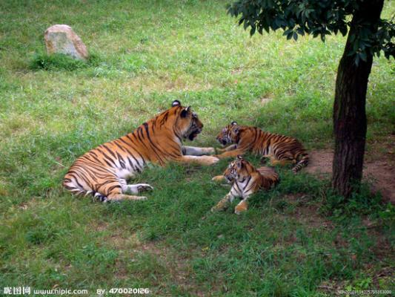
What are they?
They’re tigers.

Slide 4
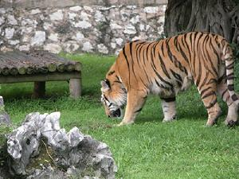
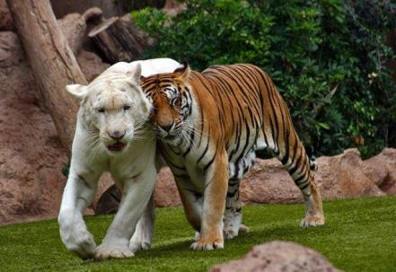
a tiger
tigers

Slide 5
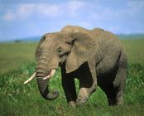
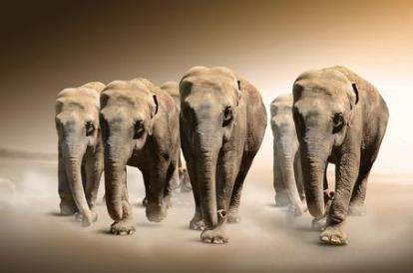
an elephant
elephants
Notes:
PPT模板：www.1ppt.com/moban/ PPT素材：www.1ppt.com/sucai/
PPT背景：www.1ppt.com/beijing/ PPT图表：www.1ppt.com/tubiao/
PPT下载：www.1ppt.com/xiazai/ PPT教程： www.1ppt.com/powerpoint/
资料下载：www.1ppt.com/ziliao/ 范文下载：www.1ppt.com/fanwen/
试卷下载：www.1ppt.com/shiti/ 教案下载：www.1ppt.com/jiaoan/
PPT论坛：www.1ppt.cn PPT课件：www.1ppt.com/kejian/
语文课件：www.1ppt.com/kejian/yuwen/ 数学课件：www.1ppt.com/kejian/shuxue/
英语课件：www.1ppt.com/kejian/yingyu/ 美术课件：www.1ppt.com/kejian/meishu/
科学课件：www.1ppt.com/kejian/kexue/ 物理课件：www.1ppt.com/kejian/wuli/
化学课件：www.1ppt.com/kejian/huaxue/ 生物课件：www.1ppt.com/kejian/shengwu/
地理课件：www.1ppt.com/kejian/dili/ 历史课件：www.1ppt.com/kejian/lishi/

Slide 6
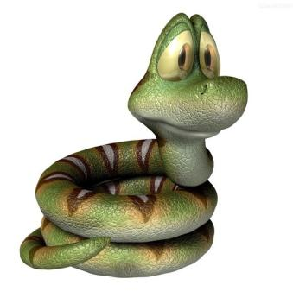
a snake
snakes

Slide 7
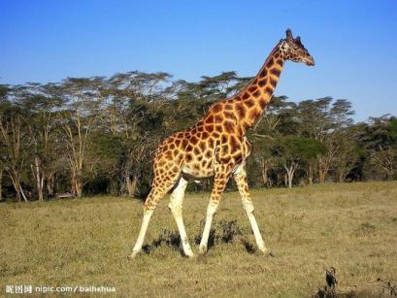
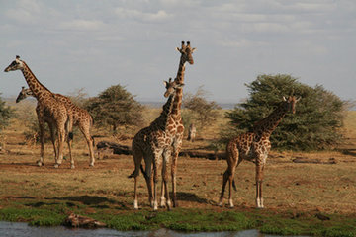
a giraffe
giraffes

Slide 8
比一比
big
The tiger is big.
small
The tiger is small.

Slide 9
比一比
long
The snake is long.
short
The snake is short.

Slide 10
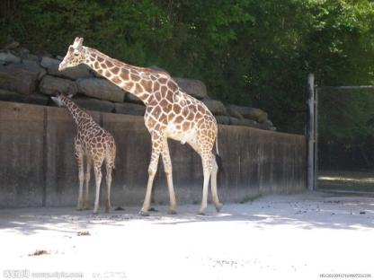
The giraffe is tall.
tall
short
The giraffe is short.

Slide 11
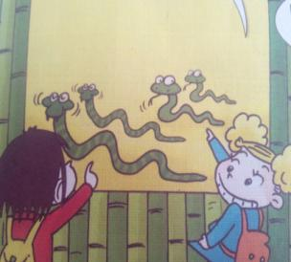
short
long

Slide 12
These snakes are long.
These snakes are short.

Slide 13
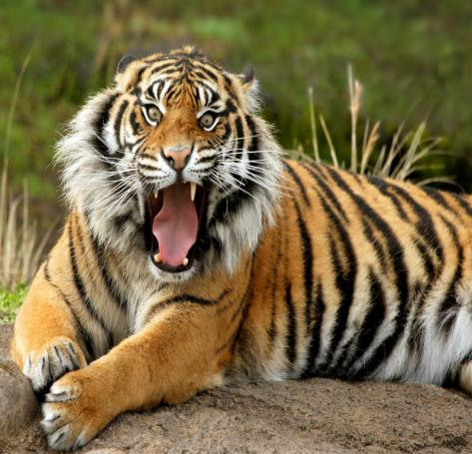
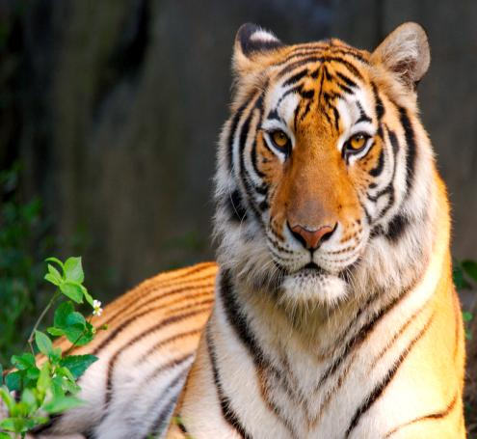
The tigers are big.

Slide 14
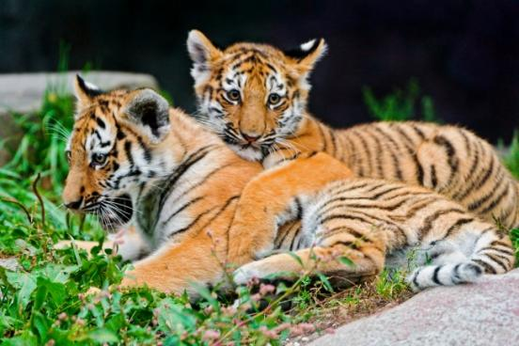
These tigers are small.

Slide 15
These ____are ___.
pencils
short
These ____are ___.
pencils
long
Pair work:
These ____are ____.

Slide 16
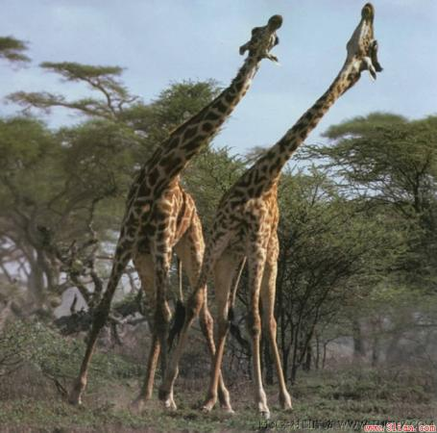
Are they tall?
Yes, they are.
Are they short?
No, they aren’t.

Slide 17
Look at the elephants.
They’re very big.

Slide 18
Chant
Tiger, tiger ,big big tiger
Snake, snake, short short snake
Elephant, elephant, long nose elephant
Giraffe, giraffe, tall tall giraffe

Slide 19
Text time
Listen carefully and answer
How many kinds of animals did Amy and Lingling see in the zoo?
（玲玲和艾米在动物园看到了几种动物？）
four
What are these animals ? （这些动物是什么？）
snake, giraffe, elephant, tiger
Listen and repeat

Slide 20
Text time
Listen, point and find
“long, short, tall, big …”
Read in groups
Group show
一人一句排火车读
分角色朗读
全组大声齐读

Slide 21
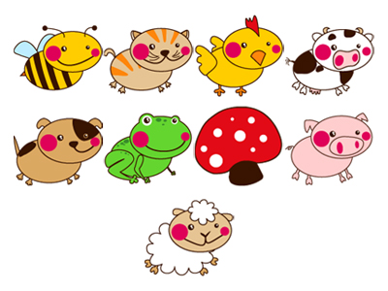
Thinking
What should we do in the zoo?
Don't feed the animals.
（不要喂动物）
Don't frighten the animals.
（不要吓唬动物）
Don't throw rubbish.
（不要乱扔垃圾）

Slide 22
Animals are our friends. (动物是我们的朋友)
Love animals
（爱护动物）
Protect animals
（保护动物）

Slide 23
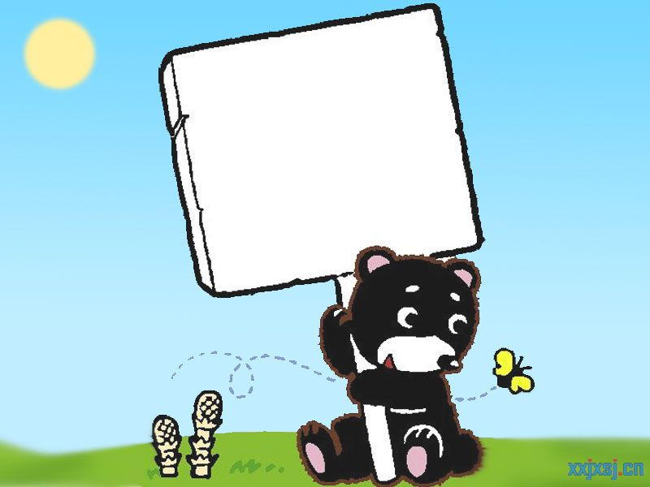
Homework:
跟录音指读课文
学会用long, short, tall, big, small 形容人和物。

