Slide 1
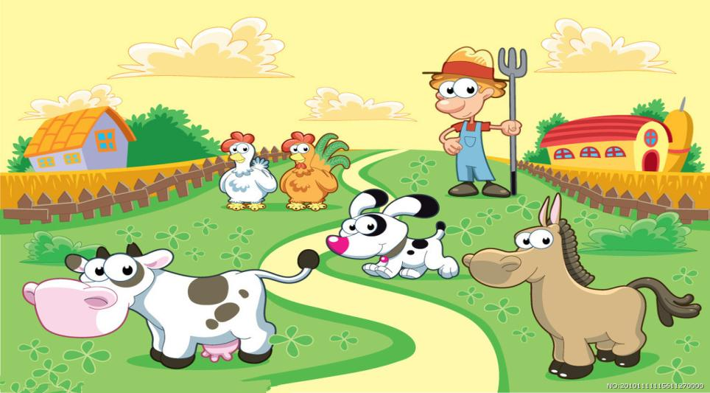
Module 6 Unit 2
They’re little and cute.

Slide 2
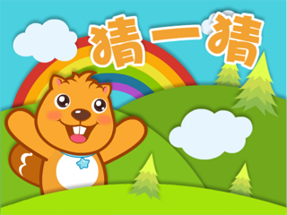
Guess
Go!

Slide 3
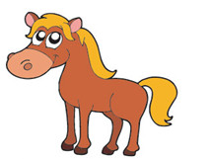
The horse is strong.

Slide 4
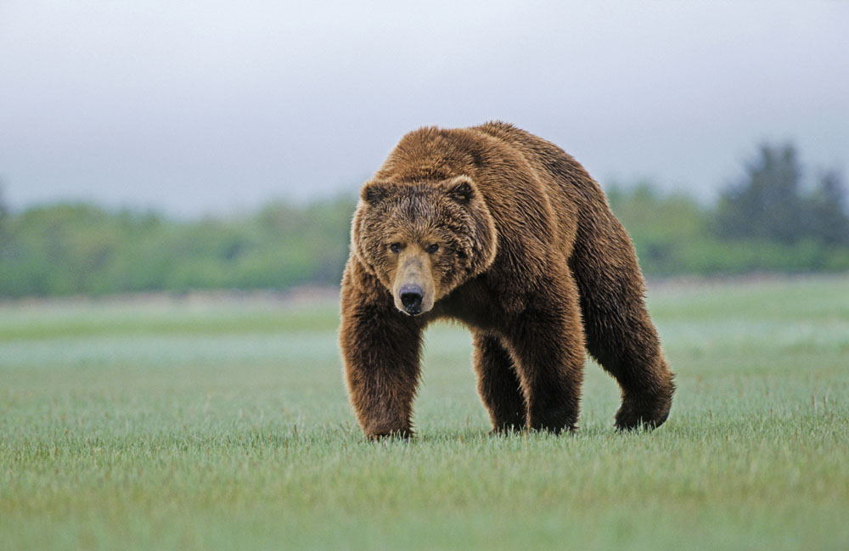
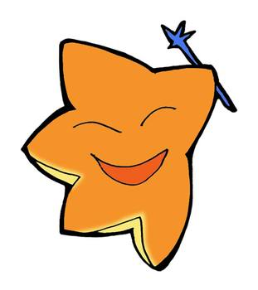
The bear is very strong.

Slide 5
They’re big and strong.

Slide 6
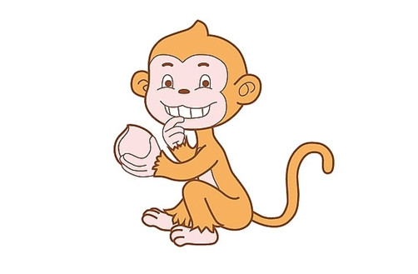
The monkey isn’t strong.
Notes:
PPT模板：www.1ppt.com/moban/ PPT素材：www.1ppt.com/sucai/
PPT背景：www.1ppt.com/beijing/ PPT图表：www.1ppt.com/tubiao/
PPT下载：www.1ppt.com/xiazai/ PPT教程： www.1ppt.com/powerpoint/
资料下载：www.1ppt.com/ziliao/ 范文下载：www.1ppt.com/fanwen/
试卷下载：www.1ppt.com/shiti/ 教案下载：www.1ppt.com/jiaoan/
PPT论坛：www.1ppt.cn PPT课件：www.1ppt.com/kejian/
语文课件：www.1ppt.com/kejian/yuwen/ 数学课件：www.1ppt.com/kejian/shuxue/
英语课件：www.1ppt.com/kejian/yingyu/ 美术课件：www.1ppt.com/kejian/meishu/
科学课件：www.1ppt.com/kejian/kexue/ 物理课件：www.1ppt.com/kejian/wuli/
化学课件：www.1ppt.com/kejian/huaxue/ 生物课件：www.1ppt.com/kejian/shengwu/
地理课件：www.1ppt.com/kejian/dili/ 历史课件：www.1ppt.com/kejian/lishi/

Slide 7
They’re cute.

Slide 8
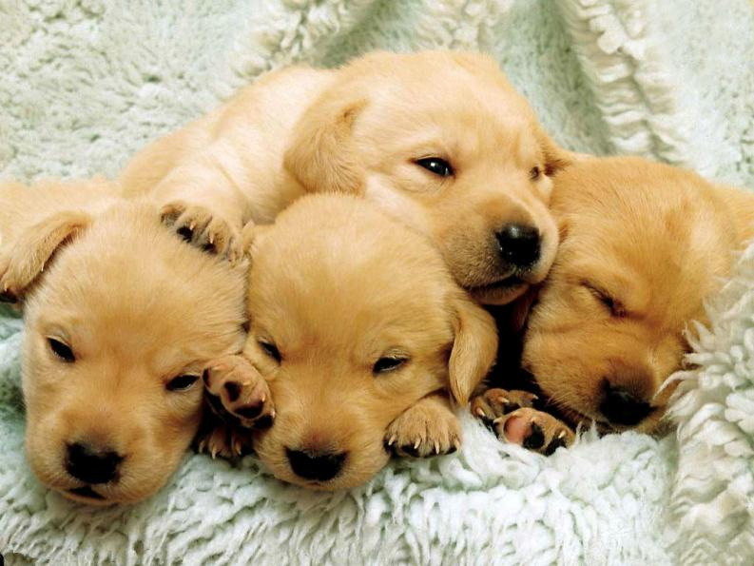
They’re little and cute.

Slide 9
Are they little?
Yes, they are.

Slide 10
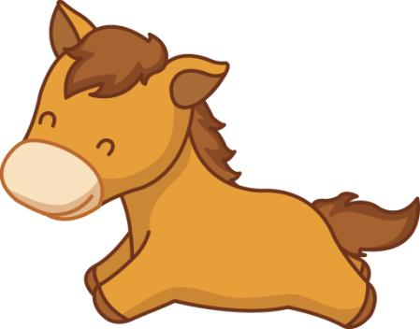
Are they cute?
Yes, they are.

Slide 11
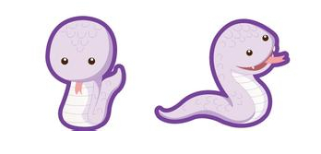
Are they long?
No, they aren’t.

Slide 12
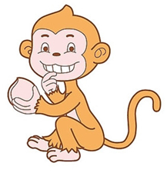
Are they strong?
No, they aren’t.

Slide 13
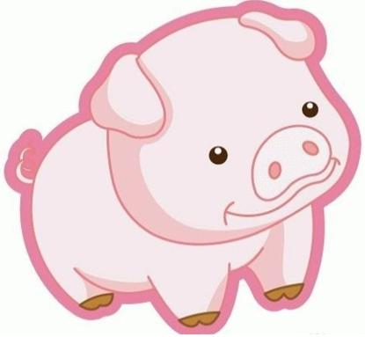
Are they thin?
No, they aren’t.

Slide 14
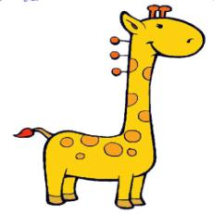
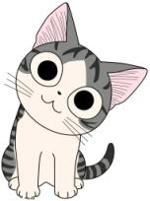
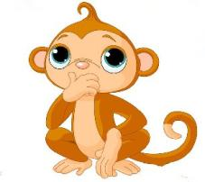
tall
short
big
little
fat
thin
cute
strong

Slide 15
tall
short
big
little
fat
thin
cute
strong

Slide 16
tall
short
big
little
fat
thin
cute
strong

Slide 17
tall
short
big
little
fat
thin
cute
strong

Slide 18
Yes, they are.
No, they aren’t.
tall
big
little
cute
strong

Slide 19
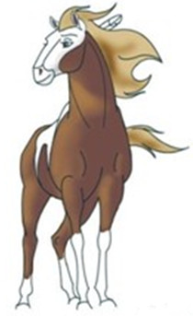
Yes, they are.
No, they aren’t.

Slide 20
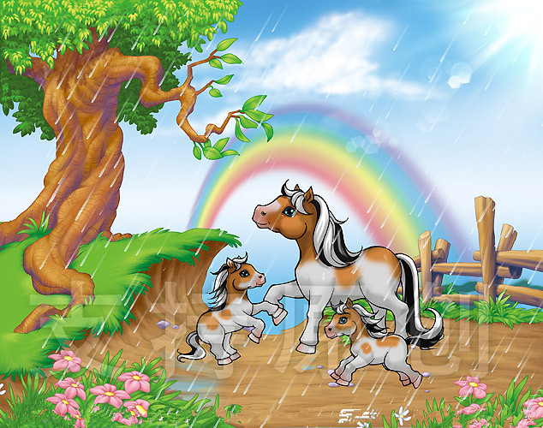
mother horses
↗
baby horses
↖

Slide 21
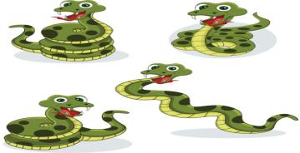
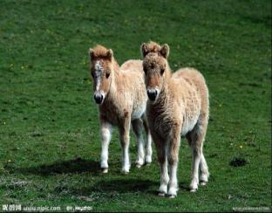
Homework
The snakes are long.
big small little long
tall short cute strong

Slide 22
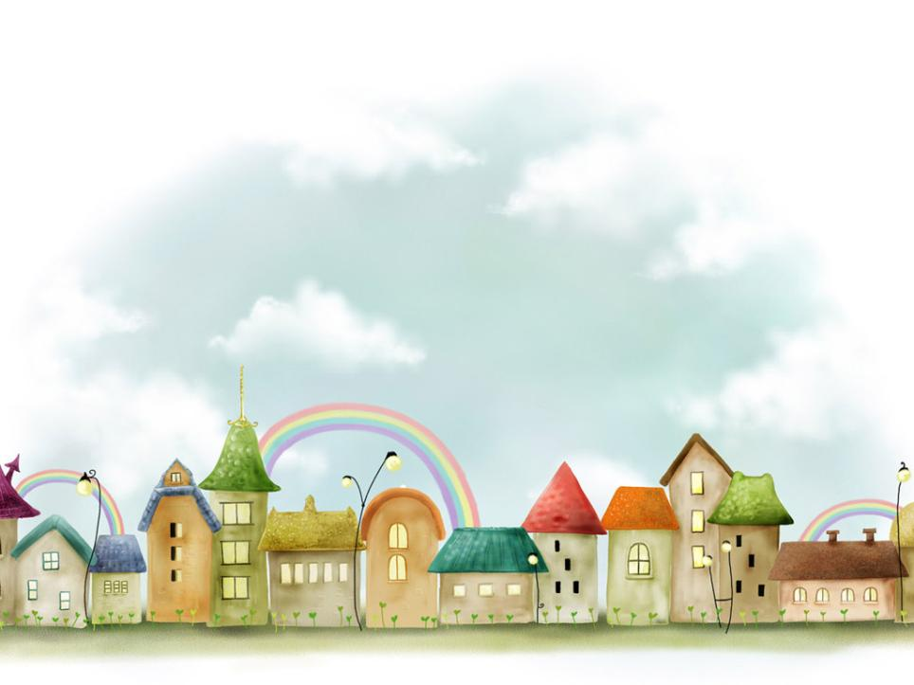
Thank you!

