Slide 1
M8U1
There’s a pair of shorts under that duck.

Slide 2
What day is today ? It’s Monday.
Tuesday
Wednesday
Thursday
Friday
Saturday
Sunday
What’ s the weather like today ? It’s a sunny day.
a rainy day
a cloudy day
a windy day
a snowy day
a foggy day

Slide 3
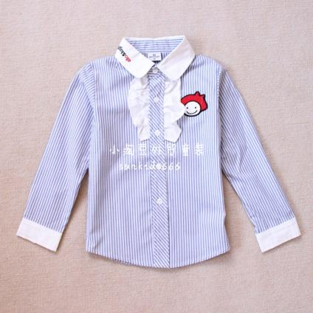
shirt

Slide 4
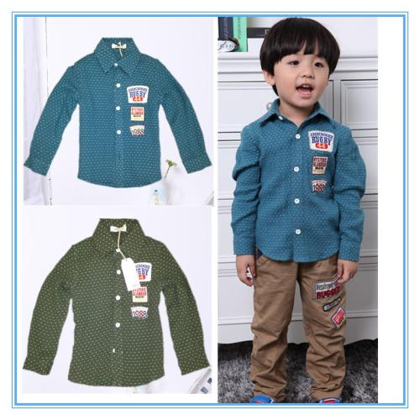
shirts

Slide 5
short
s

Slide 6
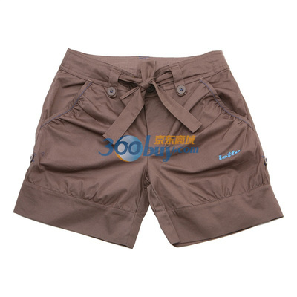
shorts
a pair of
Notes:
PPT模板：www.1ppt.com/moban/ PPT素材：www.1ppt.com/sucai/
PPT背景：www.1ppt.com/beijing/ PPT图表：www.1ppt.com/tubiao/
PPT下载：www.1ppt.com/xiazai/ PPT教程： www.1ppt.com/powerpoint/
资料下载：www.1ppt.com/ziliao/ 范文下载：www.1ppt.com/fanwen/
试卷下载：www.1ppt.com/shiti/ 教案下载：www.1ppt.com/jiaoan/
PPT论坛：www.1ppt.cn PPT课件：www.1ppt.com/kejian/
语文课件：www.1ppt.com/kejian/yuwen/ 数学课件：www.1ppt.com/kejian/shuxue/
英语课件：www.1ppt.com/kejian/yingyu/ 美术课件：www.1ppt.com/kejian/meishu/
科学课件：www.1ppt.com/kejian/kexue/ 物理课件：www.1ppt.com/kejian/wuli/
化学课件：www.1ppt.com/kejian/huaxue/ 生物课件：www.1ppt.com/kejian/shengwu/
地理课件：www.1ppt.com/kejian/dili/ 历史课件：www.1ppt.com/kejian/lishi/

Slide 7
a pair of
一对，一双

Slide 8
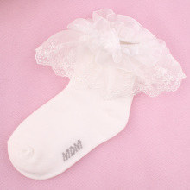
sock

Slide 9
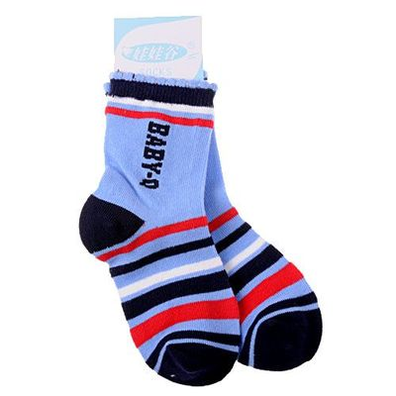
socks
a pair of

Slide 10
shoes

Slide 11
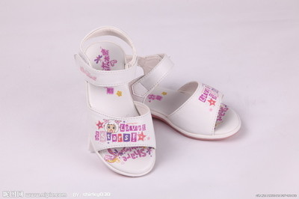
a pair of
shoes

Slide 12
a pair of shorts
a pair of shoes

Slide 13
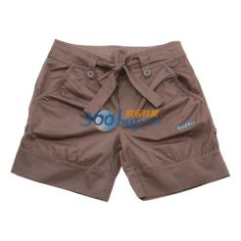
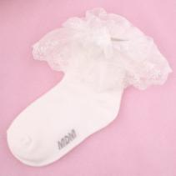
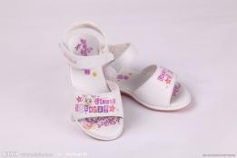
review
shorts
shirt
sock
shoes

Slide 14
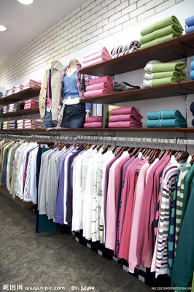
clothes

Slide 15
a shirt.

Slide 16
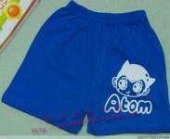
a pair of shorts.

Slide 17
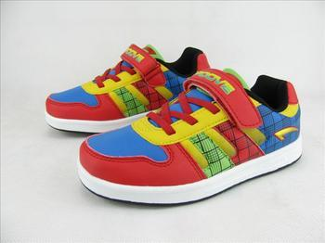
a pair of shoes.

Slide 18
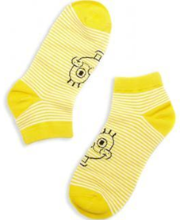
PPT模板：www.1ppt.com/moban/ PPT素材：www.1ppt.com/sucai/
PPT背景：www.1ppt.com/beijing/ PPT图表：www.1ppt.com/tubiao/
PPT下载：www.1ppt.com/xiazai/ PPT教程： www.1ppt.com/powerpoint/
资料下载：www.1ppt.com/ziliao/ 范文下载：www.1ppt.com/fanwen/
试卷下载：www.1ppt.com/shiti/ 教案下载：www.1ppt.com/jiaoan/
PPT论坛：www.1ppt.cn PPT课件：www.1ppt.com/kejian/
语文课件：www.1ppt.com/kejian/yuwen/ 数学课件：www.1ppt.com/kejian/shuxue/
英语课件：www.1ppt.com/kejian/yingyu/ 美术课件：www.1ppt.com/kejian/meishu/
科学课件：www.1ppt.com/kejian/kexue/ 物理课件：www.1ppt.com/kejian/wuli/
化学课件：www.1ppt.com/kejian/huaxue/ 生物课件：www.1ppt.com/kejian/shengwu/
地理课件：www.1ppt.com/kejian/dili/ 历史课件：www.1ppt.com/kejian/lishi/
a pair of socks.

Slide 19
chant
clothes,clothes,our clothes
shirt, shirt, my shirt
shorts,shorts, my shorts
sock, sock, my sock
shoe,shoe, my shoe

Slide 20
chant
clothes,clothes,our clothes.
shirts, shirts, our shirts.
shorts,shorts, our shorts.
socks, socks, our socks.
shoes,shoes, our shoes.

Slide 21
This is my shirt.

Slide 22
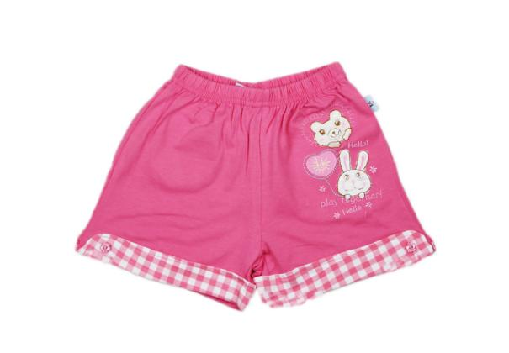
These are my shorts.
a pair of shorts

Slide 23
These are my shoes.
a pair of shoes

Slide 24
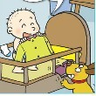
Listen and say:
PPT模板：www.1ppt.com/moban/ PPT素材：www.1ppt.com/sucai/
PPT背景：www.1ppt.com/beijing/ PPT图表：www.1ppt.com/tubiao/
PPT下载：www.1ppt.com/xiazai/ PPT教程： www.1ppt.com/powerpoint/
资料下载：www.1ppt.com/ziliao/ 范文下载：www.1ppt.com/fanwen/
试卷下载：www.1ppt.com/shiti/ 教案下载：www.1ppt.com/jiaoan/
PPT论坛：www.1ppt.cn PPT课件：www.1ppt.com/kejian/
语文课件：www.1ppt.com/kejian/yuwen/ 数学课件：www.1ppt.com/kejian/shuxue/
英语课件：www.1ppt.com/kejian/yingyu/ 美术课件：www.1ppt.com/kejian/meishu/
科学课件：www.1ppt.com/kejian/kexue/ 物理课件：www.1ppt.com/kejian/wuli/
化学课件：www.1ppt.com/kejian/huaxue/ 生物课件：www.1ppt.com/kejian/shengwu/
地理课件：www.1ppt.com/kejian/dili/ 历史课件：www.1ppt.com/kejian/lishi/
Notes:
PPT模板：www.1ppt.com/moban/ PPT素材：www.1ppt.com/sucai/
PPT背景：www.1ppt.com/beijing/ PPT图表：www.1ppt.com/tubiao/
PPT下载：www.1ppt.com/xiazai/ PPT教程： www.1ppt.com/powerpoint/
资料下载：www.1ppt.com/ziliao/ 范文下载：www.1ppt.com/fanwen/
试卷下载：www.1ppt.com/shiti/ 教案下载：www.1ppt.com/jiaoan/
PPT论坛：www.1ppt.cn PPT课件：www.1ppt.com/kejian/
语文课件：www.1ppt.com/kejian/yuwen/ 数学课件：www.1ppt.com/kejian/shuxue/
英语课件：www.1ppt.com/kejian/yingyu/ 美术课件：www.1ppt.com/kejian/meishu/
科学课件：www.1ppt.com/kejian/kexue/ 物理课件：www.1ppt.com/kejian/wuli/
化学课件：www.1ppt.com/kejian/huaxue/ 生物课件：www.1ppt.com/kejian/shengwu/
地理课件：www.1ppt.com/kejian/dili/ 历史课件：www.1ppt.com/kejian/lishi/

Slide 25
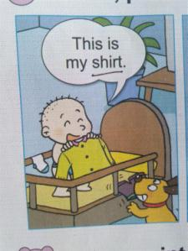
my shirt
This is my shirt.

Slide 26
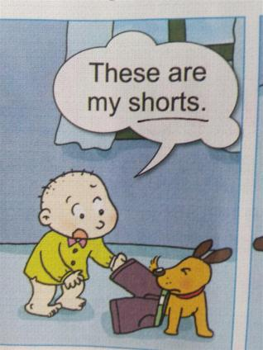
my shorts
These are
my shorts.

Slide 27
Hey! My shoes!

Slide 28
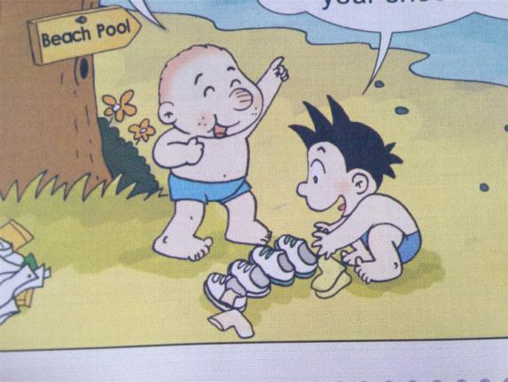

Slide 29
shoes
socks
These are
my shoes and socks.
your shoes and socks.

Slide 30
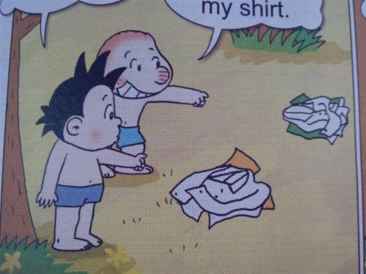
This is my shirt.
That is my shirt.

Slide 31
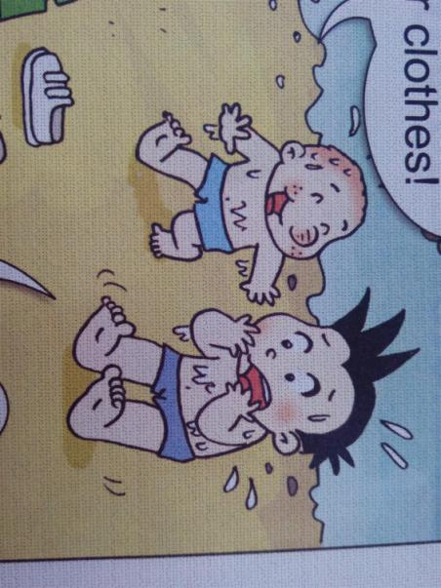
Where are our clothes?

Slide 32
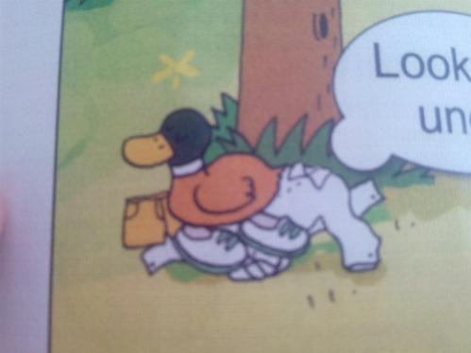
Our shirts are under that duck.

Slide 33
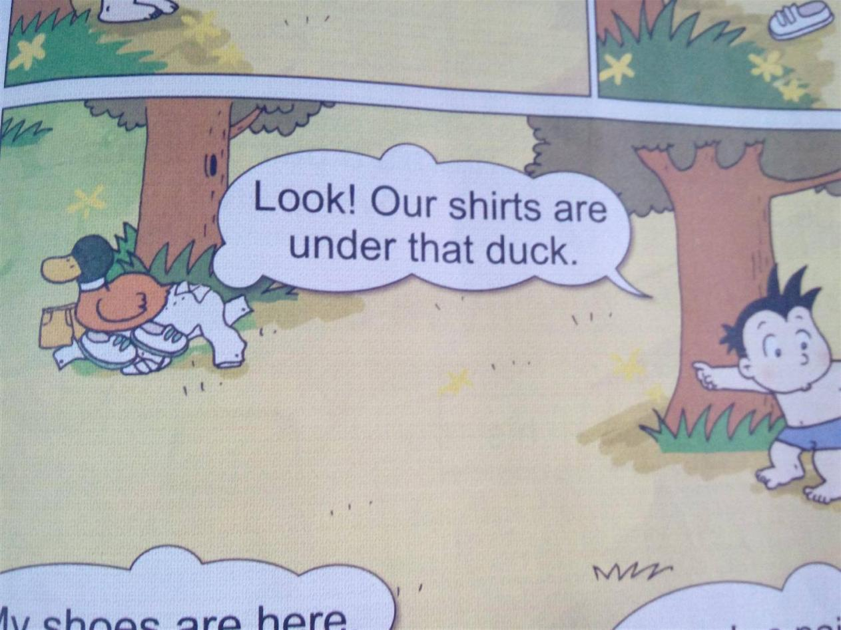

Slide 34
There's
a pair of shorts
under that duck.

Slide 35
There's
a pair of shoes
under that duck.

Slide 36
The shirts are
under
that
duck.

Slide 37
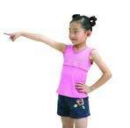
There's
a pair of shoes
over there.

Slide 38
there is
=
there's

Slide 39
my
我的
your
你的，你们的
our
我们的
his
her
他的
她的

Slide 40
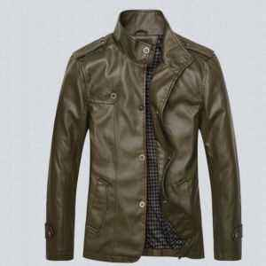
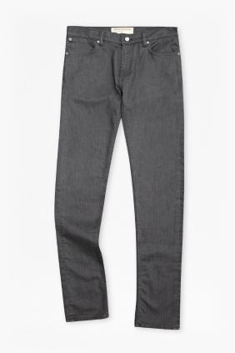
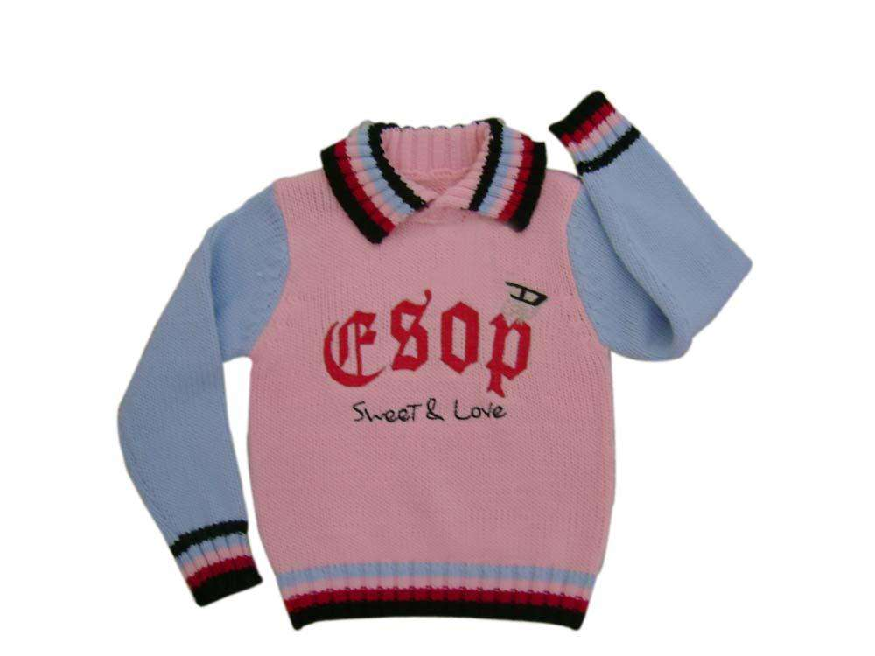
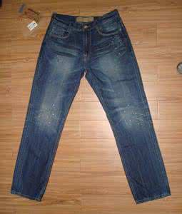
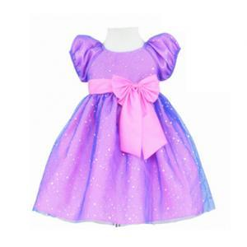
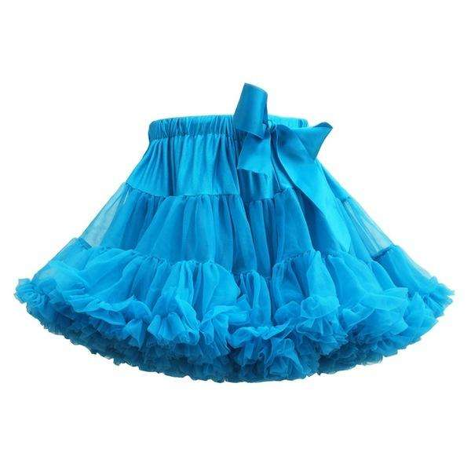
sweater
jacket
trousers
dress
skirt
jeans

Slide 41
This is
her dress .
This is
her skirt .
This is
his jacket .

Slide 42
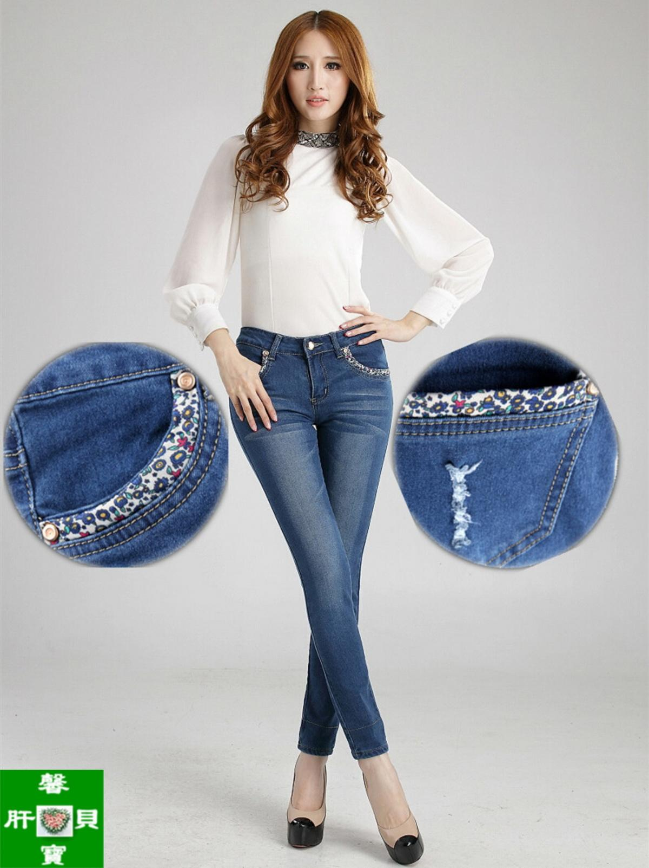
This is her…

Slide 43
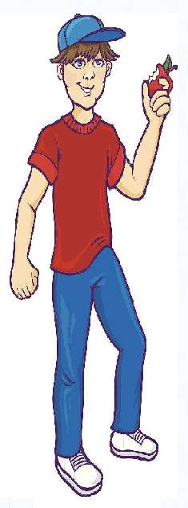
This is his…
They are his…
These are his…

Slide 44
This is my…
This is his…
This is her…
These are his…
They are his…

Slide 45
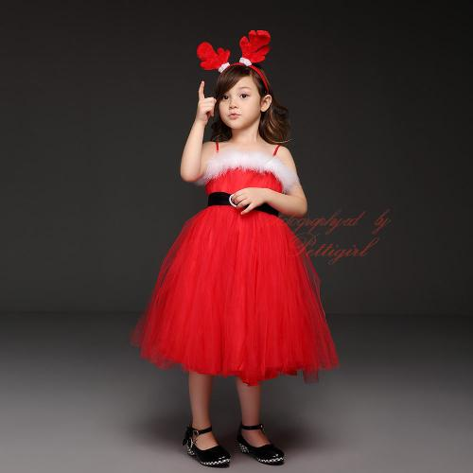
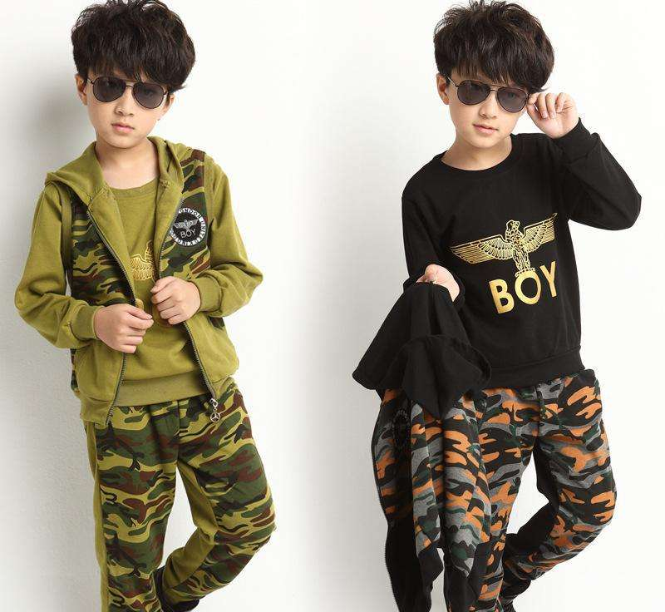

Slide 46
Module 8 Unit 1
There’s a pair of shorts under that duck.
第一PPT模板网-WWW.1PPT.COM

Slide 47
Listen and point:
Where are Daming’s shoes?

Slide 48
Listen and repeat:

Slide 49
There’s a pair of shorts under that duck.

Slide 50
There’s a pair of shoes over there.

Slide 51
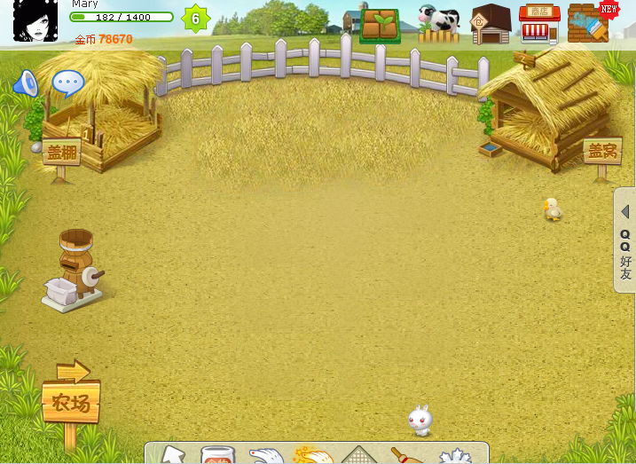
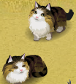
Farm
chickens
ducks
cows
cats
dogs
pigs

Slide 52
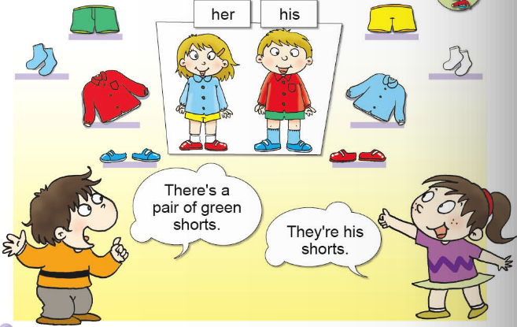
Let’s guess

Slide 53
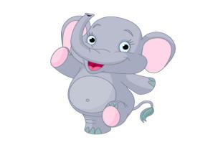
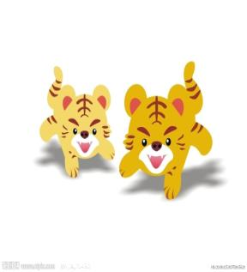
park

Slide 54
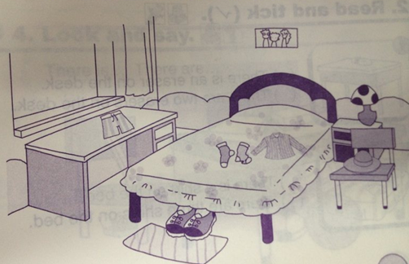
Look and say
There is a pair of socks on the bed.

Slide 55
There is a basketball.

Slide 56
There is a basketball under the chair.

Slide 57
There are four basketballs.

Slide 58
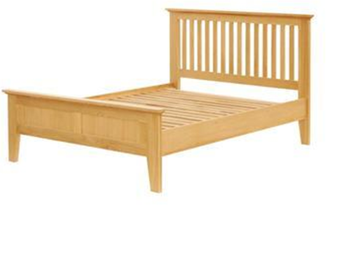
There are four basketballs on the bed.

Slide 59
There is a football.

Slide 60
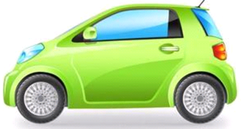
There is a football on the car.

Slide 61
There are two footballs.

Slide 62
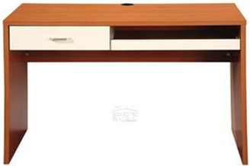
There are two footballs under the desk.

Slide 63
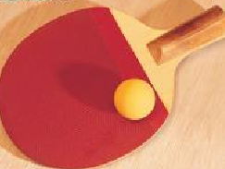
There is a ping-pong ball.

Slide 64
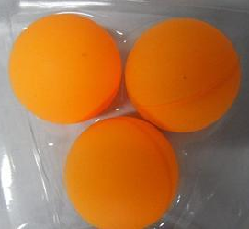
There are three ping-pong balls.

Slide 65
There are three ping-pong balls over there.
There is a ping-pong ball here.

