Slide 1
Module 1
Unit 2
She didn’t have a television.

Slide 2

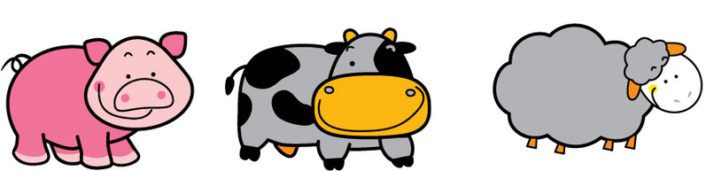
Game :Which is different?
television
Notes:
（一）复习字母

Slide 3




computer
Notes:
（一）复习字母

Slide 4




telephone
Notes:
（一）复习字母

Slide 5
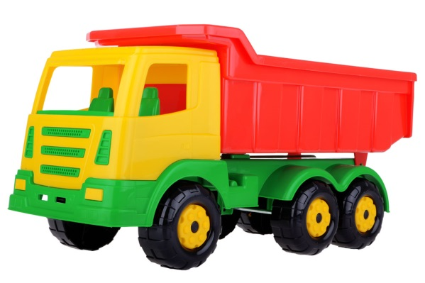
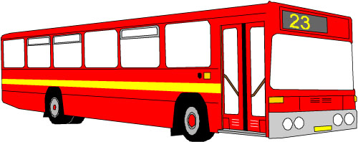


Game:找不同
radio
Notes:
（一）复习字母

Slide 6

Guess
He has strong legs.
He can jump really far.
What is he?
Notes:
（一）复习字母

Slide 7
Did he have legs then?

Slide 8
He didn’t have any legs then.
Notes:
（一）复习字母

Slide 9
He is changing from tadpole to frog.
from tadpole to frog

Slide 10
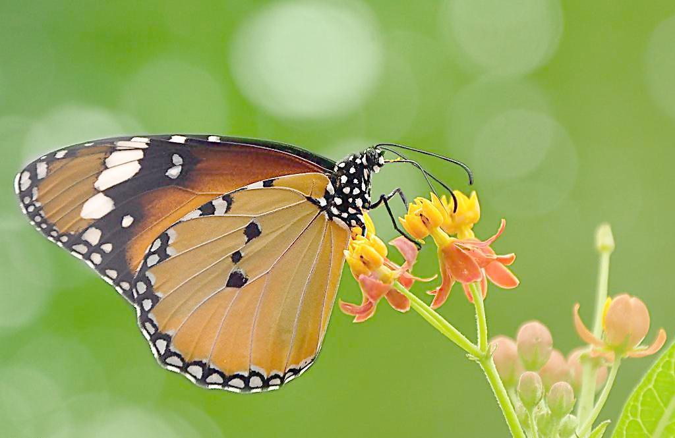
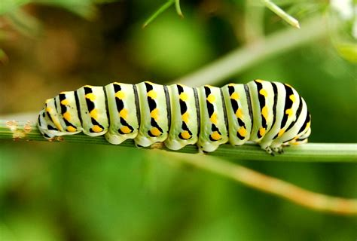
Did she have wings(翅膀) then?
Was she beautiful then?
now
then

Slide 11
She didn’t have… then. Now ,she has… Now ,she can…

Slide 12
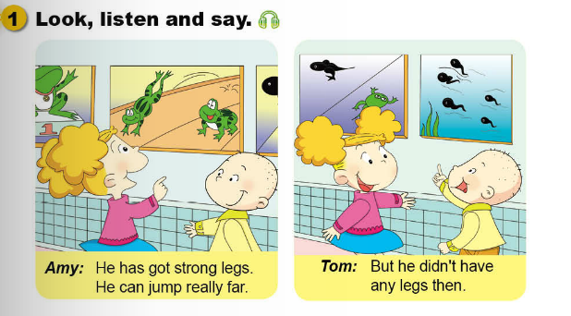
Look listen and say.
Amy: He has got strong legs.
He can jump really far.
Tom: But he didn’t have
any legs then.
Notes:
（一）复习字母

Slide 13
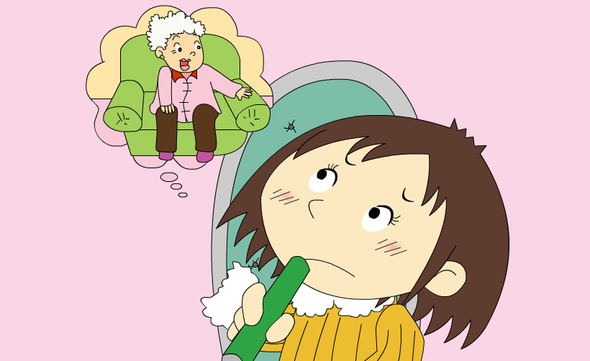
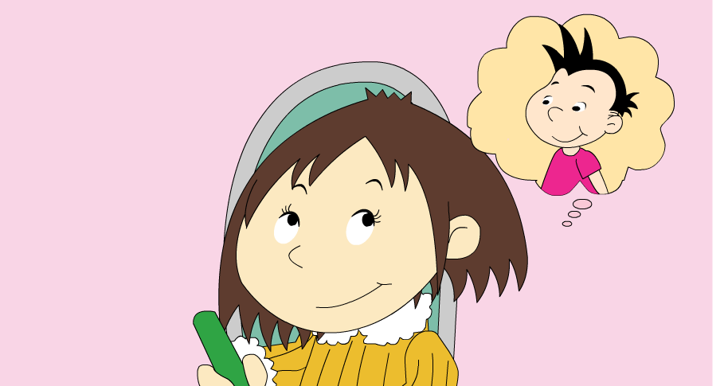
Who does Lingling miss?
How can she talk to them?

Slide 14
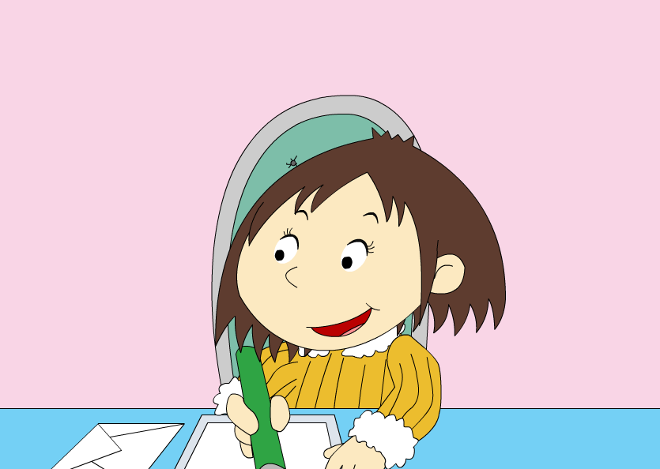
What is she doing?
What can she say in the letter?

Slide 15
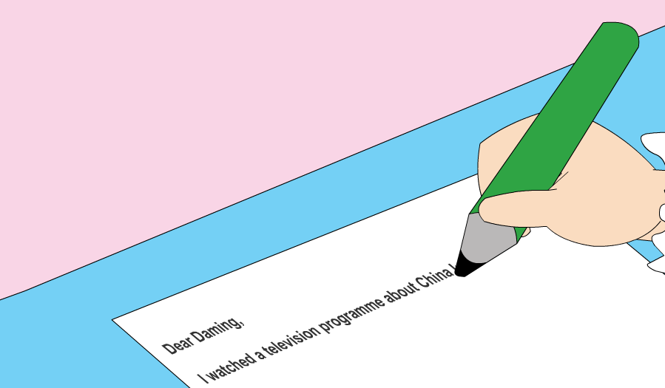
If you were Lingling, write a letter to Daming.

Slide 16
Watch and answer.
1. Did the old lady have a telephone ?
No , she didn’t.
2. Where did she work ?
She worked in the fields.
3. Where did she cook ?
She cooked on a fire.
4. Could she read or write?
No, she couldn’t read or write.
couldn’t=could not
Notes:
（一）复习字母

Slide 17
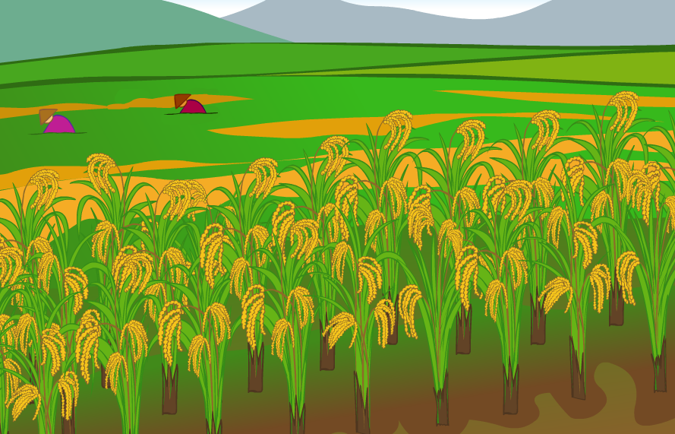
She worked in the fields.

Slide 18
Watch and answer.
1. Did the old lady have a telephone ?
No , she didn’t.
2. Where did she work ?
She worked in the fields.
3. Where did she cook ?
She cooked on a fire.
4. Could she read or write?
No, she couldn’t read or write.
couldn’t=could not
Notes:
（一）复习字母

Slide 19
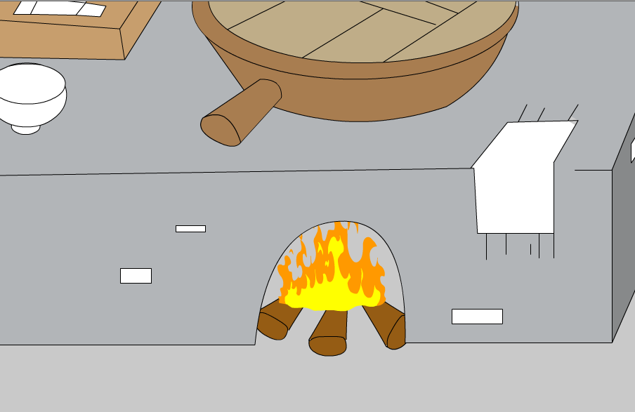
She cooked on a fire.

Slide 20
Watch and answer.
1. Did the old lady have a telephone ?
No , she didn’t.
2. Where did she work ?
She worked in the fields.
3. Where did she cook ?
She cooked on a fire.
4. Could she read or write?
No, she couldn’t read or write.
couldn’t=could not
Notes:
（一）复习字母

Slide 21
Retell
How can we retell a story
fast and remember it for a long time?

Slide 22
Retell
This is a letter from Lingling to Daming.
1.What did she do?
I watched a television programme about China last night.
2.What did the old lady talk about?
An old lady talked about her life many years ago.
3.How was her life?(5 things)
She worked in the fields.
She cooked on a fire.
She didn’t have a television or a radio.
She didn’t have a telephone.
She couldn’t read or write.
4.Who does she miss?
I miss my grandma. I miss you too.
5.Wish
I hope you are well.
Dear Daming,
…
…
Love,
Lingling

Slide 23
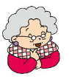
Let’s write.
The old lady talked about her life many years ago.
She worked . She cooked .
She didn't have .
She couldn't .
in the field
on a fire
a television or a radio
read or write
Notes:
（一）复习字母

Slide 24
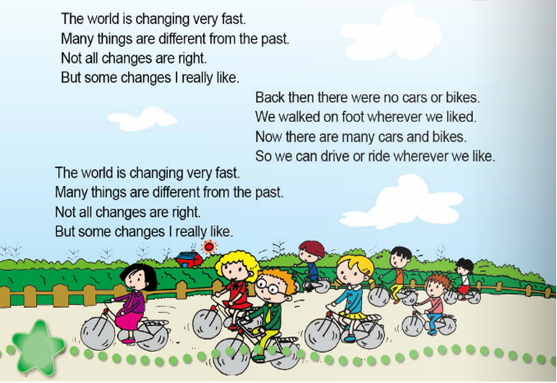
Read and chant.
What changes are wrong?
What will you do to make it better?
What changes do you like?
Notes:
（一）复习字母

Slide 25
连词成句。
a, watched, about, I,programme, TV, China.
I watched a TV programme about China.
cooked, She, a , fire, on.
She cooked on a fire.

Slide 26
连词成句。
didn’t, a , a, She, radio, have, television, or.
She didn’t have a television or a radio.
read , couldn’t, She , write, or.
She couldn’t read or write.

Slide 27

There flowers ten years ago.
A. were B. was C. are
2. A dog four .
A. have got; legs B. has got; legs
C. has got; leg
3. She didn’t have a computer a radio.
A. and B. of C. or

Slide 28
4. I hope you are .
A. good B. well C. great
5.-- ten years ago?
--I lived in a small village.
A. What did you do
B. Where did you live
C. How did you go to school
6. The world is very fast.
A. changes B. changed C. changing

Slide 29
用所给词的正确形式填空：
1. Two years ago, there ____(is)a zoo.
Now there _____(is) a market.
2. There ____ ( be not) telephone many years ago.
Now many people _______(have) ones.
3. Many years ago he _____(live) in a small house.
Now he______(live) in a big house.
was
is
weren’t
have
lived
lives

Slide 30
Summary归纳总结
1.Topic:
how was life in the past and how it is now
2.Sentence:
We lived in…There weren’t… We didn't have…We couldn’t…
We live in… There are… We have… We can….
3.Words:
P66
4.Phonics:
ai/ay al/au ar
5.Write
ai/ay al/au ar

