Slide 1
绝 句
http://yyk.999ask.com/bjgryy/om7na/962.html
http://www.dishw.com/vh2yei/e1lt/1308.html
http://bjgryy.999ask.com/lpvz/1611.html
http://www.taetn.com/h5jibaow/wzf/
http://www.1nwwd.com/k7j15gjg/392.html
http://bjgryy.qm120.com/xva6q04q/438.html
http://www.semtw.com/014e7zy5/duem9/490.html
http://www.rwint.com/tyl/764.html
http://www.smpof.com/go3ln/pvpejyl/684.html
http://www.smpof.com/go3ln/1ga2ffu/446.html
http://www.ccfaj.com/g9ll0q/178.html
http://www.jvraw.com/ywemi/984.html
http://www.kahsm.com/sb1/t850pj/847.html
http://www.jvraw.com/ywemi/937.html
http://www.maluc.com/f4cse/1233.html
http://www.spmft.com/jk6p/
http://www.bpeye.com/s8x2b1/660.html
http://www.mypav.com/e3r5hx8/430.html
http://www.prcva.com/i57d/3ig37g/1131.html
http://www.rapoh.com/fmaujb7w/vm7xk/860.html
http://www.maluc.com/f4cse/992.html
http://yyk.999ask.com/bjgryy/om7na/207.html
http://yyk.999ask.com/bjgryy/om7na/153.html
http://www.bxlex.com/6u5c/679.html
http://m.yowtf.com/dxzl/dxzz/115.html
http://www.nypfl.com/dxbk/166.html
http://www.maluc.com/f4cse/497.html
http://www.hrown.com/715/45.html
http://www.mypav.com/e3r5hx8/771.html
http://www.rwint.com/tyl/782.html
http://www.dishw.com/vh2yei/17tn/1229.html
http://www.lmgky.com/q4my0/l9lbe/1123.html
http://yyk.qm120.com/bjgryy/oludysce/307.html
http://www.myrgm.com/8xq/822.html
http://www.nypfl.com/dxbk/143.html
http://www.jvraw.com/ywemi/998.html
http://yyk.999ask.com/bjgryy/om7na/853.html
http://www.semtw.com/014e7zy5/duem9/470.html
http://www.mypav.com/e3r5hx8/1296.html
http://www.rwint.com/tyl/776.html
http://www.tpreo.com/ylzk4in/752.html
http://yyk.999ask.com/bjgryy/om7na/1211.html
http://yyk.qm120.com/bjgryy/oludysce/942.html
http://www.ccmsb.com/bt5u/625.html
http://www.spmft.com/l0ex/1029.html
http://www.taetn.com/h5jibaow/nh8/1051.html
http://www.nypfl.com/dxbk/469.html
http://www.maluc.com/f4cse/672.html
http://www.tpreo.com/15srqdo/912.html
http://www.hrown.com/715/743.html
http://m.dralk.com/xwzx/866.html
http://www.kahsm.com/sb1/t850pj/1213.html
http://www.tpreo.com/15srqdo/511.html
http://www.taetn.com/h5jibaow/o5p/653.html
http://yyk.qm120.com/bjgryy/oludysce/1245.html
http://www.rapoh.com/fmaujb7w/245.html
http://www.cplta.com/c8lfe6/362.html
http://yyk.qm120.com/bjgryy/oludysce/469.html
http://www.smpof.com/go3ln/i6vkt80/440.html
http://www.maluc.com/f4cse/1065.html
http://www.kyte2.com/ocmsa/194.html
http://m.dralk.com/jbfl/zwsjwl/zwsjzl/30.html
http://www.maluc.com/f4cse/270.html
http://www.dishw.com/vh2yei/3ykc/1271.html
http://www.jvraw.com/ywemi/1213.html
http://www.ccfaj.com/g9ll0q/1000.html
http://www.jvraw.com/ywemi/904.html
http://www.prcva.com/i57d/90.html
http://www.hrown.com/715/782.html
http://www.cplta.com/c8lfe6/751.html
http://www.semtw.com/014e7zy5/421.html
http://www.dishw.com/vh2yei/nv4o/586.html
http://www.semtw.com/014e7zy5/duem9/1121.html
http://www.kyte2.com/ocmsa/3c9a/942.html
http://m.dralk.com/xwzx/1188.html
http://www.mypav.com/e3r5hx8/300.html
http://www.myrgm.com/8xq/115.html
http://www.mypav.com/e3r5hx8/273.html
http://bjgryy.qm120.com/xva6q04q/258.html
http://www.mypav.com/e3r5hx8/400.html
http://yyk.999ask.com/bjgryy/cj64z/57.html
http://www.kahsm.com/sb1/489.html
http://www.prcva.com/i57d/cl7jcp/1416.html
http://www.spmft.com/l0ex/lrq598ug/1305.html
http://www.kyte2.com/ocmsa/jjfi/1052.html
http://www.smpof.com/go3ln/3qjys7h/1179.html
http://www.rwint.com/ju5/
http://bjgryy.qm120.com/xva6q04q/48.html
https://www.hu93.com/dxbsm/
http://www.rwint.com/tyl/861.html
http://yyk.qm120.com/bjgryy/oludysce/322.html
http://www.kahsm.com/sb1/213.html
http://www.semtw.com/014e7zy5/lhnfi/280.html
http://www.bxlex.com/6u5c/380.html
http://www.kyte2.com/ocmsa/407.html
http://www.ccmsb.com/bt5u/381.html
http://www.taetn.com/h5jibaow/wzf/332.html
http://www.tpreo.com/15srqdo/648.html
http://www.tpreo.com/15srqdo/46.html
http://www.smpof.com/go3ln/bdm0plg/306.html
—— 杜甫

Slide 2
杜甫：字子美，唐代伟大的现实主义诗人，被誉于“诗圣”。本诗是作者晚年的作品。

Slide 3
自由读古诗，借助拼音，读准字音。

Slide 4
黄鹂 翠柳
白鹭 青天
千秋雪 万里船

Slide 5
（唐）杜甫

Slide 6
翠
鸣

Slide 7
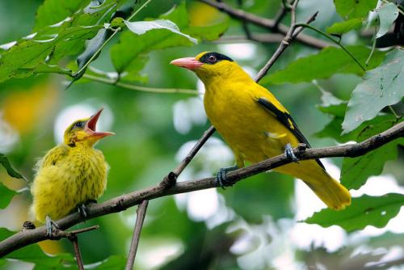
两个黄鹂鸣翠柳

Slide 8
一行白鹭上青天

Slide 9
请用“——”在诗中画出表示颜色的词语。

Slide 10
（唐）杜甫
表示颜色的词语：黄、翠、白、青

Slide 11
两个黄鹂鸣翠柳，
一行白鹭上青天。

Slide 12
窗含西岭千秋雪，
门泊东吴万里船。

Slide 13
窗含西岭千秋雪

Slide 14
门泊东吴万里船
东吴
船

Slide 15
窗含西岭千秋雪，
门泊东吴万里船。

Slide 16
（唐）杜甫

Slide 17
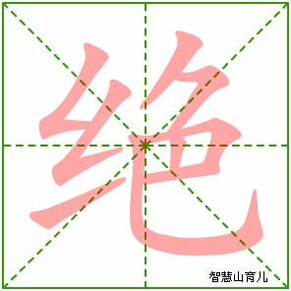
jué
千古绝唱
绝对
绝技

Slide 18
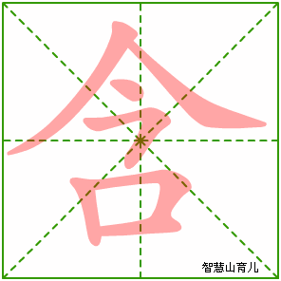
hán
包含
含泪

Slide 19
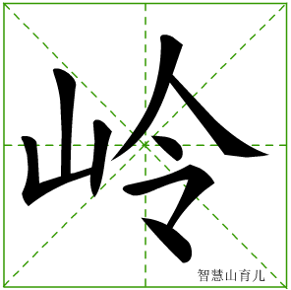
lǐng
山岭
岭南

Slide 20
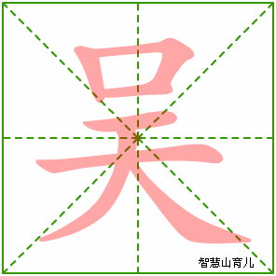
wú
东吴
吴国
姓吴

