Slide 1
Module 1 Unit 1
It's more than twenty thousand kilometres long.

Slide 2
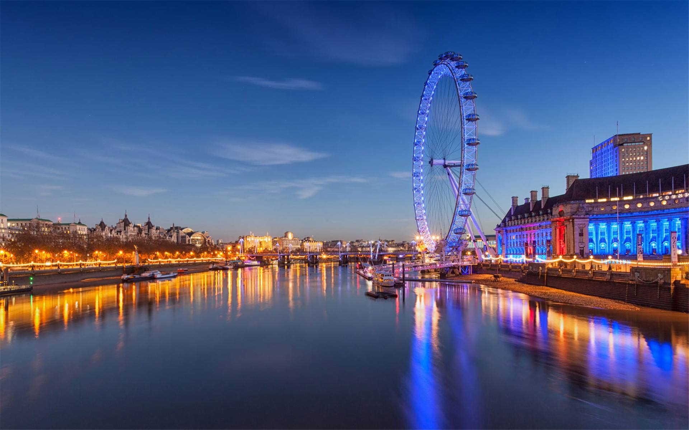
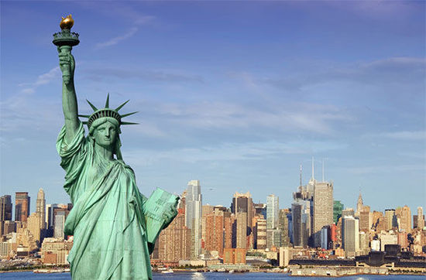
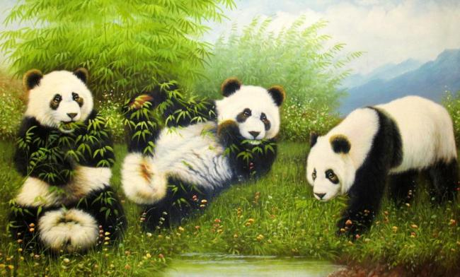
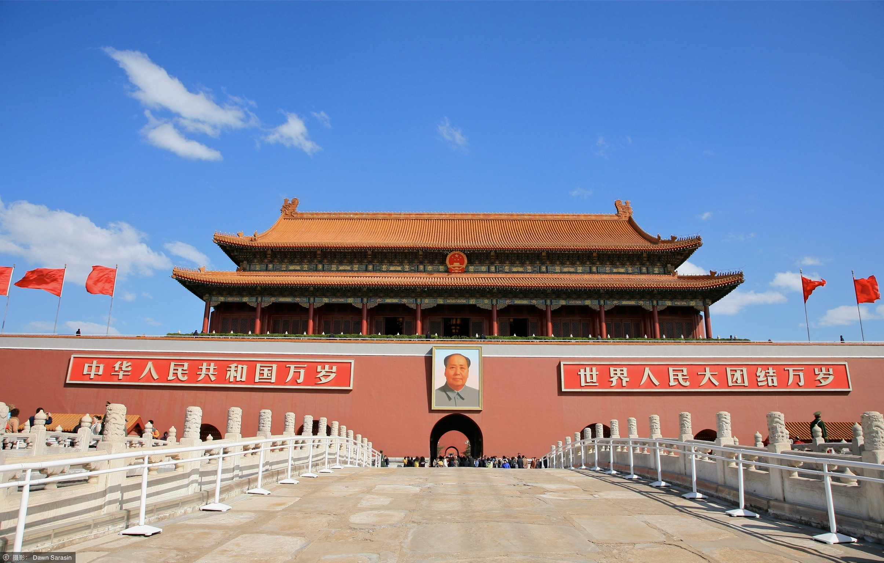
Where did you go this summer holiday?

Slide 3
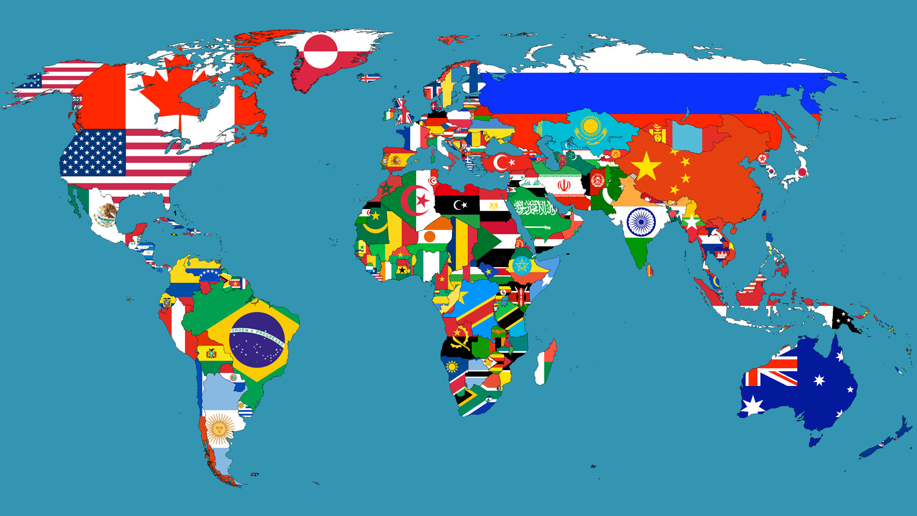

China

Slide 4
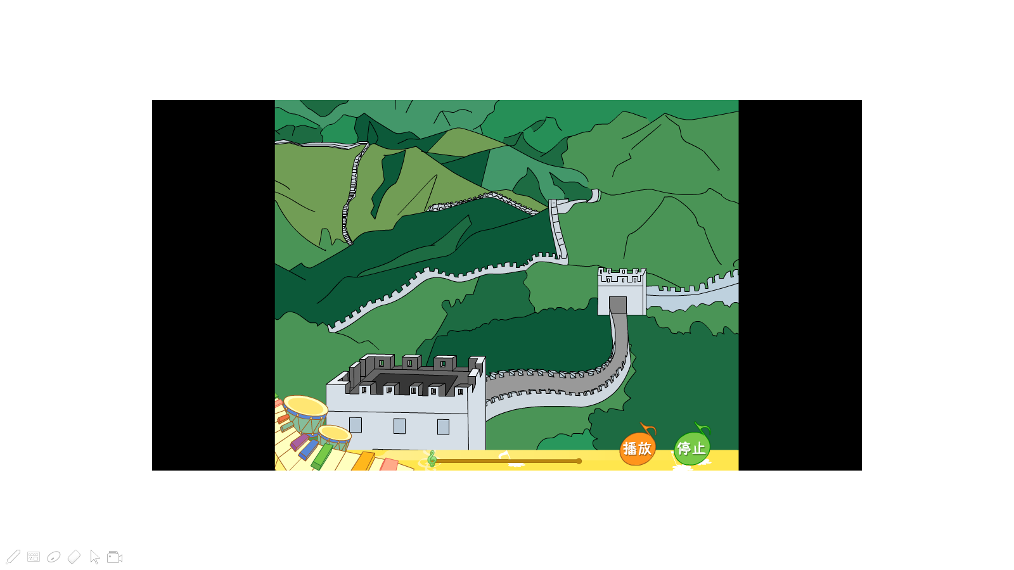
Guess.
It's a famous place in China.
It's vey long and old. It's beautiful.
Can you tell me more about it?

Slide 6
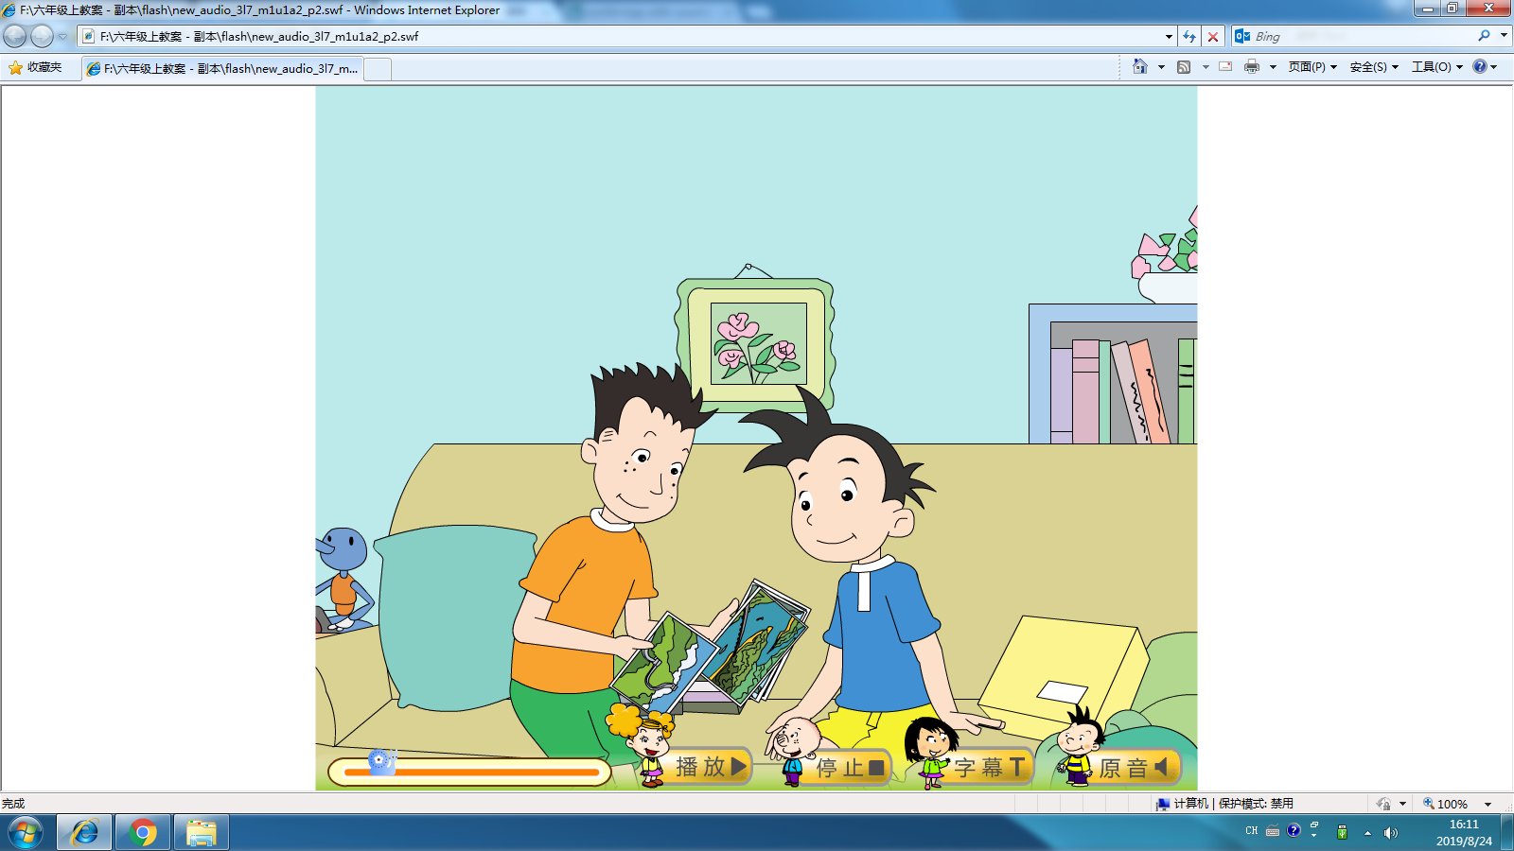
Where is Daming now?
What are they talking about?

Slide 7
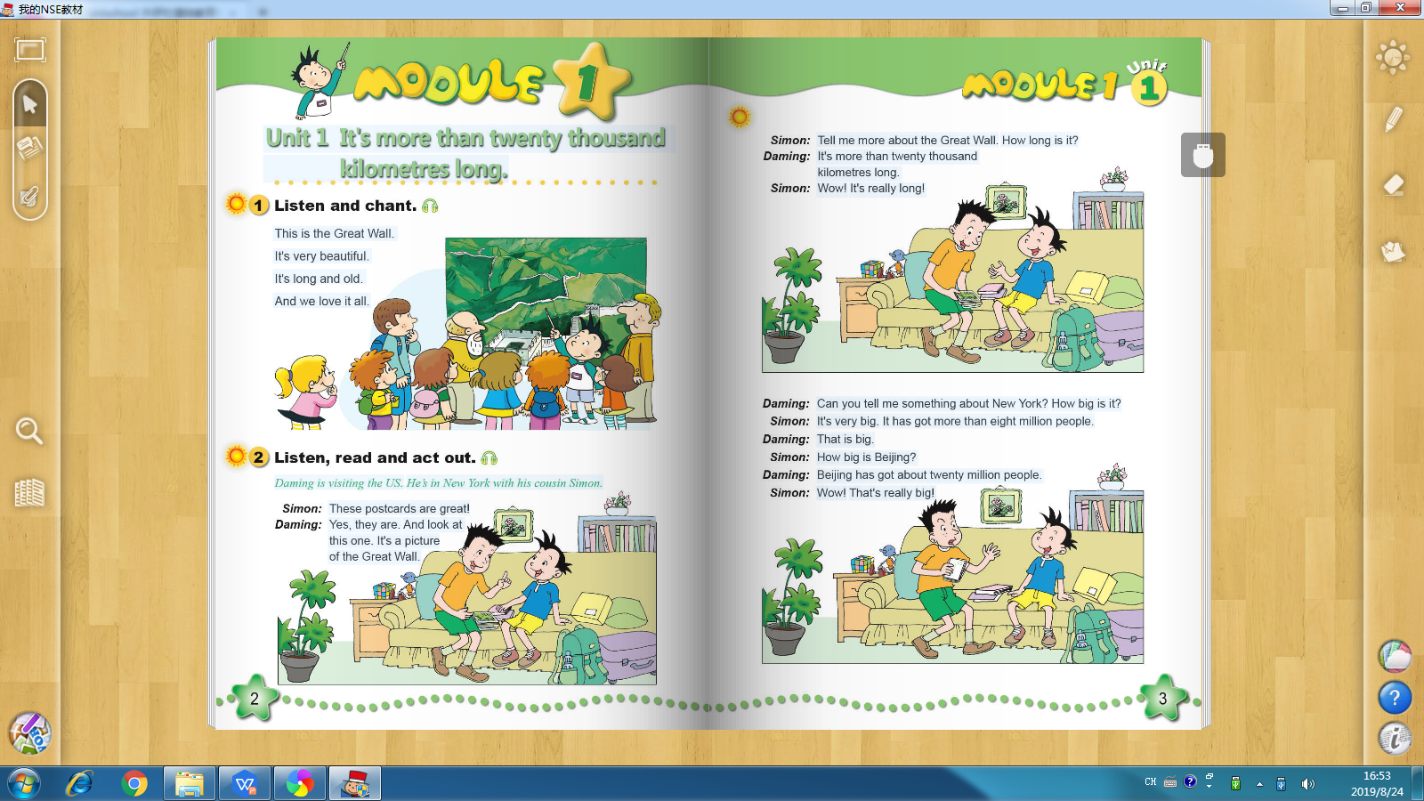
Read silently. Tell me more about the Great Wall.

Slide 8
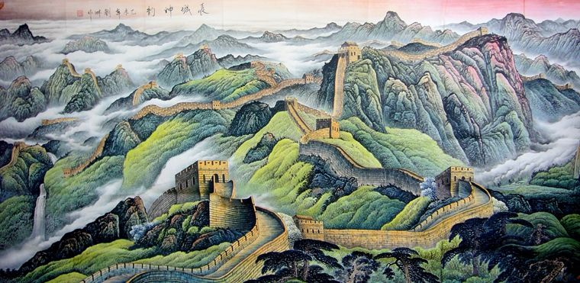
How long is it?
( )
＞
twelve thousand
( )
＞
twenty thousand kilometres
T
( )
＞
two thousand kilometres

Slide 9
100
one hundred百
1,000
one thousand千
10,000
ten thousand万
1,000,000
one million百万

Slide 10
How long is it?
It's 21196.18 kilometres.
It's more than 20,000 kilometres.
超过
twenty thousand

Slide 11
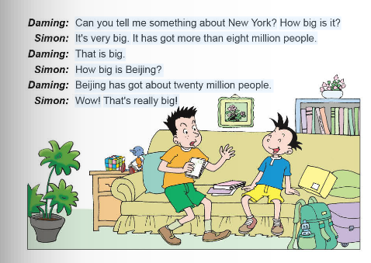
Read in pair. Find more about New York and Beijing.

Slide 12
How big is it?
people
New York
It has got...
Beijing
more than eight million
more than twenty million
( )8,510,000
( )8,000,000
( )21,540,000
( )20,000,000
T
T

Slide 14
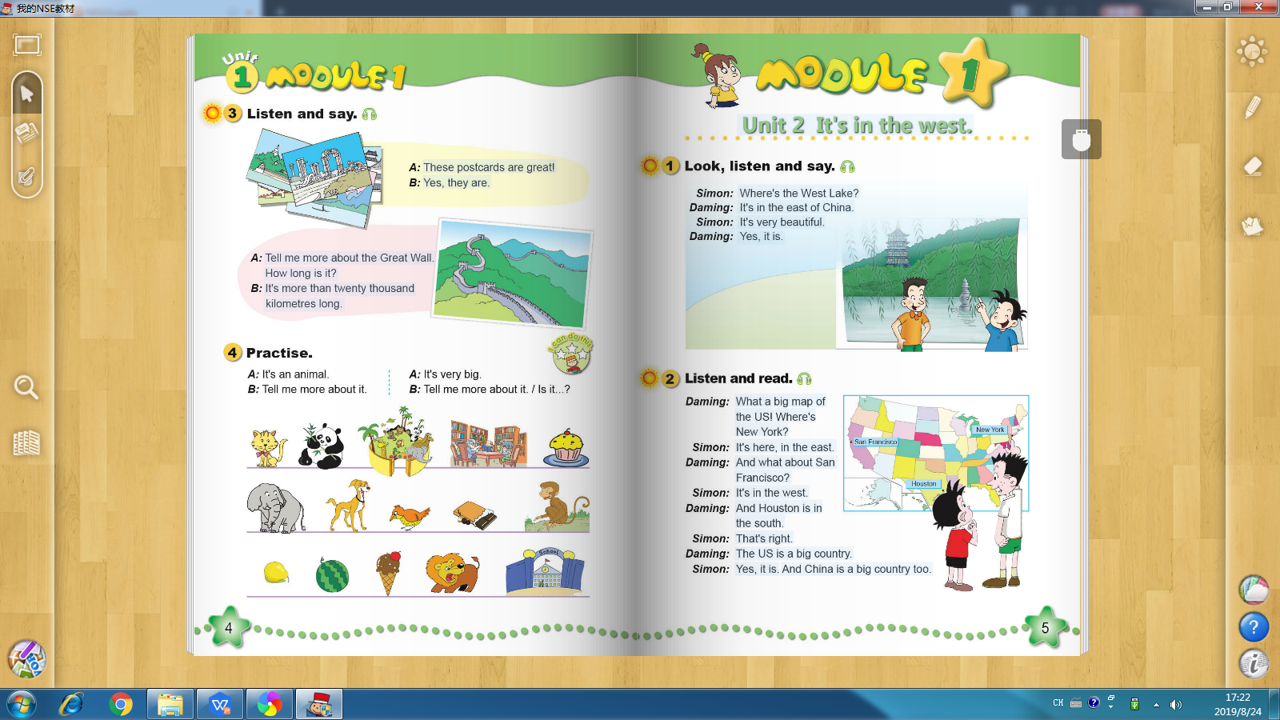
Guess
A:It's an animal.
B:Tell me more about it.
A:It's very...
It's really...
It has got...
B:Is it...?
A:Yes, it is./ No, it isn't.

Slide 15
Summary: Facts about a place
It's very/really long/old/big/beautiful/famous...
How is it?
Facts about a place
It's more than ...hundred/thousand
/million kilometres.
How long is it?
It has got...hundred/thousand
/million people.
How big is it?

