Slide 1
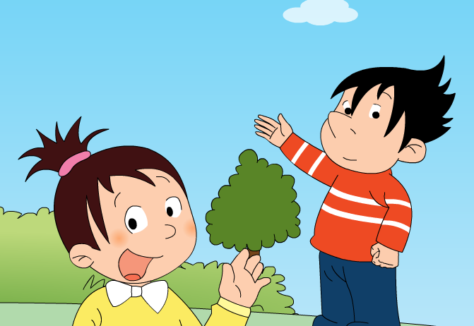
Module 1 Unit 1 She’s very nice.

Slide 2
Look! The elephant is ______.
clever, naughty

Slide 3
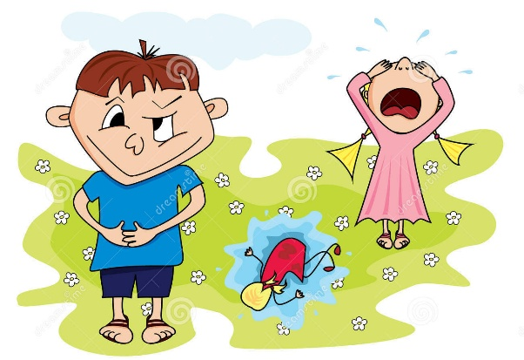
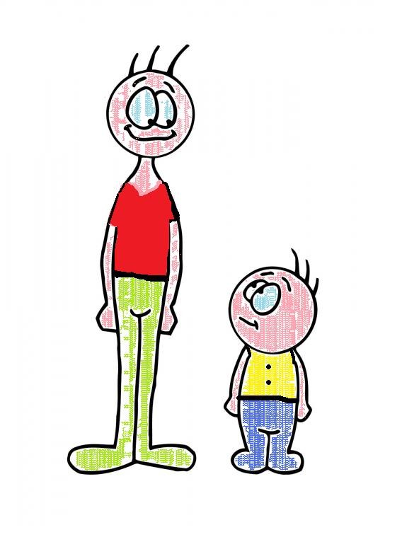
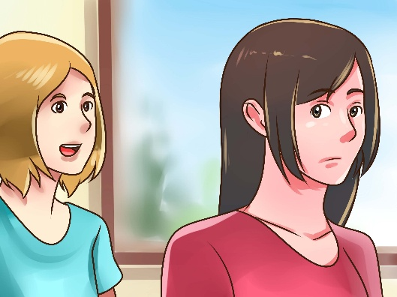
Who’s clever in our class?
Who’s naughty in our class?
Who’s tall in our class?
Who’s quiet in our class?

Slide 4
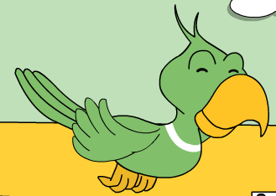
Panpan has got some friends. He would like to introduce to you.

Slide 5
Watch and say: The girl is______. Xiaoyong is _____. The parrot is ______.

Slide 6
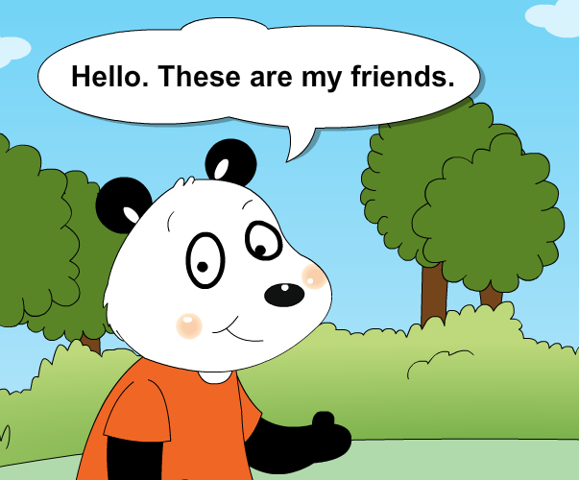
Look, listen and finish the missing words.

Slide 7
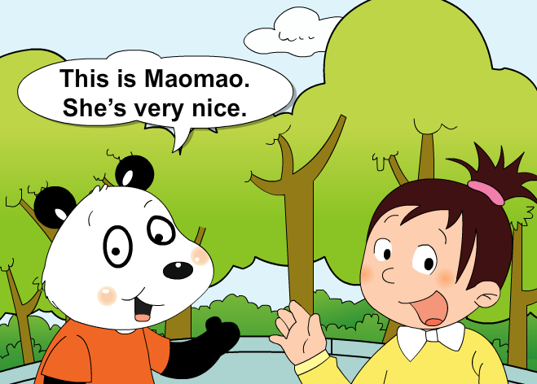
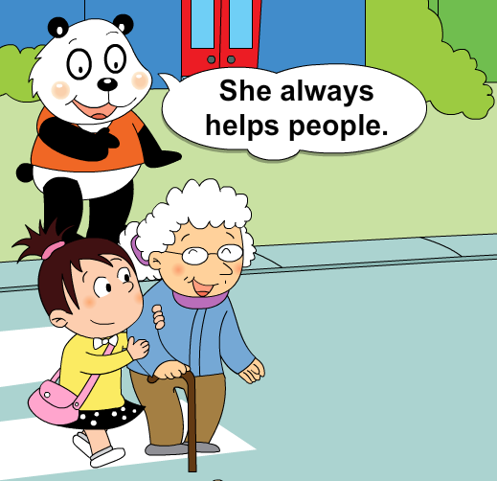
?
?

Slide 8
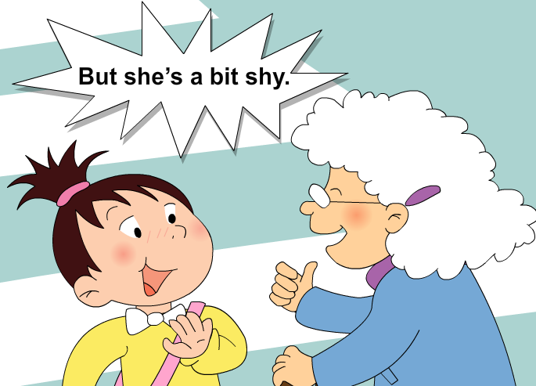
?

Slide 9
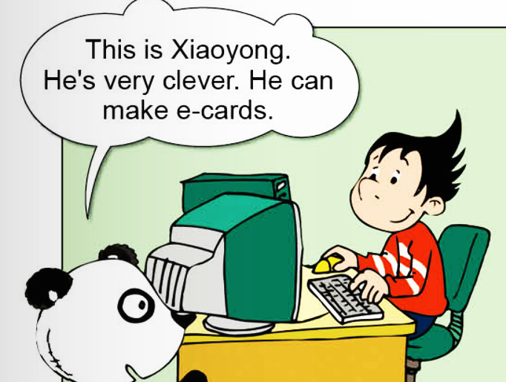
?
?

Slide 10
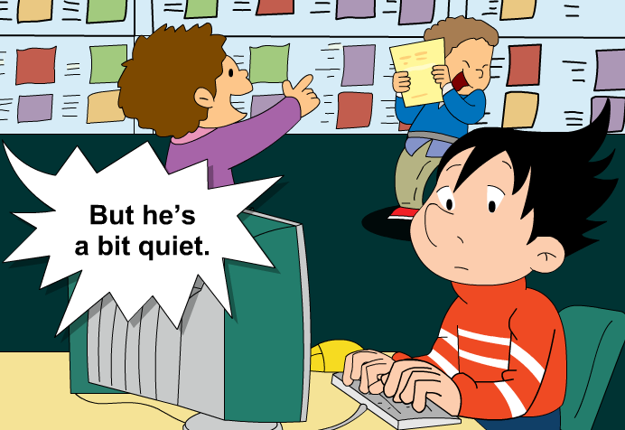
?

Slide 11
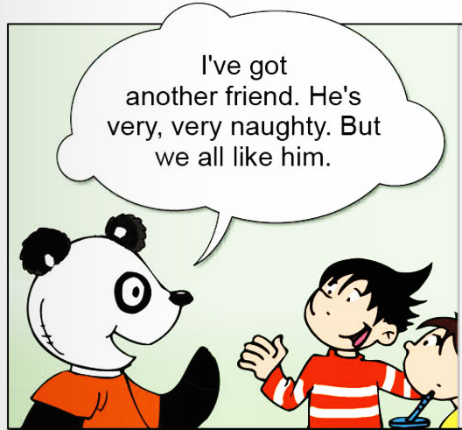
?

Slide 12
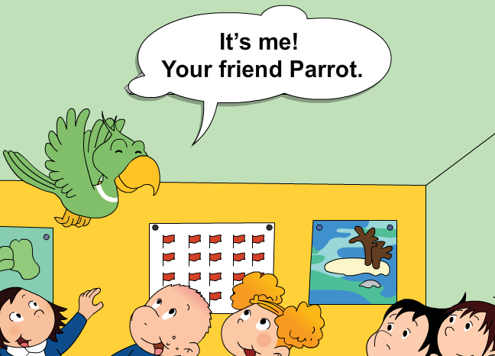
The parrot is very naughty, but it’s _____.

Slide 13
Watch and read:

Slide 14
Finish the ID card of them!
Name:__________
Personality（性格）:___________
Why?________________
Name:__________
Personality（性格）:___________
Why?________________

Slide 15
Name:__________
Personality（性格）:___________
Why?________________

