Slide 1
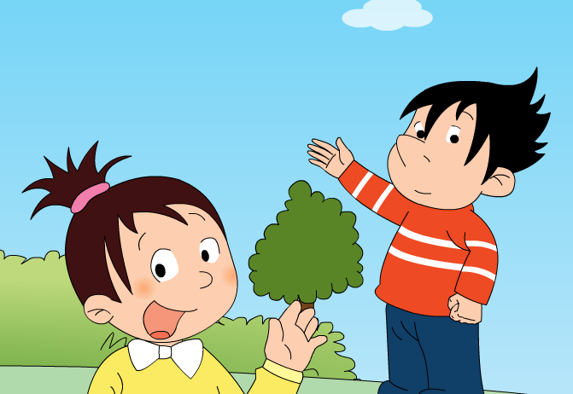
Module 1 Unit 2
I’m going to help her.

Slide 2
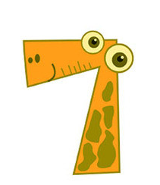










Slide 3
Can you do the Maths?

Slide 4
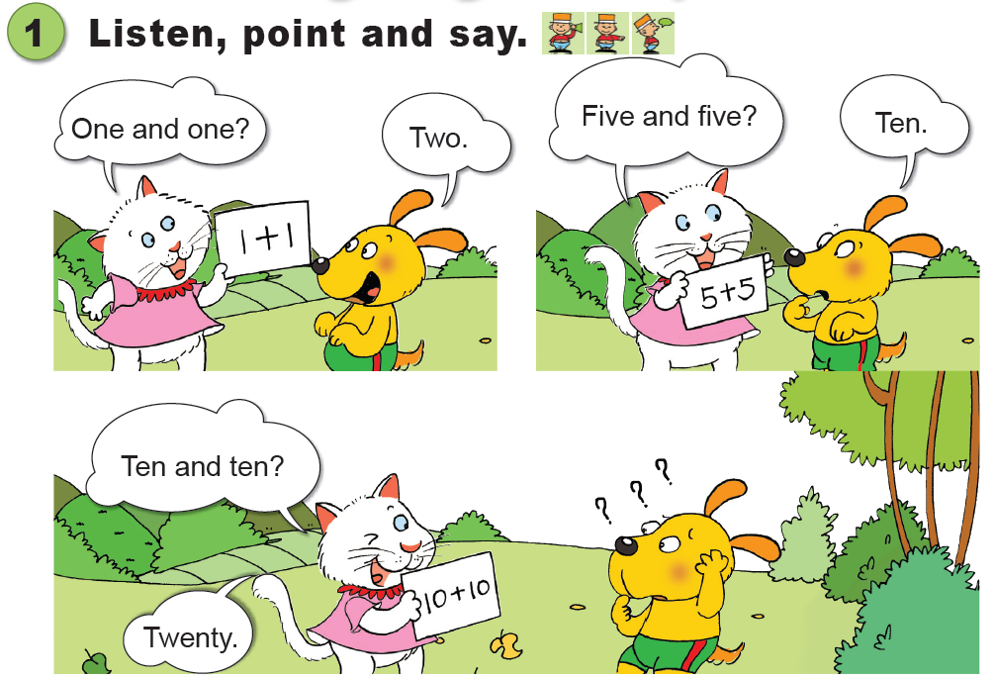

Slide 5
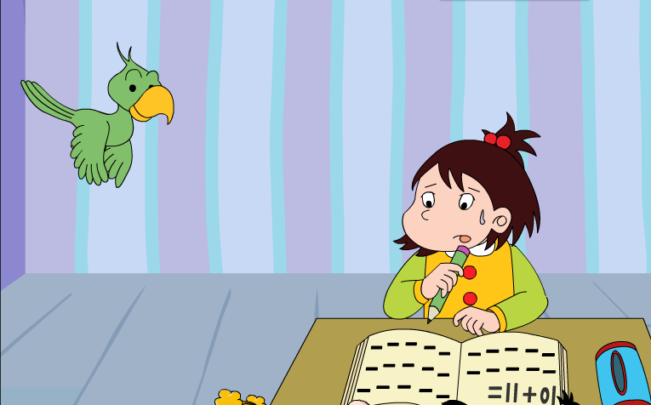
Can the little girl do the Maths?
Who’s going to help her?

Slide 6
The parrot is _______.

Slide 7
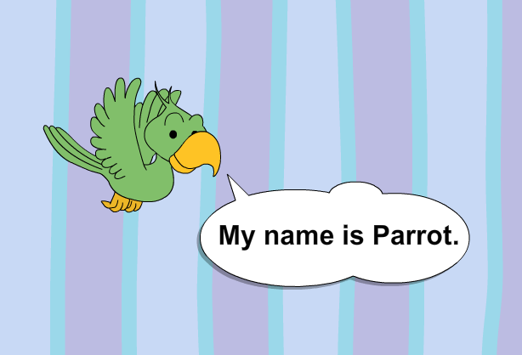

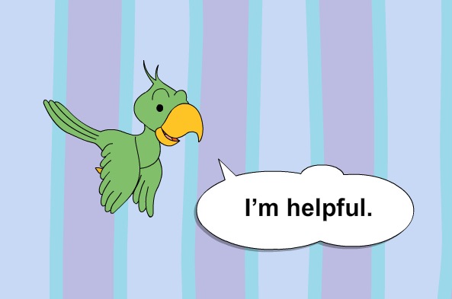
?

Slide 8
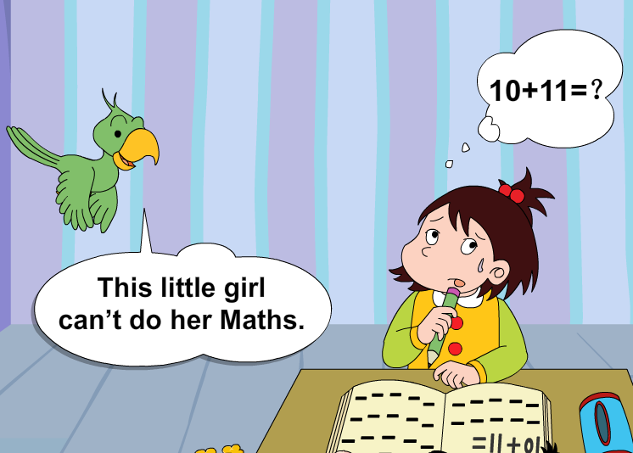
?

Slide 9
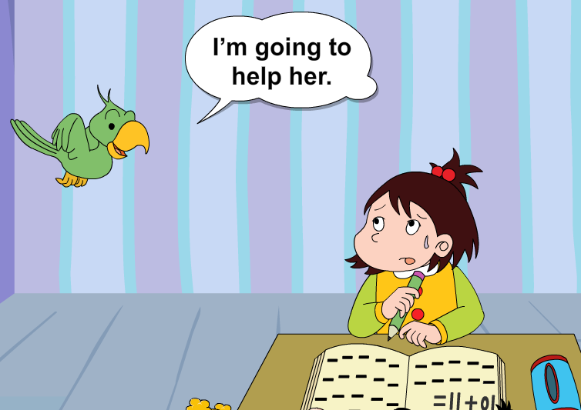
?

Slide 10
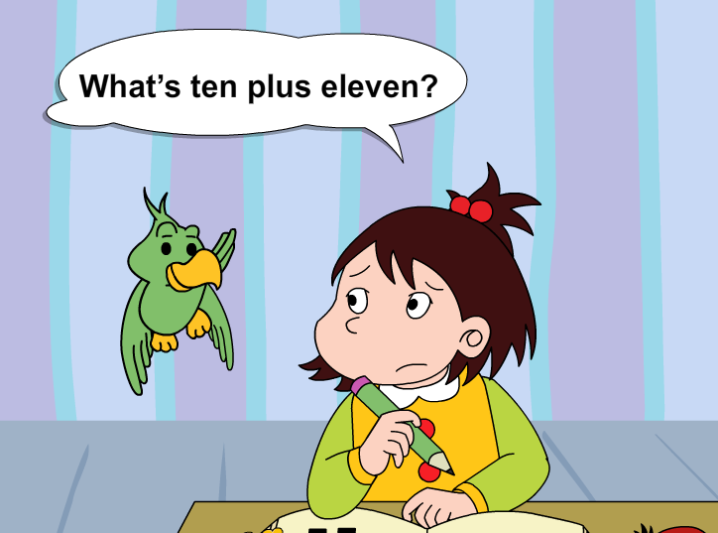
?
?

Slide 11
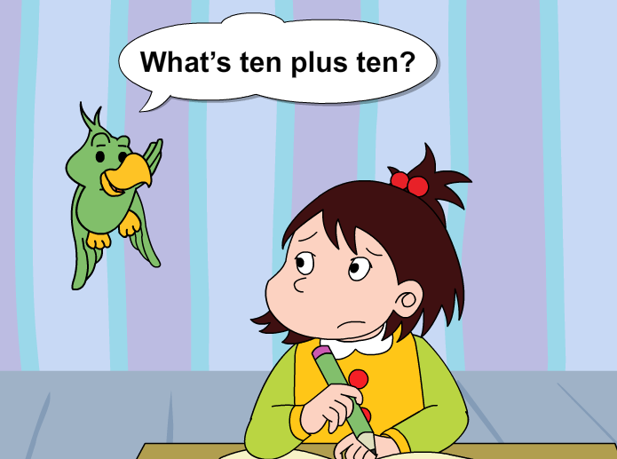
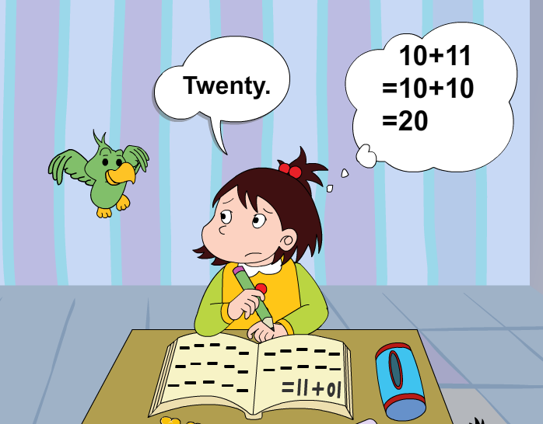
?

Slide 12
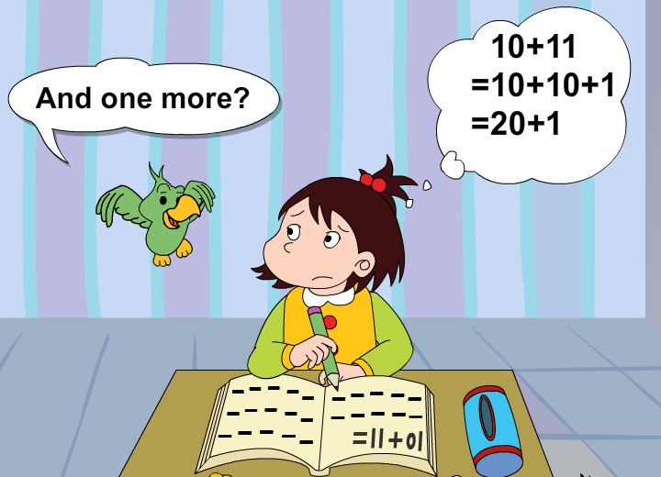
?

Slide 13
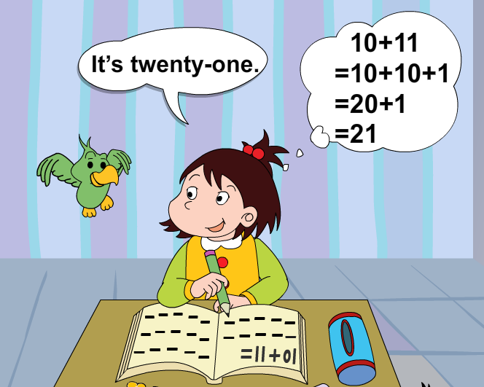
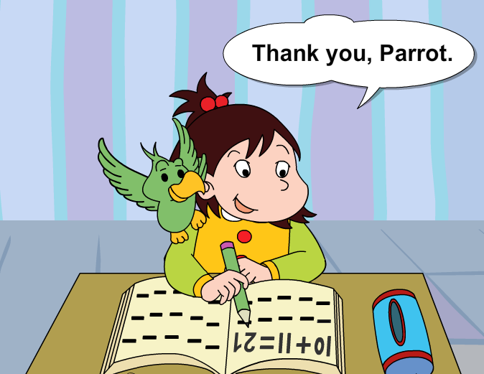
?

Slide 14
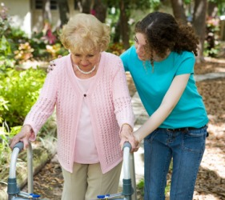
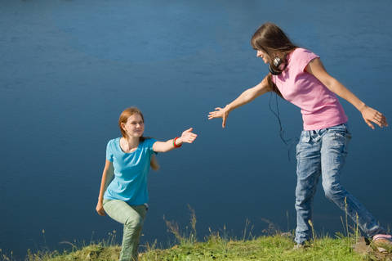
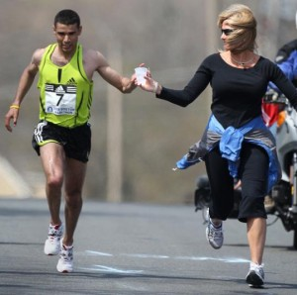
helpful

Slide 15
Can you do the Maths?

Slide 16
Reorder the sentences
3
( ) What’s ten plus ten?
( ) It’s twenty-one. Thank you Parrot.
( ) This little girl can’t do her Maths.
( ) Twenty.
( ) And one more?
( ) I’m going to help her.
6
1
4
5
2

Slide 17
+
plus
What’s ten plus ten?
=What’s ten and ten?
+
and
-
minus
Can you say them?
1+2+3=?
33-5+6=?
12+7-8=?

Slide 18





Maths
Music
Chinese
English
Science

Slide 19
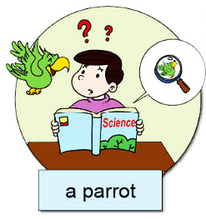
A: This … can’t …
I’m going to…It’s…
B: Oh! Thank you, …

Slide 20
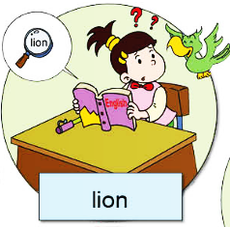
A: This … can’t …
I’m going to…It’s…
B: Oh! Thank you, …

Slide 21
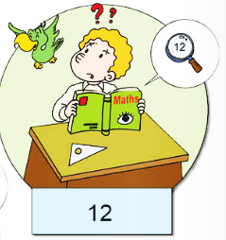
A: This … can’t …
I’m going to…It’s…
B: Oh! Thank you, …

Slide 22

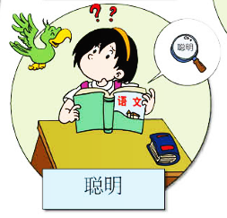
A: This … can’t …
I’m going to…It’s…
B: Oh! Thank you, …

Slide 23
Ways to introduce others
I’ve got…
This is…
These are…
He/She always…
Introduce others
But he/she is…
He/she is…
He/she can…
He/she can’t…

Slide 24
Adjectives to describe people
nice 有好的
helpful 肯帮忙的
naughty 淘气的
quiet 安静的
shy 害羞的
clever 聪明的
…

Slide 25
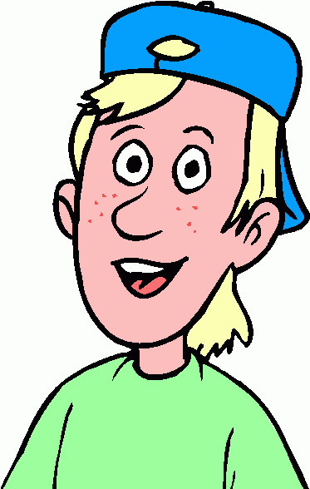
The special me!
clever
I’m clever.

Slide 26
Can you remember me?

Slide 27
Who’s going to help me?
I can’t run very fast.
I can’t run very fast.

