Slide 1
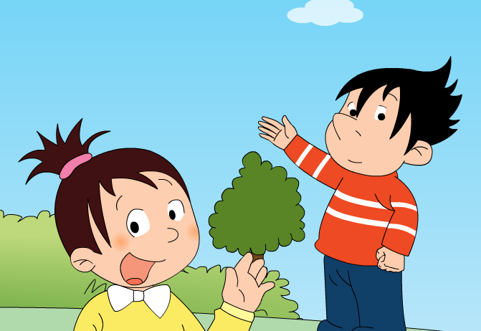
Module 1 Unit 2
I’m going to help her.

Slide 2
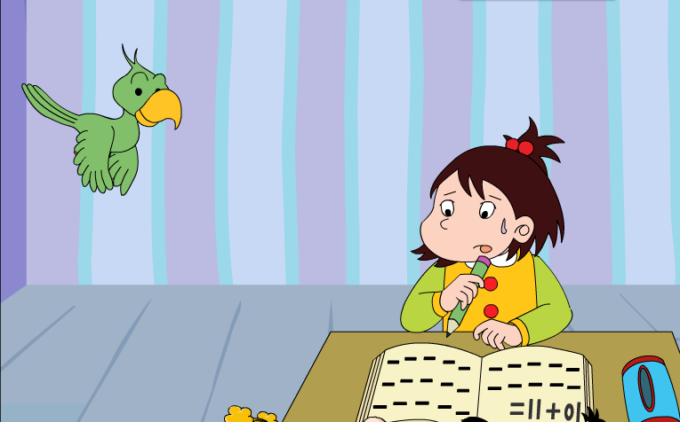
Can the little girl do the Maths?
Who’s going to help her?

Slide 3
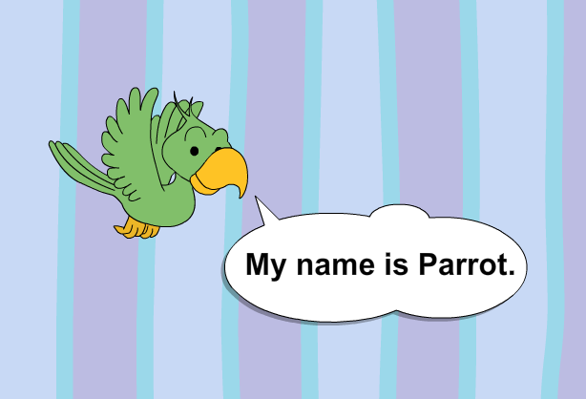

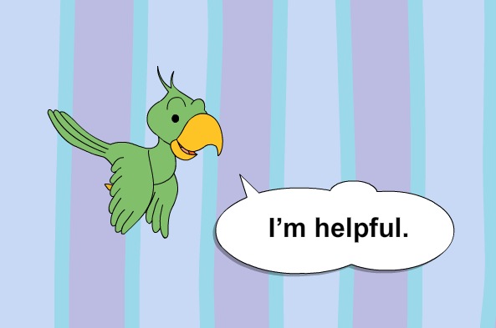
?

Slide 4
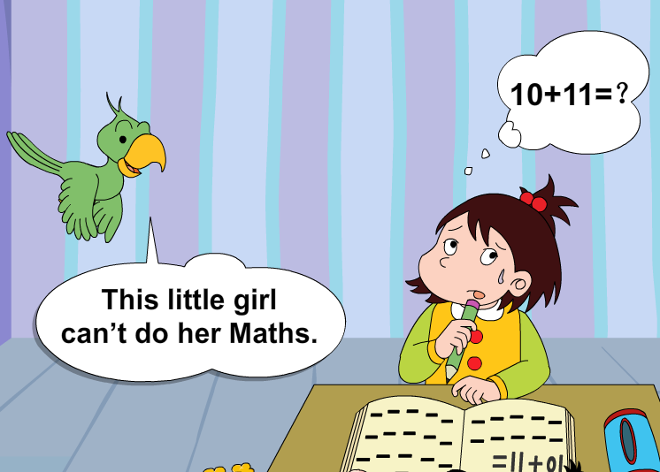
?

Slide 5
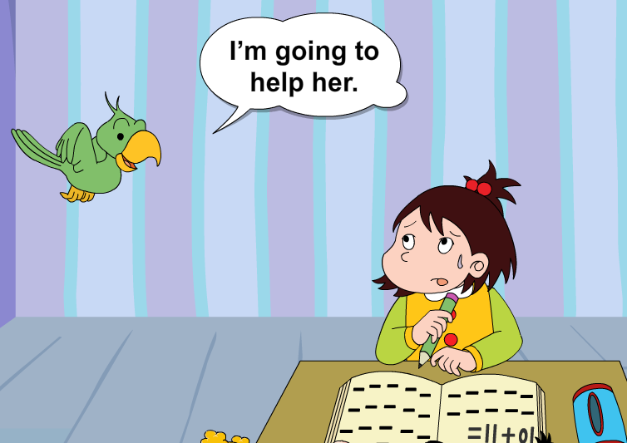
?

Slide 6
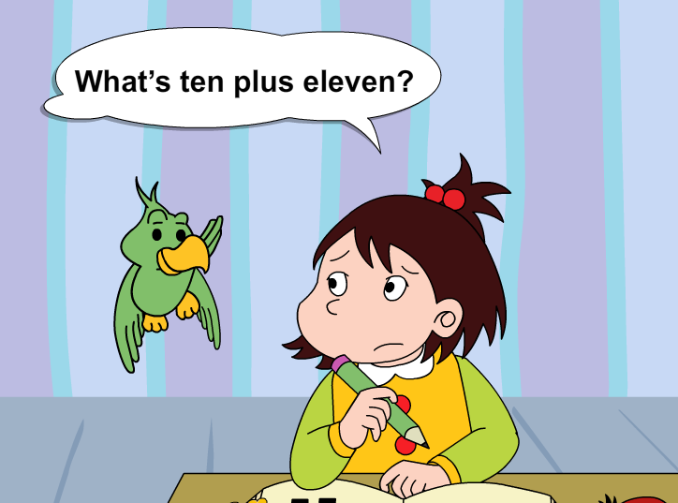
?
?

Slide 7
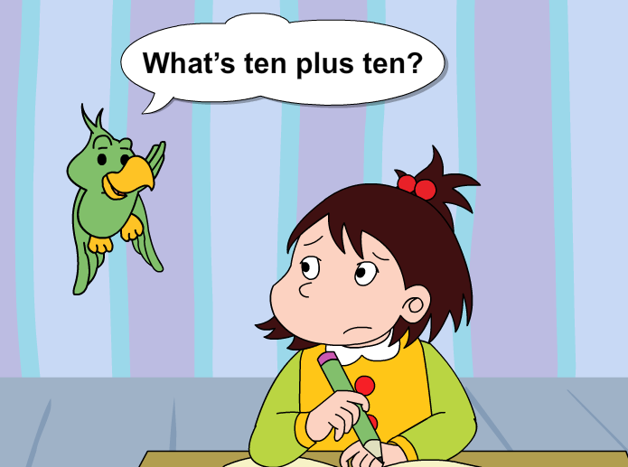
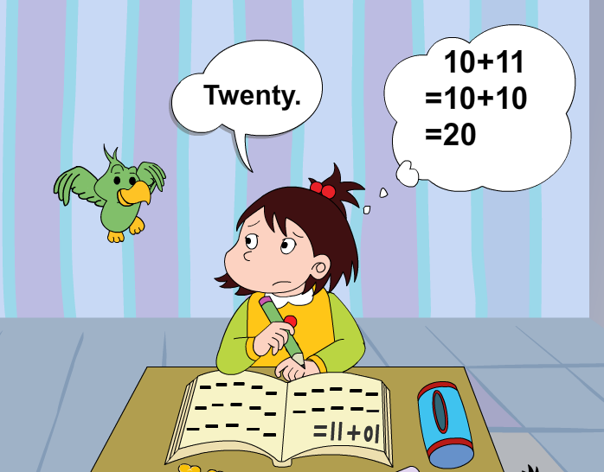
?

Slide 8
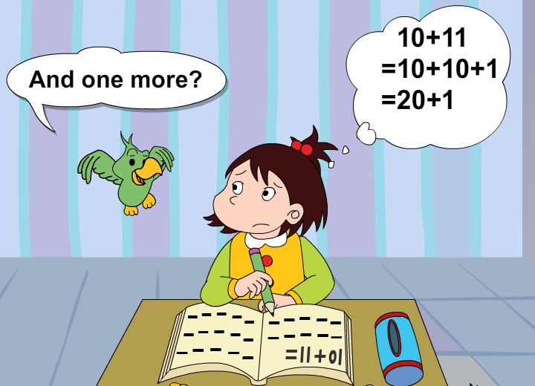
?

Slide 9
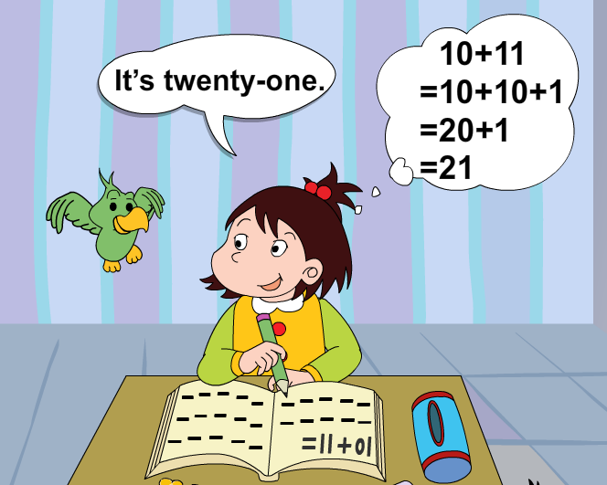
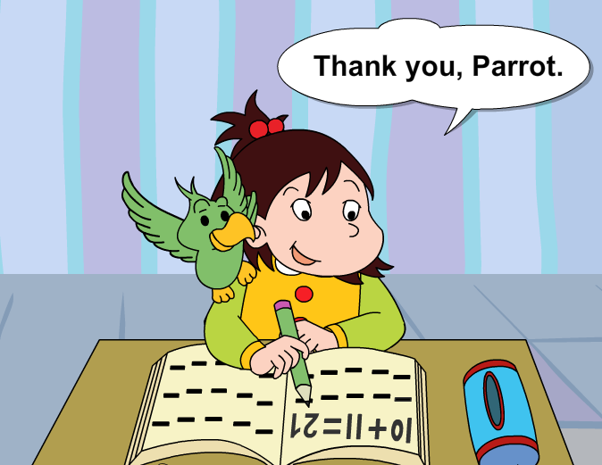
?

Slide 10
Let’s read it together

Slide 11
+
plus
What’s ten plus ten?
=What’s ten and ten?
+
and
Can you say them?
1+2=? 3+5=? 4+7=? 10+10=？
10+1=？ 10+5=？ 10+11=？ 10+12=？

Slide 12





Maths
Music
Subjects
科目
Chinese
English
Science

Slide 13
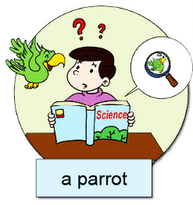
A: This_________ can’t____________.
I’m going to__________.It’s________.
B: Oh! Thank you,_______.
little boy
do his Science
help him
a parrot
parrot

Slide 14
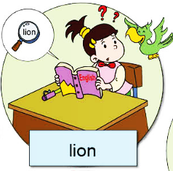
A: This_________ can’t____________.
I’m going to__________.It’s________.
B: Oh! Thank you,_______.

Slide 15
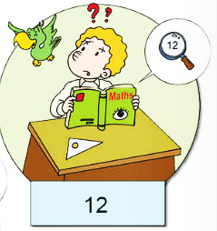
A: This_________ can’t____________.
I’m going to__________.It’s________.
B: Oh! Thank you,_______.

Slide 16

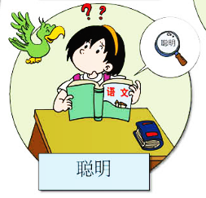
A: This_________ can’t____________.
I’m going to__________.It’s________.
B: Oh! Thank you,_______.

Slide 17
Ways to introduce friends
I’ve got…
He/she can…
He/she can’t…
This is…
These are…
Introduce friends
But he/she is…
He/she is…
He/She always…

Slide 18
Adjectives to describe people
nice 有好的
helpful 肯帮忙的
naughty 淘气的
quiet 安静的
shy 害羞的
clever 聪明的
…

Slide 19
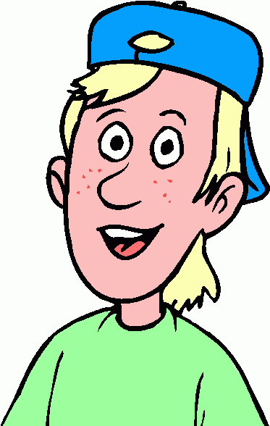
The special me!
clever
I’m clever.

Slide 20
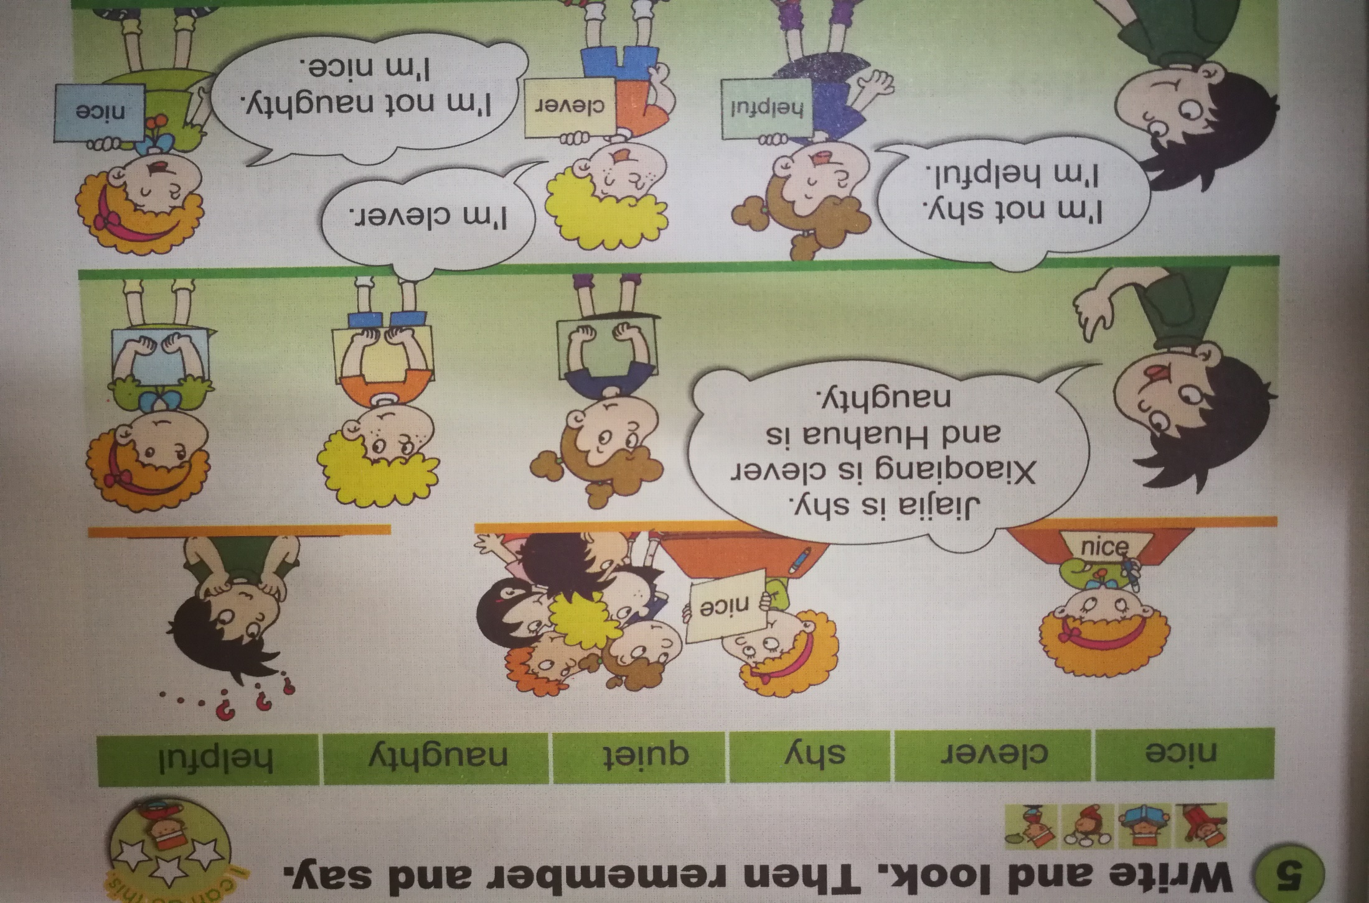
Can you remember me?

Slide 21
Let’s chant together!

